Slide 1
Title: Central Karoo Community Network Project
Group Names:
Muthambi Pfano
Botabota Matsatsi
Marakalala Harvey
Thobejane Dineo
Lorax Group

Slide 2

Project Background
Overview: Creating a reliable network infrastructure to connect Central Karoo’s community and public services.
Region Overview
Central Karoo is a rural district, 417 km from Cape Town, historically reliant on the railway industry, now focused on agriculture.
About 3,000 homes, district hospitals, and government offices serve the community’s essential needs.
Current Challenges
Unreliable and limited Internet and telecommunication coverage.
Inconsistent 5G rollout, poor network reliability, and security concerns with external suppliers accessing sensitive government data.

Slide 3

Objectives and Project Mission
Mission: Establish a sustainable, secure network infrastructure to enhance connectivity and service delivery for the Central Karoo community.
Objectives
Provide reliable Internet access for 3,000 homes, hospitals, and administrative offices.
Strengthen data security for government operations.
Improve network scalability and resilience for future growth

Slide 4

Current IT Infrastructure and Limitations
Existing Network Setup
Star topology with two access points (one sectoral and one omnidirectional).
Network Operating Center (NOC) with battery storage, servers, and backup systems.
Wireless backbone infrastructure using multi-band access points.
Key Limitations
Frequent connectivity disruptions and limited coverage.
Outdated technology unable to handle expanding demands.
Security vulnerabilities with external access to government data.

Slide 5
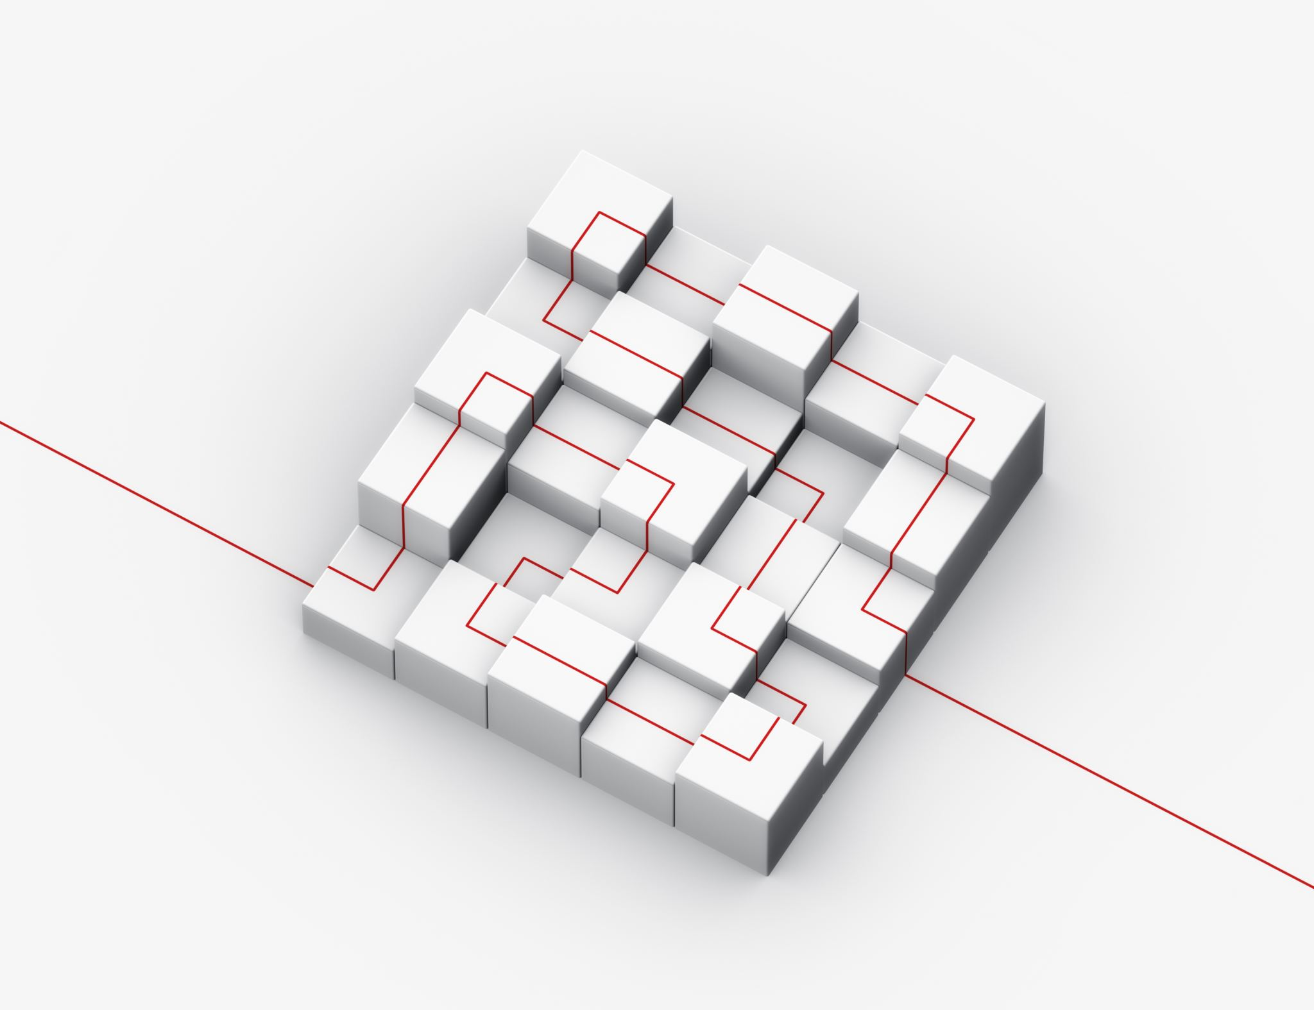
Proposed Solution
Network Expansion : Add advanced access points and antennas to expand coverage.
Introduce mesh networking to improve connectivity in remote areas.
Security Enhancements : Implement firewalls, encryption, and VPNs for remote and secure access.
Role-based access control for sensitive government data.
Reliability and Redundancy : Additional backup systems and disaster recovery plan.
Update the NOC with modern monitoring tools and centralized control

Slide 6



Project Phases and Milestones
Phase 1 (Planning & Design): Establish requirements, finalize budget, and design infrastructure (Jan - Mar 2025).
Phase 2 (Implementation): Install infrastructure, test connectivity, and address technical issues (Apr - Aug 2025).
Phase 3 (Testing & Security): Finalize network testing, implement security protocols, and conduct quality checks (Sept - Oct 2025).
Phase 4 (Rollout & Training): Network rollout and training for local staff to maintain and manage the system (Nov - Dec 2025).

Slide 7

Estimated Budget and Resources
Total Budget: R12 Million
Key Expenses :
Network equipment (antennas, access points, servers)
Security systems and software
Training and technical support for local staff

Slide 8
Project Benefits
Community Connectivity: Reliable, high-speed Internet access for homes and businesses.
Enhanced Healthcare & Public Services: Improved access to healthcare data and streamlined government services.
Data Security & Privacy: Stronger security measures protect sensitive government and patient information.
Foundation for Future Growth: Scalable infrastructure that can evolve as the community’s needs grow.

Slide 9

Conclusion
Central Karoo’s network project is a transformative initiative that addresses connectivity, security, and accessibility challenges for the district’s essential services.
By building a robust IT network, we’re not only enhancing the Central Karoo community’s access to vital services but also setting a foundation for future digital development in the region.

Slide 10

THANK YOU

