Slide 1

Managing Your Code
Using GitHub
An introduction to collaborative coding and version control
Presentation slides authored by Sophie Kay, 2013 (rev. 2015) , CC-BY-4.0.
See http://creativecommons.org/licenses/by/4.0/ for licensing details.

Slide 2



Why Use Version Control?
Introduction to GitHub
GitHub Demo
Image credits: Sun by Nasa Goddard, CC-BY-2.0; Silicon Chip by Jannes Pockele, CC-BY-2.0; Neurons by Patrick Hoesly, CC-BY-2.0.

Slide 3
CODE
FIGURES
RAW DATA
WRITTEN REPORT
RESEARCH PROBLEM

Slide 4

Users of these slides should embed the YouTube video, “What Is VCS?” here, from the following address:
http://www.youtube.com/watch?v=8oRjP8yj2Wo
Why Use Version Control?

Slide 5
Maintain a HISTORY of your work as it progresses
Facilitate COLLABORATION when working as part of a big team
Track not only the CHANGES to files, but the AUTHORS of, and REASONS for, those changes
Why Use Version Control?

Slide 6
Version Control in GitHub
CENTRAL SERVER
(viewable online)
PUSH
PUSH
PUSH
LOCAL MACHINE
LOCAL MACHINE
LOCAL MACHINE
The majority of operations are LOCAL
Work from a local directory on your machine before pushing changes to the central server

Slide 7
GitHub Structure
CENTRAL SERVER
(viewable online)
PUSH
PUSH
PUSH
LOCAL MACHINE
LOCAL MACHINE
LOCAL MACHINE
MODIFY your files in the local directory for your repo
COMMIT these changes to your local repo
Then PUSH them to the central server

Slide 8
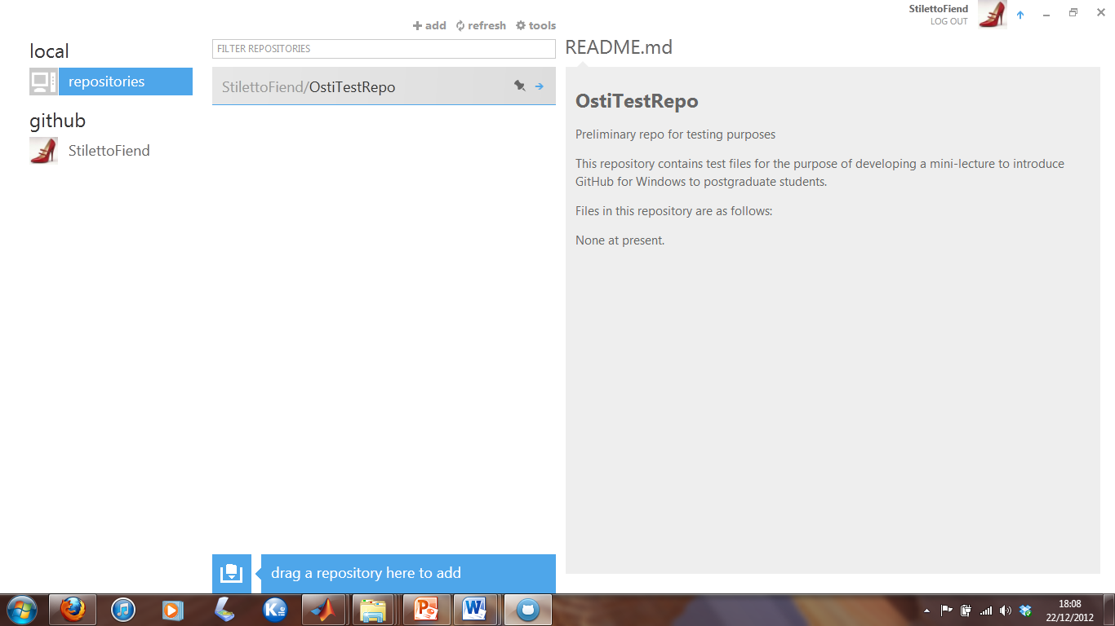
GHfW Repo Overview

Slide 9
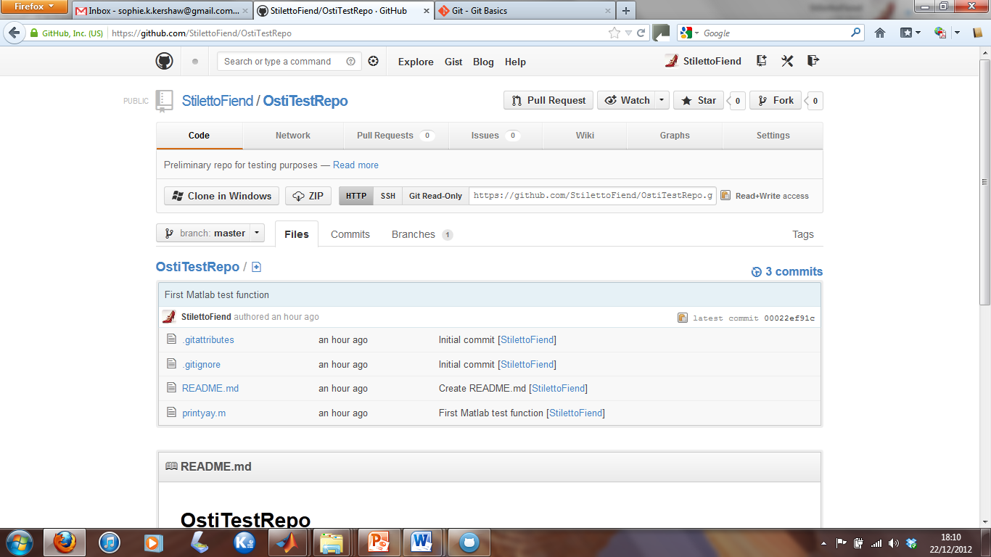
Online Repo View

Slide 10
ALWAYS check the terms of the system you’re using and whether it’s public or not
If working with industry, you may be bound by a Material Transfer Agreement – not ideal, but you should be aware of potential conflicts
You will also want to consider LICENSING your code/data/writing – we’ll cover this tomorrow!
Caveats

