Slide 1
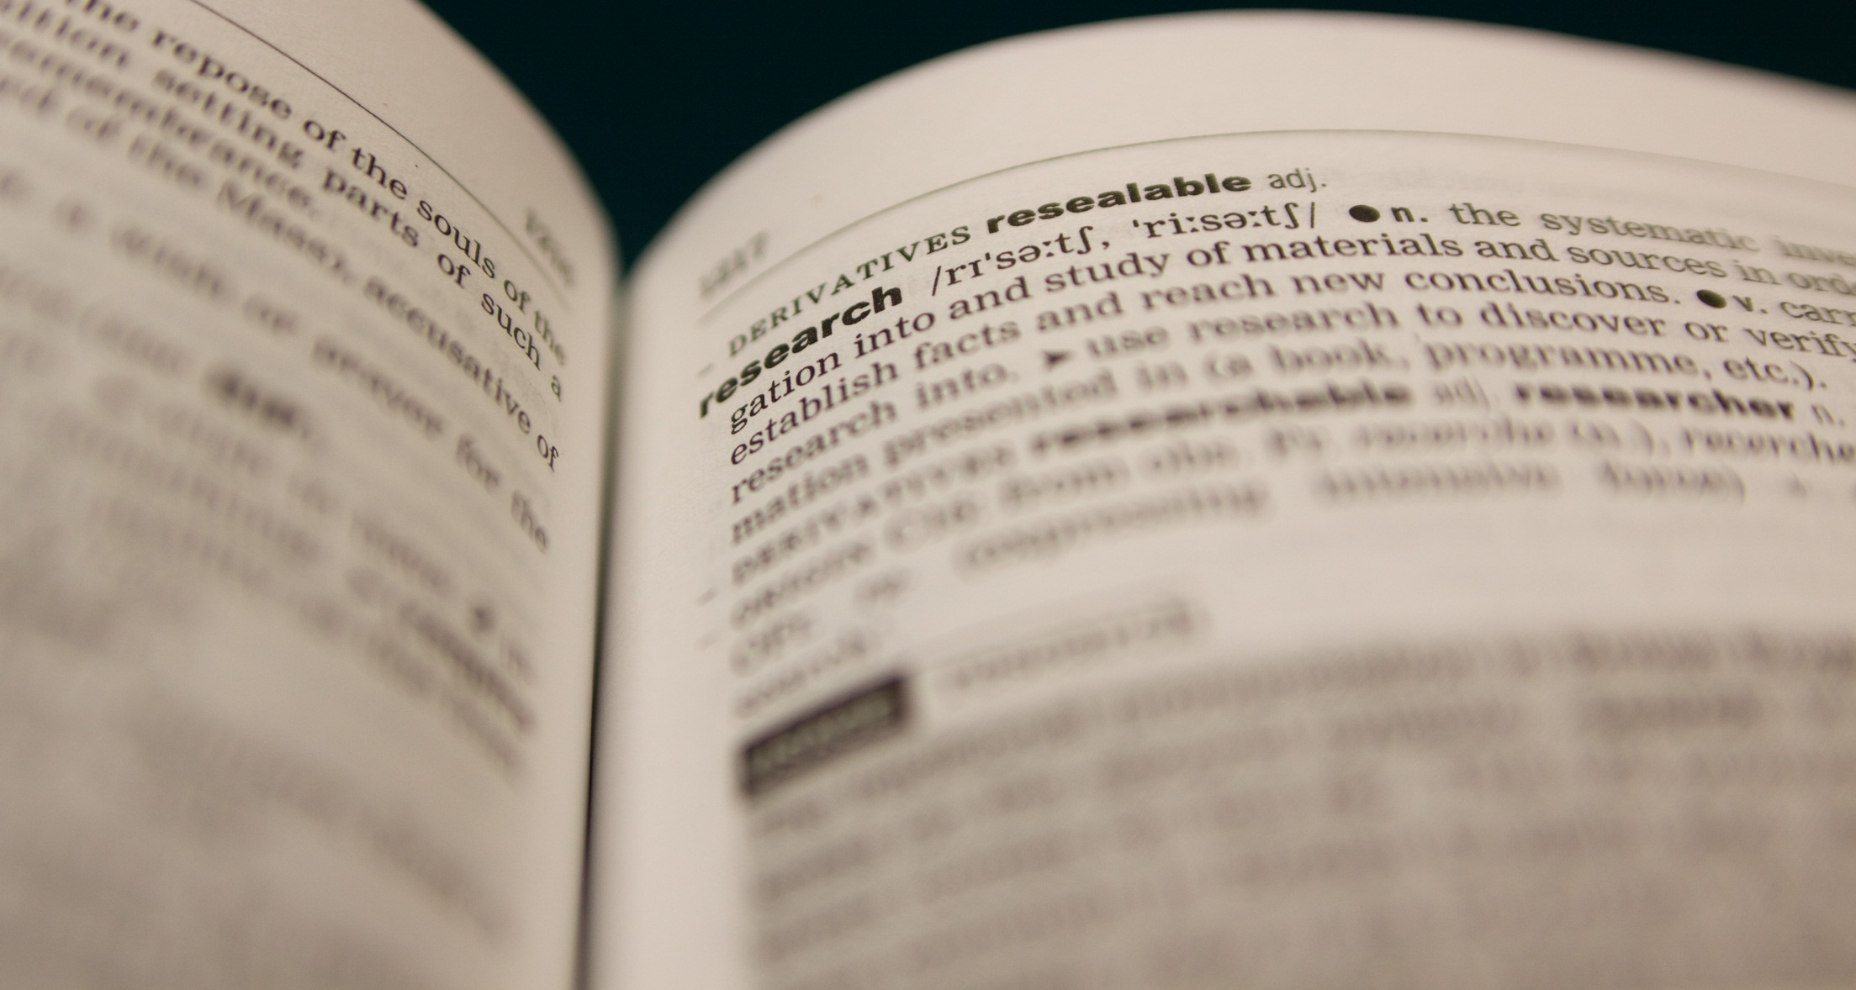
Data Management Planning
Safeguarding Your Data Outputs
The WHY and HOW of managing your data with DMPs
Presentation slides authored by Sophie Kay 2013 (rev. 2015), CC-BY-4.0.
See http://creativecommons.org/licenses/by/4.0/ for licensing details.

Slide 2
The Data Wave

Slide 3
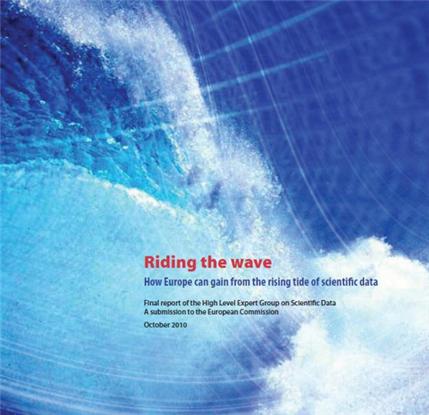
“Riding The Wave”
European Commission
October 2010
Image shown is from front cover of the 2010 report of the High Level Expert Group on Scientific Data

Slide 4
“In one day, a high-throughput DNA sequencing machine can read about 26 billion characters of the human genetic code. That translates into 9 terabytes – or 9 trillion data units – in the course of one year…”
Image shown is from front cover of the 2010 report of the High Level Expert Group on Scientific Data

Slide 5
So why is this relevant to me?
❶
Medical Image Analysis: May account for 30% of all data storage
❷
Astronomy: Square Kilometre Array, 1 petabyte of data every 20 seconds?
Systems Biology: Genes, proteins, GenBank, “1000 Genomes”…
❸
❹
Computationalists: Large-scale simulation data, HPC…

Slide 6
Analysis, Mining, Reuse…
USEFUL DATA
PROGRAMMING/
EXPERIMENTS
Create Data
DMPs
Preserve Data & Metadata
LICENSING
Legally Enable Use

Slide 7
What’s In a DMP?

Slide 8
SHORT TERM
LONG TERM
RESEARCH PHASE
DISSEMINATION PHASE
PRESERVATION
PHASE
file formats
ownership
metadata
storage
backups
share with whom?
release date?
licensing
metadata
repository?
long-term manager?

Slide 9
SHORT TERM
LONG TERM
RESEARCH PHASE
DISSEMINATION PHASE
PRESERVATION
PHASE
A DMP:
helps you to STRUCTURE your research output;
improves the EFFICIENCY of your work;
increase LONGEVITY of your research;
enables LARGE-SCALE exploration in future.

Slide 10
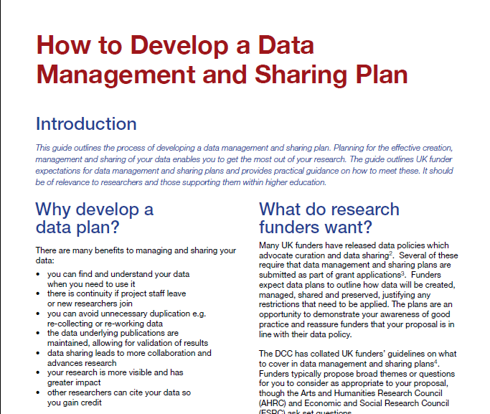
Digital Curation Centre

Slide 11
DMPs in this assessment

Slide 12
DMPs (Phase 1 only)
❶
Follow the email link to your DMP questionnaire
❷
Answer the 20 Questions in relation to your Phase 1 work
❸
Save the DMP as an .xml file and include a copy in your repository
❹
Only ONE DMP to be made per group

Slide 13
Useful Tools and Sites
Digital Curation Centre (@digitalcuration on Twitter)
Provides advice on data management and collaborates on many data curation projects
Online DMP tool (requires registration and login)
Advice leaflets and data curation guides
“How to Develop a Data Management and Sharing Plan” (see Weblearn)
Oxford-Specific Resources
Leaflet “Managing Your Research Data at the University of Oxford” (see Weblearn)
HFS Services: http://www.oucs.ox.ac.uk/hfs/index.xml
Blogs
Peter Murray-Rust: “Why you need a data management plan” (plus a wealth of other posts on Open Science and Open Data) http://blogs.ch.cam.ac.uk/pmr/category/data/
Data Resources
Lists of Open Definition conformant licenses: www.opendefinition.org
Open Data Handbook: http://opendatahandbook.org/

