Slide 1
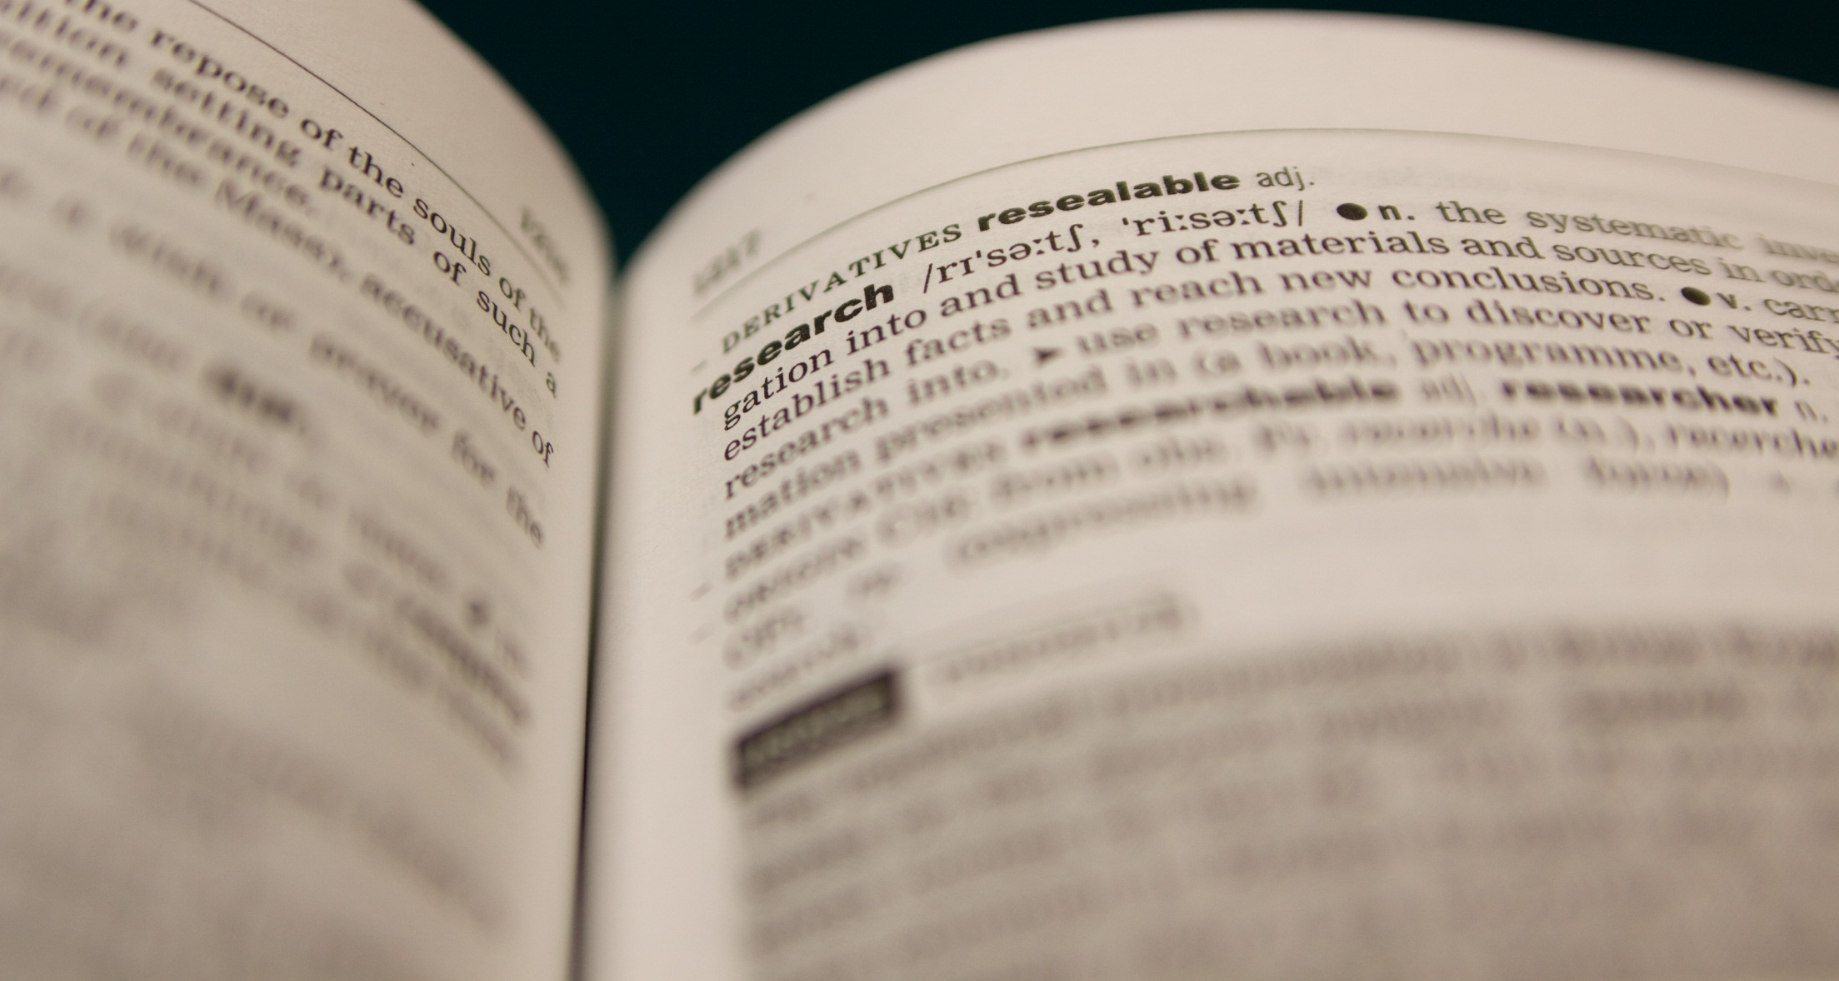
Making Research Useful:
The Consequences of (Bad) Communication
#solo13lego
SpotOn London 2013
Saturday, 9th November
Sophie Kay (@StilettoFiend)
& David Robert Grimes (@drg1985)
Presentation slides authored by Sophie Kay 2013, CC-BY-3.0.
See http://creativecommons.org/licenses/by/3.0/ for licensing details.
Download these slides at http://oxford.academia.edu/SophieKershaw

Slide 2

Reproducibility?
Begley & Ellis (2012)
Nature 483, 531-533

Slide 3
“Some non-reproducible clinical papers have spawned an entire field, with hundreds of secondary publications that expanded on elements of the original observation, but did not actually seek to confirm or falsify its fundamental basis”.
Image shown is from front page of Begley & Ellis (2012), produced by the Nature Publishing Group

Slide 4
Information Users

Slide 5
Now for the Lego…
❶
Max. 10 people per team.
Choose a group leader – your group may want to work as three smaller sub-teams.
❷
Once we’ve assigned your group a letter, head to http://sophiekershaw.wordpress.com/ and download the relevant set of instructions.
Remember…
NO TALKING TO OTHER GROUPS!
These instructions are designed to be flawed;
Your group leader should keep track of any problems and critiques as you work;
This part of the session is designed to give you the perspective of an INFORMATION USER.
❸

Slide 6
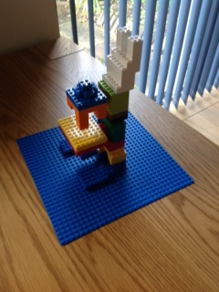
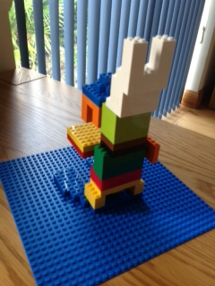
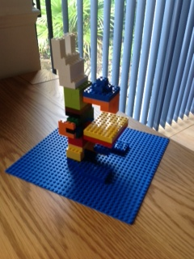
The end result…

Slide 7
Some Thoughts
Carrot vs. stick: do we incentivise or punish?
How can we train people to think about the role of the information user, rather than just the information producer?
How might this relate to non-academic spheres?
Does working culture need to change to expect reduced output, but of a higher quality/utility?
How to deal with the user vs. producer perspective within academia?

Slide 8
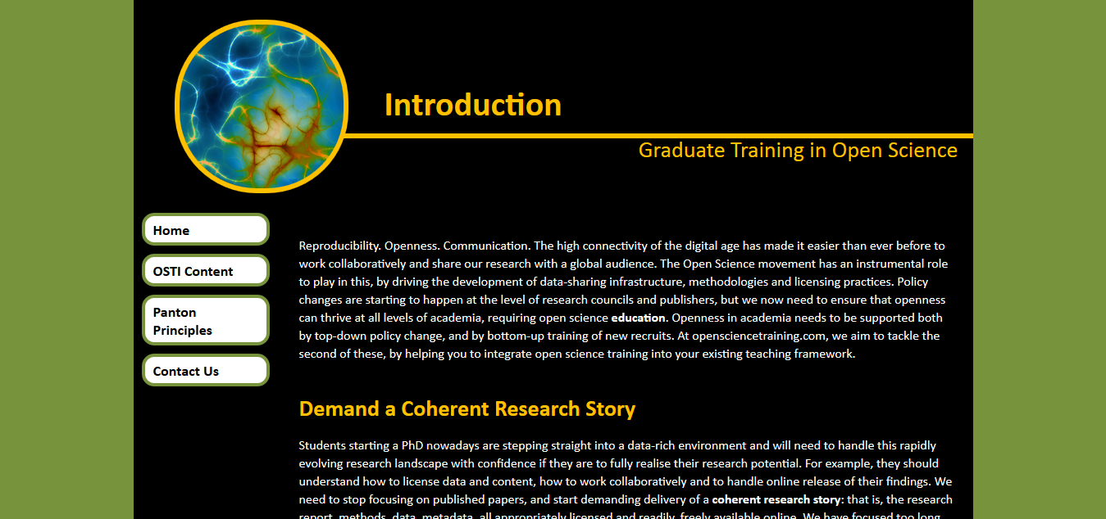
www.opensciencetraining.com
Watch out for an extended Lego session of Rotation-Based Learning at the upcoming SpotOn Hackday (date TBC)

