Slide 1
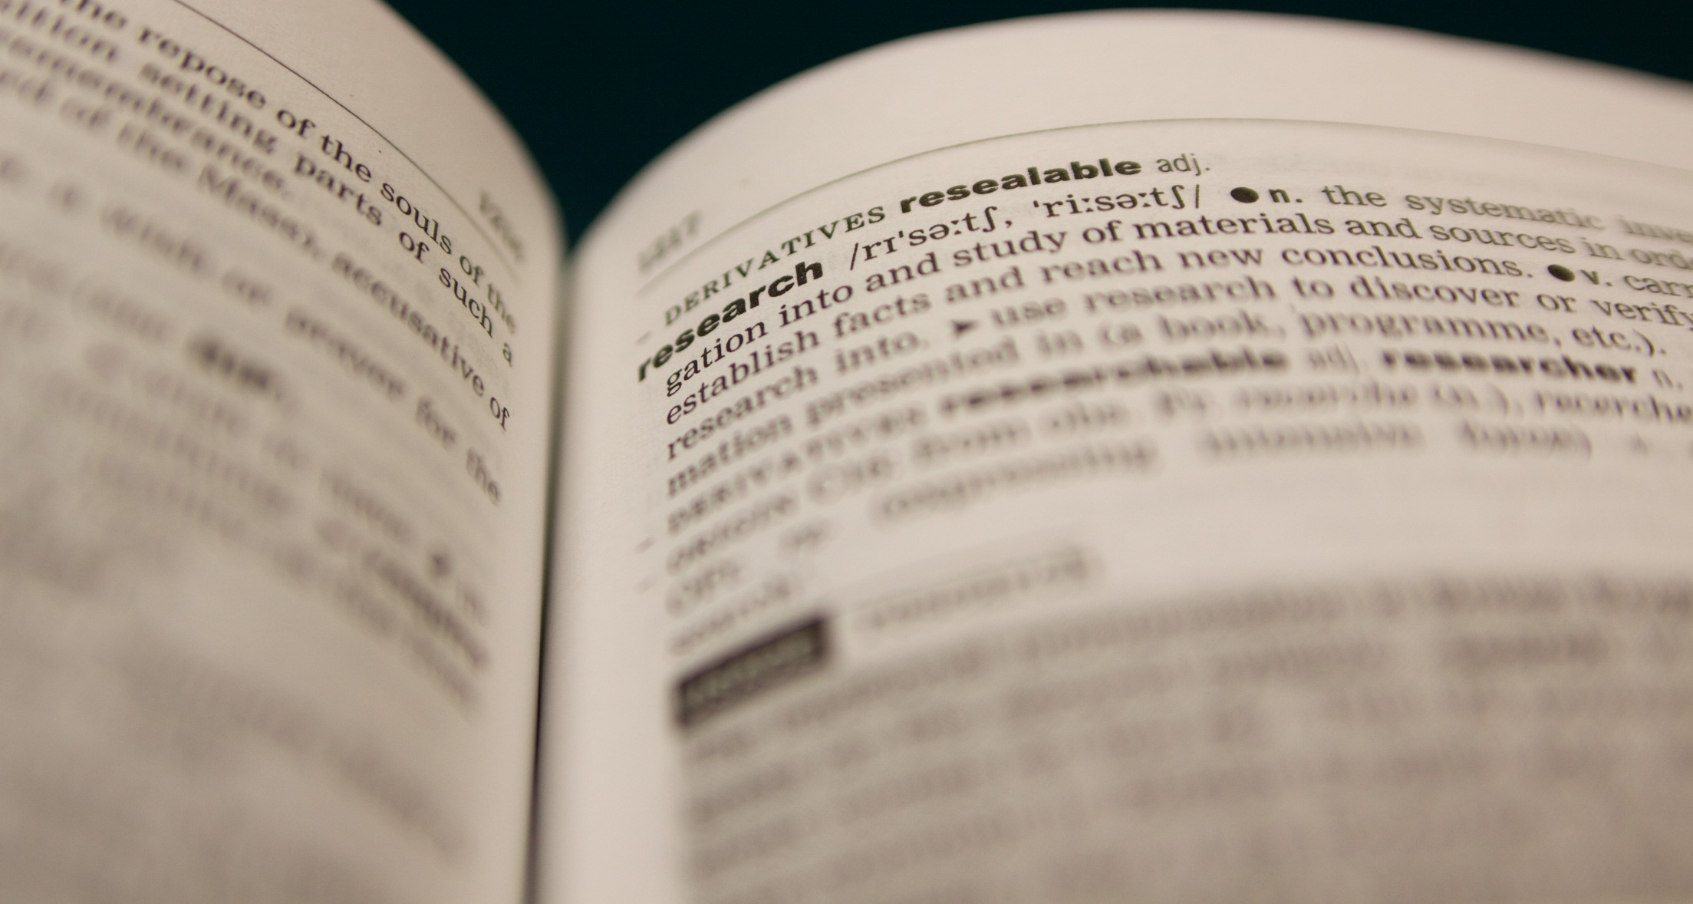
Data, Code & Content Licensing
Facilitating Scientific Reproducibility & Impact
The WHY and HOW of licensing your scientific outputs.
Presentation slides authored by Sophie Kay 2013 (rev. 2015), CC-BY-4.0.
See http://creativecommons.org/licenses/by/4.0/ for licensing details.

Slide 2
What Will Licensing Achieve?
❶
Instil confidence in others as to the terms of reuse
Support your own wishes for reuse with a legal declaration
❷
Enhance your research impact by fostering reuse of your work and inviting collaboration (stronger research network)
❸

Slide 3
Identify
What materials do you want/need to open up?
License
Legal openness = appropriate licence
Release
Availability + Ease of download = Technical openness
Promote
Let people know about your licensed materials

Slide 4
The Three Steps of Licensing
❶
Ensure you have permission from all rightsholders
Select a licence that is appropriate for your material
❷
Declare your chosen licence clearly
embed this info into file metatags
include a hyperlink to the license’s online listing
If requiring attribution, state the form of citation
❸

Slide 5
Identify Your Materials
What materials do you want/need to open up?
These will fall into one of three categories:
DATA
CONTENT
CODE
Visit www.opendefinition.org/licenses for a list of Open Definition conformant licenses
The technologically minded amongst you may be interested in machine-readable licenses:
git clone http://github.com/okfn/licenses
Visit www.opensource.org/licenses for a list of Open Source Definition conformant licenses

Slide 6
The Three Steps of Licensing
❶
Ensure you have permission from all rightsholders
Select a licence that is appropriate for your material
❷
Declare your chosen licence clearly
embed this info into file metatags
include a hyperlink to the license’s online listing
If requiring attribution, state the form of citation
❸

Slide 7

What is Creative Commons?
Creative Commons is a nonprofit organization that enables the sharing and use of creativity and knowledge through free legal tools.
Our free, easy-to-use copyright licenses provide a simple, standardized way to give the public permission to share and use your creative work — on conditions of your choice. CC licenses let you easily change your copyright terms from the default of “all rights reserved” to “some rights reserved.”
Wording from creativecommons.org, January 2013 (CC-BY-3.0)

Slide 8
Content Licensing

Slide 9




NC
BY
Attribution
No Commercial Use
CC Content Licensing Options
ND
SA
No Derivative Works
Share Alike

Slide 10
“A piece of content or data is open if anyone is free to use, reuse, and redistribute it — subject only, at most, to the requirement to attribute and/or share-alike.”
What is openness?

Slide 11
NC
BY
Attribution
No Commercial Use
CC Content Licensing Options
ND
SA
No Derivative Works
Share Alike

Slide 12

CC0
or CCZero
Public domain dedication (to greatest possible legal extent worldwide)
Most open of all licensing arrangements
No one owns rights to the materials
Public Domain

Slide 13
Data Licensing

Slide 14
Identify Your Materials
What materials do you want/need to open up?
These will fall into one of three categories:
DATA
CONTENT
CODE
Visit www.opendefinition.org/licenses for a list of Open Definition conformant licenses
The technologically minded amongst you may be interested in machine-readable licenses:
git clone http://github.com/okfn/licenses
Visit opensource.org/licenses for a list of Open Source Definition conformant licenses
Data papers, Figshare, DOIs, citable data…

Slide 15
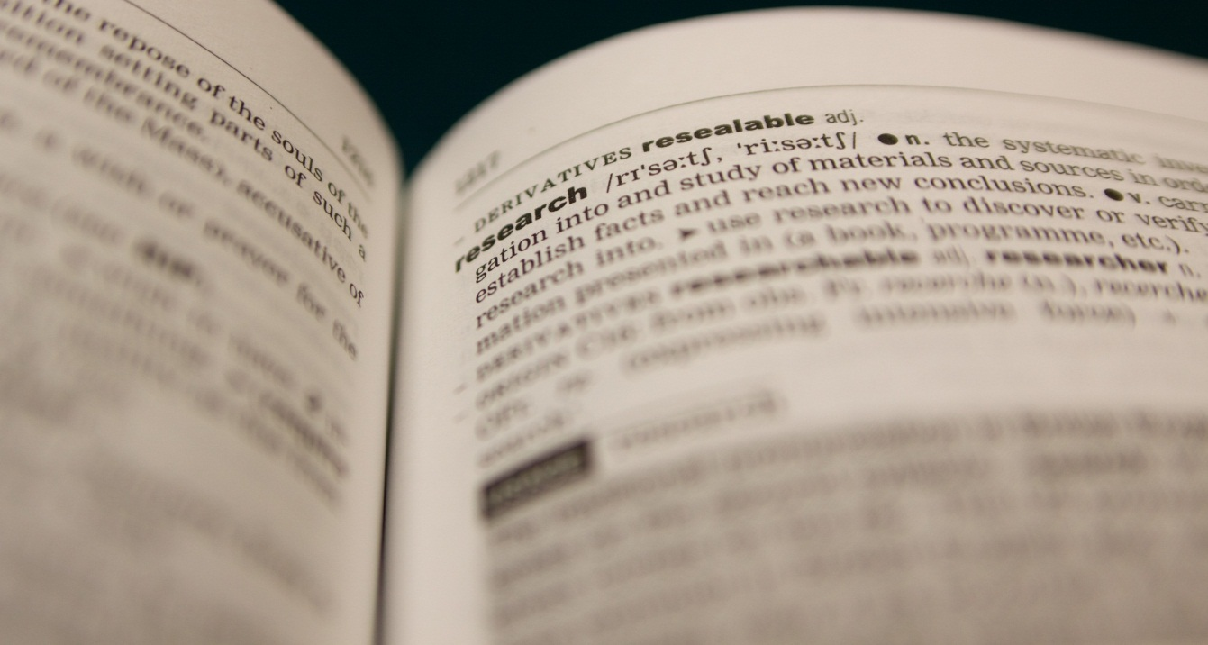
Panton Principles
Wording by Peter Murray-Rust, Cameron Neylon, Rufus Pollock, John Wilbanks,
2010-02-09
http://pantonprinciples.org
◆
When publishing data,
make an explicit and robust statement of your wishes
❖
Use a recognised
licence or waiver that is
appropriate for data
Explicit dedication of data underlying published science into the public domain via PDDL or CCZero is strongly recommended and ensures compliance with both the Science Commons Protocol for Implementing Open Access Data and the Open Knowledge/Data Definition.
⬥
If you want your data to be effectively used and added to by others, it should be open as defined by the Open Knowledge Definition: in particular, non-commercial and other restrictive clauses should not be used.


Slide 16
Code Licensing

Slide 17
Identify Your Materials
What materials do you want/need to open up?
These will fall into one of three categories:
DATA
CONTENT
CODE
Visit www.opendefinition.org/licenses for a list of Open Definition conformant licenses
The technologically minded amongst you may be interested in machine-readable licenses:
git clone http://github.com/okfn/licenses
Visit opensource.org/licenses for a list of Open Source Definition conformant licenses

Slide 18
Pointers for OS Code
❶
Separate category from data and content
❷
Licence wording needs to go at the top of each file you upload to GitHub
❸
The site opensource.org/licenses provides listings and licence wording
❹
Don’t forget to include author names and citation requirements where appropriate

Slide 19
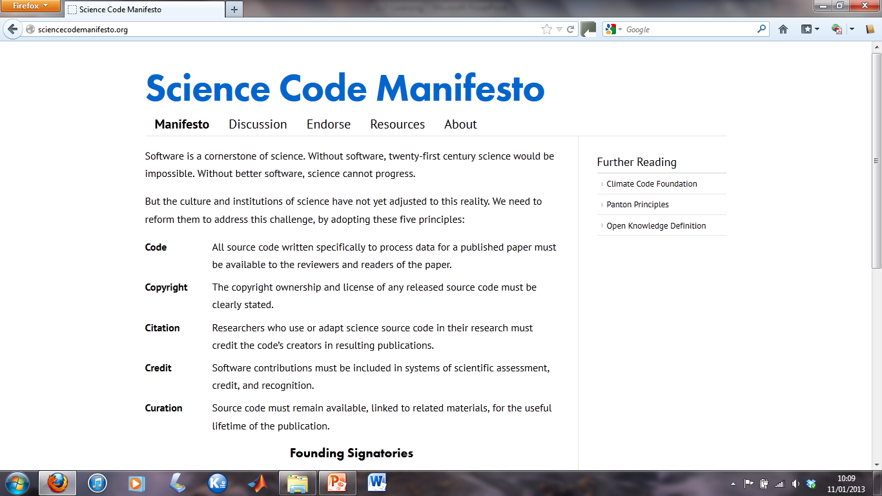
www.sciencecodemanifesto.org

Slide 20
And finally…

Slide 21
Licensing for Phase 1 & 2
❶
Discuss in your groups the licensing options available to you
❷
Select appropriate licences for your code, your data and your content
❸
Implement your chosen licenses
Your materials will need to be sufficiently open for your successors to build on them in this Assessment
❹

Slide 22
Useful Tools and Sites
General Examples
A few familiar sites may make a bit more sense now:
Flickr
YouTube
Data and/or Content Licensing
Lists of Open Definition conformant licenses: www.opendefinition.org
Open Data Handbook: http://opendatahandbook.org/
Content Licensing
Creative Commons licence selection tool: http://creativecommons.org/choose/
Licences for open source code
Lists of Open Source Definition conformant licenses: http://opensource.org/licenses
e.g. GNU General Public Licence
Users must cite you, and explicitly state when they have modified the code;
The licence delivers legal permission to use and copy the code.

