Slide 1
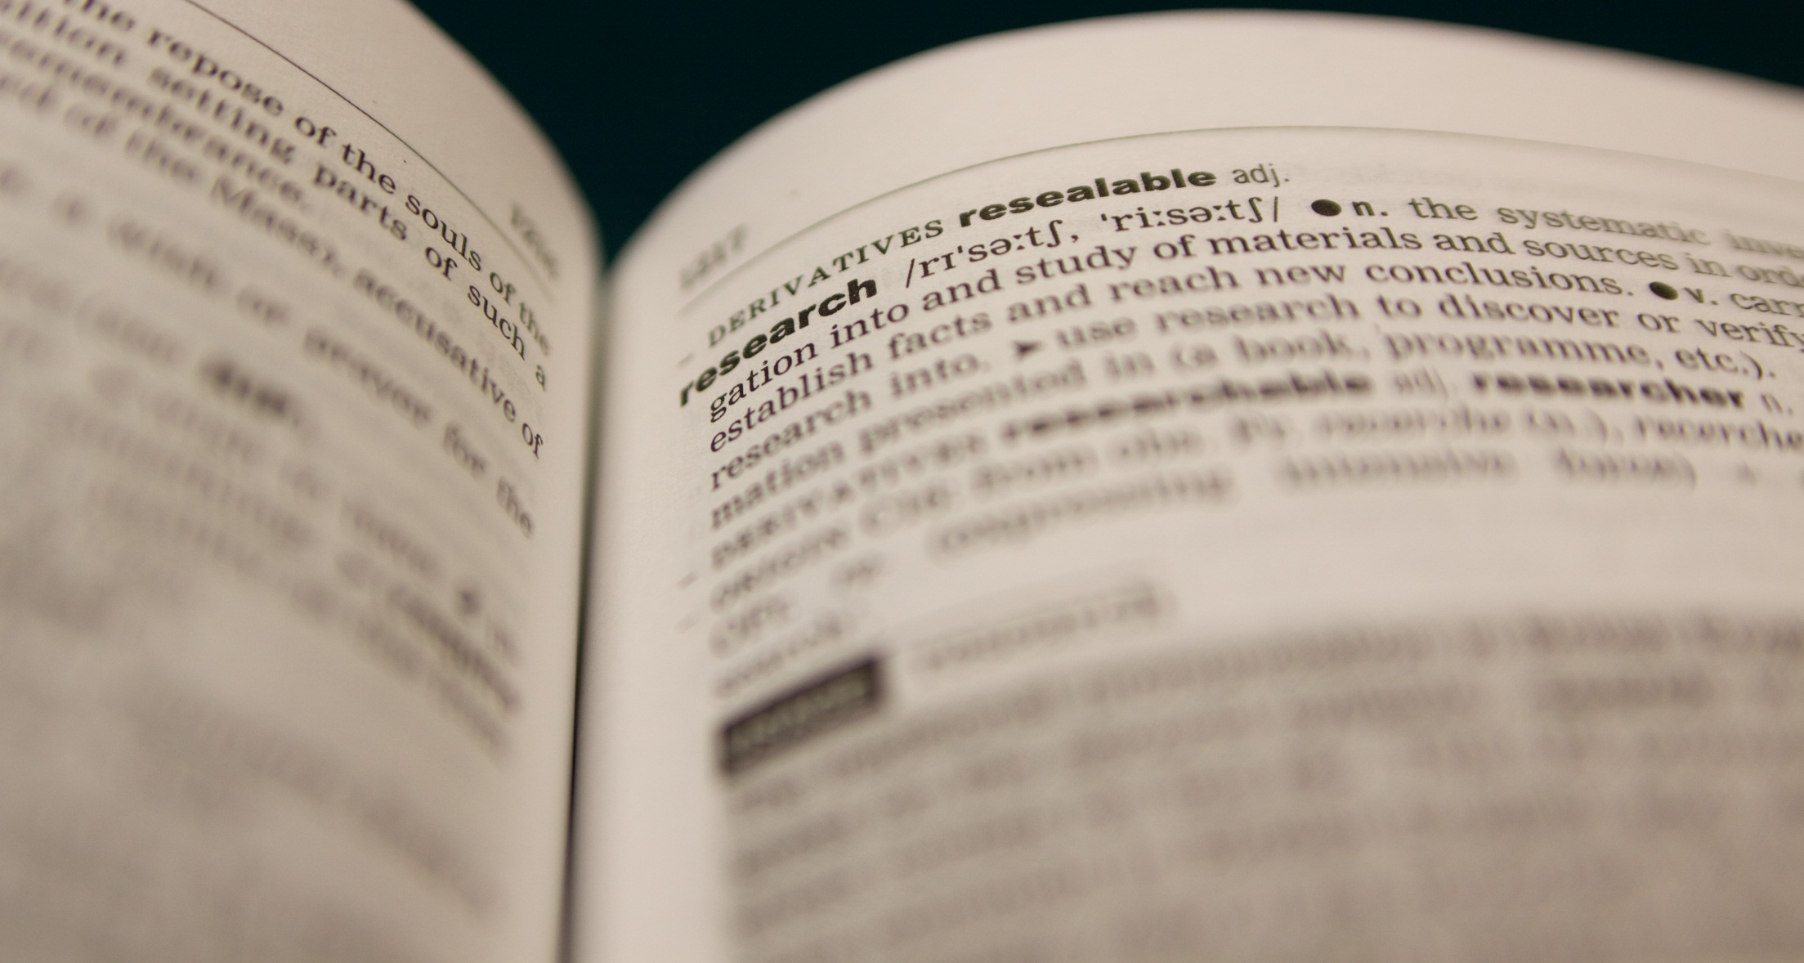
The Changing Face of Publication
An introduction to scientific publishing in the age of Open
Presentation slides authored by Sophie Kay 2013 (rev. 2015), CC-BY-4.0.
See http://creativecommons.org/licenses/by/4.0/ for licensing details.

Slide 2

“Researchers of Tomorrow”
JISC/British Library
June 2012

Slide 3
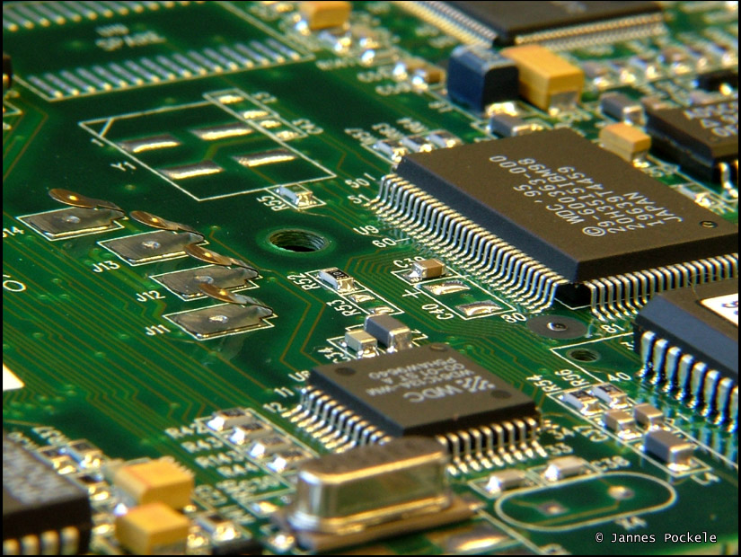

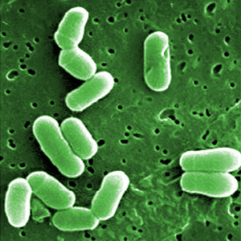
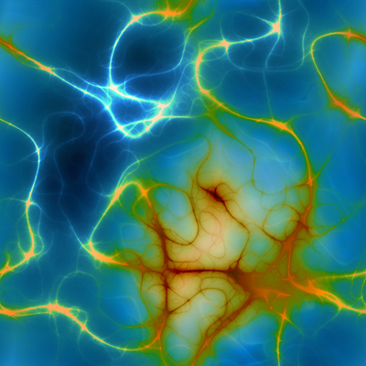
Traditional Route of Publishing
What is Open Access?
Alternative Models
Where Do We Go From Here?
Image credits: Sun by Nasa Goddard, CC-BY-2.0; Silicon Chip by Jannes Pockele, CC-BY-2.0; Bacteria by AJCann, CC-BY-NC 2.0; Neurons by Patrick Hoesly, CC-BY-2.0.

Slide 4
Traditional Model
£££
RESEARCH FUNDING
RESEARCHER
Writes Paper
RESEARCH PHASE
PUBLISHER – SUBSCRIPTION BASED JOURNAL
Typesets
Coordinates peer review
Release publication online
RESEARCHERS
Peer Review
PUBLICATION PHASE
£££
£££
INSTITUTIONAL LIBRARIES
Acquire subscriptions
NON-ACADEMIC USERS
ACADEMIC USERS
DISSEMINATION PHASE

Slide 5
Users of these slides will need to embed the PhD Comics video, “Open Access Explained”, or to view it directly, from the following address: http://www.youtube.com/watch?v=L5rVH1KGBCY
Open Access Explained

Slide 6
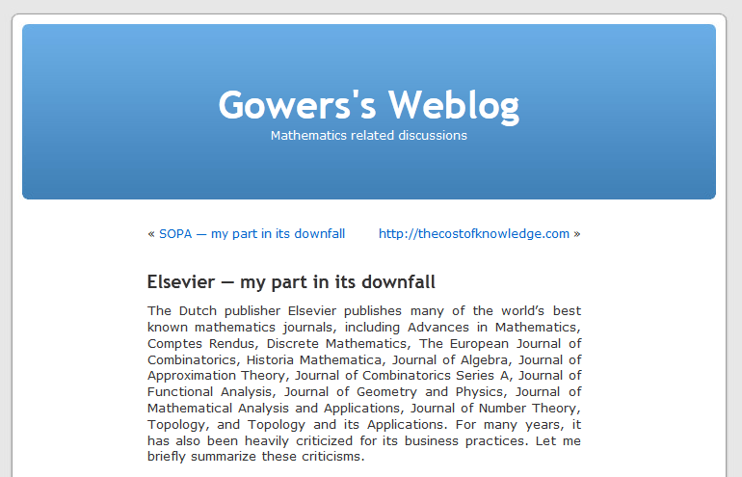
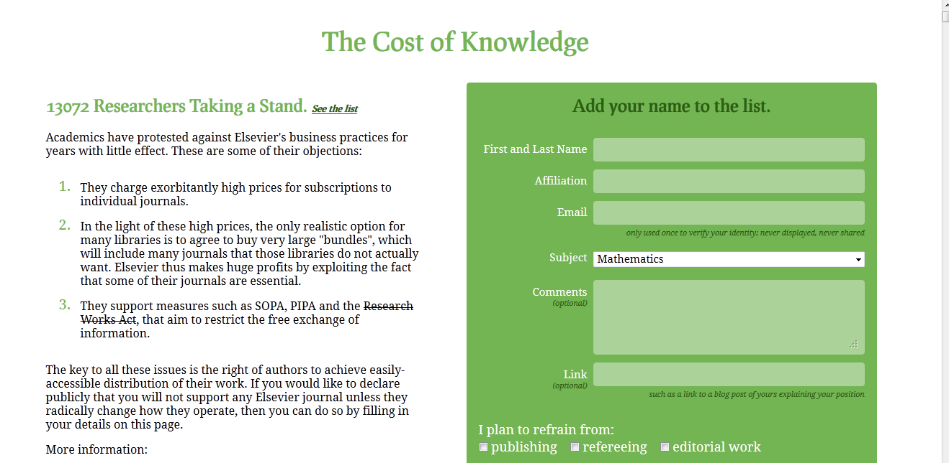
The Elsevier Boycott
January 2012: Tim Gowers’ blog
The Cost of Knowledge

Slide 7
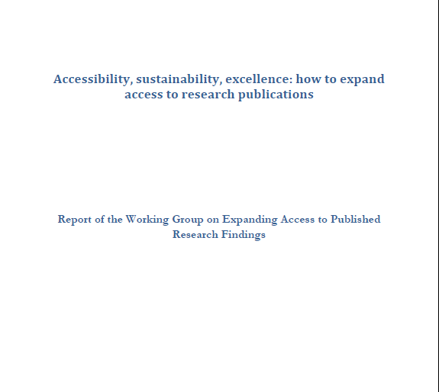
The Finch Report
Finch Report
June 2012
Licensed CC-BY

Slide 8
Gold Open Access Model
£££
RESEARCH FUNDING
RESEARCHER
Writes Paper
RESEARCH PHASE
£££ (APC)
OPEN ACCESS PUBLISHER
Typesets
Coordinates peer review
Release publication online
RESEARCHERS
Peer Review
PUBLICATION PHASE
INSTITUTIONAL LIBRARIES
NON-ACADEMIC USERS
DISSEMINATION PHASE

Slide 9
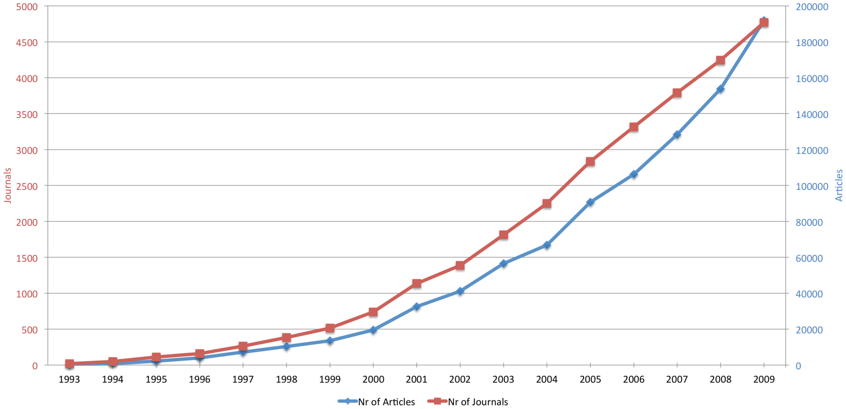
Gold OA Development
Image from Laakso, M.; Welling, P.; Bukvova, H.; Nyman, L.; Björk, B. C.; Hedlund, T. (2011). Hermes-Lima, Marcelo. ed. "The Development of Open Access Journal Publishing from 1993 to 2009". PLoS ONE 6 (6): e20961.
Licensed under a Creative Commons Attribution Licence, CC-BY-2.0

Slide 10
Green Open Access Model
£££
RESEARCH FUNDING
RESEARCHER
Writes Paper
RESEARCH PHASE
DIGITAL “SELF-ARCHIVING” REPOSITORY
Archive publication online, usually following journal acceptance (peer review)
- University (institutional) repository
- Independent repository, e.g. ArXiv
RESEARCHERS
Comments and open appraisal
PUBLICATION PHASE
INSTITUTIONAL LIBRARIES
NON-ACADEMIC USERS
DISSEMINATION PHASE

Slide 11



UK Research Councils
“…BBSRC will require a copy of any resulting published journal article…to be deposited, at the earliest opportunity, in an appropriate e-print repository…”
“Free and open access to the outputs of publicly-funded research offers significant social and economic benefits...”
“All published research articles arising from EPSRC-sponsored research…must become available on an Open Access basis through any appropriate route”

Slide 12
14th Feb 2002
BOAI opens for public signing
Jan 2012
Blog post by Fields medallist Tim Gowers starts a large-scale boycott of the publisher Elsevier
1st Dec 2001
Budapest Open Access Initiative (BOAI)
2003
Public Library of Science relaunches as a publisher
1st April 2013
RCUK policy on Open Access to RCUK-funded research commences
2001
Creative Commons founded
June 2012
Release of the Finch Report into expanding access to research publications
1991
LANL (later arXiv) repository first established
Timeline

Slide 13
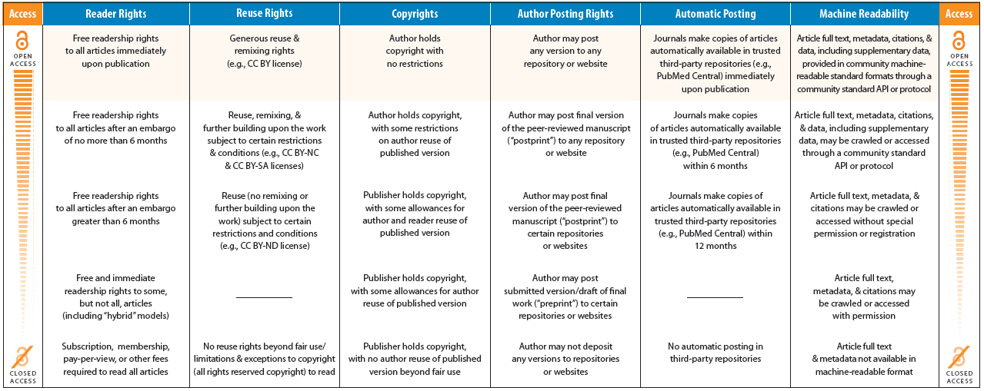
How Open Is It?
Grid taken from the “HowOpenIsIt? Open Access Spectrum” leaflet, produced through a collaboration between PLoS, SPARC and OASPA.
Licensed under CC-BY-NC-ND-3.0; leaflet subsection used here with permission.
A PDF download of the full leaflet is available at
http://www.plos.org/about/open-access/howopenisit/

