Slide 1
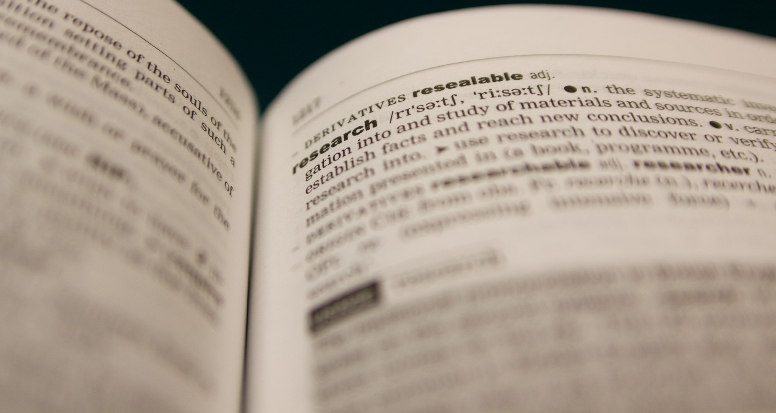
Reproducibility and Openness
Facilitating Scientific Progress and Research Impact
An introduction to Open Science and the changing face of academia
Presentation slides authored by Sophie Kay 2013 (rev. 2015) , CC-BY-4.0.
See http://creativecommons.org/licenses/by/4.0/ for licensing details.

Slide 2
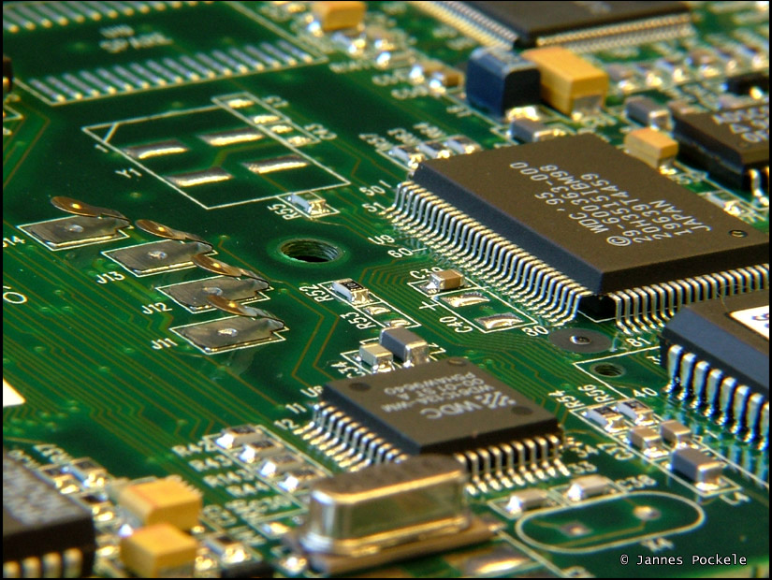

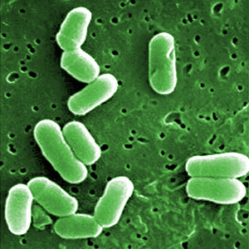
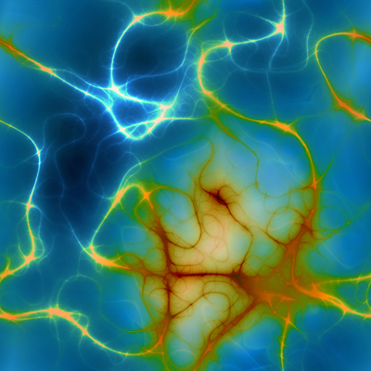
What items have you produced in your [subject name] course so far?
Reproducibility in research
The role of Open Science
Discussion of course assessment
Image credits: Sun by Nasa Goddard, CC-BY-2.0; Silicon Chip by Jannes Pockele, CC-BY-2.0; Bacteria by AJCann, CC-BY-NC 2.0; Neurons by Patrick Hoesly, CC-BY-2.0.

Slide 3
CODE
FIGURES
RAW DATA
WRITTEN REPORT
RESEARCH PROBLEM

Slide 4
Reproducibility

Slide 5

Reproducibility?
Begley & Ellis (2012)
Nature 483, 531-533

Slide 6
“Some non-reproducible clinical papers have spawned an entire field, with hundreds of secondary publications that expanded on elements of the original observation, but did not actually seek to confirm or falsify its fundamental basis”.
Image shown is from front page of Begley & Ellis (2012), produced by the Nature Publishing Group

Slide 7
“It lies in our hands – the community of editors and reviewers – to insist that publications are accompanied by the source code and data required to allow their results and conclusions to be reproduced…”
Scientific Publication or Advertisement?
Landrum & Stiefl (2012)
Future Med. Chem.
4(15), 1885-1887

Slide 8
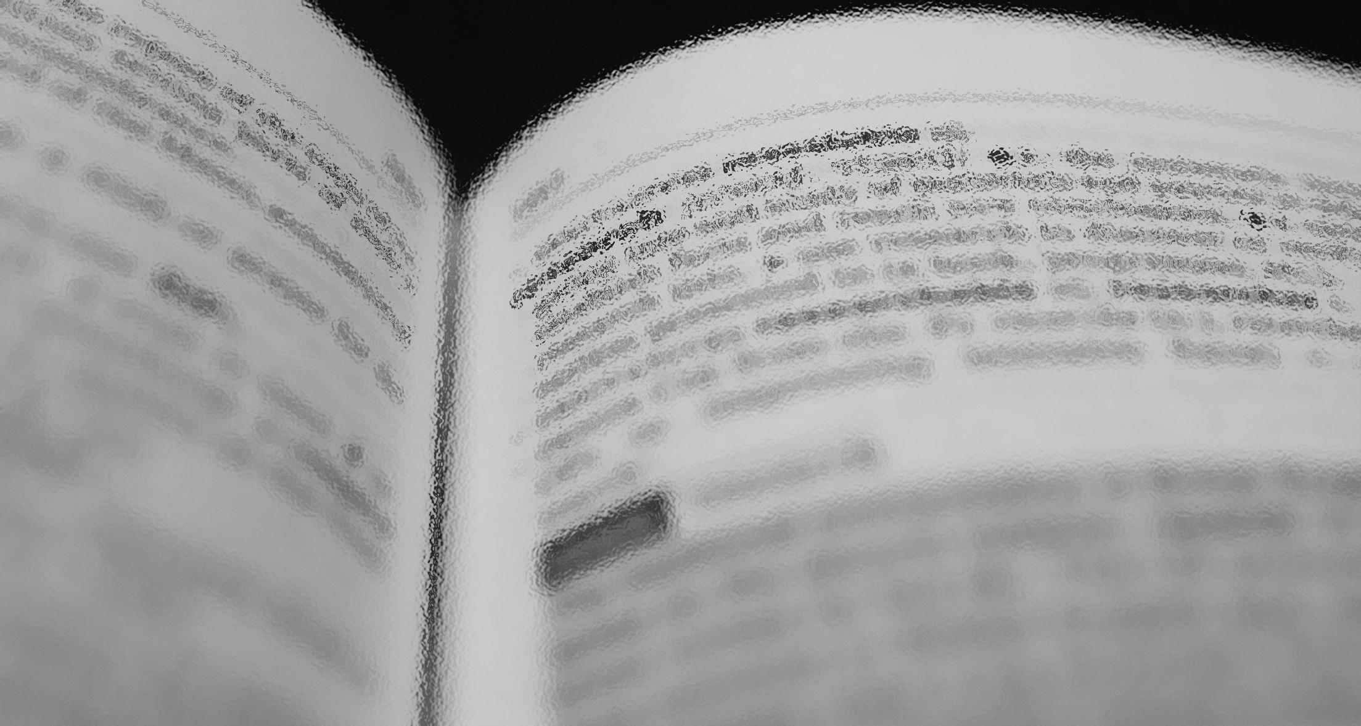
CODE
FIGURES
Coherent Research Story
RAW DATA
WRITTEN REPORT
RESEARCH PROBLEM

Slide 9
The Role of Open Science

Slide 10
“A piece of content or data is open if anyone is free to use, reuse, and redistribute it — subject only, at most, to the requirement to attribute and/or share-alike.”
What is openness?

Slide 11
In learning about open science, you’ll learn how to effectively and safely share your research outputs, through licensing, code repositories and publication, and in doing so, to foster reproducibility in your work and enhance your research impact.
What is openness?

Slide 12
Users of these slides will need to embed the video from Science Commons here, available on youTube at the following address: http://www.youtube.com/watch?v=hZAcTNFzF-s
Big Data, Networked Research

Slide 13
And all sorts of other approaches…
Data Mining
Crowdsourcing
Understanding Negative Results
Web-based Lab Books
Open Science facilitates discovery by supporting the dissemination and availability of information, and enabling its reuse through provision of legal licensing.

Slide 14


Examples of Data-Enabled Research
Søren Brunak, Denmark Technical University
molecular level sys bio + healthcare sector data.
Mining electronic health records: towards better research applications and clinical care’ http://www.ncbi.nlm.nih.gov/pubmed/22549152
Chas Bountra,
Structural Genomics Consortium
- accelerate identification of candidate targets for drug discovery by generating freely available novel reagents
• They crystallize 5–10 structures per month!
• SGC is responsible for 25 - 50% of all structures deposited into the Protein Data Bank on human parasites + biomed proteins

Slide 15



UK Research Councils
“…BBSRC will require a copy of any resulting published journal article…to be deposited, at the earliest opportunity, in an appropriate e-print repository…”
“Free and open access to the outputs of publicly-funded research offers significant social and economic benefits...”
“All published research articles arising from EPSRC-sponsored research…must become available on an Open Access basis through any appropriate route”

Slide 16
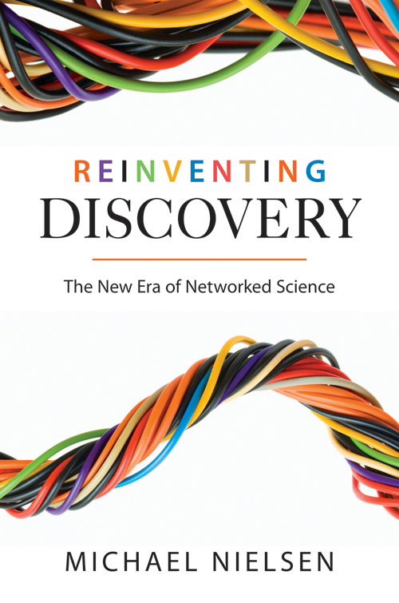
Further Reading
Michael Nielsen’s book
“Reinventing Discovery”

