Slide 1
5’
4
6
7
9
3’
G T T
C A T
Given:
C A A
G T A
3’
5’
How do we annotate the red box in the direction of the arrow?
7
9
5’
3’
Parent DC
C A T
DC_{s1}
Annotation
(7-9)+
SA_{pos_dcs1_dcs2_2}
Sub-component
5’
3’
CAT
DC_{s2}
This is the annotation use case we’ve explored the most.

Slide 2
5’
4
6
7
9
3’
G T T
C A T
Given:
C A A
G T A
3’
5’
How do we annotate the blue box in the direction of the arrow?
5’
4
6
3’
Parent DC
G T T
DC_{s1}
Annotation
(4-6)-
SA_{pos_dcs1_dcs3_1}
Sub-component
5’
3’
AAC
DC_{s3}
Why is DC_{s2} the reverse complement of subsequence “GTT”?
Why is it not “CAA”?
– This is the most useful form, as we can expect subcomponents
to be defined in their own sense strand. More on that…

Slide 3
5’
4
6
7
9
3’
G T T
C A T
Given:
C A A
G T A
3’
5’
What is the meaning of the arrow? Why is there an arrow?
Importantly, how do we know when the arrow should point one direction or another?
5’
4
6
7
9
3’
Parent DC
G T T
C A T
DC_{s1}
Annotation
(4-9)-
SA_{pos_dcs1_dcs4_3}
Sub-component
5’
AAC
3’
ATG
DC_{s4}
The arrow is a visual cue which helps us read the sequence in the diagram in terms
of the transcriptional direction. The arrow helps us understand how to relate
a parent DNA component to its subComponent. The convention is for the arrow
to point direction of transcription and for the sequence to be written as the ‘sense
strand’ the strand (corresponds to the mRNA, except for U->T). The direction is
obvious in this example, as the CDS is being annotated. Not so in other cases.

Slide 4
5’
3’
But why were we
given:
G T T
C A T
C A A
G T A
3’
5’
5’
3’
this one:
is exactly the same?
A T G
A A C
T A C
T T G
3’
5’
I think we should aim to allow both to be annotated using the same subcomponent DC (eg DC_{s4})
and allow the design of the parent DC to remain in the hands of the designer.
5’
3’
G T T
C A T
DC_{s1}
DC_{s5}
5’
3’
A T G
A A C
SA_{pos_dcs1_dcs4_3}
(4-9)-
(4-9)+
SA_{pos_dcs5_dcs4_3}
Sub-component
5’
AAC
3’
ATG
DC_{s4}
Maybe we can provide some best practices for DC types, such as CDS, 5’UTR..
Is there a precedent for this recommendation? But how will we know DC_{s4} actually complies
with such a “transcriptional” direction convention?

Slide 5
5’
20
25
3’
G A A T T C
C T T A A G
3’
5’
What direction does the arrow go in for a palindrome? Eg EcoRI site?
What strand value do we annotate for a DNA component that “goes” in both directions or
Neither direction?
20
25
5’
3’
Parent DC
G A A T T C
DC_{s6}
Annotation
(20-25).
SA_{pos_dcs6_dcs7_3}
Sub-component
5’
3’
GAATTC
DC_{s7}
We need a new value for “both/neither” directions.
Seems like a “.” is used in combination with +/- in other systems.
In the “both/neither” case we would make the sequence of the subComponent be the
Substring 20 to 25. In the example it doesn’t matter but “both” directions will not always be
a palindrome.

Slide 6
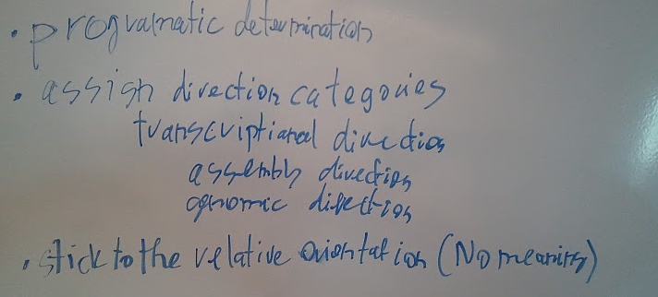
some solutions

