Slide 1

Parallel Programming in C with MPI and OpenMP
Michael J. Quinn

Slide 2
Chapter 2
Parallel Architectures

Slide 3
Outline
Interconnection networks
Processor arrays
Multiprocessors
Multicomputers
Flynn’s taxonomy

Slide 4
Interconnection Networks
Uses of interconnection networks
  Connect processors to shared memory
  Connect processors to each other
Interconnection media types
  Shared medium
  Switched medium

Slide 5
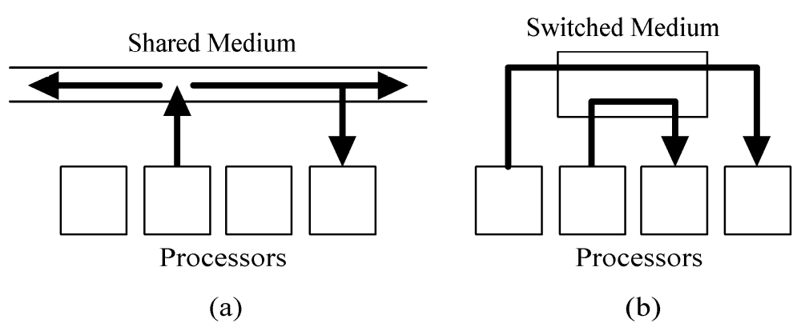
Shared versus Switched Media

Slide 6
Shared Medium
Allows only message at a time
Messages are broadcast
Each processor “listens” to every message
Arbitration is decentralized
Collisions require resending of messages
Ethernet is an example

Slide 7
Switched Medium
Supports point-to-point messages between pairs of processors
Each processor has its own path to switch
Advantages over shared media
  Allows multiple messages to be sent simultaneously
  Allows scaling of network to accommodate increase in processors

Slide 8
Switch Network Topologies
View switched network as a graph
  Vertices = processors or switches
  Edges = communication paths
Two kinds of topologies
  Direct
  Indirect

Slide 9
Direct Topology
Ratio of switch nodes to processor nodes is 1:1
Every switch node is connected to
  1 processor node
  At least 1 other switch node

Slide 10
Indirect Topology
Ratio of switch nodes to processor nodes is greater than 1:1
Some switches simply connect other switches

Slide 11
Evaluating Switch Topologies
Diameter
Bisection width
Number of edges / node
Constant edge length? (yes/no)

Slide 12
2-D Mesh Network
Direct topology
Switches arranged into a 2-D lattice
Communication allowed only between neighboring switches
Variants allow wraparound connections between switches on edge of mesh

Slide 13
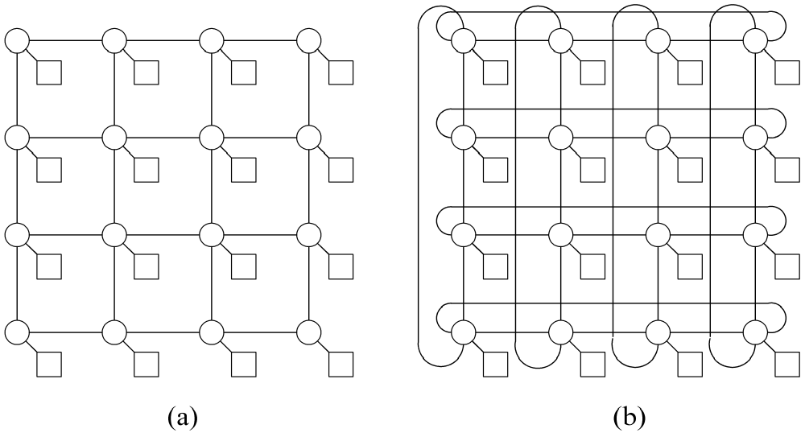
2-D Meshes

Slide 14
Evaluating 2-D Meshes
Diameter: Θ(n^{1/2})
Bisection width: Θ(n^{1/2})
Number of edges per switch: 4
Constant edge length? Yes

Slide 15
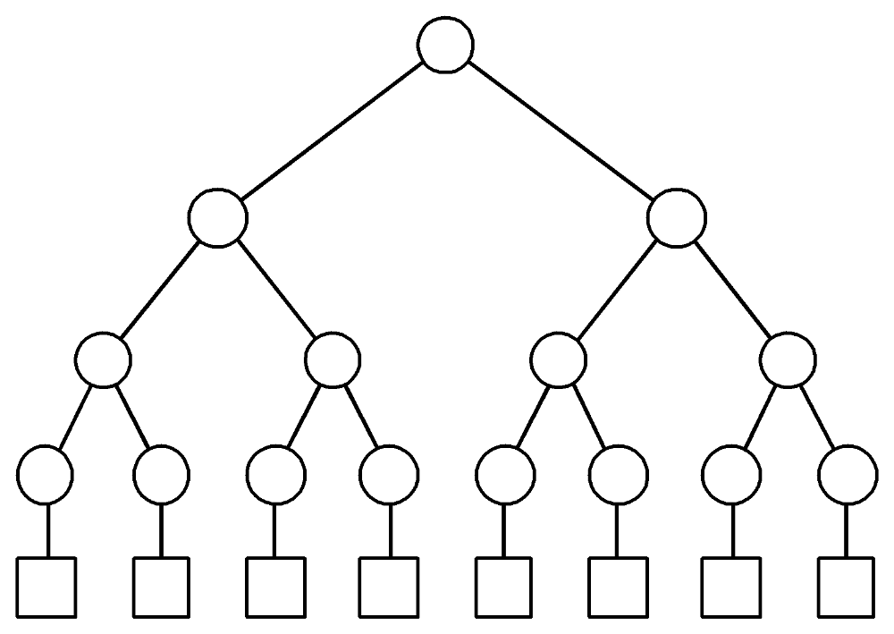
Binary Tree Network
Indirect topology
n = 2^{d} processor nodes, n-1 switches

Slide 16
Evaluating Binary Tree Network
Diameter: 2 log n
Bisection width: 1
Edges / node: 3
Constant edge length? No

Slide 17
Hypertree Network
Indirect topology
Shares low diameter of binary tree
Greatly improves bisection width
From “front” looks like k-ary tree of height d
From “side” looks like upside down binary tree of height d

Slide 18
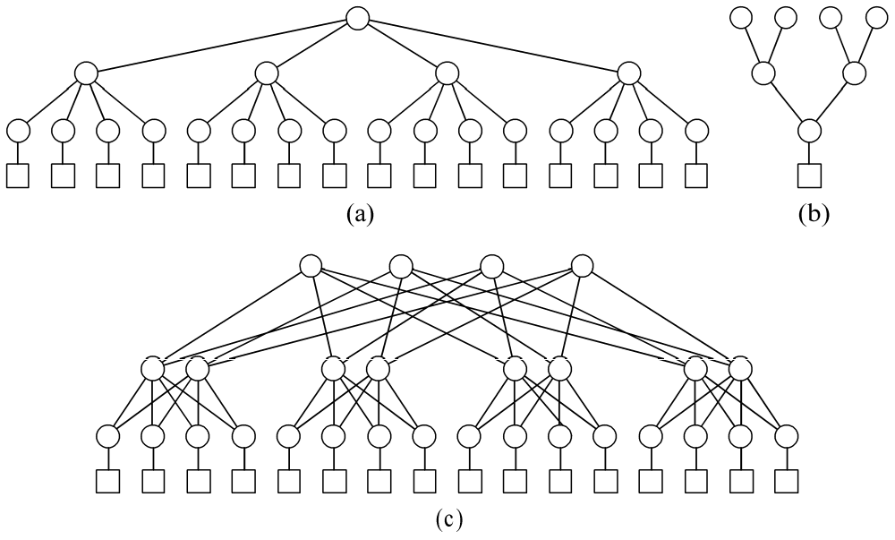
Hypertree Network

Slide 19
Evaluating 4-ary Hypertree
Diameter: log n
Bisection width: n / 2
Edges / node: 6
Constant edge length? No

Slide 20
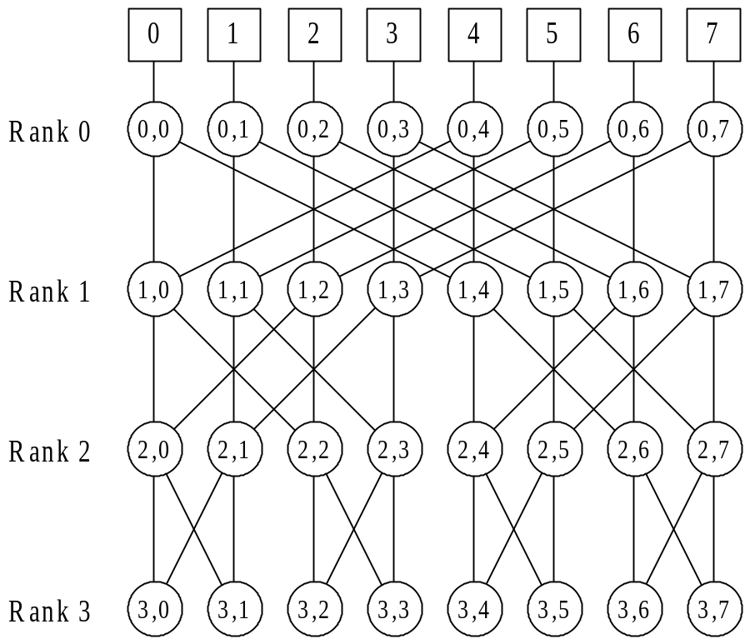
Butterfly Network
Indirect topology
n = 2^{d} processor
nodes connected
by n(log n + 1)
switching nodes

Slide 21
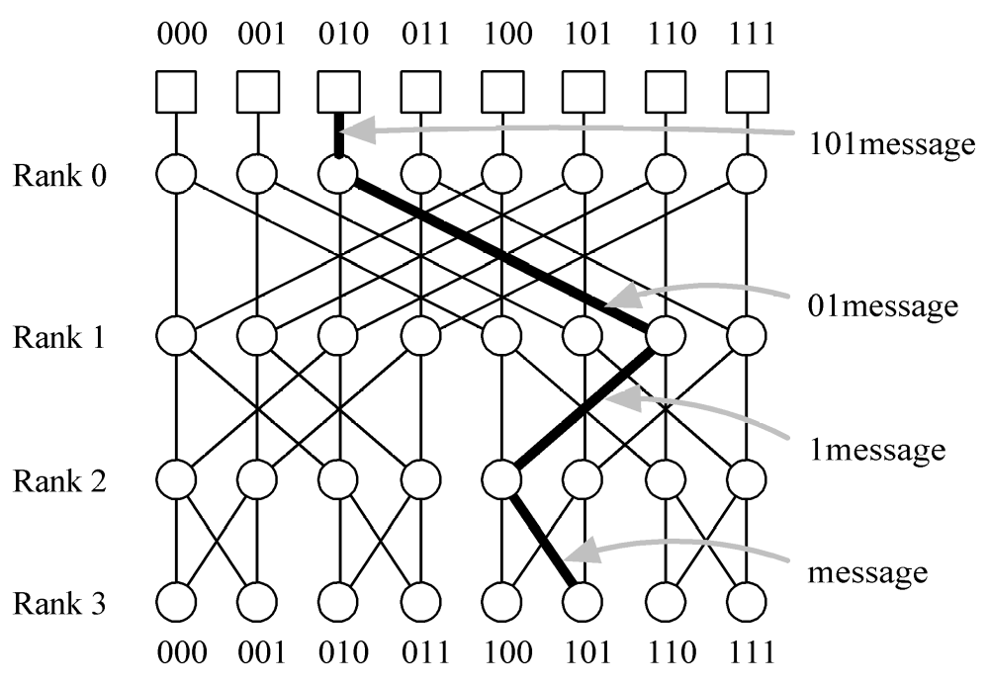
Butterfly Network Routing

Slide 22
Evaluating Butterfly Network
Diameter: log n
Bisection width: n / 2
Edges per node: 4
Constant edge length? No

Slide 23
Hypercube
Directory topology
2 x 2 x … x 2 mesh
Number of nodes a power of 2
Node addresses 0, 1, …, 2^{k}-1
Node i connected to k nodes whose addresses differ from i in exactly one bit position

Slide 24
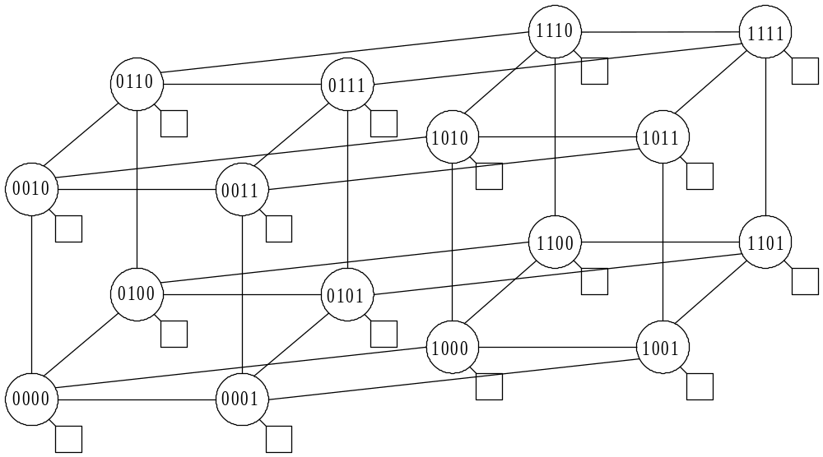
Hypercube Addressing

Slide 25
Hypercubes Illustrated

Slide 26
Evaluating Hypercube Network
Diameter: log n
Bisection width: n / 2
Edges per node: log n
Constant edge length? No

Slide 27
Shuffle-exchange
Direct topology
Number of nodes a power of 2
Nodes have addresses 0, 1, …, 2^{k}-1
Two outgoing links from node i
  Shuffle link to node LeftCycle(i)
  Exchange link to node [xor (i, 1)]

Slide 28
Shuffle-exchange Illustrated
0
1
2
3
4
5
6
7

Slide 29
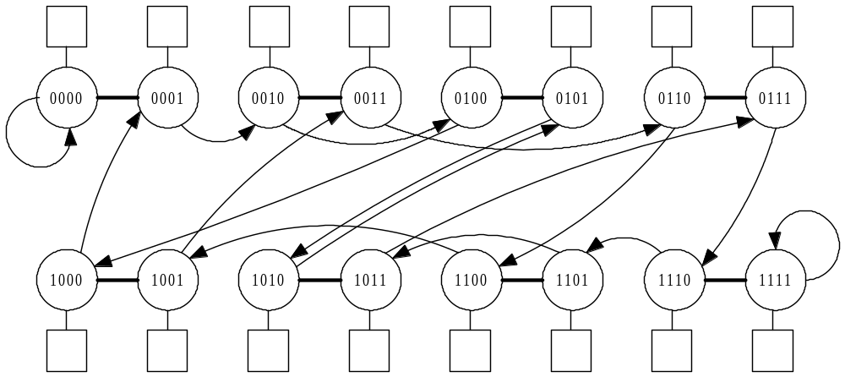
Shuffle-exchange Addressing

Slide 30
Evaluating Shuffle-exchange
Diameter: 2log n - 1
Bisection width: ≈ n / log n
Edges per node: 2
Constant edge length? No

Slide 31
Comparing Networks
All have logarithmic diameter
except 2-D mesh
Hypertree, butterfly, and hypercube have bisection width n / 2
All have constant edges per node except hypercube
Only 2-D mesh keeps edge lengths constant as network size increases

