Slide 1


COVID-19 Impact & Vaccination Intent
December 2, 2021
Kate Alden, Bhargav Desai, Prateek Gulati, Ai Vi Truong, Sze Ki (Zalon) Wong
Notes:
Bhargav

Slide 2
Agenda
Introduction
Business understanding
Data understanding
Analysis
Descriptive: Addressing COVID-19 Impact
Predictive: Predicting Vaccination Intention
Recommendations & Conclusion

Slide 3
Business Understanding

Slide 4

Business Understanding
Introduction
Descriptive Analysis
Predictive Analysis
Conclusion
COVID-19 Background:
First discovered in 2019 in Wuhan Hubei Province, China
Declared a pandemic on March 12, 2020
Impact in the United States:
47.9 Million Cases
773,000 deaths

Slide 5
Business Understanding
Introduction
Descriptive Analysis
Predictive Analysis
Conclusion
COVID-19 Challenges:
Impacted Healthcare Systems, Childcare, Education, Mental Health and Employment
Lockdowns, social distancing
Shortages for ventilators, hospital beds
Closings of schools, universities and offices
Vaccinations
Slow approval process
Vaccination hesitancy

Slide 6
Business Understanding
Introduction
Descriptive Analysis
Predictive Analysis
Conclusion
Two topics of interest to inform PwC, its clients and employees:
Which characteristics of COVID-19 impact are the most significant and why?
What characteristics are important in influencing vaccination in the United States and why?
We completed our analysis with the goal of assisting PwC with accelerating vaccination programs and adopting policies related to COVID-19.

Slide 7
Recommendation Overview
Introduction
Descriptive Analysis
Predictive Analysis
Conclusion
Descriptive Analysis: Addressing COVID-19 Impact
Talent Acquisition: Younger Individuals
Predictive Analysis: Vaccination Intention
Target Variable Definition: Vaccination Intention (Yes/No Opinions)
Employee Benefits: Childcare Support, Mortgage Allowance
Employee Benefits: Compensation for Vaccination, Mental Health, Widespread Education

Slide 8
Data Understanding
Notes:
Zalon

Slide 9
Data Understanding
Introduction
Descriptive Analysis
Predictive Analysis
Conclusion
Introduction
Household Pulse Survey (HPS) was conducted by the United States Census Bureau to understand how people’s lives have been impacted by the coronavirus pandemic
Questionnaire topics include questions about: Employment, Physical & Mental Health, Health Insurance & Access, Housing, Spending & Economic Impact Payments, Food Sufficiency & Security, Education Disruptions, Vaccination Intention
 | Phase 3 | Phase 3.1 | Combined
Collection Period | Jan 6 – Mar 29, 2021 | Apr 14 – Jul 5, 2021 | Jan 6 – Jul 5, 2021
Number of Variables | 204 | 237 | 258
Number of Observations | 459,235 | 425,460 | 884,695
Notes:
Zalon

Slide 10
Data Understanding
Introduction
Descriptive Analysis
Predictive Analysis
Conclusion
Introduction
Variables
Primary variables & secondary variables
Variable consistency
Irrelevant variables
Primary Variable
(mandatory question)
Secondary Variable
(optional question)
Additional Variables in Phase 3.1
Childcare | Food security | Telehealth | Unemployment
Service in US Armed Forces | COVID preventive behaviors | Being outside of home | Economic Impact Payment (stimulus)
Rideshare | Cash use | Income sources | Physical capabilities
Have you received a COVID-19 vaccine?
Did you receive (or do you plan to receive) all required doses?
Once a vaccine to prevent COVID-19 is available to you, would you…
YES
NO
Notes:
Zalon

Slide 11
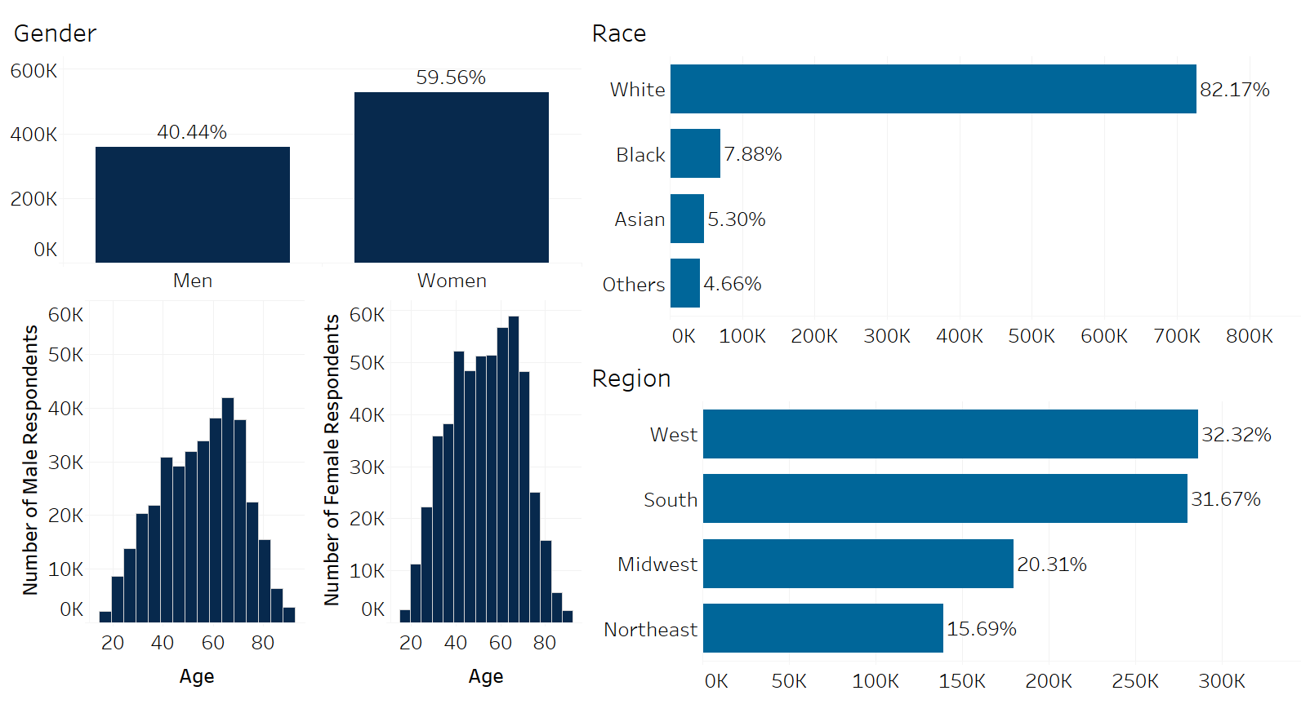
Data Understanding
Introduction
Descriptive Analysis
Predictive Analysis
Conclusion
Introduction
The share of survey respondents who are female is greater, but average age remains close at 54, with the average age for female respondents as 53 and the average age for male respondents as 55.
Over 700,000 survey respondents were white, and made up 82.17% of all reported races.
United States regions are well represented in this dataset, with West and South making up larger shares.
Notes:
Zalon

Slide 12
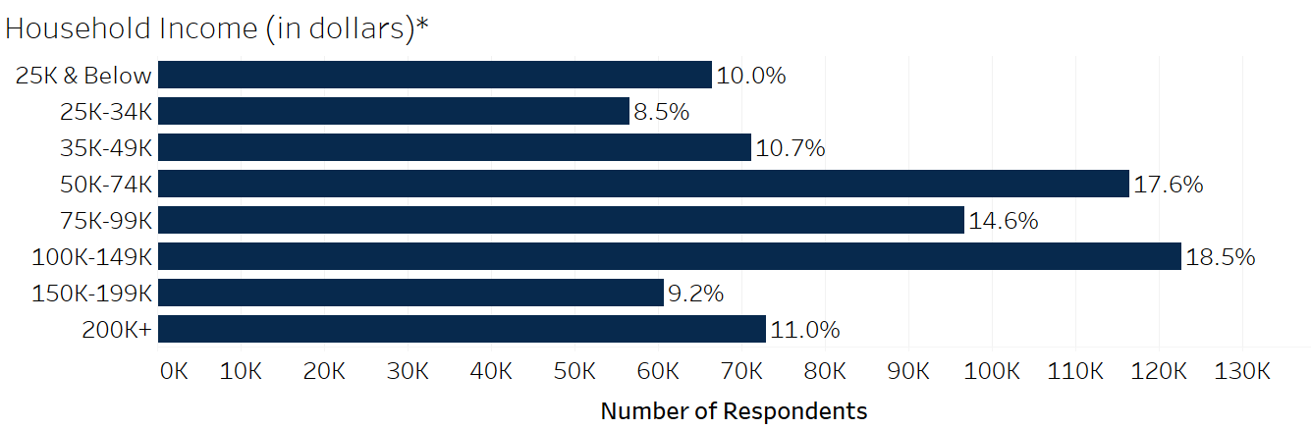
Data Understanding
Introduction
Descriptive Analysis
Predictive Analysis
Conclusion
Introduction
38.7% of respondents reported earning an income over $100,000 annually. On the other side, 10% reported earning an income below the U.S. poverty level for a family of 4.
*25% respondents did not respond
Notes:
Zalon

Slide 13
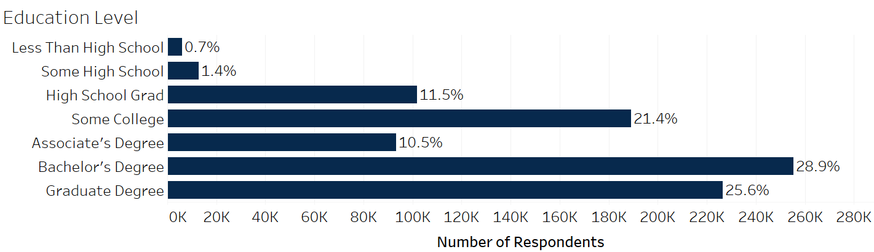
Data Understanding
Introduction
Descriptive Analysis
Predictive Analysis
Conclusion
Introduction
86.4% of all survey respondents reported having at least a high school education, with 54.5% of all survey respondents holding a bachelor’s degree or higher. Survey respondents with a less than a high school graduation made up the minority, with 2.1%.
Notes:
Zalon

Slide 14
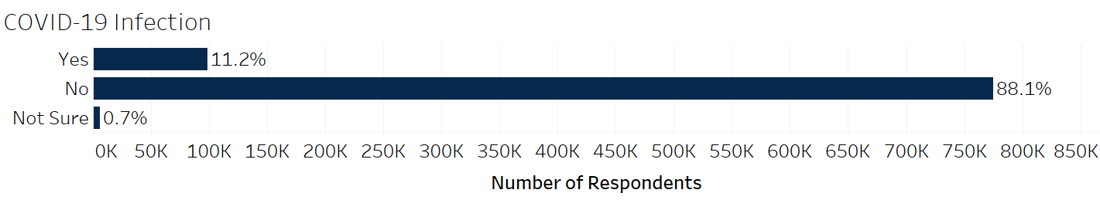
Data Understanding
Introduction
Descriptive Analysis
Predictive Analysis
Conclusion
Introduction
88.1% of survey respondents confirmed they had not been infected with COVID-19 at the time of taking the survey. The US reported an infection rate of ~15% when this survey was released, close to the survey respondent COVID-19 infection rate of 11%.
Notes:
Zalon

Slide 15
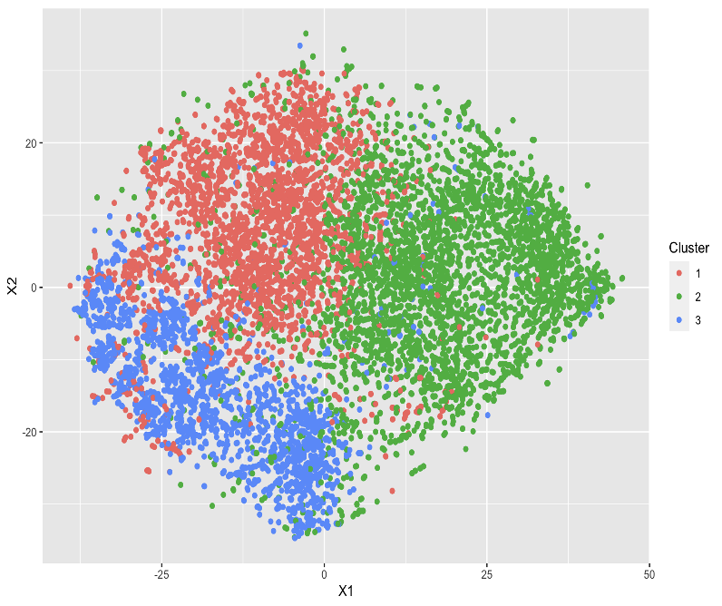
Descriptive Analysis: COVID-19 Impact
Descriptive & Cluster Analysis
Notes:
Zalon

Slide 16
Descriptive analysis
Employment & Mental Health
Notes:
Zalon

Slide 17
Employment
Descriptive Analysis
Introduction
Predictive Analysis
Conclusion
Age Disparities
Overall, 26% lost their job during the COVID-19 impact
Highest employment loss rate was for individuals below 30 years of age (34%)
Proportion test: Percent difference significant is in all groups
Notes:
Zalon

Slide 18
Employment
Descriptive Analysis
Introduction
Predictive Analysis
Conclusion
Gender Disparities
Women experienced more employment loss than men (younger than 60 years old)
Proportion test: Percent difference between genders is significant at 18 - 49
Most impacted: 20s
Women: Unemployment - 10.2% NILF-others* - 6.6% up
Men Unemployment - 8.5% NILF-others* - 6.2%
(Moen, Pedtke & Flood, 2020)​
+1.5%
+2.2%
+0.5%
+1.4%
+2.1%
+0.6%
*NILF-other: Not In Labor Force for reasons other than retirement or disability, not actively seeking jobs​
Notes:
Zalon

Slide 19
Employment
Descriptive Analysis
Introduction
Predictive Analysis
Conclusion
Reason for not working recently
42% of respondents did not work in the past 7 days
Young adults: Personal choice
Women below 50 years old: Childcare duty
Men: Company decision
Asian & Hispanic women most likely to move to NILF-other* (Moen, Pedtke & Flood, 2020)
Men are more likely to be laid off or furloughed, ​this reason is primary in ages 30-50 and secondary in 20 & below.
Top Two Reasons of Men and Women Aged 18 – 59 for Not Working Recently (excluding “Others”)
 | Reason | Men | Women
20’s & Below | Primary | Personal Choice (23%) | Childcare duty (17%)
 | Secondary | Being laid off / furloughed due to coronavirus pandemic (16%) | Personal Choice (15%)
30’s | Primary | Being laid off/ furloughed due to coronavirus pandemic (26%) | Childcare duty (36%)
 | Secondary | Childcare duty (9%) | Being laid off/ furloughed due to coronavirus pandemic (13%)
40’s | Primary | Being laid off/ furloughed due to coronavirus pandemic (24%) | Childcare duty (21%)
 | Secondary | Sickness/ disability (not COVID) (9%) | Being laid off/ furloughed due to coronavirus pandemic (13%)
50’s | Primary | Being laid off/ furloughed due to coronavirus pandemic (19%) | Sickness/ disability (not COVID) (15%) Retirement (15%)
 | Secondary | Retirement (18%)
*NILF-other: Not In Labor Force for reasons other than retirement or disability, not actively seeking jobs​
Notes:
Zalon

Slide 20
Mental Health
Descriptive Analysis
Introduction
Predictive Analysis
Conclusion
Mental Health
Survey respondents aged 18-30 felt anxious more frequently than not
49% of people who took the survey reported that they have anxiety
31% with 1 or more children
60% are female
60% are married
40% unemployment
37% difficulty with expense
88% of survey respondents over age 60 reported not feeling anxious, possibly due to issues with employment not affecting them
Notes:
Zalon

Slide 21
cluster analysis
Notes:
Zalon

Slide 22
Data Preprocessing
Descriptive Analysis
Introduction
Predictive Analysis
Conclusion
Variables retained for cluster analysis:
Variable Selection
Remove
Random Sampling
Obtain Consistency
Consistent primary variables
Rename variables
Recode categories
Employment, Mental Health, Demographic variables
Redundant variables
Observations with missing values
28 variables
10,000 observations
COVID-19 Related | Employment | Mental Health | Demographic
Had COVID | Work Loss | Anxiousness | Age
Vaccinated | Expected Work Loss | Down Emotion | Education
 | Worked in past 7 days | Lack of Interest | Gender
 | Unemployment Insurance Applied | Worry | Marital Status
 | Social Security Benefits Applied | Mental Health Medication Prescription | Income
 | Social Security Benefits Received | Mental Health Service Absent | Race
 | Work From Home | Mental Health Service Received | Hispanic Origin
 |  |  | Region
 |  |  | State
 |  |  | Number of Adults in household
 |  |  | Number of Kids in household
 |  |  | Number of Persons planning to take post-secondary education
Notes:
Zalon

Slide 23
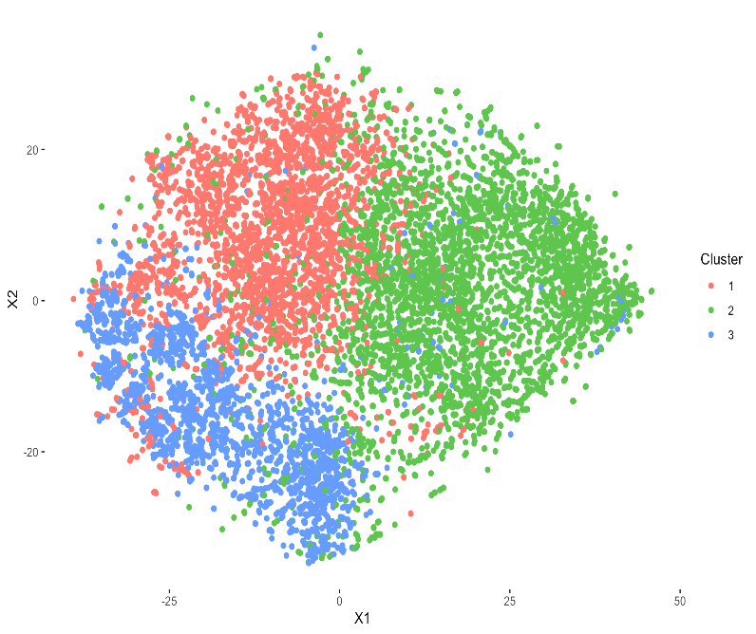
Cluster Analysis
Introduction
Descriptive Analysis
Predictive Analysis
Conclusion
Cluster 1
10,000 observations
28 variables
Combined dataset
(Phase 3 & 3.1)
Random sampled
Hierarchical Clustering
Method: Ward’s Minimum Variance Method
Distance: Gower
Cluster 2
Cluster 3
Distribution of demographics
Similar to original dataset
Cluster Validation (Internal)
Cophenetic Correlation = 0.39
Notes:
Prateek

Slide 24
Cluster Analysis Insights
Descriptive Analysis
Predictive Analysis
Introduction
Conclusion
Cluster 1 – Somewhat Impacted
Cluster 2 – Most Impacted
Cluster 3 – Least Impacted
Average Age : 52 years
Not living alone
Average Age : 47 years
Not living alone
Non-College Degree
Females
Average Age : 70 years
Living alone
Demographics
High Income (> $99K)
~22% lost work
~9% Expecting loss of work
Didn’t specify reason for lost work
>50% option of WFH
Enjoyed volunteer work in Healthcare and work seemed essential during COVID
Mid Income ($50K-$99K)
~40% lost work
>20% Expecting loss of work
Employer temporarily closed or went out of business
50% option of WFH
Unemployment Incentive
Stimulus Check
To pay off debt
Low Income (< $50K)
~5% lost work
~2% Expecting loss of work
Retired
No WFH
>90% Retirement benefits
Employment
Mental Health
Anxious, depressed, worried
Mental health counseling & prescription/
Least confident in paying mortgage, foreclosure in next 2 months anticipated

Slide 25
Recommendations
Introduction
Descriptive Analysis
Predictive Analysis
Conclusion
Recruit Young Talent
Enhance Childcare Support
Mortgage Allowance
Dedicated entry-level positions
Help young talent enter/ re-enter workforce
Avoid competition for mid-career employees
Provide on-board training for new entrants
Current program: allowance, subsidized childcare services (PricewaterhouseCoopers, n.d.)
Enhanced support: reserved spots in childcare network for internal application
Offer mortgage allowance as part of salary
Take off the stress related to housing from mid income employees.
ESG* Commitment &
Talent Management
*ESG: Environmental, Social & Governance

Slide 26
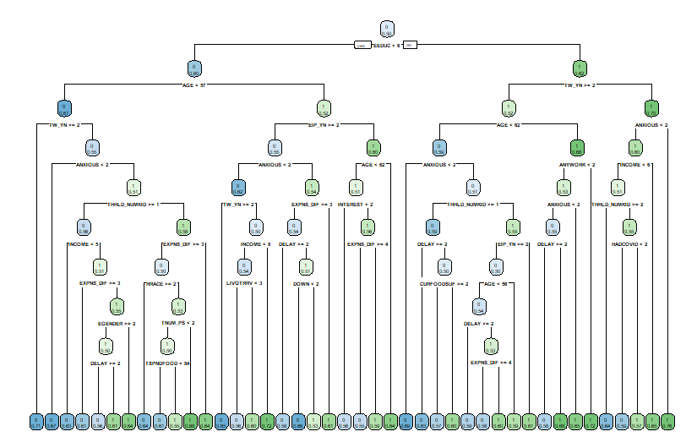
Predictive Analysis: Vaccination intention
Decision Tree
Notes:
Ai Vi

Slide 27
Data Preprocessing
Descriptive Analysis
Predictive Analysis
Conclusion
Introduction
Define Target Variable
Variable Selection
Final Dataset
Obtain Consistency
Remove all missing data
Rename variables
Recode categories
Remove “unsure” category from Phase 3.1
Retain consistent primary variables
Remove redundant variables and those with high missingness
40 variables
356,735 observations

Slide 28
Target Variable
Descriptive Analysis
Predictive Analysis
Conclusion
Introduction
Target Variable: Vaccination Intention
Yes: comprised of respondents who designated they would “definitely get vaccine” or “probably get vaccine”
No: comprised of respondents who designated they would “definitely not get vaccine” or “probably not get vaccine”

Slide 29
Data
Descriptive Analysis
Predictive Analysis
Introduction
Conclusion
Combination of Phase 3 and 3.1
40 predictor variables
Target variable: Vaccination Intention
Prediction Dataset:
75% intend to get vaccine
25% do not intend to get vaccine
Initial Insights
People with higher education levels are more likely to intend to get vaccinated

Slide 30
Decision Tree
Descriptive Analysis
Predictive Analysis
Introduction
Conclusion
Method: Decision Tree (Classification)
Training/Testing Split: 70/30
Hyperparameter tuned model trained using 5-Fold Cross validation, repeated 3 times
Class Imbalance handled using Random Undersampling
 | Train | Test
Overall Accuracy | 0.65 | 0.64
Precision | 0.70 | 0.75
Sensitivity | 0.68 | 0.62
Specificity | 0.63 | 0.67
Recall | 0.69 | 0.68
F1 | 0.68 | 0.69

Slide 31
Decision Tree Results
Introduction
Descriptive Analysis
Predictive Analysis
Conclusion
Variable Importance
Education, Age, Telework
Lowest percentages of willingness to be vaccinated were among those with only some high school education (Nguyen, 2021)
Among younger age groups, concerns with vaccine safety and effectiveness were big impediments in their wish to be vaccinated (Baack, 2021)
62% of all workers using Telework to work remotely reported having a bachelor’s degree or higher (Parker, 2021)
Income
Those with lower incomes are less likely to get vaccinated (Baack, 2021)
Mental Health
Young adults and elderly reported having mental health issues during the pandemic, with 80% of college age students reporting feelings of loneliness (Fernandez, 2021)
Notes:
Conversely, those with bachelor’s degrees were most likely to trust the vaccine’s efficacy and plan on receiving it
Ages 55-64 showed the largest share of willingness to get vaccinated, followed by 45-54

Slide 32
Decision Tree Results
Introduction
Descriptive Analysis
Predictive Analysis
Conclusion
Prediction Model: COVID-19 Vaccination Intention
Summary:
68% Accuracy
Most important variables include Education, Age, Telework, Income, and Mental Health
Recommendations:
Offer compensation perks to employees to get vaccinated, such as offering a day off to give time for the injection as well as recovery time, similar to Aldi’s pledge to pay hourly wages for time taken to get vaccinated (Terrell, 2021)
Distribute helpful materials to employees that serve to inform on the importance of getting vaccinated, such as “Diseases and the vaccines that prevent them”, an educational material the CDC recommends (CDC, 2019)
Offer mental health benefits to vaccination counseling services, in the hopes that it will counteract vaccine hesitancy, as well as prompt employees to get vaccinated as was done in a study in Palermo, Italy (Constantino, 2020)
Notes:
Another idea – a central hub website with educational information

Slide 33
Recommendations & Conclusion

Slide 34
Recommendations
Descriptive Analysis
Introduction
Predictive Analysis
Conclusion
Addressing COVID-19 Impact
Recruit and support entry of young people into the workforce, as those under 30 have been most affected by layoffs
Enhance childcare services to assist working females who have difficulty finding childcare
Offer compensation benefits for home-related expenses to ease the financial hit of mortgages on employees
Predicting COVID-19 Vaccination Intent
Offer days or hours off to get employees vaccinated while they are compensated for this time
Distribute educational materials to employees to gently influence them to reduce their vaccine hesitancy and think about getting vaccinated
Offer mental health benefits to counteract vaccine hesitancy and build general confidence in the US vaccination program
Notes:
All descriptive are as a result of the pandemic, all predictive are to incentivize vaccination

Slide 35
Thank You! Questions?

Slide 36
References
Baack, B. N., Abad, N., Yankey, D., Kahn, K. E., Razzaghi, H., Brookmeyer, K., Kolis, J., Wilhelm, E., Nguyen, K. H., & Singleton, J. A. (2021). COVID-19 vaccination coverage and intent among adults aged 18–39 years — United States, March–May 2021. Centers for Disease Control and Prevention, 70.
Banerjee, D. (2020). The impact of COVID‐19 pandemic on Elderly Mental Health. International Journal of Geriatric Psychiatry, 35(12), 1466–1467. https://doi.org/10.1002/gps.5320
Centers for Disease Control and Prevention. (2019, May 7). Education info about vaccines and diseases they prevent. Centers for Disease Control and Prevention. Retrieved December 1, 2021, from https://www.cdc.gov/vaccines/ed/patient-ed.html.
Costantino, C., Caracci, F., Brandi, M., Bono, S. E., Ferro, A., Sannasardo, C. E., Scarpitta, F., Siddu, A., Vella, C., Ventura, G., Vitale, F., Casuccio, A., & Restivo, V. (2020). Determinants of vaccine hesitancy and effectiveness of vaccination counseling interventions among a sample of the general population in Palermo, Italy. Human Vaccines & Immunotherapeutics, 16(10), 2415–2421. https://doi.org/10.1080/21645515.2020.1728157
del Rio-Chanona, R. M., Mealy, P., Pichler, A., Lafond, F., & Farmer, J. D. (2020). Supply and demand shocks in the COVID-19 pandemic: An industry and occupation perspective. Oxford Review of Economic Policy, 36(Supplement_1), S94-S137.
Dingel, J. I., & Neiman, B. (2020). How many jobs can be done at home? Journal of Public Economics, 189, 104235. https://doi.org/10.1016/j.jpubeco.2020.104235
Fernandez, M. E. (2021, March 5). COVID-19 mental health crisis is hitting Young Adults. www.heart.org. Retrieved October 19, 2021, from https://www.heart.org/en/news/2021/03/05/COVID-19-mental-health-crisis-is-hitting-young-adults.
Javed, B., Sarwer, A., Soto, E. B., & Mashwani, Z. U. (2020). The coronavirus (COVID-19) pandemic's impact on mental health. The International journal of health planning and management, 35(5), 993–996. https://doi.org/10.1002/hpm.3008

Slide 37
References
Loomba, S., de Figueiredo, A., Piatek, S.J. et al. Measuring the impact of COVID-19 vaccine misinformation on vaccination intent in the UK and USA. Nat Hum Behav 5, 337–348 (2021). https://doi.org/10.1038/s41562-021-01056-1
Moen, P., Pedtke, J. H., & Flood, S. (2020). Disparate disruptions: Intersectional COVID-19 employment effects by age, gender, education, and Race/Ethnicity. Work, Aging and Retirement, 6(4), 207–228. https://doi.org/10.1093/workar/waaa013
Nguyen, Kimberly. “Changes in Covid-19 Vaccination Receipt and Intention to Vaccinate by Socioeconomic Characteristics and Geographic Area, United States, January 6 – March 29, 2021.” https://www.tandfonline.com/doi/full/10.1080/07853890.2021.1957998.
Parker, Kim, et al. “How Coronavirus Has Changed the Way Americans Work.” Pew Research Center's Social & Demographic Trends Project, Pew Research Center, 25 May 2021, https://www.pewresearch.org/social-trends/2020/12/09/how-the-coronavirus-outbreak-has-and-hasnt-changed-the-way-americans-work/.
PricewaterhouseCoopers. (n.d.). Employee benefits. PwC. Retrieved November 15, 2021, from https://www.pwc.com/us/en/careers/why-pwc/employee-benefits.html.
Terrell, K. (2021, September 10). Companies paying employees to get COVID-19 vaccine. AARP. Retrieved November 30, 2021, from https://www.aarp.org/work/working-at-50-plus/info-2021/companies-paying-employees-covid-vaccine.html.
Wong, S. Y., Zhang, D., Sit, R. W., Yip, B. H., Chung, R. Y.-nork, Wong, C. K., Chan, D. C., Sun, W., Kwok, K. O., & Mercer, S. W. (2020). Impact of COVID-19 on loneliness, mental health, and Health Service Utilisation: A prospective cohort study of older adults with multimorbidity in primary care. British Journal of General Practice, 70(700). https://doi.org/10.3399/bjgp20x713021

