Slide 1

PREDICTIVE ANALYSIS: CHRONIC KIDNEY DISEASE
GROUP 2
BUYS, Charlotte
GULATI, Prateek
KHUAT, Trang
WONG, Sze Ki (Zalon)

Slide 2
INTRODUCTION TO CKD

Slide 3
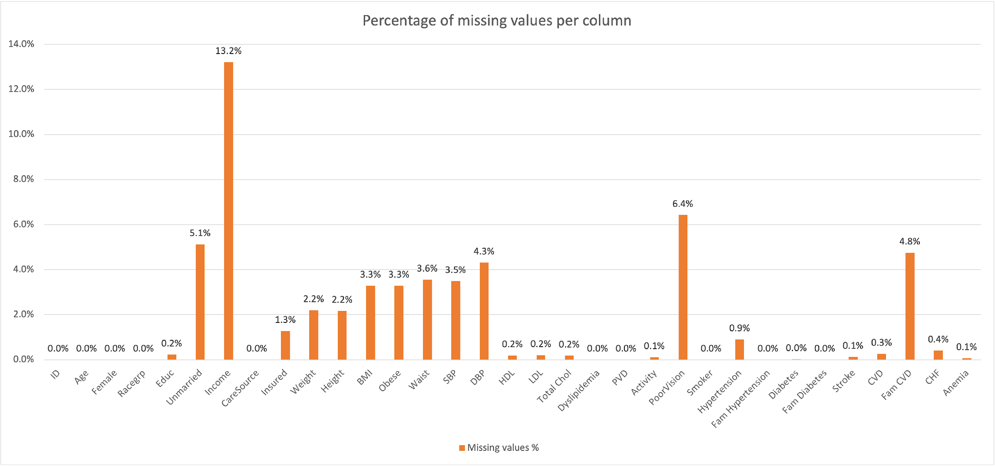
INTRODUCTION TO DATASET

Slide 4
DATA PRE-PROCESSING
Missing data imputed with missForest
multiple imputation
non-parametric
random forest
--------------------------
For a more in detail explanation of missForest method, see Stekhoven, D., J., & Buhlmann, P. (2011). MissForest—non-parametric missing value imputation for mixed-type data. Bioinformatics, 28(1), 112-118. https://doi.org/10.1093/bioinformatics/btr597

Slide 5
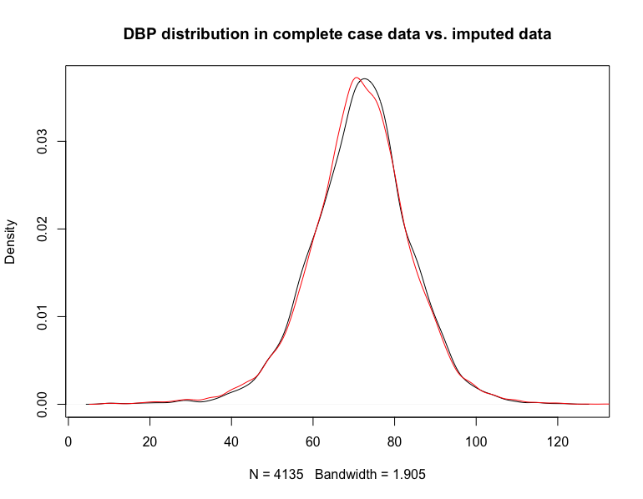
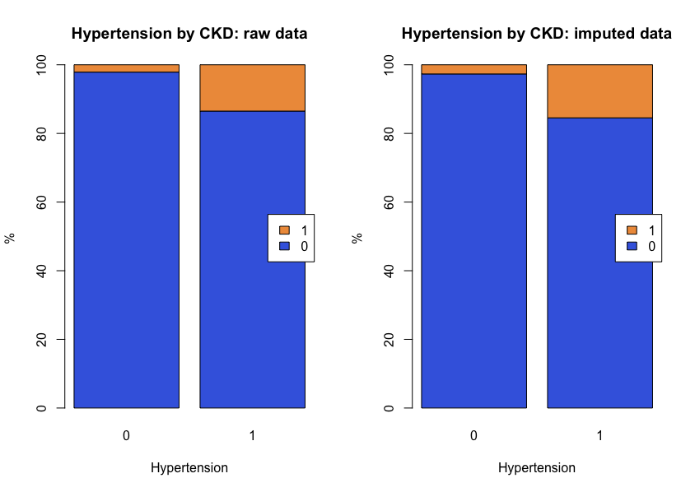
DATA PRE-PROCESSING

Slide 6
MODEL DEVELOPMENT

Slide 7
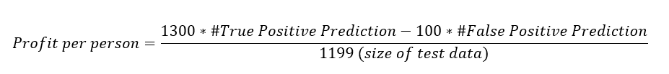
Model Selection Criteria
•Simplicity
•Model size
•Binary variables
•True Positive Rate / False Positive Rate
•Balance
•Represented by profit per person
Profit per person=(1300∗#True Positive Prediction-100∗#False Positive Prediction)/(1199 (size of test data))
(this is supposed to be a formula)

Slide 8
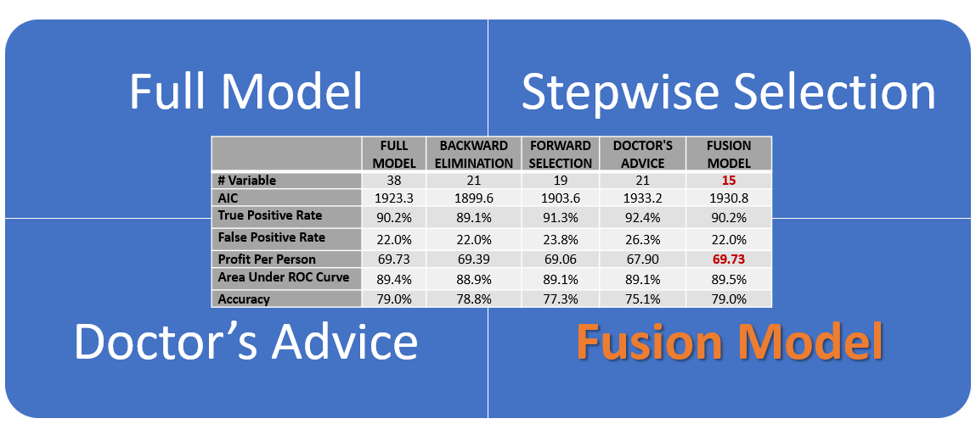
Model Comparison
[I used smartart on MS powerpoint and it cannot be pasted on google doc, so i just took a screenshot for now]

Slide 9
Final Model – Fusion Model
•Doctor’s advice + CKD research + statistical significance
•Simple: 11 Variables (9 categorical)
•TPR/ FPR
•True Positive Rate: 90.2%
•Total Profit: $83,600
•Profit per person: ~$69.7

Slide 10
SCREENING TOOL

