Slide 1
Shri Shivaji Vidya Prasarak Sanstha’s Bapusaheb Shivajirao Deore Polytechnic, Vidyanagari, Deopur, Dhule-424005 (Academic Year 2020-2021)
INPLANT TRAINING 2020
Studies on ITR Report
Department of Computer Engineering

Slide 2
PROJECT SUBMITED TO
S.S.V.P.S.’s B. S. Deore Polytechnic, Dhule
For the Industrial Training Report
In Full stack web developer
BY
Mr. Prashant Kailas Kedar
Deploma In Computer Enginering
Seat No : 74 , Enrollment No :- 1900590183
Head Of Department
Dr. Surekha Patil
Associate Professor
Department of Computer Engineering(0059)
Under the Guidance of
Mr. G. U. Pimpale
Associate Professor
Department of Computer Engineering(0059)

Slide 3
ROADMAP OF INDIAN EDUCATION SYSTEM

Slide 4
INDEX
Chapter No. | Title |  | Page No.
 | Certificate from Industry |  | i
 | Abstract |  | iii
 | Acknowledgment |  | iii
1 | Introduction |  | 7
 | 1.1 | Pages of the project | 7
 | 1.2 | Technology Used in this project | 7
 | 1.3 | Supported Operating System | 7
 | 1.4 | Snapshot Of Web Page
 | 1.5 | My Other Work in Training Time
 | 1.6 | My Github Profile
 | 1.7 | My Testing/Project Website Link
2 | Company’s Profile / Background |  | 8
3 | Weekly Job Summary |  | 9
4 | Technical Contents / Report |  | 17
5 | Findings & Suggestions |  | 18
6 | Conclusion |  | 18
7 | References |  | 18

Slide 5
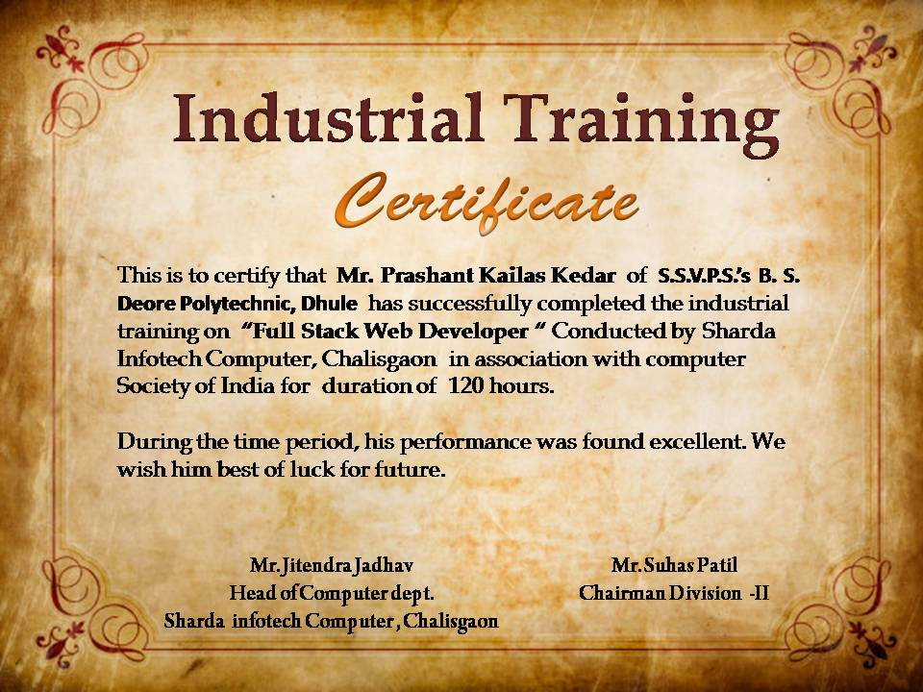
Certificate from Industry

Slide 6
Abstract
A website is a collection of Web pages, images, videos and other digital assets that is hosted on one or several Web server, usually accessible via the Internet, Mobile phone or a LAN.
The pages of websites can usually be accessed from a common root URL called the homepage, and usually reside on the same physical server. The URLs of the pages organize them into a hierarchy, although the hyperlinks between them control how the reader perceives the overall structure and how the traffic flows between the different parts of the sites.

Slide 7
Acknowledgment
This project consumed huge amount of work, research and dedication. Still, implementation would not have been possible if we did not have a support of many individuals and organizations. Therefore we would like to extend our sincere gratitude to all of them.
First of all we are thankful to Dr. Surekha Patil for their financial and logistical support and for providing necessary guidance concerning projects implementation.
We are also grateful to mentor Mr. G.U. Pimpale for provision of expertise, and technical support in the implementation. Without their superior knowledge and experience, the Project would like in quality of outcomes, and thus their support has been essential.
We would like to express our sincere thanks towards volunteer researchers who devoted their time and knowledge in the implementation of this project.
Never the less, we express our gratitude toward our families and colleagues for their kind co-operation and encouragement which help us in completion of this project.

Slide 8
Introduction
This project base on Roadmap of a Education has been developed on HTML,CSS and JavaScript. The main objective of developing this project was to create a static website for the college, from which user can get the details of the Road map of education, student such as about the Home Page, Contact Details, Address, Images etc.
This project is in HTML and CSS so it’s static website and does not perform any type of dynamic database operations. This Website project in HTML is suitable for O level.
Our website is to provide info about ‘what to do in the future’. This Project is very Useful for All of student and parent for the designing itself future

Slide 9
Pages of the Project
Home Page : This project contains the important information with understandable Tree about the Road map of education.
About Page : It contains all about the Details basis on project.
Contact Us Page : contact details for any quires and any help.
Credit To Page : A special thanks to all those teachers for giving me this chance.

Slide 10
1.2 Technology Used in this project
I have developed this project using the below technology
HTML : Page layout has been designed in HTML.
CSS :CSS has been used for all the designing part
JavaScript : All the pop up have been developed by JavaScript
Visual Studio code : I was using visual studio code editor for this website development for easy to make this website.
Git Hub : I am using Git hub for deploying my website on free and fast web hosting with free domain portal.

Slide 11
1.3 Supported Operating System
I can configure this project on following the operation system.
Window: This project can easily be configured on windows operating system.
Linux: We can run this project also on all version of Linux operating system.
Mac: We can also easily configure this project on Mac operating system without any problem.

Slide 12
1.4 Snapshot of Web Page
Credit Section
About Section
Contact Section
Home Section

Slide 13
1.5 My Other Work in Training Period:
I am using Git hub for deploying my website on free and fast web hosting with free domain
Platform.
I was uploading my project time to time and now I created small playlist of my work in my training period. You can visit to my profile.
github.com/001pk1997
1.7 My Testing/Project Website Link :
https://okprashant.github.io/myweb.github.io/
https://okprashant.github.io/YES-YES-VPS/
https://pgabbar.githu1.6
https://github.com/okprashant
https://github.com/Pgabbar
https://b.io/Moviebookingsystem/
https://pgabbar.github.io/career-option/
https://pgabbar.github.io/YesYesVPS/
https://001pk1997.github.io/webtest

Slide 14
Chapter 2: Company’s Profile / Background
2.1. Profile:
Sharda Infotech Computer, Gayatri Complex Chalisgaon Dist jalgaon Maharashtra.
Head of Company’s Mr. Jitendra Jadhav.
2.2. Company’s business activities: -
MSCIT, GOVT Typing, Website Development, Skill India, Industrial Training.
2.3. Vision:-
We aim to develop well-rounded and thoughtful students prepared to cope with a changing post-modern and globalized world.

Slide 15
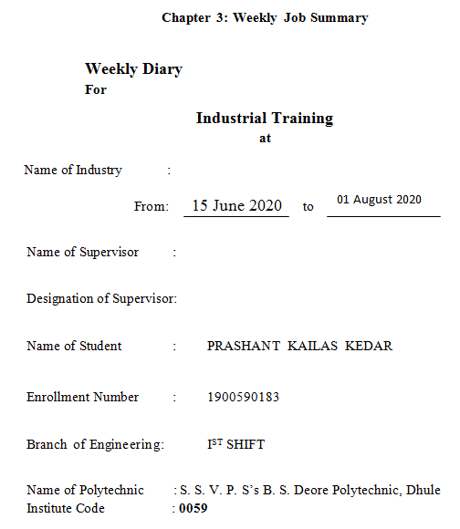

Slide 16
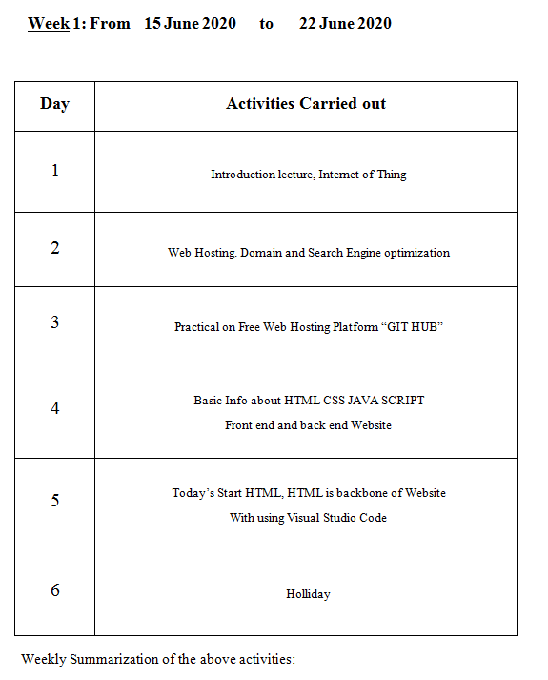

Slide 17
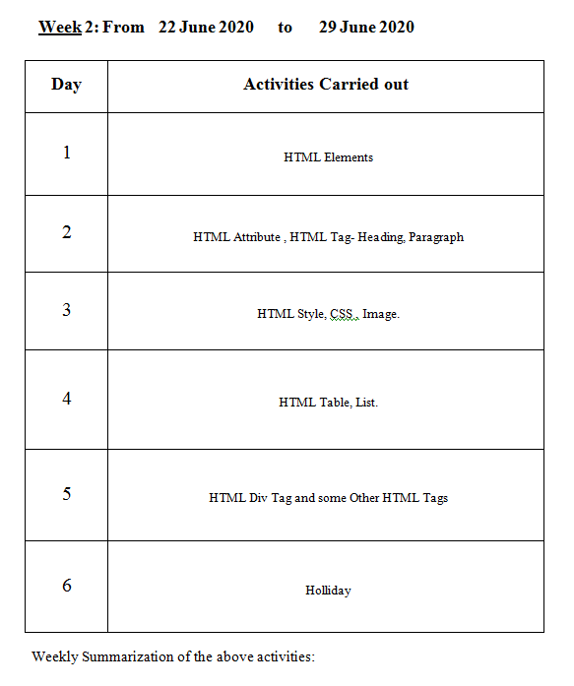

Slide 18
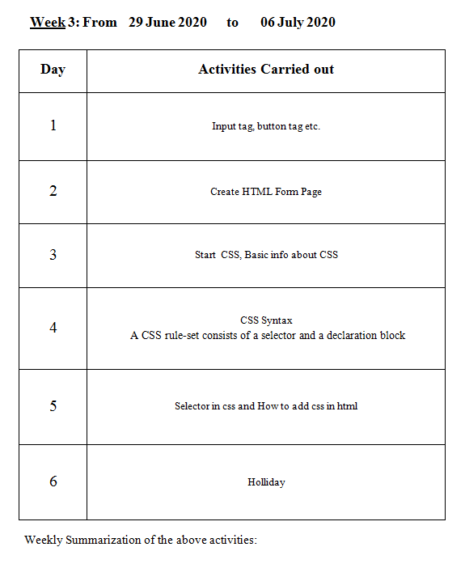

Slide 19
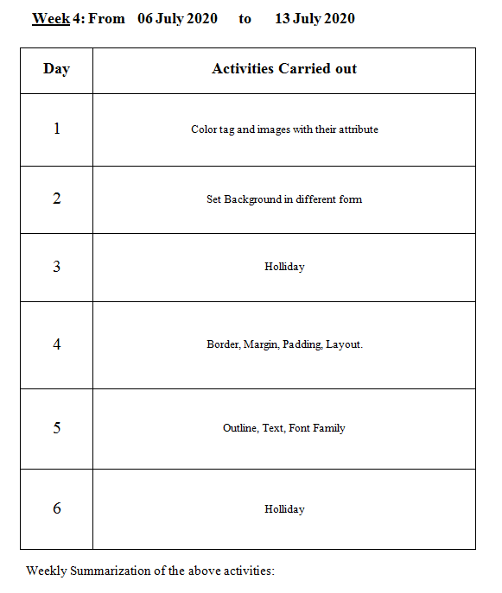

Slide 20
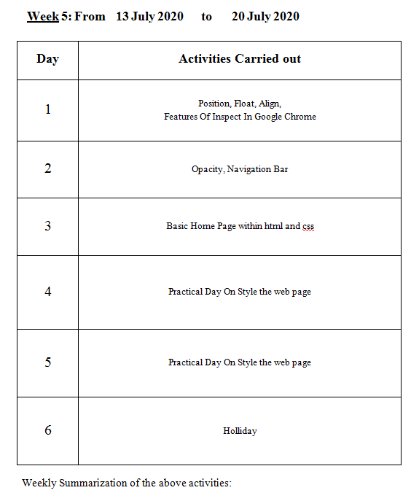

Slide 21
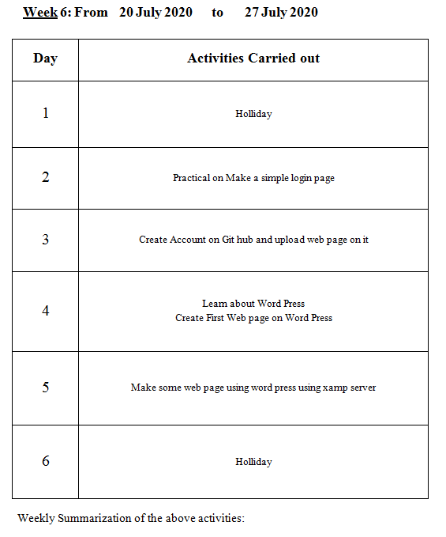

Slide 22
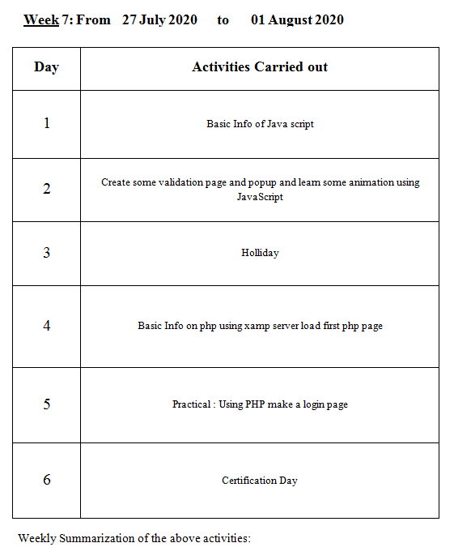

Slide 23
Chapter 4 : Technical Contents / Report
The process of studying a job to determine which activities and responsibilities it includes, its relative importance to other jobs, the qualifications necessary for performance of the job and the conditions under which the work is performed. An important concept in job analysis is that the job, not the person doing the job, is assessed, even though human resources (HR) may collect some job analysis data from incumbents.
Collecting information on characteristics that differentiate jobs. The following factors help make distinctions between jobs:
Knowledge, skills and abilities needed.
Work activities and behaviors.
Interactions with others (internal and external).
Performance standards.
Financial budgeting and impact.
Machines and equipment used (Hardware).
Working conditions.
GroupWork.
Submit the project in the time.

Slide 24
Chapter 5 : Findings & Suggestions
I took the ideas and researched about this topic from the websites and some books which are mentioned in the bibliography. I wish this assignment will be a useful and the knowledgeable one.
Chapter 6 : Conclusion
After completing this project on the topic (Road map of Education). I can concluded that (about what u made and what's in your project about the topic). This project includes future education plan which increases its reliability. Now I am able to talk any issue related with Education Road Map. The whole credit goes to my subject teacher, my brother, my friends; they refined my ideas and make this project wonderful.. Thank you...
This chapter summarizes the whole contents of the report and matters pertain to Industrial Training.

Slide 25
References
Website :
www.w3schools.com
www.tutorialrepublic.com
www.docs.oracle.com
www.en.wikipedia.org
www.youtube.com (Lectures)
Book :
HTML5 and CSS3 Web Publishing in One Hour a Day

