Slide 1

Using QGIS
Peter Galante
Biodiversity Informatics Scientist
Center for Biodiversity and Conservation
American Museum of Natural History

Slide 2
Outline
QGIS overview
GIS Data files
Basic operations
QGIS interface
Follow along

Slide 3
QGIS
QGIS is a powerful software built by many developers as a free, open-source tool to perform GIS tasks.
Open-source indicates that it’s programming, content, and design are open to use and modification by anybody*
* Some terms apply: Some licenses do not allow commercial use.

Slide 4
GIS
While other open-source GIS software exist (e.g. DIVA-GIS), QGIS is the most popular and best supported.
Another software that is important to know about is ArcGIS, developed by ESRI. All of the principles and techniques learned for QGIS are able to translate over to ArcGIS. Fortunately, there is no cost for QGIS. Some of the higher-end tools are less elegant in QGIS, but there is a lot of overlap.

Slide 5
Outline
QGIS overview
GIS Data files
Basic operations
QGIS interface
Follow along

Slide 6
Vector Data Files
The most common type of vector data (polygon, point, line) you will come across are “shapefiles”. These data are usually broken up into many ancillary files that help to plot the data.
These file types were developed by ESRI, the developer of arguably the most popular GIS software: ArcGIS.
.shp file is the geometry file that described the shapes
.shx file is the “index” file used for plotting
.dbf file contains the database that is paired with each shape. This is where the shape’s attribute table is found
Other files:
.prj contains information relating to the projection of the shape
When managing your GIS data, you MUST keep all shapefile ancillary files together in the same directory.
The easiest way to do this without using a databasing software (e.g., ArcCatalog, DB Manager) is to save shapefiles into their own directory.

Slide 7
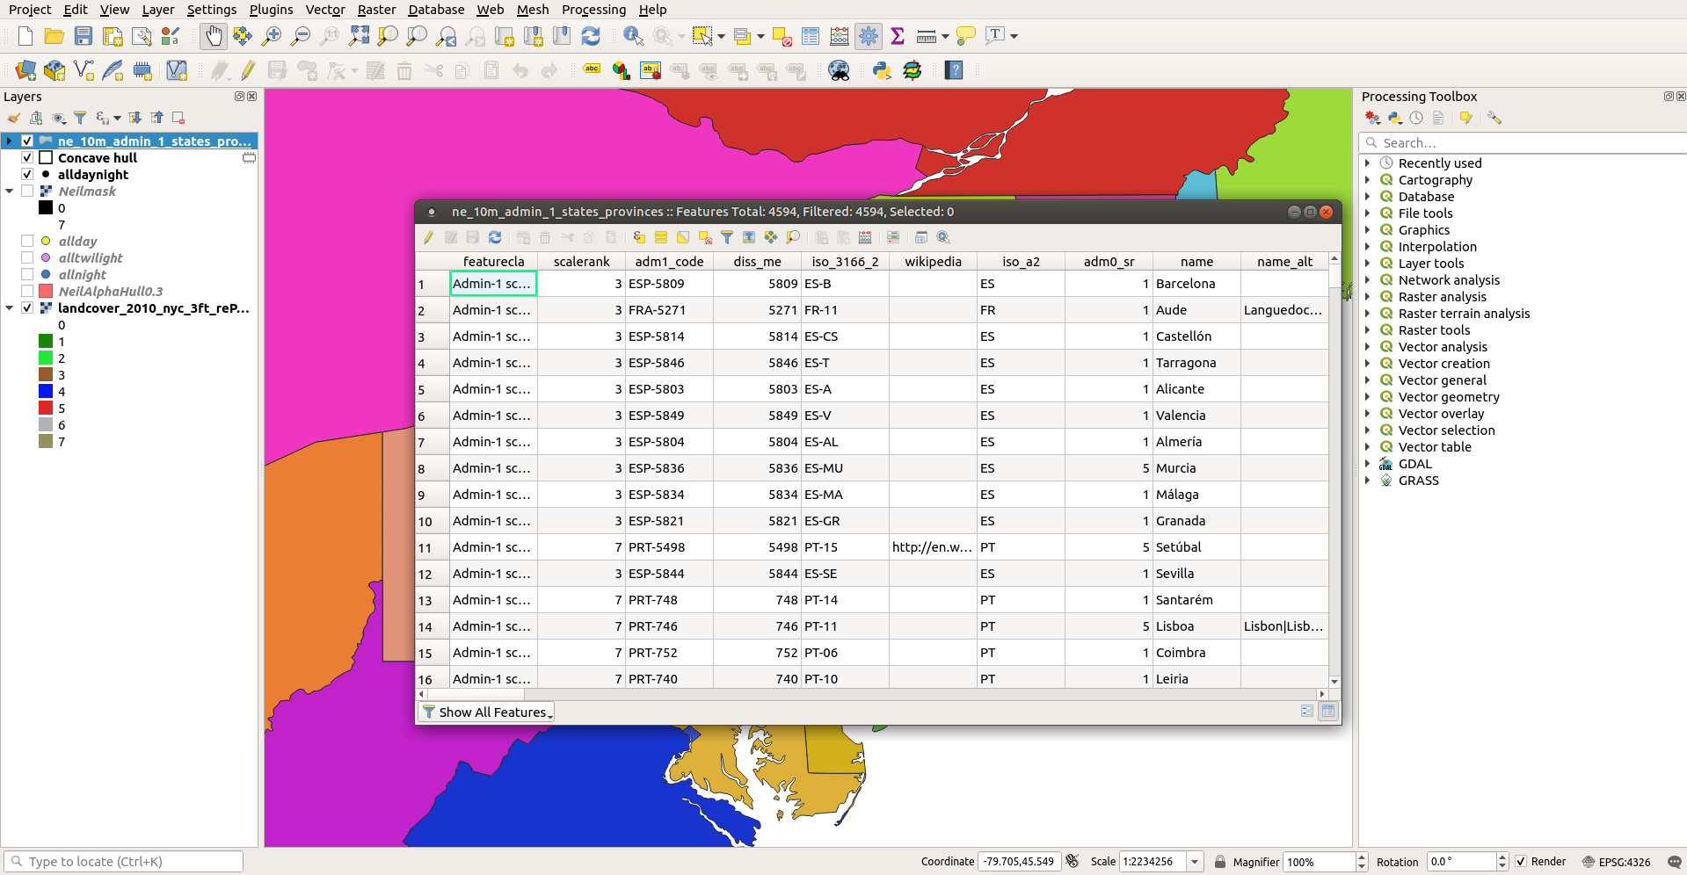
Attribute Table

Slide 8
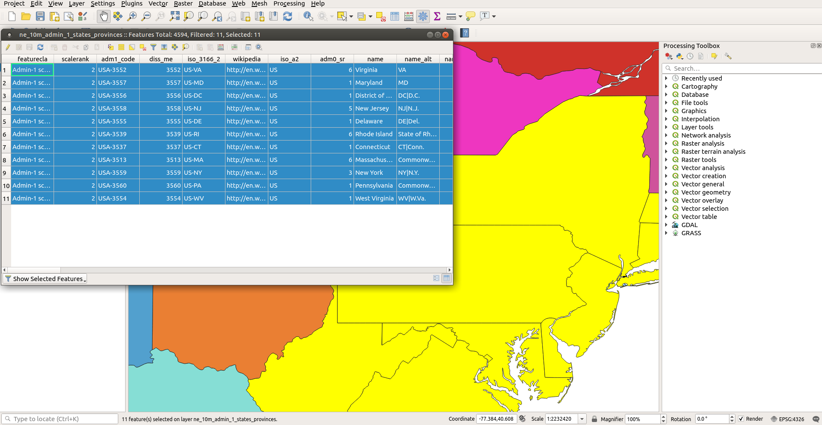
The table is paired with geographic data and can be queried
graphically, and through basic SQL.

Slide 9
Raster Data Files
Since rasters are essentially grids, many types of files can be plotted as rasters.
The most popular are:
1. GeoTiff – .tif files with geography metadata associated (origin, x, y, information)
These are by far the most popular in biology
2. Ascii – .asc files are text files with geography metadata in the header
3. netCDF – .cdf files are popular with some older datasets
There are many more, but you are most likely to come across these. Since rasters are essentially image files, even .jpg or .jpeg files can be used.

Slide 10
Outline
QGIS overview
GIS Data files
Basic operations
QGIS interface
Follow along

Slide 11
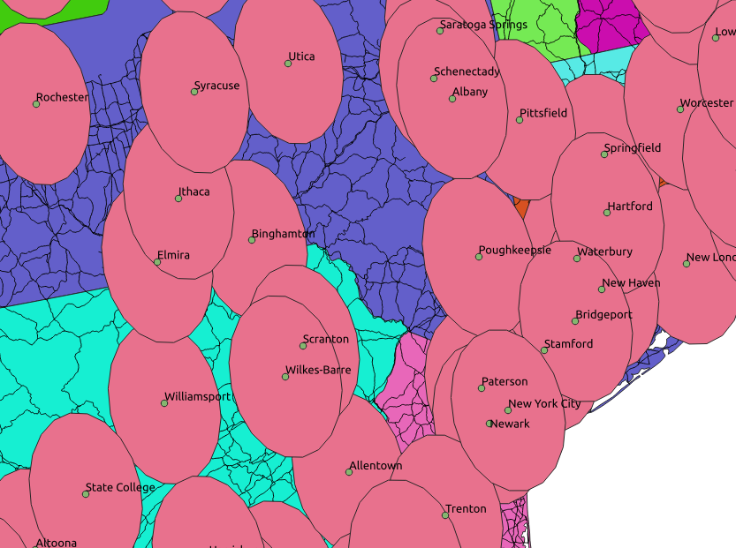
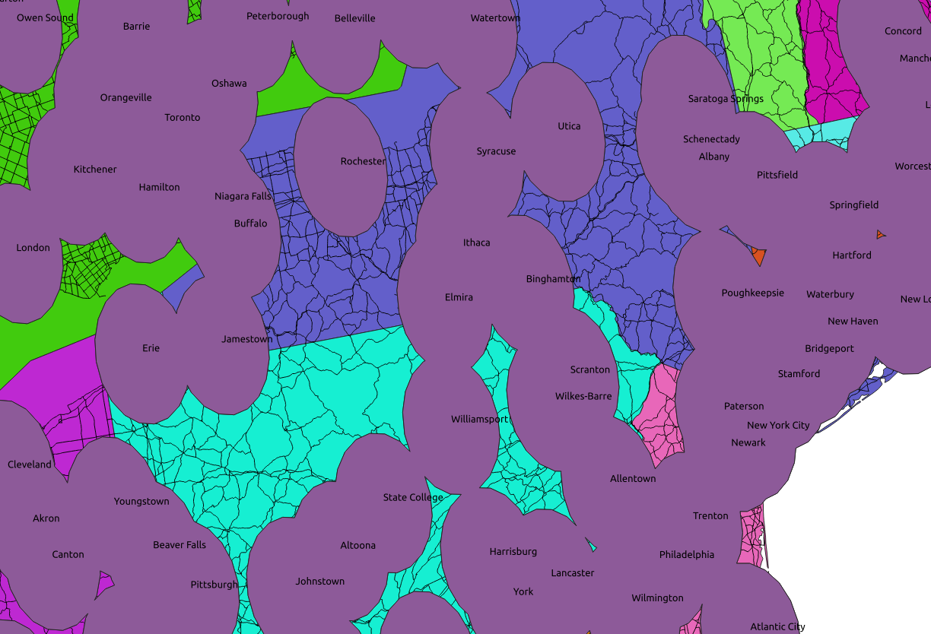
GIS operations
Spatial analyses.
- Buffers
- Dissolves
- Differences
- Centroids
- Masks

Slide 12
Outline
QGIS overview
GIS Data files
Basic operations
QGIS interface
Follow along

Slide 13
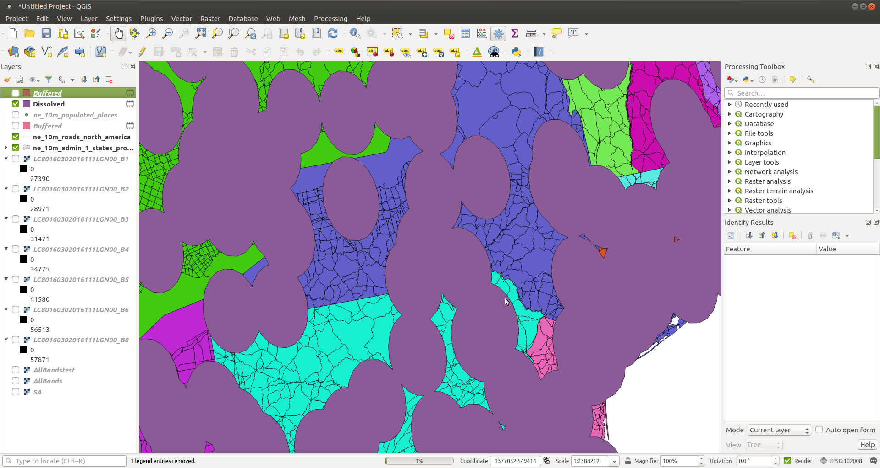
Adding
data
Print
layout
Table
of
Contents
Processing
Toolbar
Processing
Toolbox
Hover over buttons to see function
Status of
Processing
Operation
Coordinate and
scale information

Slide 14
Outline
QGIS overview
GIS Data files
Basic operations
QGIS interface
Follow along

Slide 15

Follow Along
Mapping nearby Bigfoot! sightings.

Slide 16
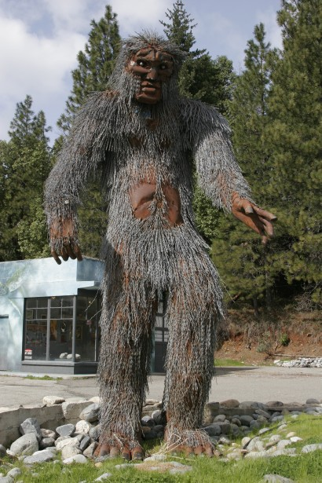
Follow Along
Mapping nearby Bigfoot! sightings.

Slide 17
Follow Along
Bigfoot analysis: Data
Find vector data online
Navigate to naturalearthdata.com and download large scale states and provinces
2. Download bigfoot occurrence from Courseworks
These data come from the Bigfoot Research Organization and were accessed from the R package ‘plotKML’; Hengl et al., 2015

Slide 18
Follow Along
Add the data to QGIS:
Vector data:
Easily dragged into the map pane
Point data:
Must be added through the “Add delimited text layer” button

Slide 19
Follow Along
Data can be subset in a number of ways:
1. Open up the attribute table for the states/provinces layer and explore it.
Sort the column header “admin” by clicking on it and scroll to “United States of America” and highlight all of these rows. (there should be 51 – why?)
Right click on the layer and export>Save selected features as...
2. Using “Select features by area or single click” tool, highlight the northeastern states and save as a new layer

Slide 20
Follow Along
Data can be subset in a number of ways:
2. Using “Select features by area or single click” tool, highlight the northeastern states and save as a new layer
3. Using “Select by location” tool, find all Bigfoot sightings within the northeastern states. Save these as a new layer.

Slide 21
Follow Along
Change custom colors for points and states.
Add labels for states

Slide 22
Follow Along
First, take a look at some examples of bad maps:
https://blog.stratasan.com/bad-maps-bad-maps
https://sites.psu.edu/swabmaps/2014/03/28/good-and-bad-maps/

Slide 23
Follow Along
Using the “Print Composer” tool, create a map
All maps should include:
1. Map Contents – what are you showing
2. Legend – how does the viewer interpret
3. Title
4. Scale bar – usually in km, but depends on context
5. North Arrow – for orientation
6. Data source

