Slide 1

Deep dive: vector data
Peter Galante
Biodiversity Informatics Scientist
Center for Biodiversity and Conservation
American Museum of Natural History

Slide 2
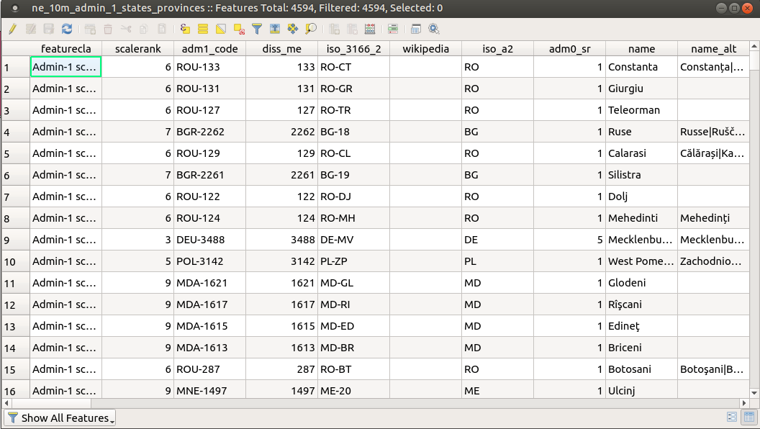
Vector data
Classifying vector data by attributes
Attribute tables show categories of values (usually)
Some columns are necessary for making useful maps
Attribute data can also be used for labeling
Many artistic options for adding labels

Slide 3
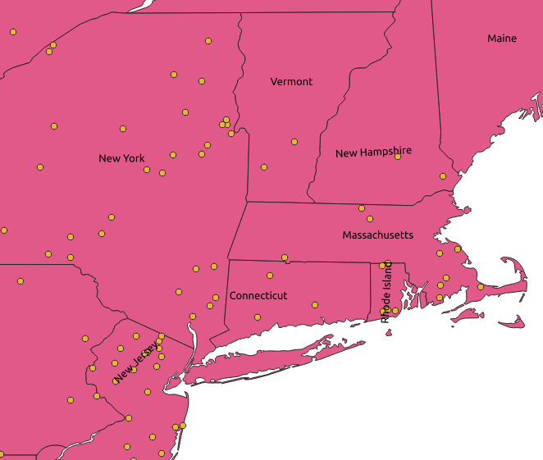
Vector data
Classifying vector data by attributes
Attribute tables show categories of values (usually)
Some columns are necessary for making useful maps
Attribute data can also be used for labeling
Many artistic options for adding labels

Slide 4
Vector data
Vector data types:
1. Whole number (integer) (1,2,3)
2. Whole number (64 bit integer) (1,2,3)
3. Decimal number (real) (1.00, 2.00, 3.00)
4. Text (string) (One, Two, Three)
5. Date (2/1/21, 2-1-21, 1 February 2021)
6. Date & Time (2/1/21 18:10)
Set the length (number of significant digits, etc.)

Slide 5
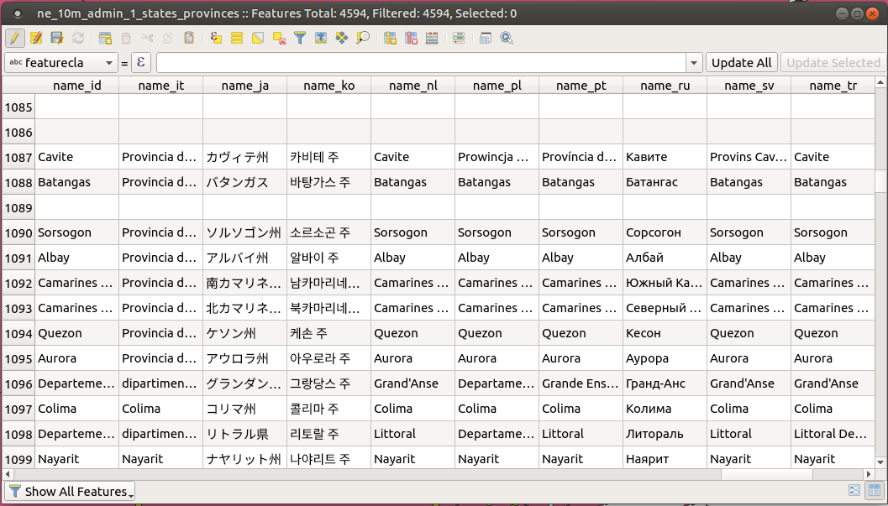
Vector data
Vector data types:
1. Whole number (integer) (1,2,3)
2. Whole number (64 bit integer) (1,2,3)
3. Decimal number (real) (1.00, 2.00, 3.00)
4. Text (string) (One, Two, Three)
5. Date (2/1/21, 2-1-21, 1 February 2021)
6. Date & Time (2/1/21 18:10)
Set the length (number of significant digits, etc.)

Slide 6
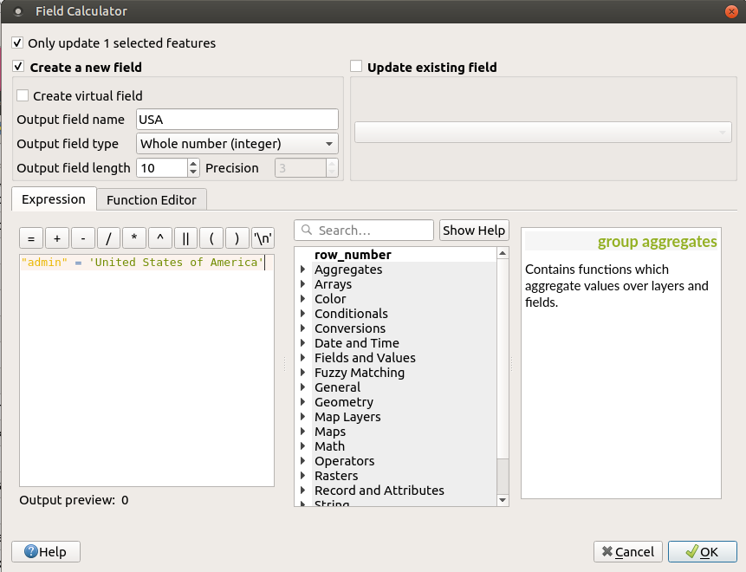
Vector data
Field calculator
Create/ edit fields using SQL (or the GUI)

Slide 7
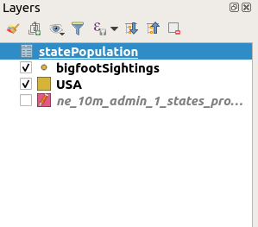
Vector data – follow along
Joining Tables
The United States shapefile does not have an attribute for population
Open the population data downloaded from the website. Data are from Wikipedia
Add population file as layer to QGIS

Slide 8
Vector data
Joining Tables
In the layer properties of USA layer, go to Joins
+ sign
Select layer, Join field (State), and target field (name)
VERY important to have exactly the same strings
Create new integer field based on new joined field (field calculator)
Joined as string instead of integer without .csv file
Edit state colors showing population (choropleth)

