Slide 1

Deep dive: raster data
Peter Galante
Biodiversity Informatics Scientist
Center for Biodiversity and Conservation
American Museum of Natural History

Slide 2
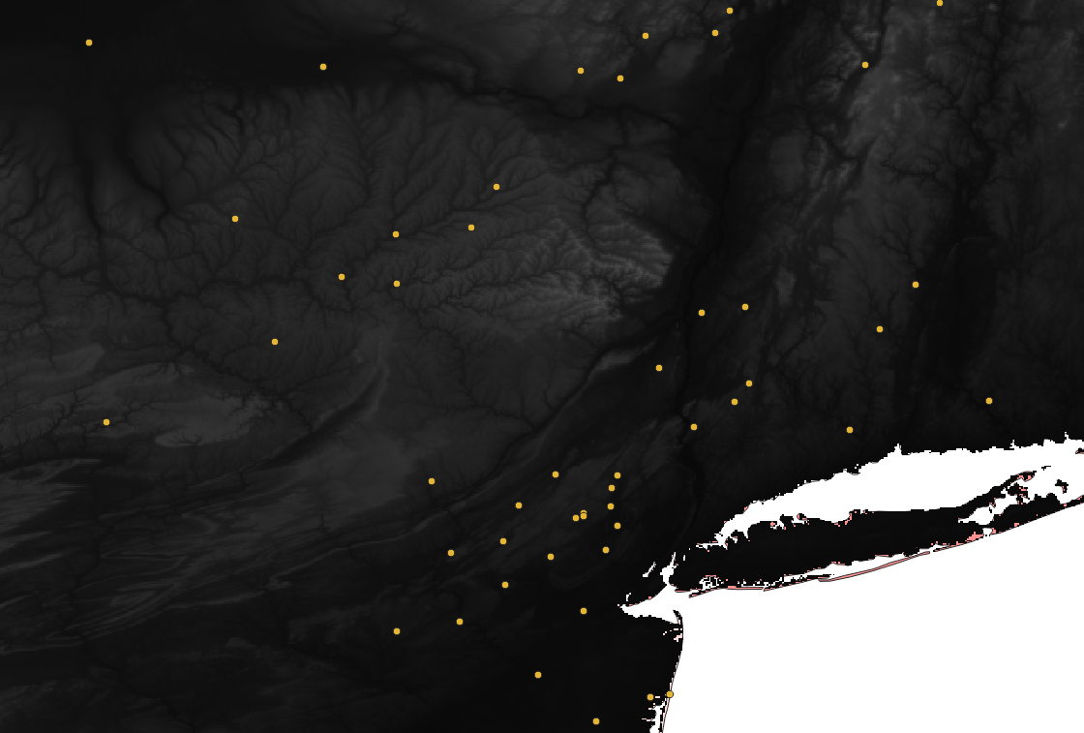
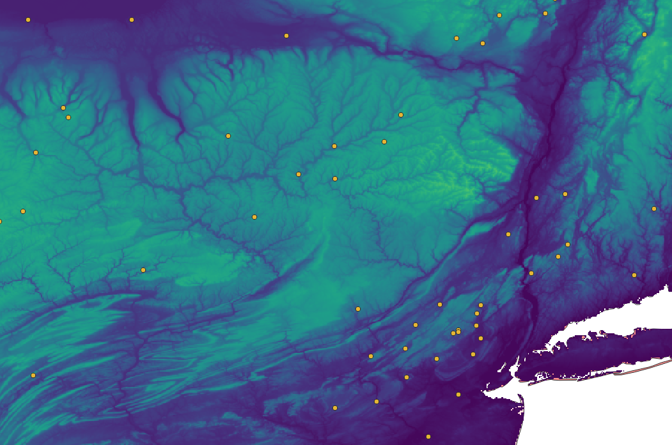
Raster data
Rasters can be rendered to have custom colors
No attribute table

Slide 3
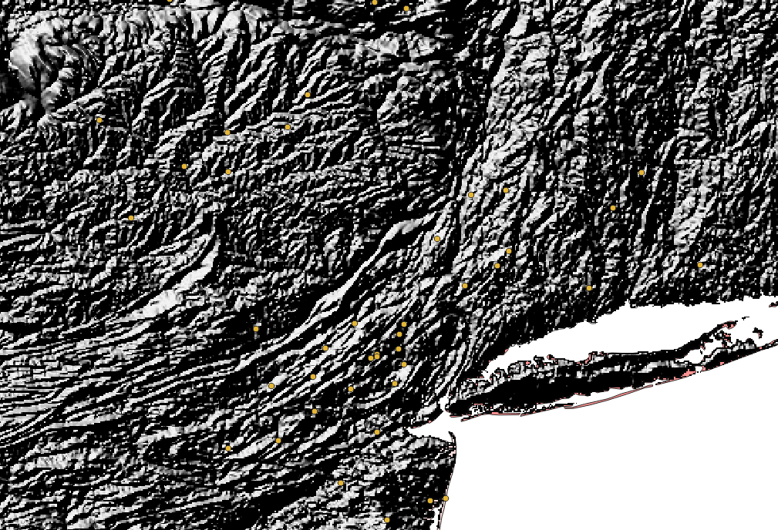
Raster data
Elevation rasters can be used to create hillshade layers
Viewshed analyses
Slope
Aspect
Raster Calculator

Slide 4
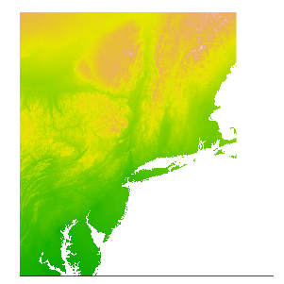
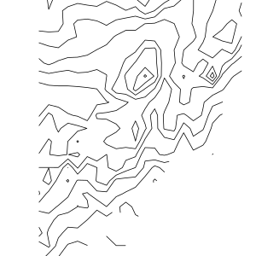
Raster data
RASTER | VECTOR
Resolution is explicit in the size of the grid cells / pixels | Resolution is difficult to define and therefore typically poorly defined (not rigorous)

Slide 5
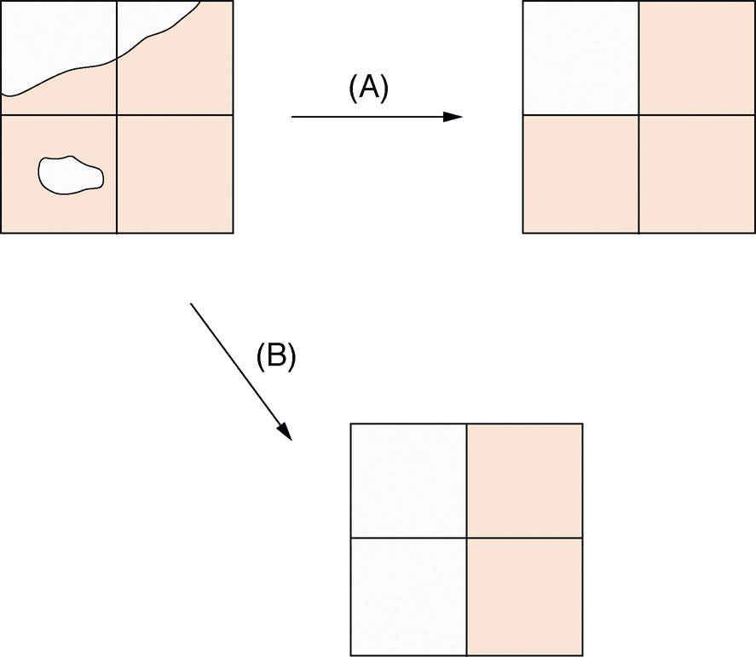
Raster data
Conversion from vector to raster data
the largest share rule
(B) the central point rule

Slide 6
The nature of spatial data
Tobler’s First Law of Geography:
Everything is related to everything else, but near things are more related than distant things.
Most of the things we are interested in are not randomly distributed in space.
Con: Need to correct for spatial autocorrelation and bias in analyses
Pro: Allows for interpolation

Slide 7
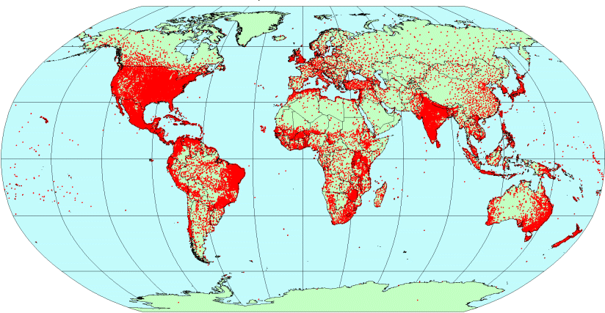
Raster data
Conversion from vector to raster data
Weather station records
(vector point data;
Hijmans et al. 2005)
Interpolated raster climate surfaces (WorldClim)

