Slide 1

Raster calculator and follow-along
Peter Galante
Biodiversity Informatics Scientist
Center for Biodiversity and Conservation
American Museum of Natural History

Slide 2
Raster data
A raster is a grid of pixels
- Each pixel is given a value

Slide 3
Raster data
If a raster is a fancy spreadsheet:
- Perform math on values
- values are reflected visually as color

Slide 4
Raster data
Simple raster evaluations
Conversions
Changing units
Meters to feet = “elevation@1” * 3.28
⁰F to ⁰C = (“temp@1” – 32)*(5/9)

Slide 5
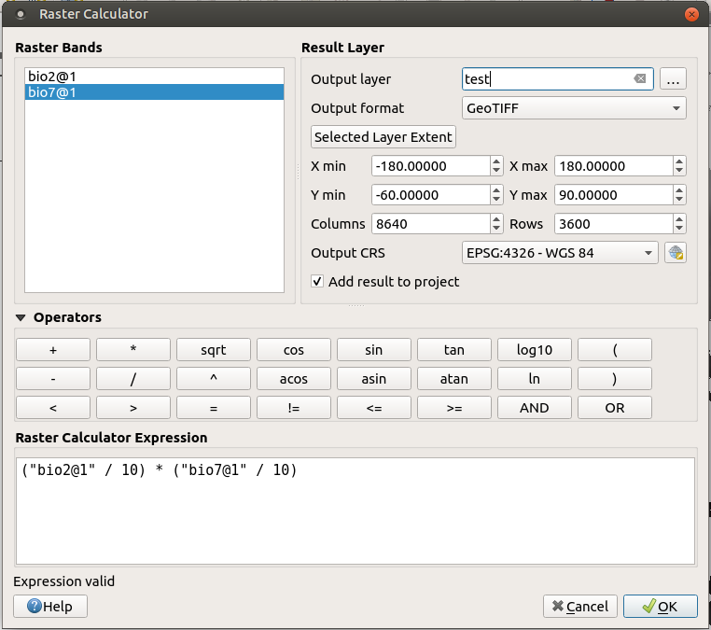
Raster data
For example:
Worldclim
Converting to
actual values
Save as
new layer

Slide 6
Raster data
For example:
Double-click to add raster to expression box
Best to use operator buttons (rather than type)
Can change output CRS
Can select new extent,
resolution

Slide 7
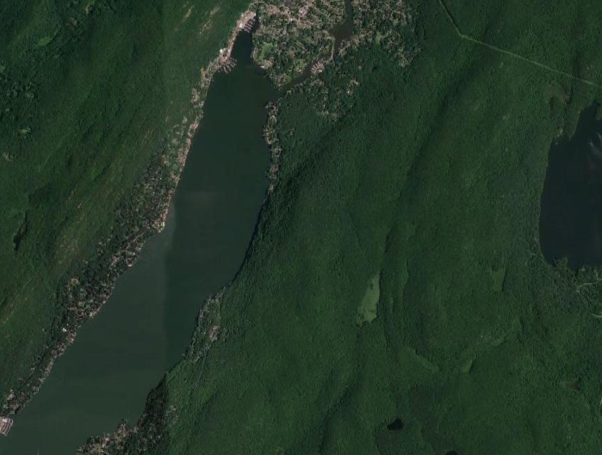
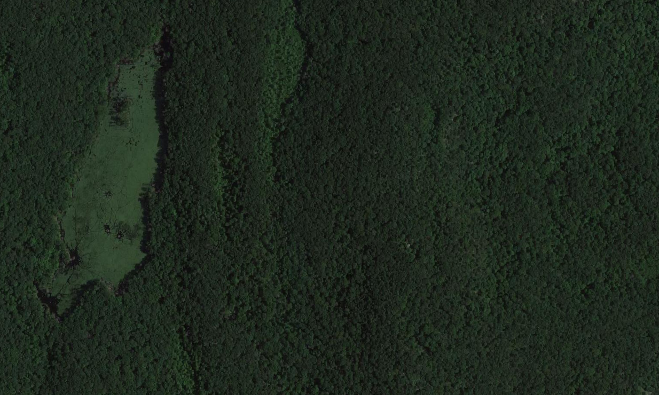
Follow-along
Import GWLOrangeCounty layer
Zoom to the layer
Add Google maps imagery
Zoom to fire tower
East of large lake → find the marsh→ east of the marsh, locate the fire tower.
Fire tower

Slide 8



Follow-along
Use the New Shapefile Layer tool to add point layer
Name the layer firetower. Then enable editing → Add Point Feature
Click on the firetower
Id = 1. End editing and save.

Slide 9
Follow-along
Plugins → Install Visibility Analysis plugin
Create Viewpoints
Observer height = 15m
GWLOrangeCounty as DEM
Viewshed tool
Create binary viewshed from firetower observer location
Any better areas for firetower?

