Slide 1

Georeferencing a map follow-along
Peter Galante
Biodiversity Informatics Scientist
Center for Biodiversity and Conservation
American Museum of Natural History

Slide 2
Georeferencing a map
GIS has the ability to assign coordinates to a map that has no spatial information
- e.g., paper map scans
Images can be warped through mathematical transformations to fit within the coordinate system

Slide 3
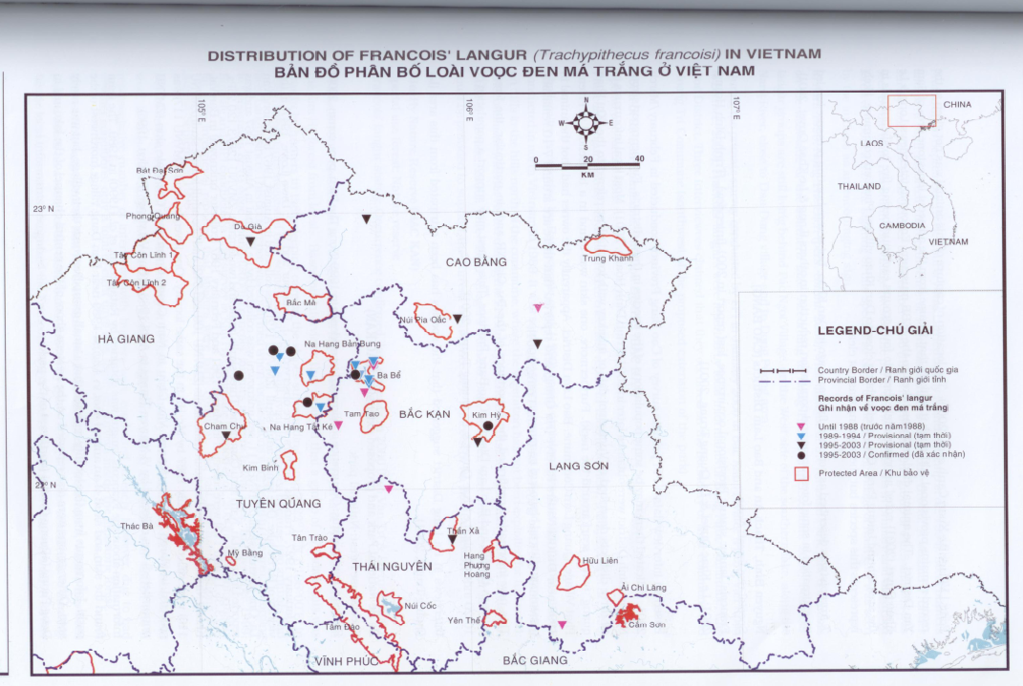
Georeferencing a map

Slide 4
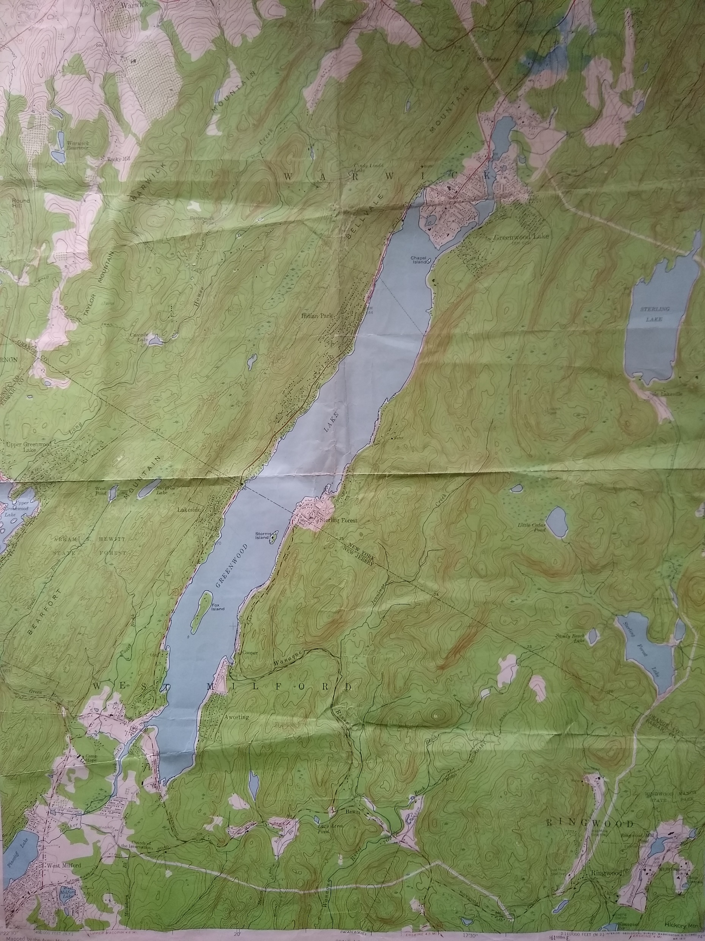
Georeferencing a map
USGS Quadrangle
1954 “Quad map”
7.5 minute = between 49 – 70 square miles
Image normally has thick border, but was cropped out

Slide 5
Georeferencing a map
Use the OpenLayers plugin
Add a useful map showing the region of interest
Must be at least as detailed as the map you want to georeference

Slide 6
Georeferencing a map
Open Georeferencer plugin
Found in raster toolbar
Add gwlquad.jpg raster
Click “Add point”
Two ways to add a georeferencing point
Clicking between maps
Add known coordinates for point
Add as many points as you can in a large area
Change transformation settings to match map

Slide 7
Georeferencing a map
Flicker the layer
Highlight the layer in the table of contents and hit space bar to turn the layer on and off to check against the openlayer

