Slide 1
Using QGIS
Peter Galante
Biodiversity Informatics Specialist
Center for Biodiversity and Conservation
American Museum of Natural History
Notes:
For those of you who took my other class – this is different - you might have some slide repetitions. But overall,
This is includes both more basic and more advanced info, - its broader coverage of topics, and more intensive because its in a smaller amount of time!
1

Slide 2
QGIS
QGIS is a powerful software built by many developers as a free, open-source tool to perform GIS tasks.
Open-source indicates that it’s programming, content, and design are open to use and modification by anybody*
* Some terms apply: Some licenses do not allow commercial use.
Notes:
1
A lot of the power of GIS has to do with layering – or being able to stack several datasets on top of one another, related by geography.
NOTES: The figure shows how gap analysis was applied to identify biodiversity conservation gaps at the Podocarpus National Park in the southern Andes, Ecuador (Echavarria et al. 1994). As shown in the figure, gap analysis consists of four basic steps:
Map natural assemblages of biotic communities (such as plant or coral cover).
Map the predicted distributions of key biodiversity elements, such as species that breed or use the habitat for an important part of their life history.
Map the managed areas
- Permanence of protection
- Amount of the tract protected
- Inclusiveness of the protection
- Type of management program
Identify gaps in existing biodiversity protection
DISCUSSION POINTS: After going over the process, students are encouraged to consider some potential limitations of gap analysis.
POTENTIAL RESPONSES: These could include: The analysis presumes that vegetation cover can predict vertebrate distribution accurately. It also assumes predicted vertebrate distribution will be a good surrogate for diversity in other groups.
REFERENCE: Fernando R. Echavarria, Ph.D.Sunil Narumalani, Ph.D.Yingchun Zhou, M.S. 1994. GAP ANALYSIS OF THE MONTANA FORESTS OF PODOCARPUS NATIONAL PARK, ECUADOR.
GIS/LIS (1994): 235-244.

Slide 3
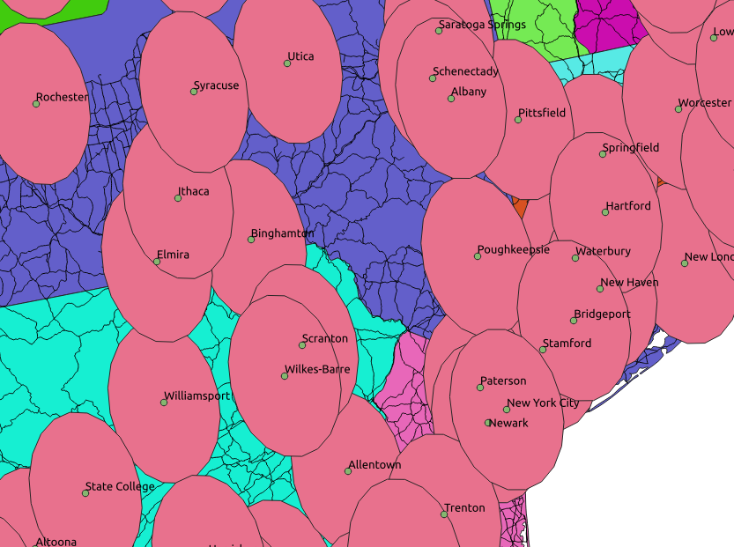
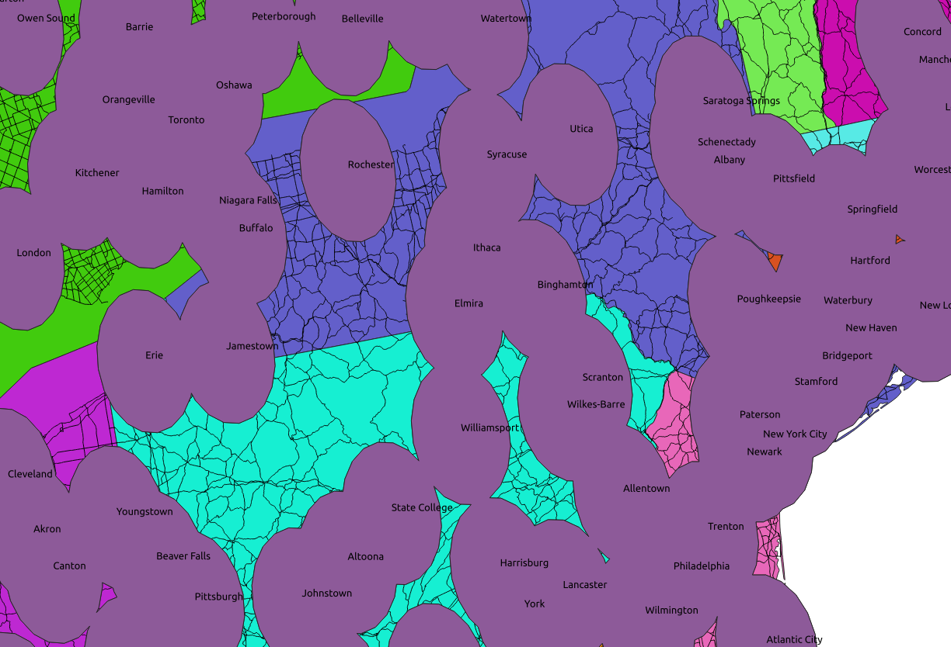
GIS operations
One important way to perform analyses in GIS are by spatial analysis.
- Buffers
- Dissolves
- Differences
- Centroids
- Masks

Slide 4
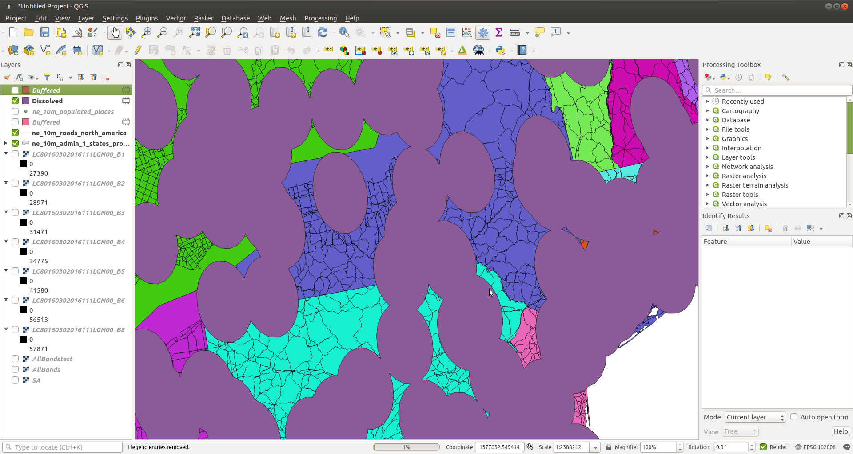
Adding
data
Print
layout
Table
of
Contents
Processing
Toolbar
Processing
Toolbox
Hover over buttons to see function
Status of
Processing
Operation
Coordinate and
scale information

Slide 5
Creating a finished map
Using the “Print Composer” tool, you will create final publication quality maps
All maps should include:
1. Map Contents – what are you showing
2. Legend – how does the viewer interpret
3. Title
4. Scale bar – usually in km, but depends on context
5. North Arrow – for orientation
6. Data source

