Slide 1
Using QGIS
Peter Galante
Biodiversity Informatics Specialist
Center for Biodiversity and Conservation
American Museum of Natural History
Notes:
For those of you who took my other class – this is different - you might have some slide repetitions. But overall,
This is includes both more basic and more advanced info, - its broader coverage of topics, and more intensive because its in a smaller amount of time!
1

Slide 2
QGIS
QGIS is a powerful software built by many developers as a free, open-source tool to perform GIS tasks.
Open-source indicates that it’s programming, content, and design are open to use and modification by anybody*
* Some terms apply: Some licenses do not allow commercial use.
Notes:
1
A lot of the power of GIS has to do with layering – or being able to stack several datasets on top of one another, related by geography.
NOTES: The figure shows how gap analysis was applied to identify biodiversity conservation gaps at the Podocarpus National Park in the southern Andes, Ecuador (Echavarria et al. 1994). As shown in the figure, gap analysis consists of four basic steps:
Map natural assemblages of biotic communities (such as plant or coral cover).
Map the predicted distributions of key biodiversity elements, such as species that breed or use the habitat for an important part of their life history.
Map the managed areas
- Permanence of protection
- Amount of the tract protected
- Inclusiveness of the protection
- Type of management program
Identify gaps in existing biodiversity protection
DISCUSSION POINTS: After going over the process, students are encouraged to consider some potential limitations of gap analysis.
POTENTIAL RESPONSES: These could include: The analysis presumes that vegetation cover can predict vertebrate distribution accurately. It also assumes predicted vertebrate distribution will be a good surrogate for diversity in other groups.
REFERENCE: Fernando R. Echavarria, Ph.D.Sunil Narumalani, Ph.D.Yingchun Zhou, M.S. 1994. GAP ANALYSIS OF THE MONTANA FORESTS OF PODOCARPUS NATIONAL PARK, ECUADOR.
GIS/LIS (1994): 235-244.

Slide 3
GIS
While other open-source GIS software exist (e.g. DIVA-GIS), QGIS is the most popular and best supported.
Another software that is important to know about is ArcGIS, developed by ESRI. All of the principles and techniques learned for QGIS are able to translate over to ArcGIS. Fortunately, there is no cost for QGIS. Some of the higher-end tools are less elegant in QGIS, but there is a lot of overlap.
Notes:
1
A lot of the power of GIS has to do with layering – or being able to stack several datasets on top of one another, related by geography.
NOTES: The figure shows how gap analysis was applied to identify biodiversity conservation gaps at the Podocarpus National Park in the southern Andes, Ecuador (Echavarria et al. 1994). As shown in the figure, gap analysis consists of four basic steps:
Map natural assemblages of biotic communities (such as plant or coral cover).
Map the predicted distributions of key biodiversity elements, such as species that breed or use the habitat for an important part of their life history.
Map the managed areas
- Permanence of protection
- Amount of the tract protected
- Inclusiveness of the protection
- Type of management program
Identify gaps in existing biodiversity protection
DISCUSSION POINTS: After going over the process, students are encouraged to consider some potential limitations of gap analysis.
POTENTIAL RESPONSES: These could include: The analysis presumes that vegetation cover can predict vertebrate distribution accurately. It also assumes predicted vertebrate distribution will be a good surrogate for diversity in other groups.
REFERENCE: Fernando R. Echavarria, Ph.D.Sunil Narumalani, Ph.D.Yingchun Zhou, M.S. 1994. GAP ANALYSIS OF THE MONTANA FORESTS OF PODOCARPUS NATIONAL PARK, ECUADOR.
GIS/LIS (1994): 235-244.

Slide 4
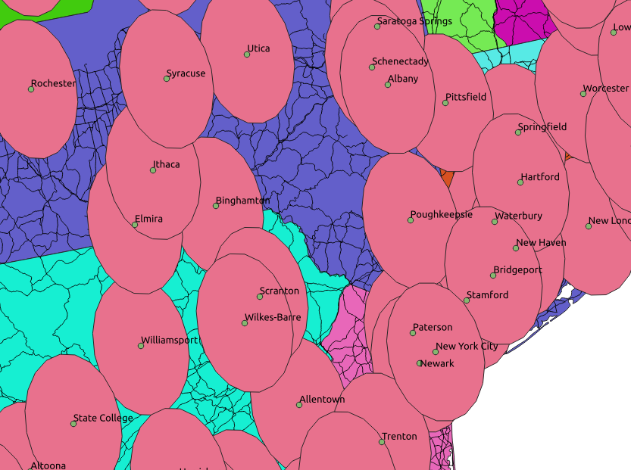
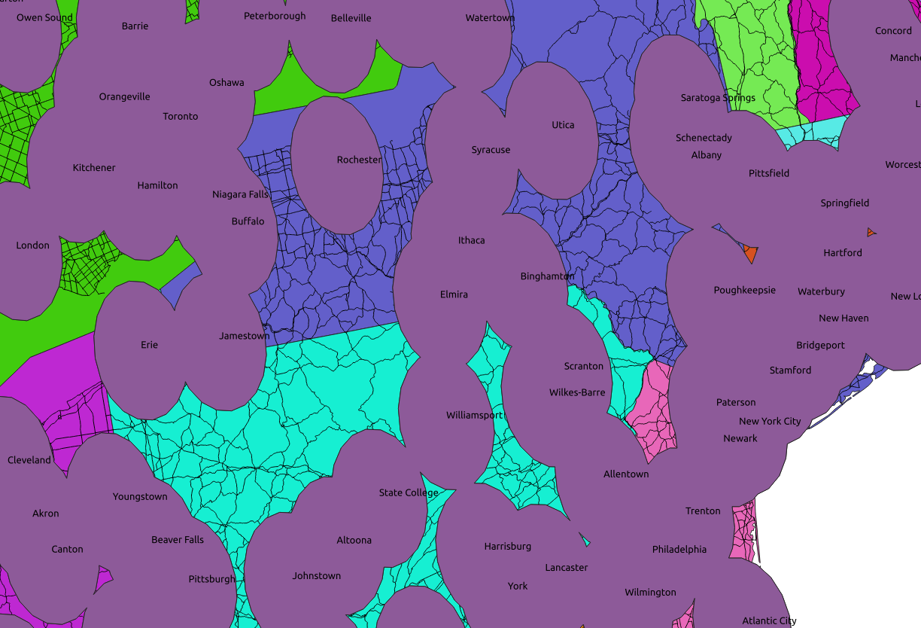
GIS operations
One important way to perform analyses in GIS are by spatial analysis.
- Buffers
- Dissolves
- Differences
- Centroids
- Masks

Slide 5
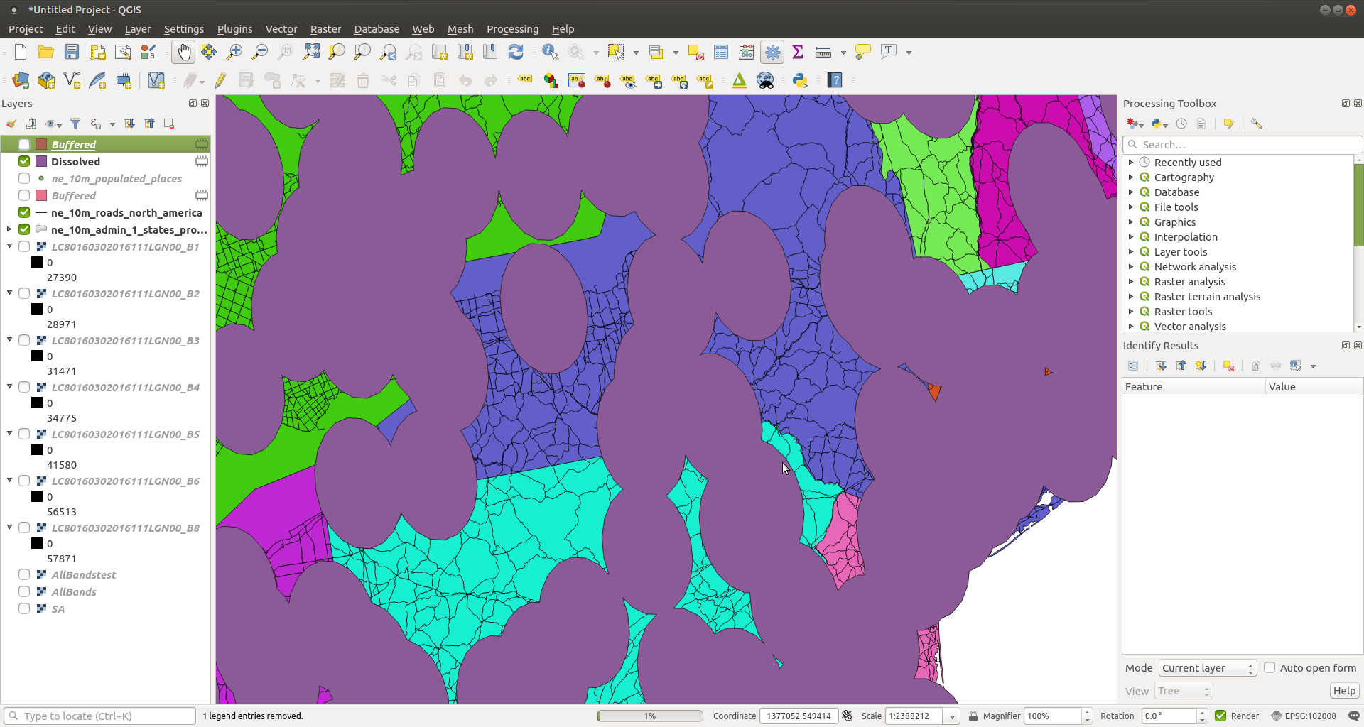
Adding
data
Print
layout
Table
of
Contents
Processing
Toolbar
Processing
Toolbox
Hover over buttons to see function
Status of
Processing
Operation
Coordinate and
scale information

Slide 6
Vector Data Files
The most common type of vector data (polygon, point, line) you will come across are “shapefiles”. These data are usually broken up into many ancillary files that are necessary to plot the data.
These file types were developed by ESRI, the developer of arguable the most popular GIS software: ArcGIS.
.shp file is the geometry file that described the shapes
.shx file is the “index” file used for plotting
.dbf file contains the database that is paired with each shape. This is where the shape’s attribute table is found
Other files:
.prj contains information relating to the projection of the shape
When managing your GIS data, you MUST keep all shapefiles ancillary files together in the same directory.
The easiest way to do this without using a databasing software (e.g., ArcCatalog, DB Manager) is to save shapefiles into their own directory.

Slide 7
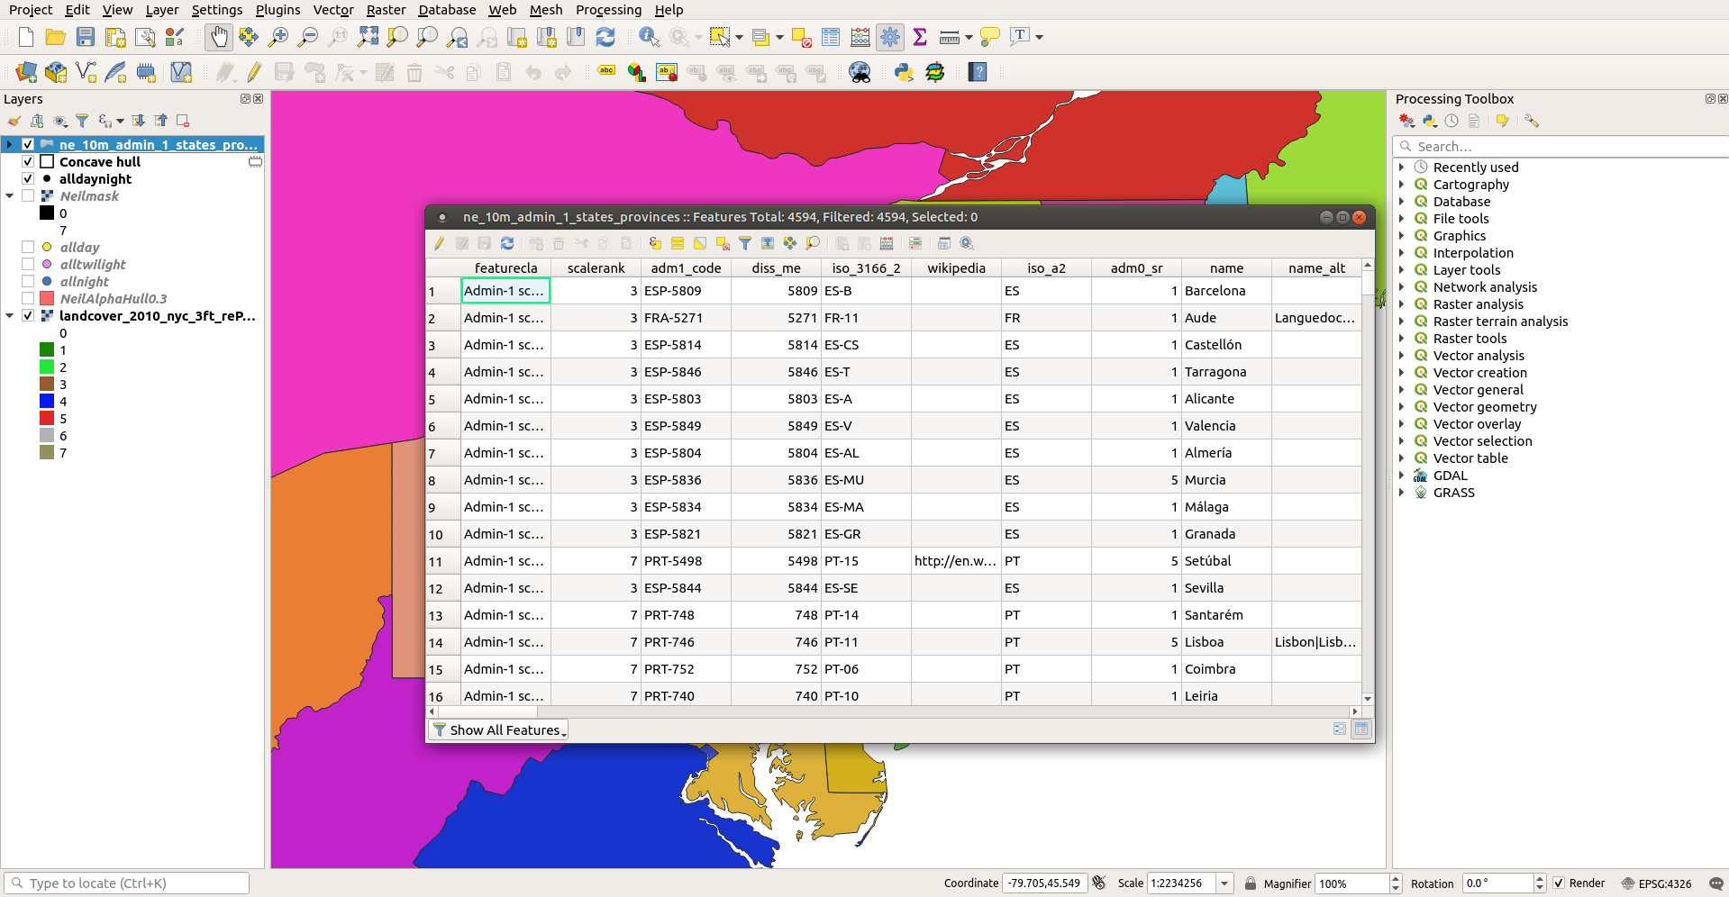
Attribute Table

Slide 8
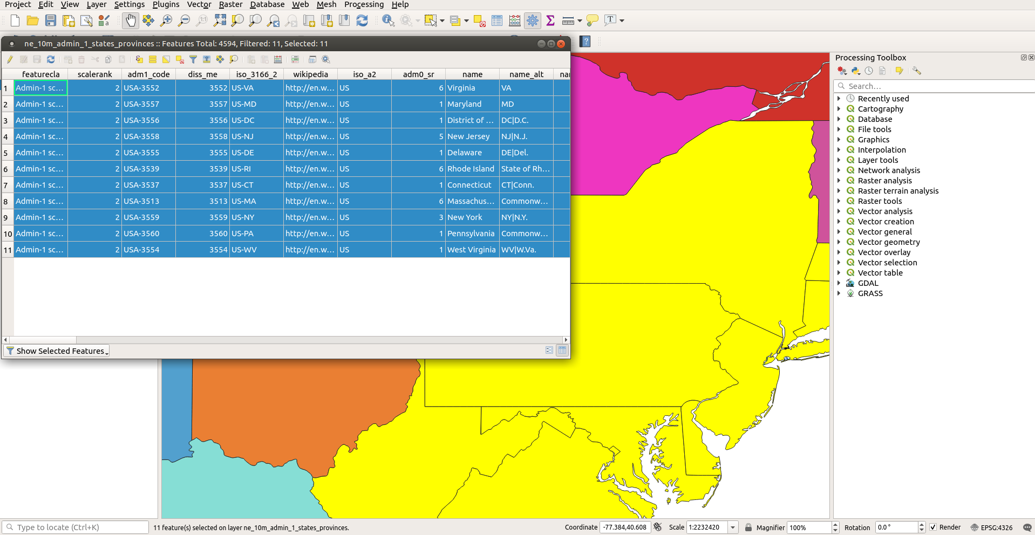
The table is paired with geographic data and can be queried
graphically, and through basic SQL.

Slide 9
Raster Data Files
Since rasters are essentially grids, many types of files can be plotted as rasters.
The most popular are:
1. GeoTiff – .tif files with geography metadata associated (origin, x, y, information)
These are by far the most popular in biology
2. Ascii – .asc files are text files with geography metadata in the header
3. netCDF – .cdf files are popular with some older datasets
There are many more, but you are most likely to come across these. Since rasters are essentially image files, even .jpg or .jpeg files can be used.

Slide 10
Creating a finished map
Using the “Print Composer” tool, you will create final publication quality maps
All maps should include:
1. Map Contents – what are you showing
2. Legend – how does the viewer interpret
3. Title
4. Scale bar – usually in km, but depends on context
5. North Arrow – for orientation
6. Data source

Slide 11
GIS Projects
The majority of your grade for this course will be based on a comprehensive final project. Ideally, your project will represent some aspect of your graduate research. It should be of sufficient quality to be used in a publication, whether as just a map (or series of maps), supporting documentation, or values generated as part of an analysis.
If you do not have a project, or an interesting spatial aspect of a project, we can chat and come up with one.

