Slide 1
Spatial Analysis
Peter Galante
Biodiversity Informatics Specialist
Center for Biodiversity and Conservation
American Museum of Natural History
Notes:
For those of you who took my other class – this is different - you might have some slide repetitions. But overall,
This is includes both more basic and more advanced info, - its broader coverage of topics, and more intensive because its in a smaller amount of time!
1

Slide 2
Tables in GIS
Attribute tables link geographic data with metadata about the polygons.
Polygons can be queried to select only those that fulfill certain attributes.
Each row in the attribute table related to a unique geometry
Rows can also be selected manually in the table, or by selecting on the map

Slide 3
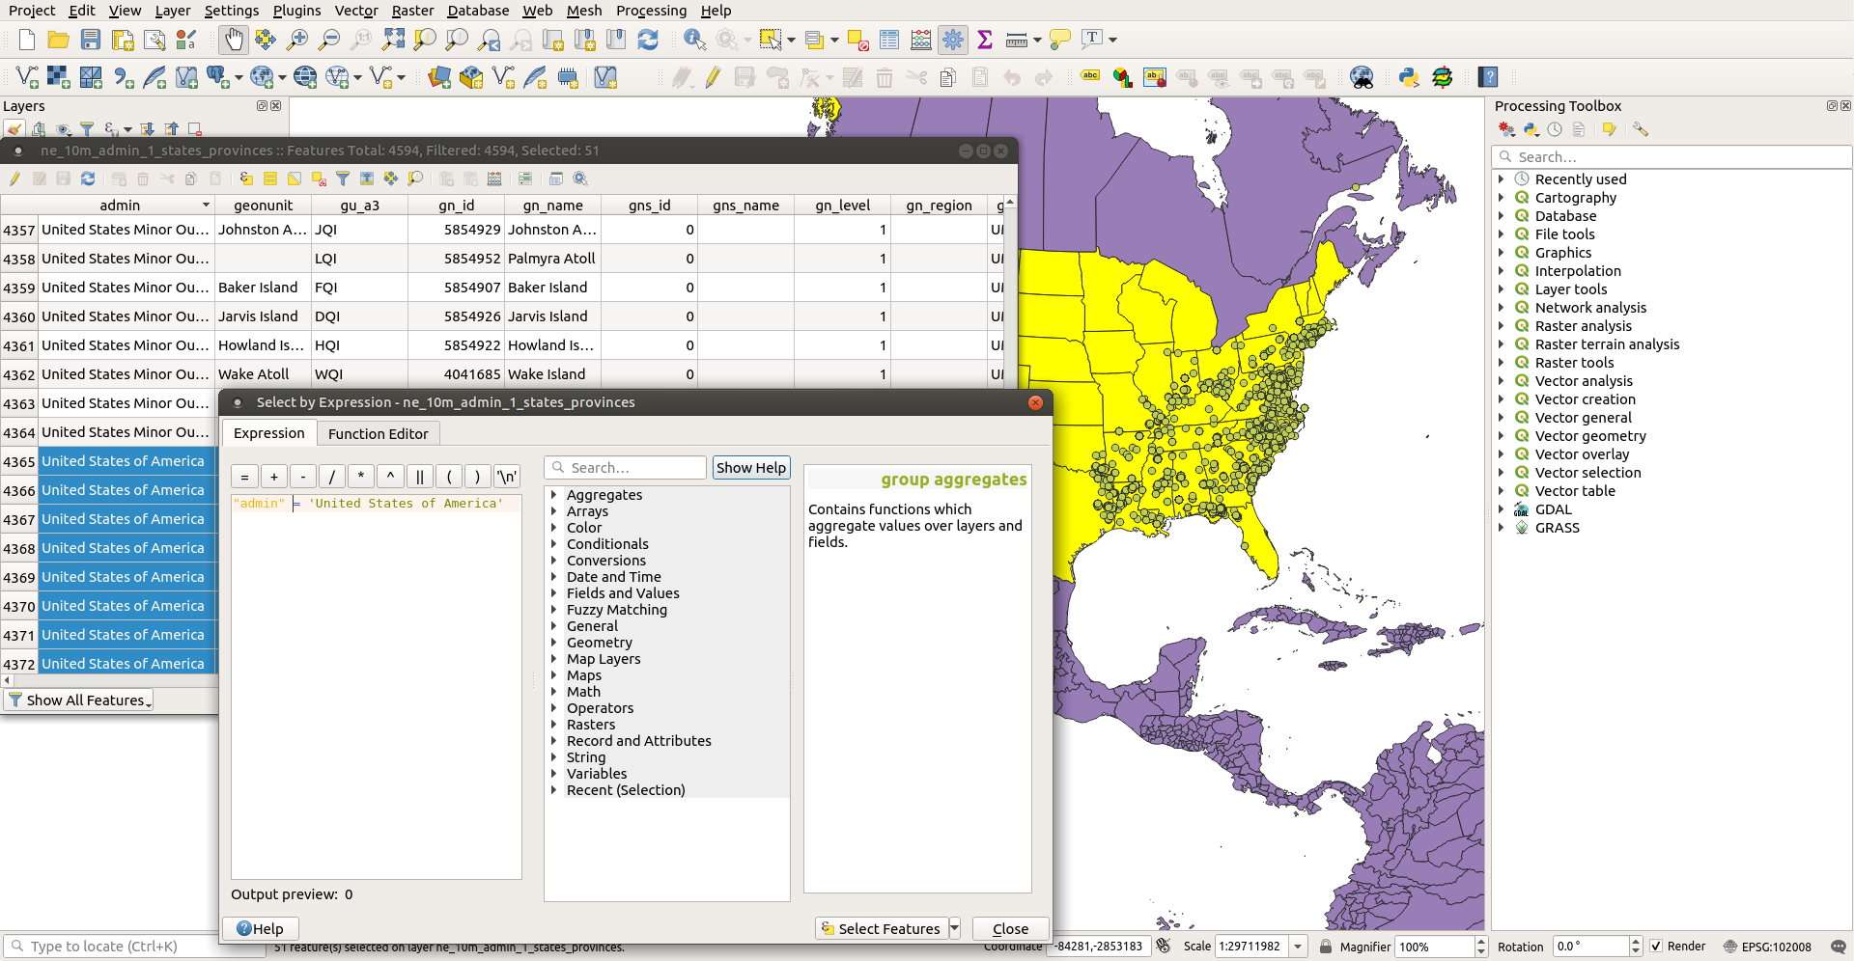
Select by Expression
Example using the global layer of States and Provinces:
Select the states of the United States of America using an expression:
“admin” = ‘United States of America’

Slide 4
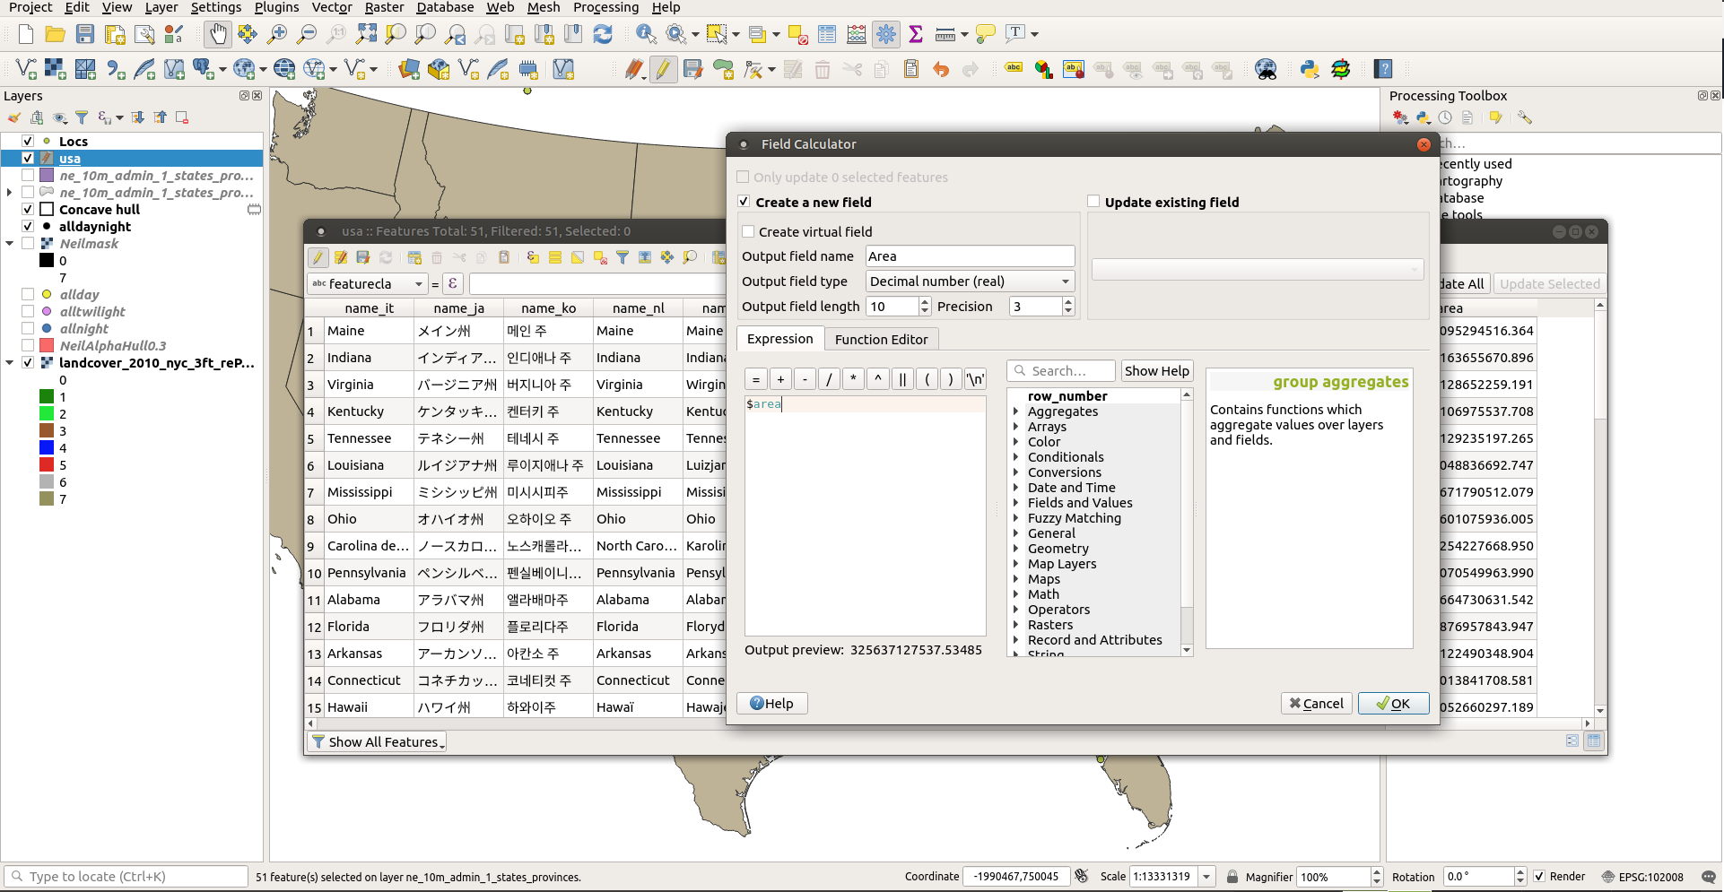
Field Calculator
Example using the global layer of States and Provinces:
Calculate the area of polygons using $area as the expression

Slide 5
Joins and Relates
To combine data from multiple sources with geospatial data, you can join tables based on a shared field.
For example, you delineated research plots in a forest and you have alpha diversity data for each plot. If you want to make a map showing the alpha diversity differences between each plot, you can join the attribute table of the polygons with the spreadsheet with diversity information.

Slide 6
Spatial Joins
You can perform conditional joins based on spatial relationships.
For example, summing an attribute of one later within the geometries of another layer.

Slide 7
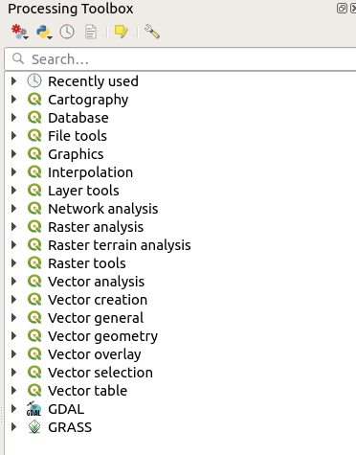
Geoprocessing
Geoprocessing tools can be found in 2 places.
The Vector and Raster tool bars house processing tools for those data types
The Processing Toolbox contains many more tools, organized by theme, and is searchable.

