Slide 1

Entity Framework
Code-First Migrations
By
Sam Nasr, MCAD, MCT, MCTS
Nasr Information Systems
June 1, 2013

Slide 2
Housekeeping
Bathrooms
Forum for learning - Feel free to ask questions
Cell Phones on mute please

Slide 3
Introduction
Sam Nasr (sam@nasr.info)
Software developer since 1995
Independent Software Consultant (Nasr Information Systems)
MCAD, MCT, MCTS(WSS/MOSS)
President - Cleveland C#/VB.Net User Group
President – Cleveland WPF User Group
President - .Net Study Group
INETA Mentor for Ohio
INETA Community Champ (2010, 2013)
Author for Visual Studio Magazine

Slide 4
Poll
How many have used EF before?
  Model First
  DB First
  Code First

Slide 5
What is Entity Framework?
EF is an ORM (Object Relational Mapping) framework
Abstracts details of DB structure from app via a model.
Utilizes LINQ for querying:
  User result = (context.Users.Where(u => u.LName == "Nasr")).FirstOrDefault();

Slide 6
EF Methodology
Database First: Importing an existing database into the EF Model
Model First: Creating the model and using it to generate the database
Code First: Using code classes to generate the database

Slide 7
Code First
classes = tables
properties = columns
property contains “*ID" = Primary Key
Primary Keys automatically set to be Not Null.
String without a size = nvarchar(max), null in DB
Other DB object are set as foreign keys.

Slide 8
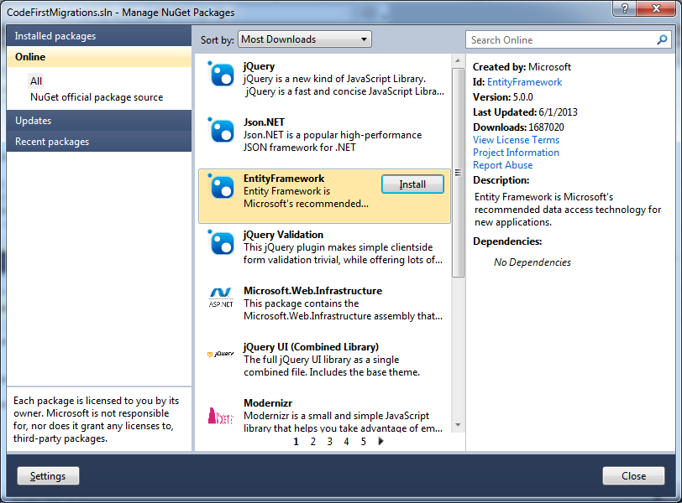
Code First

Slide 9
DbSet and DbContext
Defined in the System.Data.Entity namespace.
Tables are defined using the DbSet collections.
DbSet: wrapper object around ObjectSet, utilized for all CRUD operations.
DbContext is object wrapper for the ObjectContext
Abstracting away the complexities (preferred method)
Class defining DB structure will inherit the DbContext class.

Slide 10
Data Annotations
<Table("VehicleTable")>
  “Vehicle” in code = "VehicelTable" in DB
<Column("MakeOfCar")>
  "Make" in code = “MakeOfCare” in DB
Namespace: System.ComponentModel.DataAnnotations.

Slide 11
Data Annotations
Key
Required
MinLength
MaxLength(n, ErrorMessage="...")
NotMapped
ComplexType
ConcurrencyCheck
TimeStamp
Table
Column
DatabaseGenerated
InverseProperty
ForeignKey

Slide 12
Database Usage
SQL Express installed -> DB is created on local SQL Express instance
SQL Express not installed -> DB is created on LocalDb
Connection string in App.Config

Slide 13
Demo
Code First Deployment

Slide 14
Migrations
Enable Migrations
"Migration" folder with a “Configuration.vb”
Seeks out classes deriving from DbContext and scaffolds a NotInheritable class called "Configuration".
AutomaticMigrationsEnabled = True

Slide 15
Migration Plans
Enable-Migrations: creates a configuration class used for migrations
Add-Migration: creates a class representing the new migration plan.
Update-Database: updates the current database with the migration plan

Slide 16
Demo
Code First Migrations

Slide 17
Custom Migration Logic
Public Overrides Sub Up()
AlterColumn("VehicleTable", "VIN", Function(v) v.String(defaultValue:="TBD"))
End Sub
Public Overrides Sub Down()
AlterColumn("VehicleTable", "VIN", Function(v) v.String(defaultValue:=vbNull))
End Sub

Slide 18
Update-Database Options
–Script: changes are written to a script rather than applied
–SourceMigration
–TargetMigration
Default source migration: uses current state of the database.
Default target migration: uses latest migration plan
Initial database: $InitialDatabase
Notes:
Update-Database –TargetMigration: MySpecificPackageName
Update-Database –TargetMigration: $InitialDatabase = Roll back to an empty database
–Script flag so that changes are written to a script rather than applied
If you don’t specify a target migration, Migrations will use the latest migration as the target. If you don't specify a source migrations, Migrations will use the current state of the database.
To go from an empty database ($InitialDatabase) to the latest version (migration AddPostAbstract):
Run the Update-Database -Script -SourceMigration: $InitialDatabase -TargetMigration: AddPostAbstract

Slide 19
Code First Advantages
Speed - You do not have to worry about creating a DB you just start coding.
POCOs – No auto-generated code. You have full control of each of your classes.
Simple - you do not have a .edmx model to update or maintain

Slide 20
Conclusion
Let’s recap…

Slide 21
References
Code First Migrations Tutorial (C#)
http://msdn.microsoft.com/en-us/data/jj591621.aspx
Data Annotations
http://msdn.microsoft.com/en-us/data/gg193958.aspx
EF Code First Tutorial (VB.Net)
http://visualstudiomagazine.com/articles/2012/03/07/an-ef-code-first-tutorial.aspx
EF Code-First Migrations Tutorial (VB.Net)
http://visualstudiomagazine.com/articles/2012/04/10/entity-framework-code-first-migrations.aspx

Slide 22



Contact Info
  sam@nasr.info
http://ClevelandDotNet.blogspot.com
@SamNasr
http://www.linkedin.com/in/samsnasr
http://speakerrate.com/samnasr
Thank you for attending!

