Slide 1

Practical Spring Boot: For the Non-Enthusiast
@Groovypgh
Spring Boot
Notes:
----- Meeting Notes (9/22/15 18:58) -----
Welcome

Slide 2
def me =
[
name : 'Billy Conner, Jr.',
title: ’Software Engineer, Alpha Technologies’,
affiliation: ‘Pittsburgh Groovy Meetup (GroovyPGH)’,
email : 'billyconnerjr@groovypgh.org',
twitter : '@billyconnerjr'
]
print me.values().each{ println it }

Slide 3
Introduction
Spring Boot

Slide 4
What is Spring Boot?
Java-based Framework
Designed to get you up and running quickly
Simplifies the bootstrapping of Spring Applications
Notes:
How many have worked with Spring Applications?

Slide 5
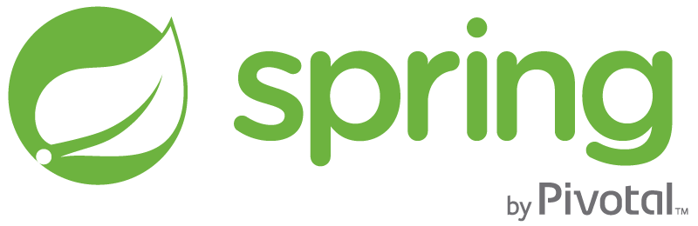
Hold on...What is Spring?
Includes many different features for Java-based Enterprise Applications:
Spring MVC Web applications
Data Access
Security (Authorization and Authentication)
Transaction Management
Messaging
Testing support
many more...
Notes:
core support for dependency injection,
transaction management

Slide 6
So...What is Spring Boot?
No need for abundant XML configuration
This was a big criticism of Spring applications.
Spring Boot takes an opinionated approach to the configuration
Spring Boot favors annotations over XML
No war files to configure
Embedded Apache
XML

Slide 7
In other words...
As described in his blog, Phil Webb, the Project Lead for Spring Boot..
Notes:
However, although you get a ’baked cake’, you can still determine whether you want chocolate, vanilla, vegan, flourless cake, the filling, icing , etc.!

Slide 8
How Can ‘I’ use Spring Boot?
IF:
I don’t work in a Spring Environment
I’m strictly a Front-end Developer
I don’t have the resources to create a full-stack (such as a server or database)
Notes:
I = Non=Enthusiast
use spring to build prototypes rapidly
create restful services to be consumed by the front end

Slide 9
Use cases
Build prototypes applications quickly
Build an API for your front-end to consume
Build full blown MVC application quickly

Slide 10
Diving in

Slide 11
Getting Spring Boot
Requirement: Java Development Kit 1.6+ (1.8 recommended)
Via Software Version Manager
*sdkman – a software development kit manager
http://sdkman.io/
Via Dependency Management System:
Gradle build - included as a dependency
Maven build – included as a dependency
*my personal recommendation

Slide 12
Running Spring Boot
Using Gradle build
Using Maven build
Spring boot itself ships with a Command Line Interface (CLI)
Add the spring-boot.*.jar to your Java Class path Spring Boot is simply a java library
Using an IDE such as Intellij or Eclipse

Slide 13
Supported Languages
Officially supported:
Java
Groovy
Kotlin
Plugins and modules allow:
Scala
Jython
And many others

Slide 14

Bare Minimum Application
Using Groovy:
@RestController
class App {
@RequestMapping(‘/’)
def home(){
‘Hello, I am a Spring Boot Web Application!’
}
// Using the spring boot CLI and groovy, run: // spring run app.groovy

Slide 15
Demystified
Embedded Apache Server Started
@RestController - signifies Spring MVC to look for web routes and write the results to an HTTP response
@RequestMapping – maps the method home()to the default route “/”
In this example the Groovy syntax allows the exclusion of a return statement and semi-colons ”;”

Slide 16
Lets get more interesting
Including another route:
@RequestMapping(‘/create/{name}’)
def nameDoesntMatter(@PathVariable def name){
“Hello ${name}, Your account has been created”
}
// @PathVariable binds ‘name’ to URI template variable
//Groovy provides the string interpolation for ${name}
// alternate: "Hello” + name + “thank you for visiting"

Slide 17
Further more
A route with this context implies a POST request.
@RequestMapping(value = "/account/{name}", method=RequestMethod.POST)
def nameDoesntMatter(@PathVariable def name){
"Hello ${name}, Your account has been created"
}
Starting to look like a basic rest service!
Notes:
Use Advance Rest client to make this request

Slide 18

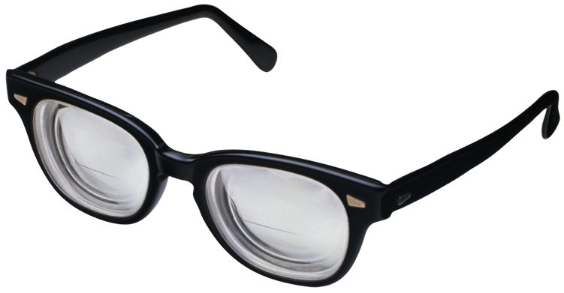
What is Groovy?
Sits on top of the Java platform
‘Java plus more’
Compiles to Java bytecode
Groovy can run Java classes!
Groovy can run all Java libraries!
.groovy
Notes:
Groovy is used in Gradle, and Jenkins, Spock Framework

Slide 19
Java
public class Person {
private String name;
private int age;
public Person(){}
public String getName(){
return name;
}
public int getAge(){
return age;
}
public void setName(String name){
this.name = name;
}
public void setAge(int age){
this.age = age;
}
}
Groovy
class Person {
String name
int age
}
=
Notes:
Show in the console how this works

Slide 20
Spring Initializer
Visit http://start.spring.io/
Allows you to create the skeleton Spring Boot application
Gradle build script and wrapper
Folder structure
IMPORTANT
Notes:
Show Java vs Groovy

Slide 21
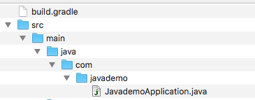
Formal Application folder Structure
For Groovy applications this folder will be titled groovy. For Kotlin it will be kotlin

Slide 22
Demo: book service 1
Notes:
bookgroovy 1
bookgroovy 2

Slide 23
Demo: book service 2
Wrote three files( Main, Model, Controller)
Specifying acceptable method
Automatic Jackson marshalling and un-marshalling
http codes generated
Notes:
comment and uncoment your code as you are explaining it

Slide 24
Demo: book service 3
Spring data jpa as a dependency
Defining entities and repository
Free methods
findOne(ID id)
findAll()
save(Iterable<S> entities
save(S entity)
exists(ID id)
count()
multiple delete methods
Notes:
comment and uncoment your code as you are explaining it

Slide 25
Demo: book service 4
auto loading data
endpoints for books and authors
query methods
CORS annotation

Slide 26
Query Method Keywords
Example: findByAgeGreaterThan(21)
And
Or
Is,Equals
Between
LessThan
LessThanEqual
GreaterThan
GreaterThanEqual
After
Before
IsNull
IsNotNull,NotNull
Like
NotLike
StartingWith
EndingWith
Containing
OrderBy
Not
In
NotIn
True
False
IgnoreCase

Slide 27
Persisted Data: Using H2
Currently using in memory db
View in web console http://localhost:8080/h2-console
use correct url reference from application.properties
jdbc:h2:mem:mydb
Notes:
use correct url reference from application.properties
jdbc:h2:mem:mydb
loading data using data.sql

Slide 28
Persisted Data: Using MySQL
Include the MySql driver as a dependency (Gradle example below):
dependencies { compile("org.springframework.boot:spring-boot-starter-data-jpa") compile("com.h2database:h2") // remove the in memory database compile (“mysql:mysql-connector-java”) . . . }
Update the applications.properties file with database information
spring.datasource.url=jdbc:h2:mysql://hostname/dbname spring.datasource.username: yourDbUsername spring.datasource.password: yourDbPassword spring.jpa.database-platform=org.hibernate.dialect.MySQL5Dialect spring.jpa.hibernate.ddl-auto=none
Notes:
use correct url reference from application.properties
jdbc:h2:mem:mydb
loading data using data.sql

Slide 29
Where to go now
Use this service for development simulations
You can begin build this into production level application
provide executable jar for distribution

Slide 30









GroovyPGH
@groovypgh
Pittsburgh Groovy Programming Meetup
http://www.meetup.com/Pittsburgh-Groovy-Programming/
Spring Boot
Spock Framework
Notes:
New group
Meetup Monthly
Things we discuss

Slide 31

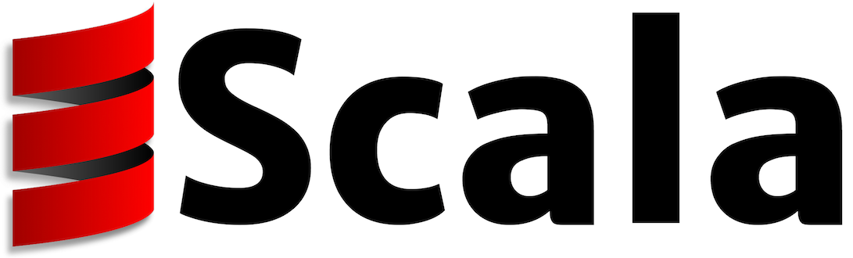

Welcome other JVM Languages
and more...

Slide 32
Resources
Code for this demo:
https://github.com/billyconnerjr/springboot4nonenthusiast
Spring Boot Initializer
http://start.stpring.io
Spring Boot Documentation
https://spring.io/docs
Spring Boot Guides
https://spring.io/guides

Slide 33
Thank you!

