Slide 1
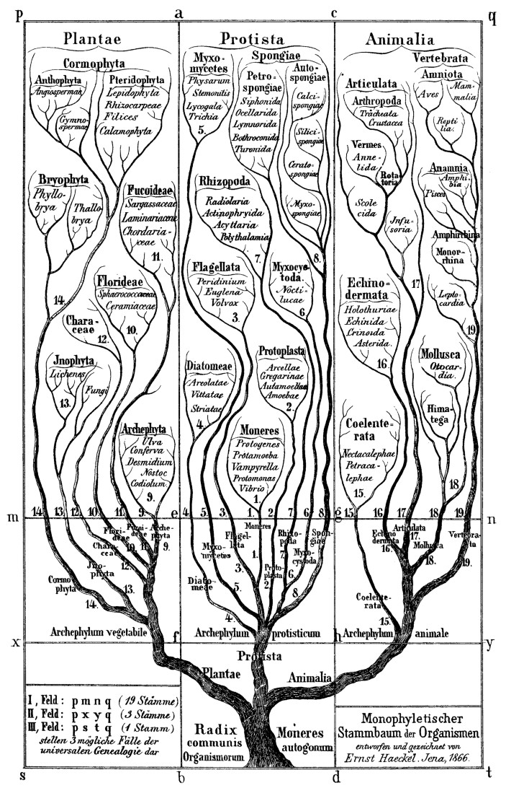
Phylogenetics
Theory and practical tree building

Slide 2
Phylogenetics
Study of evolutionary relationships between groups of organisms
Modern phylogenetics are based on cladistics, in which organisms grouped based on shared unique characteristics deriving from a common ancestor
Parsimony
Maximum Likelihood
Bayesian inference
Contrast this with phenetics, in which groups are made based on similarities regardless of ancestry
Neighbor-joining

Slide 3
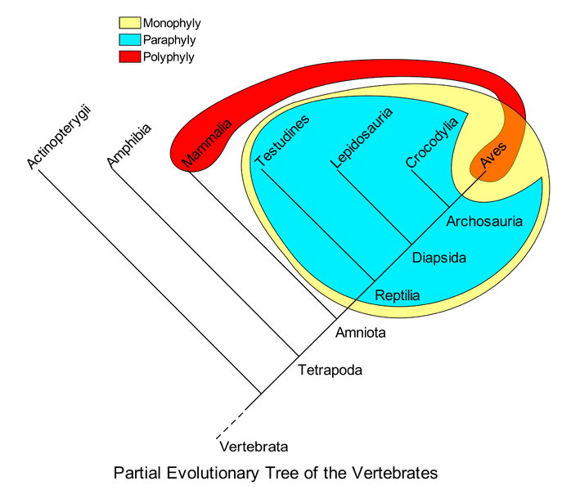
Evolutionary relationships
Cladistics
Based on a clade, which is an ancestor taxon and all of its descendants
Terminology (node-based)
Monophyly: a group of nodes containing a common ancestor taxon, all descendant taxa, and no others
Paraphyly: A group of nodes created by removing a taxon from a monophyletic clade
Polyphyly: A group of nodes that is neither mono- or para-phyletic

Slide 4
Cladistics: Character-based terminology
Monophyly is characterized by one or more autapomorphies: derived characters inherited by all members of the group from a common ancestor and not inherited in other taxa
Sauropsida (lizard-faces; yellow)
Amniotes
Paraphyly is characterized by plesiomorphies: characters inherited from ancestors but not present in all descendants
Class Reptilia (blue)
Polyphyly is characterized by homoplasy: characters that do not arise from a common ancestor
Endothermy (red)

Slide 5
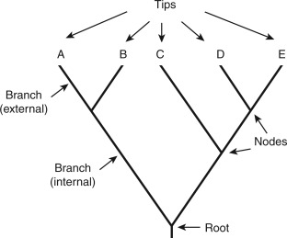
Anatomy of a phylogenetic tree
Tips can be anything from orders to species to strains (or populations
Branches represent continuous lineages
Nodes represent last common ancestor (extant or extinct)
Root is inferred to be oldest common ancestor of all members of tree

Slide 6
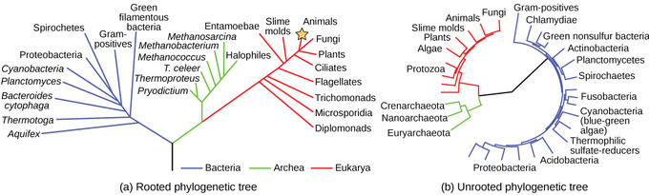
Rooted and unrooted trees
Phylogenetic trees can be rooted or unrooted.
Unrooted trees show only relationships, not ancestry

Slide 7
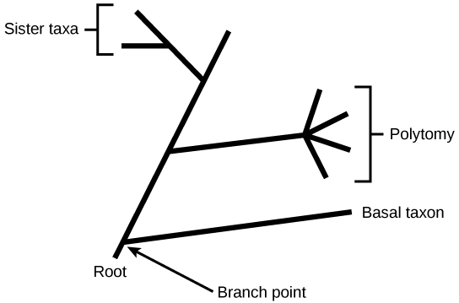
Other terms
Sister taxa are tips from the same node
A polytomy arises when relationships among sister taxa are ambiguous
Taxa closer to the last common ancestor (root) are referred to as basal

Slide 8
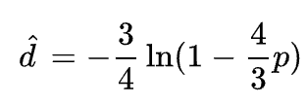
Estimating distances
Taxon, n., plural tax·a: A taxonomic group or unit, esp. when its rank in the taxonomic hierarchy is not specified.
If two taxa are related, how closely related are they?
Simplest model: Jukes and Cantor 1969 (JC69)
Equates to number of nucleotide changes since last common ancestor (one parameter, p)
Assumes equal base frequencies, equal probabilities of mutations
Take two 10-mer sequences:
ATCCTGGGAG
ATCCTGAGAG
Distance is 0.107 (not 0.1!)
Accounts for probability of homoplasy

Slide 9
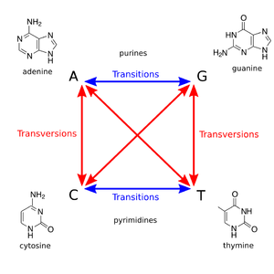

Estimating distances
Next simplest: Kimura 1980 (K80)
We now have two parameters, p and q
p is proportion of sites with transitions
q is proportion of sites with transversions
Still assumes equal base frequencies
Transition
ATCCTGGGAG
ATCCTGAGAG
Transversion:
ATCCTGGGAG
ATCCTGCGAG
K=0.112
K=0.108
Transition mutations are more common than transversions.
Why is the distance greater for the transition mutation here?

Slide 10
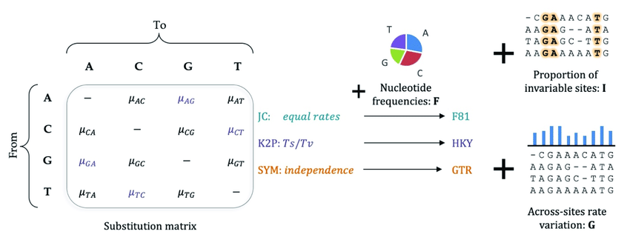
Evolutionary (substitution) models
Models (below) for nucleotides
Jukes-Cantor (1969): equal base frequencies, equal mutation rates
Kimura 1980 model: Allows for different transition (e.g. purine to purine) and transversion (e.g. pyrimidine to pyrimidine) rates
Felsenstein 1981: Extension of JC, allows base frequencies to differ
Tamura-Nei (1993): Transition rates allowed to differ from each other and transversions, base frequencies differ
Generalized time-reversible (GTR, Tavaré 1986): specifies all substitution rates and differing base frequencies
Abadi, Shiran; Learning Evolutionary and Genomic Processes from Massive Nucleotide Data
Advanced models may be extended for rate-variation across sites (gamma) and invariant sites
BLOSUM models for amino acids

Slide 11
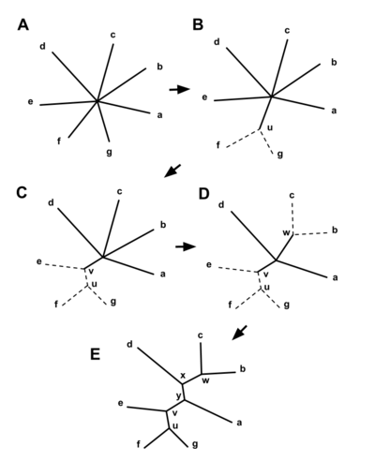
Neighbor-joining
Neighbor-joining (NJ) is historically a highly-used technique, and often results in “correct” representation of phylogeny
Computationally cheap
Distance-based
1) calculate distance matrix between all taxa
2) find pair of taxa closest together (f, g), make a node (u)
3) calculate distance of pair within node to the node
4) calculate distance of all other taxa to node
5) repeat, replacing joined pair with node

Slide 12
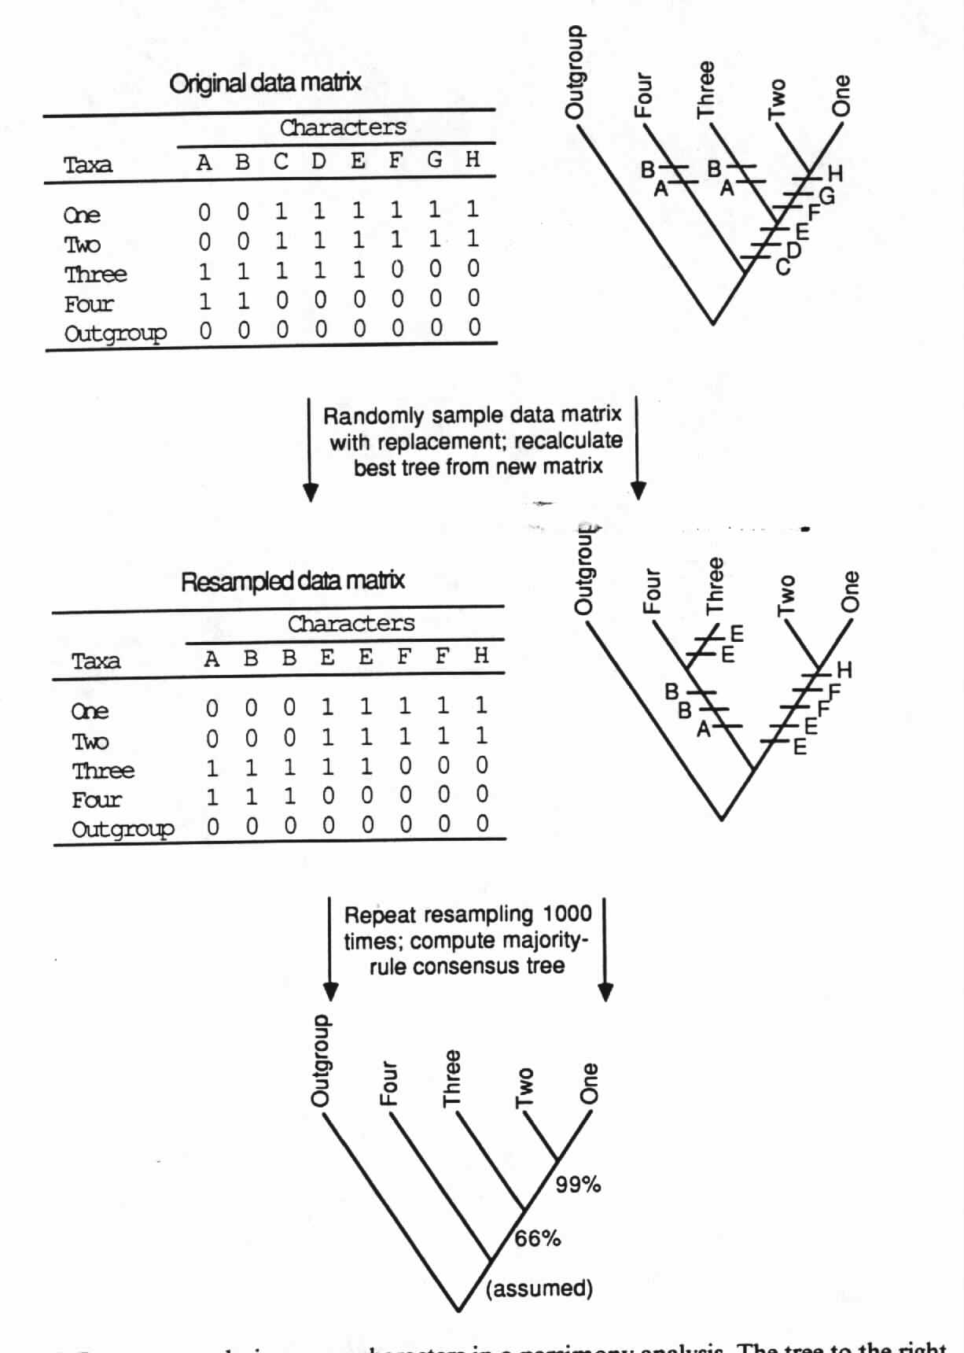
Bootstrapping
Bootstrapping is a way of assessing the statistical error where sampling distribution is unknown
Take a row/column matrix of individuals and characters, and randomly resample the columns with replacement
Do this a few hundred times and see how many times the original tree (or any tree) is reconstructed
In general, bootstrap values:
>80% are well supported
50-80% somewhat supported
<50% unsupported
http://akira.ruc.dk/~olesk/sekvens/bootstra.jpg

Slide 13
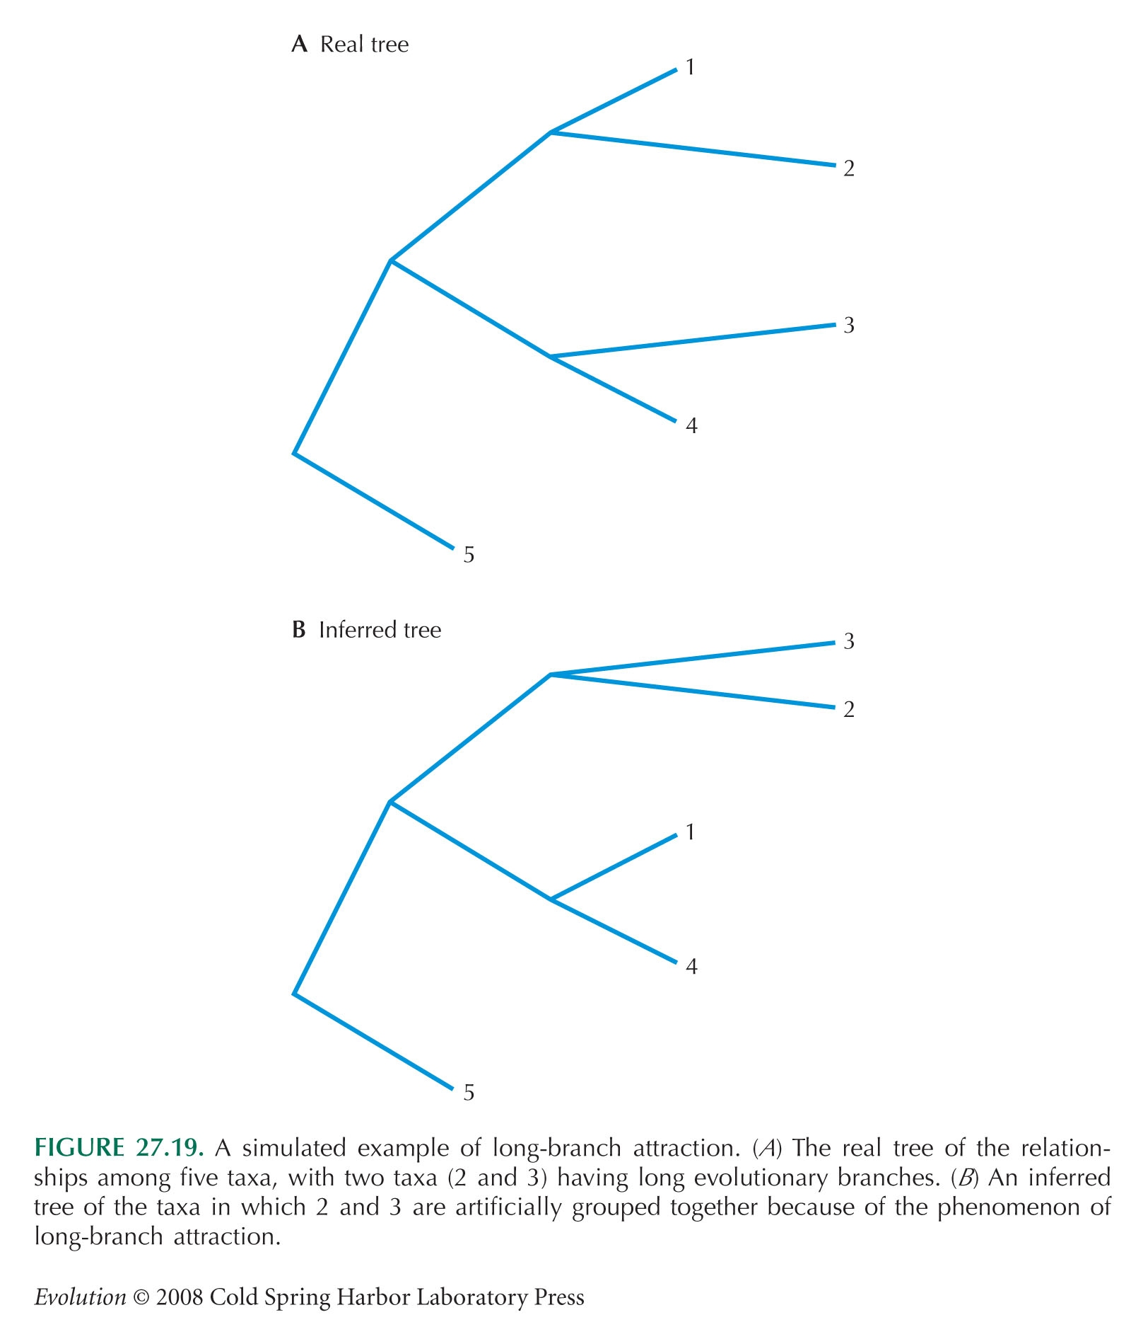
Phylogenetic methods
Parsimony: seeks the tree that minimizes amount of evolutionary change to explain the data
Minimizing evolutionary change is an optimality criterion, distinguishes this method from NJ
Problems with parsimony analysis include statistical inconsistency and long-branch attraction

Slide 14
Phylogenetic methods
Maximum likelihood (ML): returns the tree with the highest likelihood given a particular model of evolution
Probably the most currently-used method of phylogenetic inference
Robust to violations of assumptions in evolutionary models
Statistically consistent
Relatively immune to long-branch problems
ML is computationally intensive, but computational power has largely overcome this limitation

Slide 15
Model Testing
Specification of an appropriate substitution model is paramount to correct tree reconstruction
The trick is to specify only as many parameters as needed, no more
Several ways to do this, including Likelihood Ratio Tests and Akaike Information Criterion
AIC: Likelihood penalized for number of parameters
Excel example

