Slide 1
Codecademy Data Visualization w/ Python Capstone Project: Netflix Data
Made by: Philip van Laar

Slide 2
Index
Role
Distribution of 2017 Netflix Stock Prices by Quarter
Earnings Per Share in Cents
Revenue vs. earnings reported by Netflix of fiscal year 2017 [in billion dollars]
Netflix stock compared to the Dow Jones Industrial Average in 2017

Slide 3
Role
My role as a data visualization developer at Yahoo Finance, was to support the Stock Profile team of Netflix by creating the specific visualisations needed for the report to assess the risk of the Netflix stock.

Slide 4
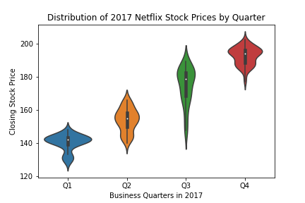
Distribution of 2017 Netflix Stock Prices by Quarter

Slide 5
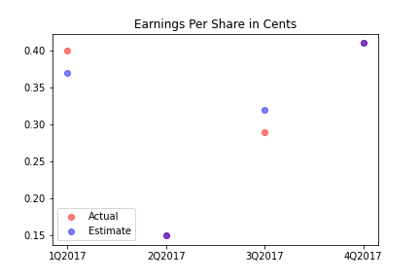
Earnings Per Share in Cents
Notes:
In the first quarter of 2017 the Earnings Per Share (EPS) exceeded the estimations. In the second and fourth quarter, these where equal. In the third quarter the actual earnings were below the estimations, which is not very good in general.

Slide 6
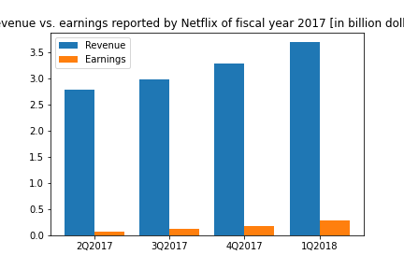
Revenue vs. earnings reported by Netflix of fiscal year 2017 [in billion dollars]
Notes:
When the revenue grows, earnings grow with it. Earnings ranges from approximately 5-10% of the total revenue.

Slide 7
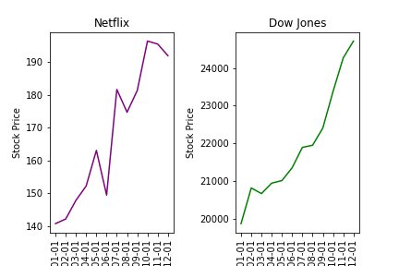
Netflix stock compared to the Dow Jones Industrial Average in 2017

