Slide 1




UM HACKATHON 2026 · FINAL ROUND
AI SYSTEMS & AGENTIC WORKFLOW AUTOMATION
Komplain.ai
From a Manglish complaint to an approved bilingual resolution in under 10 seconds — with the receipts.
TEAM
LIVE DEMO
REPO
DATE
as - 178
https://komplain-test-xi2r.vercel.app/
github.com/Ph0enix19/Komplain.AI
May 3rd of 2026
Notes:
Good afternoon judges. We're team Komplain.ai. For the next ten minutes I'll show you an AI complaint resolution copilot we built for Malaysian e-commerce SMEs — fully deployed, fully tested, and honest about what's MVP versus what's production-ready.
1

Slide 2
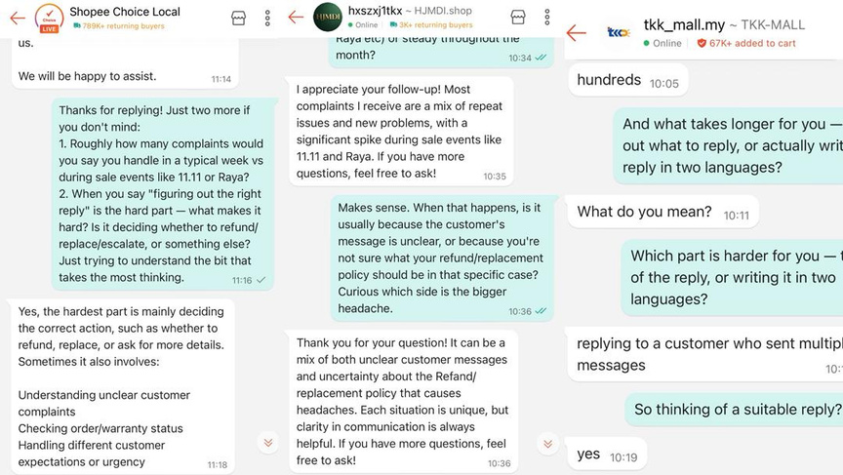
Komplain.ai
02 / 12 · PROBLEM
PROBLEM
01
02
Volume
Language
Malaysian SME sellers are drowning in messy, code-switched complaints with no audit trail.
Five marketplaces, one inbox per channel, no unified queue.
English, Bahasa Malaysia, and Manglish in the same message.
03
04
Inconsistency
No paper trail
Two staff members give two different refund decisions for the same case.
Disputes escalate; sellers have no log of why a decision was made.
A typical Malaysian seller juggles Shopee, Lazada, and TikTok Shop. Each complaint arrives in Manglish — a mix of Bahasa Malaysia and English that generic AI doesn't handle. Every wrong reply means a platform penalty, a negative star rating, or a lost sale. And there is zero audit trail.
Notes:
Here's the problem. A Malaysian seller running Shopee, Lazada, TikTok Shop and WhatsApp gets a constant stream of complaints — code-switched between English and Bahasa Malaysia, often messy 'Manglish'. Manual replies are slow, inconsistent across staff, emotionally risky, and — most importantly for a marketplace dispute — completely unauditable. There's no log of why a refund was issued.
2

Slide 3

Komplain.ai
03 / 12 · MARKET
MARKET OPPORTUNITY
A $23B market growing faster than sellers can cope.
Malaysia e-commerce GMV (USD)
1.1M
2025
$10.62B
MSME sellers across Shopee, Lazada & TikTok Shop in Malaysia
2026
$12.18B
2031
$23.11B
15–30 min
13.67% CAGR · fastest-growing SEA market
per complaint handled manually — complaints scale with GMV growth
Shopee
THE MANGLISH MOAT
Lazada
"barang tak sampai, nak refund" is not handled well by existing AI tools.
TikTok Shop
SHIFT 01
SHIFT 02
SHIFT 03
LLMs got cheap
Code-switching is solved
Marketplace APIs are open
Per-complaint cost is now sub-RM-0.01
EN/BM/Manglish handled natively
Shopee & Lazada webhook ingestion
Sources: Mordor Intelligence · Momentum Works · MDEC
Notes:
1

Slide 4
Komplain.ai
04 / 12 · SOLUTION
SOLUTION
[Complaint Input]
[6-Agent Pipeline]
[Human Review]
[Approved Reply]
A copilot — not an autopilot.
Paste a raw complaint → 6 agents process it in under 10 seconds → seller reviews and approves the bilingual reply.
DECISION
DECISION
DECISION
DECISION
REFUND
RESHIP
CLARIFY
DISMISS
Damaged or missing item, policy permits.
Lost in transit, stock available.
High-value, ambiguous, or fraud risk.
Out of policy, with a respectful explanation.
EVERY OUTPUT IS BILINGUAL · POLICY-BOUNDED · SUPERVISOR-VALIDATED · HUMAN-APPROVED
Notes:
Komplain.ai turns a raw complaint — in any language mix — into a structured, auditable, bilingual resolution in under five seconds. The decision space is deliberately small and policy-bounded: refund, reship, escalate, or dismiss. And critically, a human supervisor approves every reply before it sends. We are not replacing the seller. We are giving them a copilot.
4

Slide 5
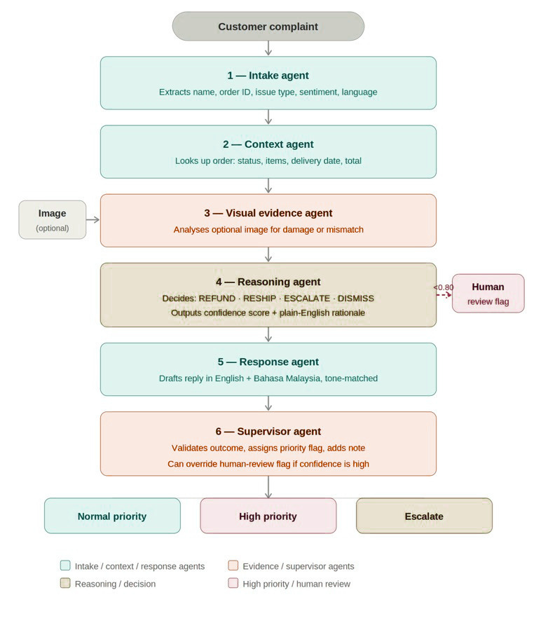
Komplain.ai
05 / 12 · PIPELINE
AGENTIC WORKFLOW
Six agents. One audit trail.
Each agent has a typed contract, a measured latency, and a token bill. Nothing is hidden behind one big prompt.
AGENT 01
AGENT 02
AGENT 03
Intake
Context
Visual Evidence Optional
Extracts order ID, complaint type, language, tone from raw text.
Looks up the order; synthesises a contextual note.
Extracts and summarises visual findings if present
EN / BM / MANGLISH
RULE + LLM
IMAGE / SKIP IF NONE
AGENT 04
AGENT 05
AGENT 06
Reasoning
Response
Supervisor
Evaluates complaint against policy. Outputs the decision.
Drafts a bilingual EN + BM customer reply aligned to the decision and the chosen tone .
Independent validation, confidence flag, escalation priority.
REFUND / RESHIP / CLARIFY/ DISMISS
EN + BM PAIRED
CONFIDENCE 0–100
EVERY EVENT LOGGED · PER-AGENT LATENCY & TOKENS · TYPED PYDANTIC I/O · JSON-MODE LLM
Notes:
Under the hood is a five-agent pipeline. Intake parses the complaint and detects language. Context looks up the order. Reasoning evaluates against policy and outputs the decision. Response drafts the bilingual reply. Supervisor independently validates everything and assigns a confidence score. Every step is logged with input tokens, output tokens, and latency — that audit trail is the product.
6

Slide 6
Komplain.ai
06 / 12 · ARCHITECTURE
PRODUCTION ARCHITECTURE & DEPLOYMENT
Boring stack. Honest seams.
FRONTEND
BACKEND
LLM ENGINE
React 18 UMD
FastAPI · Python 3.13
Provider-agnostic
No build step · hosted on Vercel
Uvicorn · Pydantic v2 · SSE event stream · hosted on Render
Groq today · GLM / z.ai next · OpenAI-compatible client · JSON mode + KV fallback
STORAGE
CI / CD
SECRETS
JSON flat-file (MVP)
GitHub Actions
Dashboard env vars
FIFO cap of 5 complaints · documented Postgres migration path in SAD
lint · test · security · runs on every push, PR, and dispatch
Never in repo · detect-secrets baseline · .env.example checked in
SCALABILITY
PORTABILITY
OBSERVABILITY
Stateless API
One env var to switch LLM
Telemetry on every call
Horizontal scaling on Render; storage is the only stateful boundary.
Swap providers without code changes. Tested with mocked clients.
Latency, tokens, cost surfaced from API to UI.
Notes:
Architecture. React 18 UMD on Netlify — no build step, deploys in seconds. FastAPI on Render. JSON storage for the MVP, with a documented Postgres migration path. Provider-agnostic LLM client running on Groq today, with a switch path to GLM. GitHub Actions runs lint, tests, and security on every push. Secrets live in dashboard environment variables, never in the repo.
7

Slide 7
Komplain.ai
07 / 12 · QA
QUALITY ASSURANCE & RELIABILITY
No evidence, no points.
55
DEFECT LOG · WHAT WE OPENLY DEFER
PASSING PYTEST TESTS
JSON storage (FIFO cap of 5)
Postgres migration · SAD documented
DEFERRED
10
No auth / authz
Supabase Auth · multi-tenant scope
DEFERRED
POSTMAN API CONTRACTS
No API rate limiting
slowapi · per-IP + per-tenant
DEFERRED
3
External LLM dependency
Provider-agnostic client mitigates
MITIGATED
CI GATES · LINT · TEST · SECURITY
No frontend tests
Playwright in next sprint
DEFERRED
5
KNOWN LIMITATIONS · DOCUMENTED
THESE LIMITATIONS ARE ALREADY ISSUED AS TECHNICAL DEBT ON GITHUB
https://github.com/Ph0enix19/Komplain.AI/issues
Notes:
Quality assurance. Thirty pytest tests covering API endpoints, the LLM client's JSON parsing and fallback, every agent's logic, and storage FIFO behaviour. A Postman collection covers the full API surface. Ruff lint, pip-audit, and detect-secrets run in CI. We track our defect log openly — including the security job currently set to non-blocking, which we'll explain on the next slide.
8

Slide 8
Komplain.ai
08 / 12 · PRODUCTION ENGINEERING
PRODUCTION ENGINEERING & COST CONTROL
Every complaint shows you what it cost.
15.8–33.9s
2,133–2,896tokens
TOTAL PIPELINE LATENCY · LIVE IN UI
PER COMPLAINT · MEASURED, NOT GUESSED
RM 0.004–RM 0.006
1env var
SWITCHES GROQ → GLM · ZERO CODE CHANGE
COST PER COMPLAINT · PUBLISHED FORMULA
estimated_cost_rm = (total_tokens / 1000) × COST_PER_1K_TOKENS_RM // 0.002 default
RUFF · PIP-AUDIT · DETECT-SECRETS · TYPED PYDANTIC I/O · ENV-VAR SECRETS · FIFO BACKPRESSURE
Notes:
Production engineering. Every complaint shows the seller exactly what it cost — total latency, total tokens, and ringgit cost using our published formula. The provider-agnostic client means we can switch from Groq to GLM in one environment variable. Secrets are scanned in CI. This is what cost discipline looks like at the MVP stage.
9

Slide 9
Komplain.ai
09 / 12 · BUSINESS MODEL
PRODUCTION ENGINEERING & COST CONTROL
Land on free. Break even at Month 8.
Year 1 · 2026
Break-even Month 8
Year 2 · 2027
Year 3 · 2028
Free MVP
Freemium
SaaS Scale
Users
Paying users
Paying users
~150
~100
~1,000
Revenue
Annual revenue
Annual revenue
RM 0
RM 58,800
RM 708,000
Beta testers from Shopee seller communities. Validate pipeline & Manglish handling.
30 free resolutions/month → RM49 Starter. 20% conversion target.
Tiered SaaS, agency white-label, API integrations.
UNIT ECONOMICS
GO-TO-MARKET
Cost per resolution
RM 0.003
Shopee FB groups
Lowyat.net
Marketplace APIs
Free tier cost
< RM 0.12
Starter price
RM 49 / month
TikTok/YouTube (BM)
J&T co-marketing
MDEC grants
Break-even
> 5%
University networks
Agency white-label
Time saved
15–30 min / complaint
Financial projections are forward-looking estimates · USD 1 = RM 3.98
Notes:
1

Slide 10
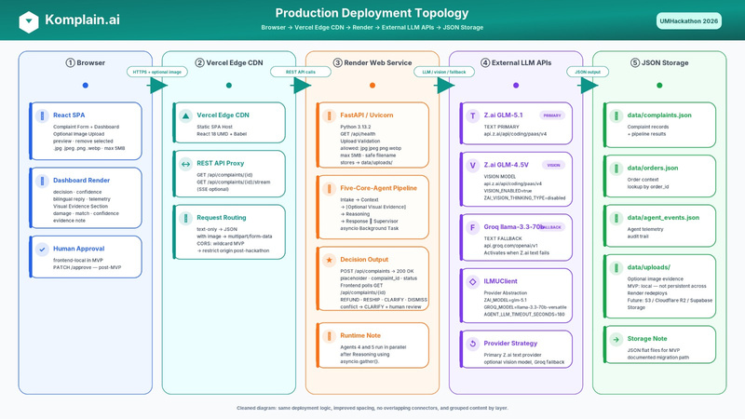
Komplain.ai
10 / 12 · VALIDATION
VALIDATION & FEASIBILITY
Real pain. Real users. Realistic path.
PROBLEM-SOLUTION FIT
TECHNICAL FEASIBILITY · TODAY
Frontend & backend deployed on free-tier infrastructure six-agent pipeline runs end-to-end with telemetry 55 pytest tests + Postman collection green in CI Per-complaint cost measured at sub-RM-0.006
Provider-agnostic — not locked to a single LLM vendor
Would you be interested in trying that kind of product later in the future and give us your feedback?
“Yes, sure”
— INTERVIEWED SME SELLER
SURVEY
Validation data
SME sellers surveyed · top pain ranked: response time and consistency.
MVP → PRODUCTION ROADMAP
MONTH 1
MONTH 2
MONTH 3
MONTH 4+
Postgres + auth
Marketplace ingest
Hardening
Pilot & price
JSON → Postgres, Supabase Auth, multi-tenant.
Shopee, Lazada, WhatsApp webhooks.
Rate limiting, Playwright, security gate.
10 paid SME pilots; validate unit economics.
Notes:
Validation and feasibility. Problem-solution fit: every Malaysian SME seller we've spoken to has the same pain — placeholder for our actual interview quotes. Technical fit: the system already runs end-to-end on free-tier infrastructure. The roadmap from MVP to production is concrete: Postgres, auth, rate limiting, marketplace webhooks, frontend tests — three months, fundable.
11

Slide 11
Komplain.ai
11 / 12 · CLOSING
THE ASK
We are not replacing sellers. We are giving them a reliable AI copilot to resolve complaints faster, fairer, and with evidence.
DEPLOYED
TESTED
HONEST
Live on Vercel + Render
55 pytest · CI green
Defect log on the table
komplain-ai.netlify.app · works in your browser today.
Lint · tests · security · run on every commit.
We tell you what's MVP and what we'd ship next.
Notes:
To close. Komplain.ai is not a slide-ware demo. It's a deployed, tested, telemetered system that resolves a real Malaysian SME pain with a defensible architecture and an honest defect log. We're not replacing sellers — we're giving them a reliable AI copilot to resolve complaints faster, fairer, and with evidence. Thank you.
12

Slide 12
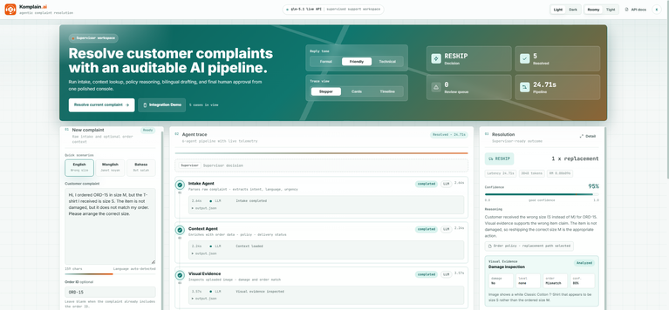
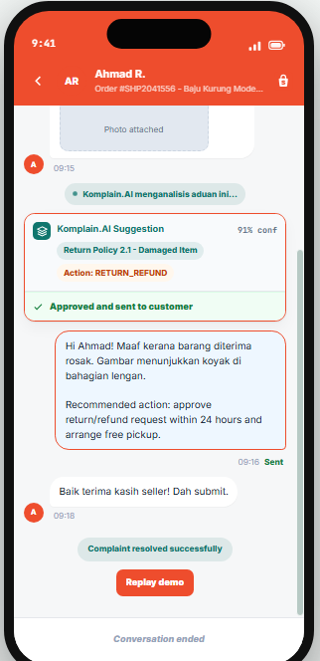
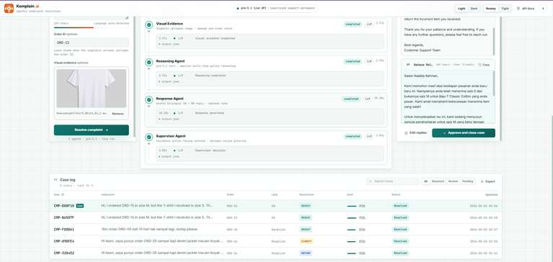


Komplain.ai
12 / 12 · DEMO
PRODUCT DEMO FLOW
Let the system speak for itself.
STEP 01
STEP 02
Paste
Watch
Paste complaint + optional image
Watch text + visual evidence agents
STEP 03
STEP 04
Review
Approve
Review decision, visual evidence, bilingual reply, confidence
Approve or request clarification
LIVE DEMO
Notes:
Here's the actual user journey. Step one, paste the complaint and order ID. Step two, watch each agent run live with real latency and token telemetry. Step three, review the decision, the policy reasoning, and the bilingual reply. Step four, edit if needed and approve. The whole loop is under thirty seconds.
5

