Slide 1
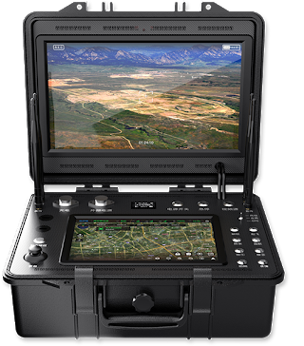
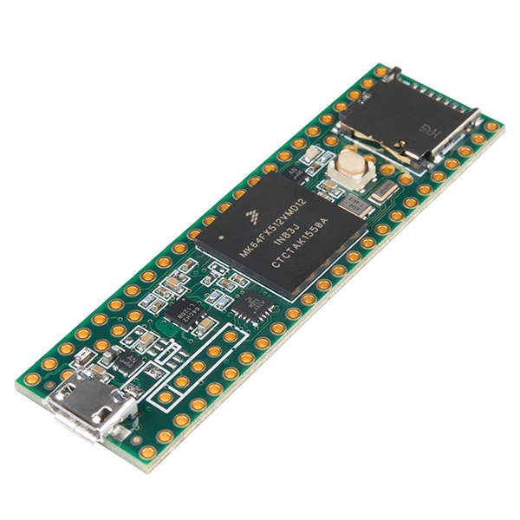
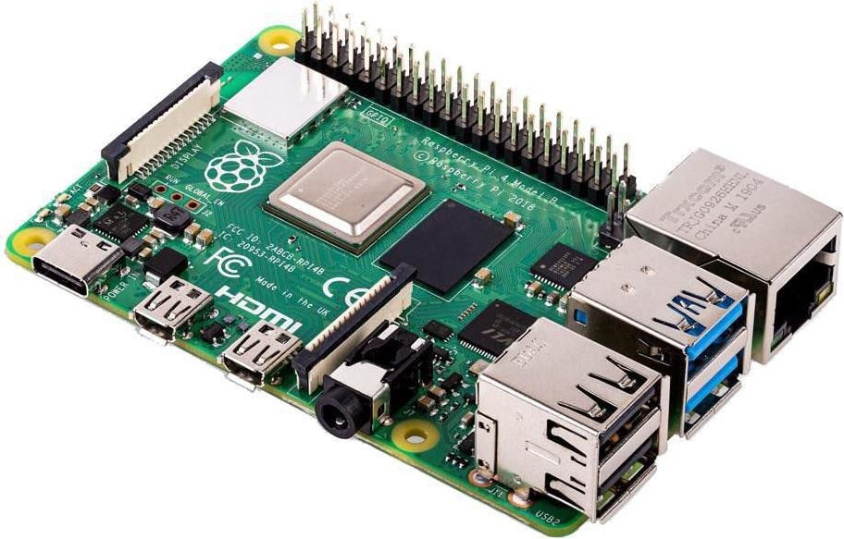
GroundStation
Avionic
Teensy 3.5
Raspberry Pi 3
RF communication
Serial communication

Slide 2


GroundStation
On board Teensy 3.5
Raspberry Pi 3
Avionic communication
Data visualization
State Machine
Capteurs :
IMU (Inertial measurement unit)
Barometer / Temperature / Altitude
Pi control
Camera control + recording
Reset pin
RF communication
Serial communication

