Slide 1
CSCE 606: Software Engineering
PhD Annual Review System
Instructor: Philip Ritchey Client: John Keyser
Development Team: Neha Joshi, Shwetima Sakshi, Harshvardhan Surolia, Shashank Jagtap, Prachi Surbhi, William Harper

Slide 2
Project Overview: PhD Annual Review
PhD candidates complete an annual review to benchmark their progress through the program
PhD Annual Review System: Online application which manages the review process
Key Features:
Students fill out questionnaire and submit supporting documents (ex: résumé/CV)
The student’s faculty committee reviews the submission and submits their feedback

Slide 3
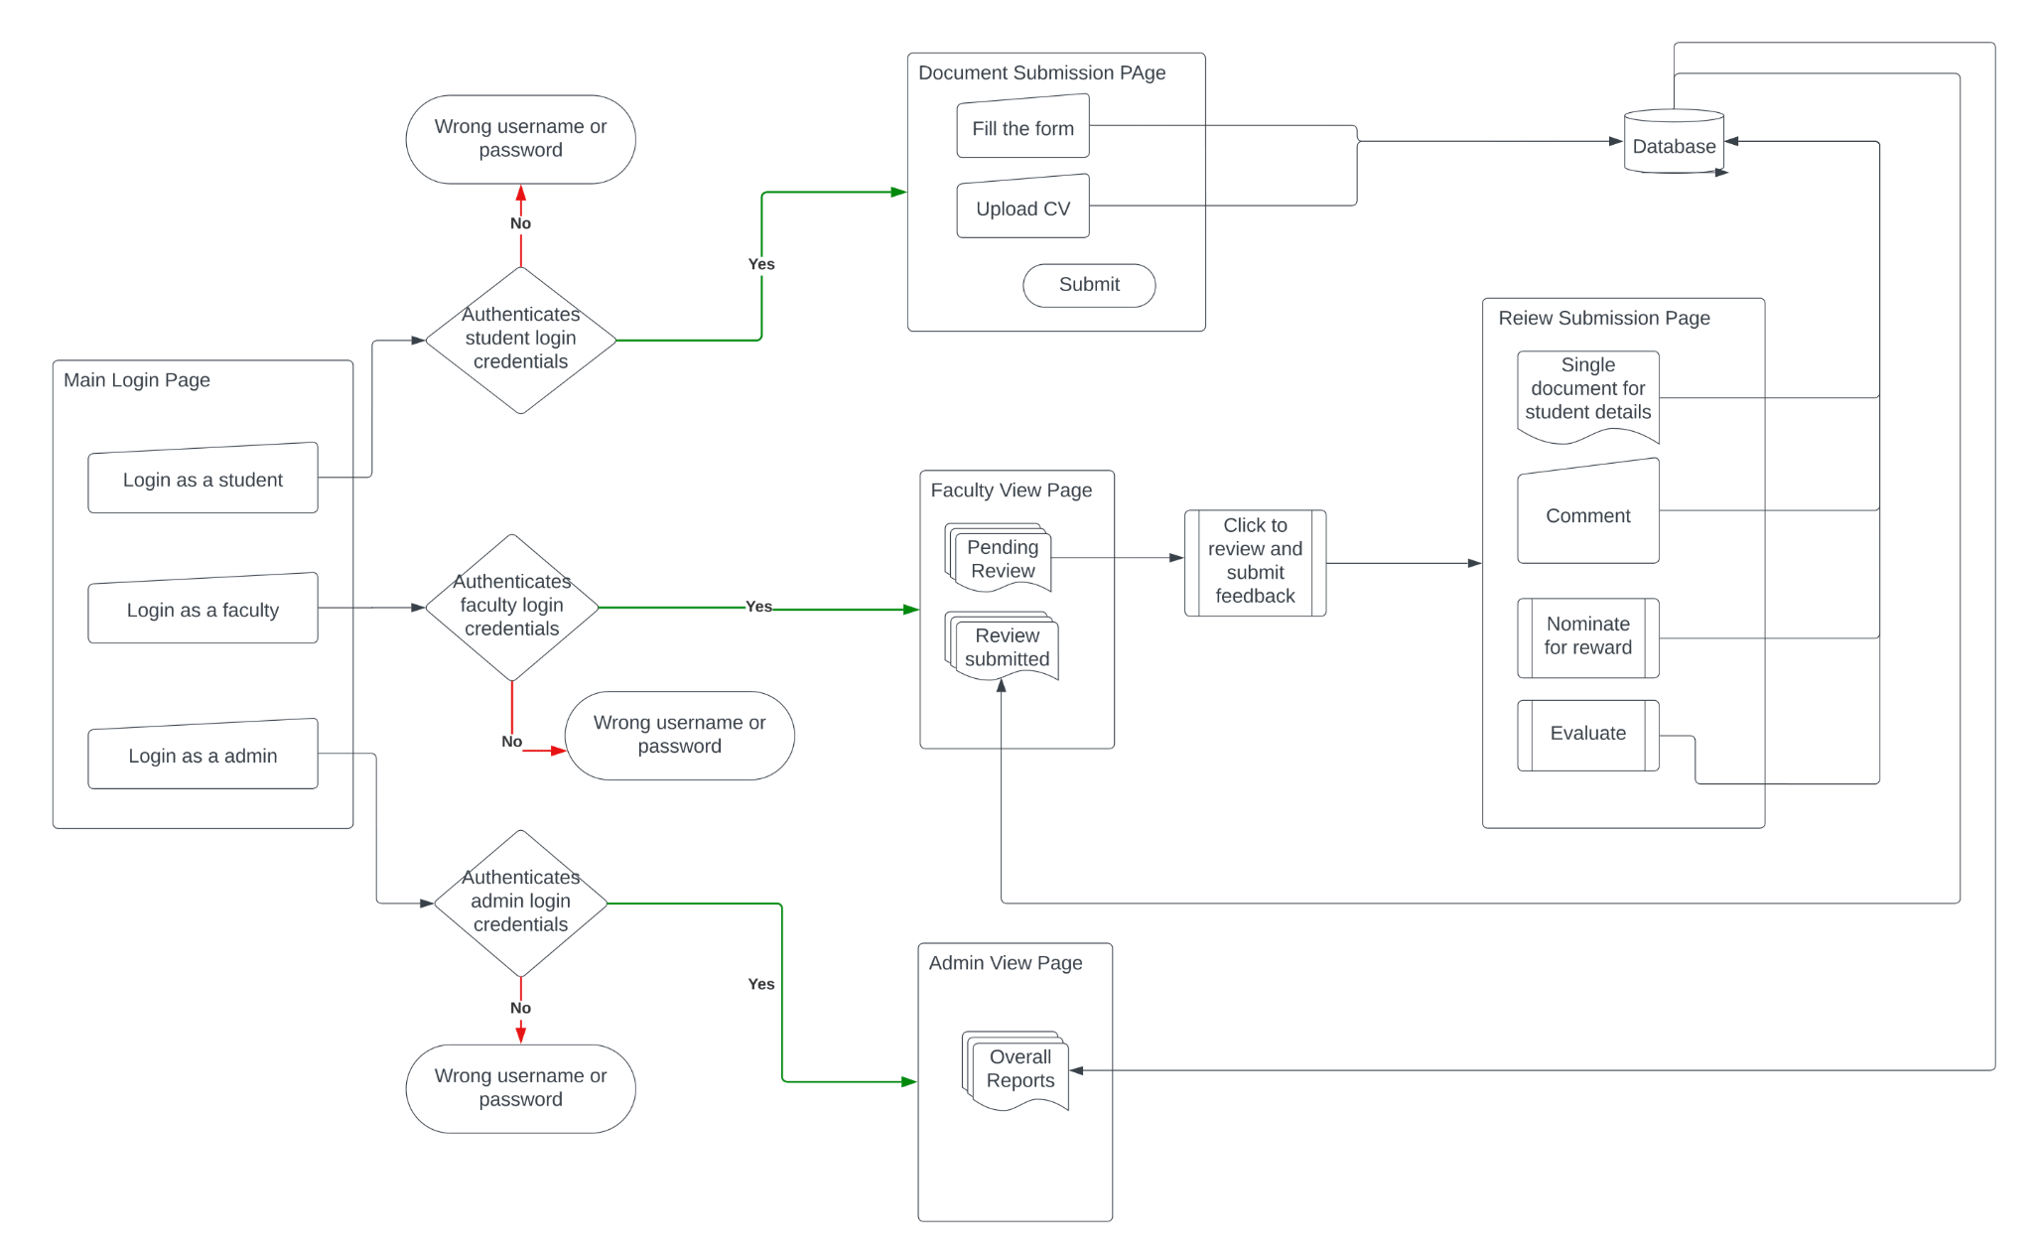
User Navigation Flow:

Slide 4
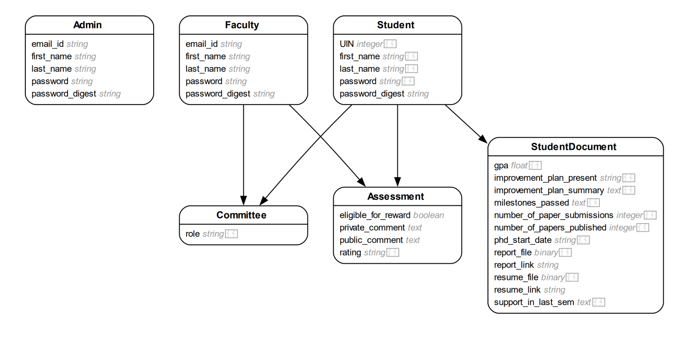
Class Diagram:

Slide 5
Project Validation: Testing
BDD (Cucumber)
Login & Sign-Up: Validate a proper email (@tamu.edu), password, and ensure no blank fields
Students: Check responses to committee changes and document submissions
Faculty: Ensure that assigned students are visible
TDD (RSpec)
Fully tested all backend models (student, documents, assessments, etc.)

Slide 6
Challenges Encountered
Initial Setup
Managing developers on multiple operating systems
PostgreSQL and Amazon S3 Bucket setup
Deployment
Finding a back end storage system that can cheaply store large files (student documents)
Integrating Postgres and S3 Bucket with Heroku

Slide 7
Conclusions
Future Works
The core functionality requested by the client has been fully implemented
Project is deployed on Heroku
Numerous test cases have been written covering the majority of use cases and actions
Further enhance UI and overall user experience
Minor feature additions
Faculty approval joining student committees
Increased admin functionality

Slide 8
Project Demo

