Slide 1
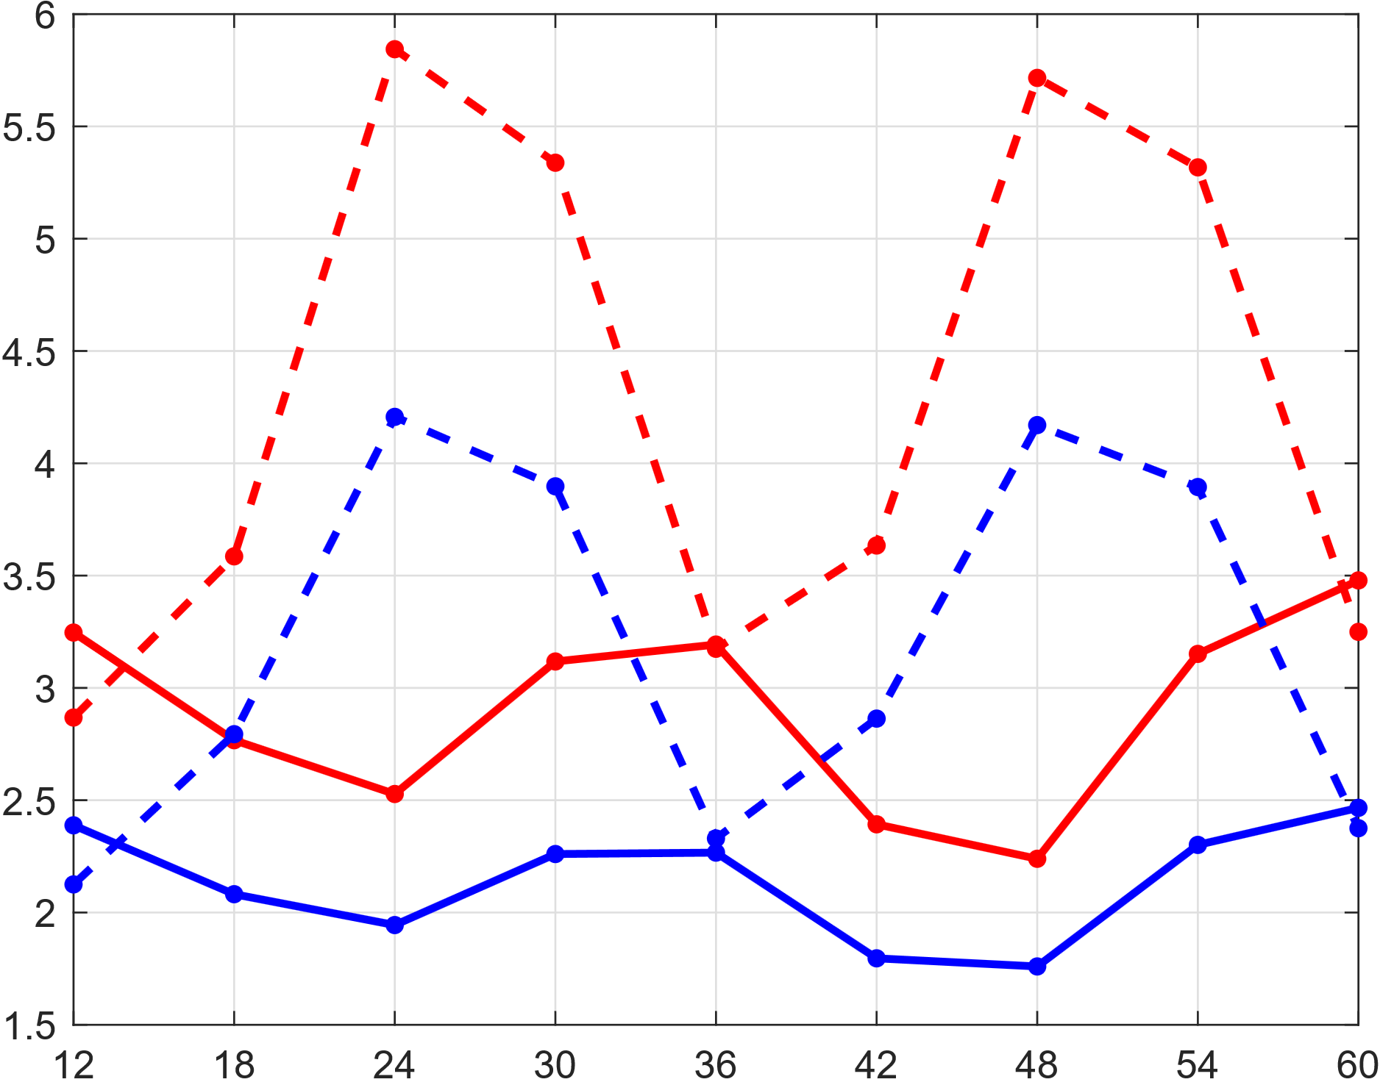
“La Costa”
ENS
“La Sierra”
ecPoint
Rainfall, Annual mean (mm/12h)
Day1
Day2
Final step of 12-hourly accumulation periods (in hours) for 00 UTC runs
0600 – 1800 UTC
0000 – 1200 LST
1200 – 0000 UTC
0600 – 1800 LST
1800 – 0600 UTC
1200 – 0000 LST
0000 – 1200 UTC
1800 – 0600 LST
0600 – 1800 UTC
0000 – 1200 LST
1200 – 0000 UTC
0600 – 1800 LST
1800 – 0600 UTC
1200 – 0000 LST
0000 – 1200 UTC
1800 – 0600 LST
0000 – 1200 UTC
1800 – 0600 LST

