Slide 1
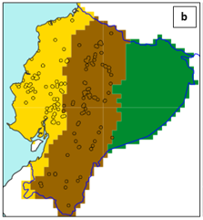
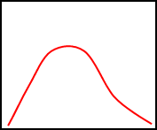
Generation of rainfall thresholds to be used in verification
Flash floods for year X
Nearest-gridbox 1-day ecPoint FC (proxy for rainfall observations) – 99 realizations
FF n.1
FF n.2
FF n.3
FF n.4
FF n.5
+
+
+
+
+ … =
Distribution of point-based rainfall amounts associated with the flash flood events observed in year X
99th
=
75th
Percentiles
RT(99th)
Rainfall Thresholds (mm/12h)
Verification methodology
Deterministic managed ff observations: transpose the point flash flood observations for the verification year Y to the forecasts grid-box. Create one file for each 12-hourly overlapping accumulation period (0-12 UTC / 6-18 UTC / 12-0 UTC / 18-6 UTC) in each day in Y. Each grid-box with at least one flash flood observation is assigned the value 1; 0 otherwise.
Extract ecPoint/ENS forecasts for each grid-box in Ecuador’s domain.
Create the contingency tables for the probabilistic forecasts for different rainfall events, i.e. RT(75th/85th/90th/95th/98th/99th)
Plot the ROC curves and areas under the ROC curve.

