Slide 1
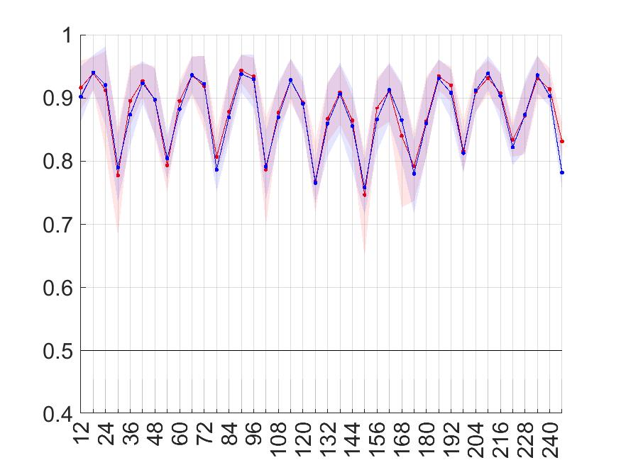
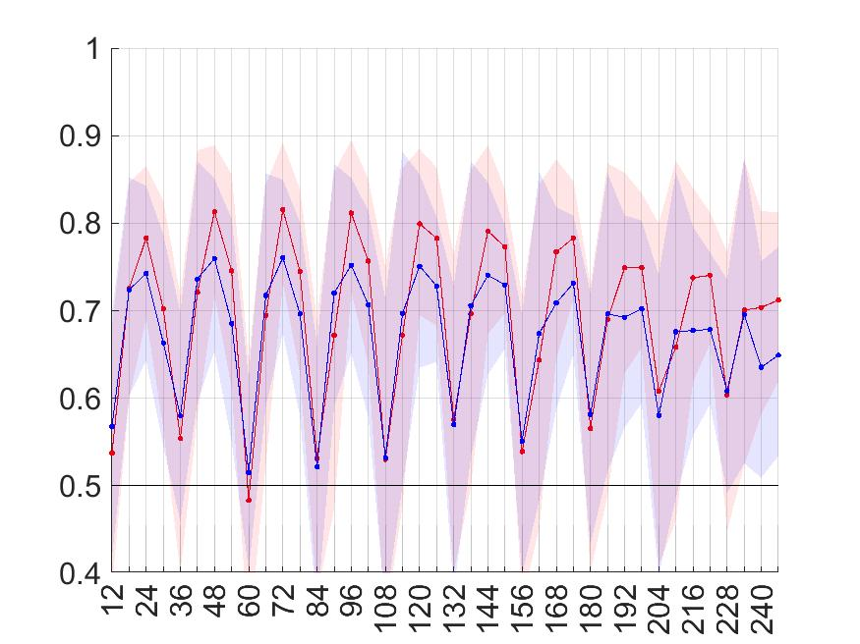
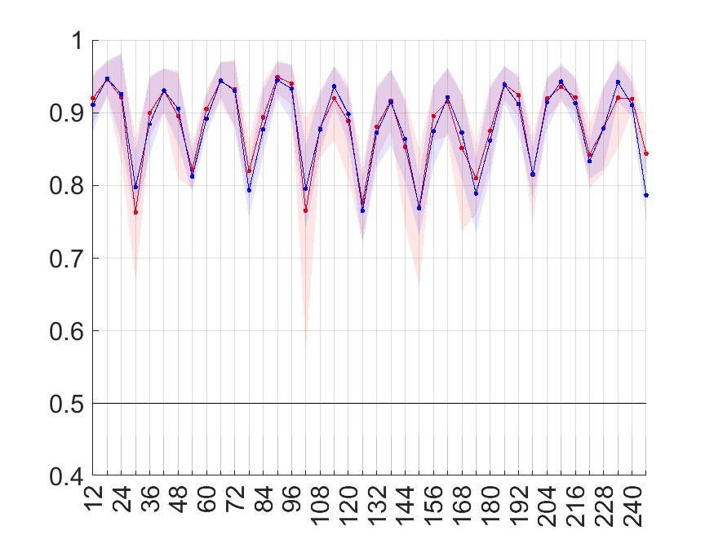
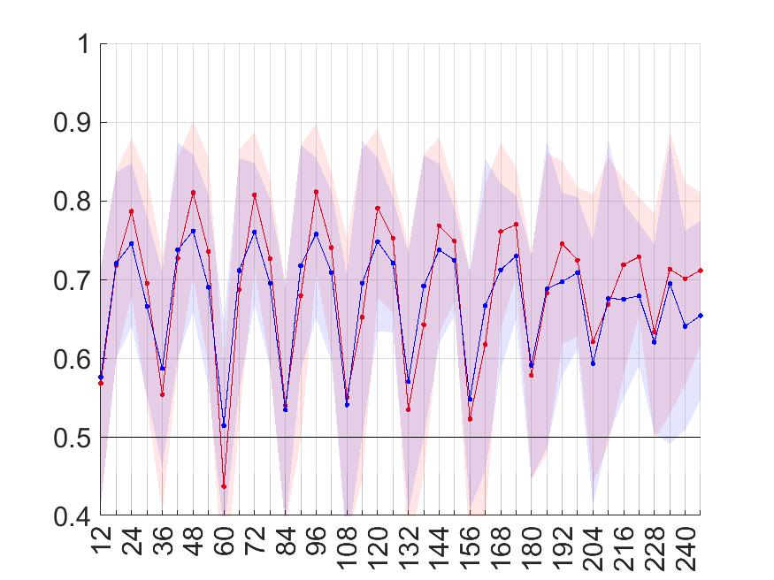
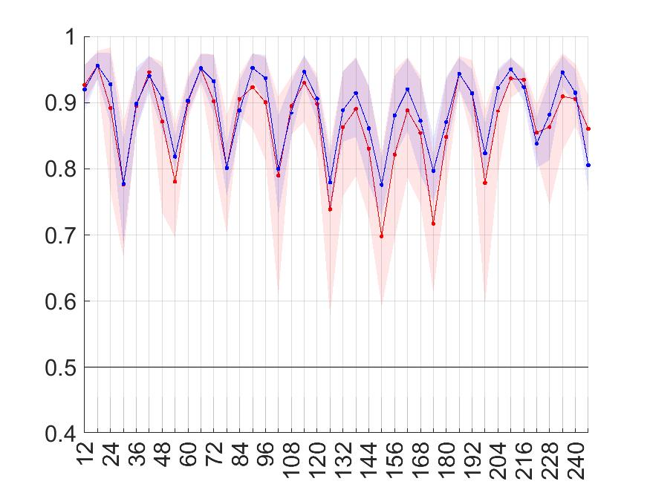
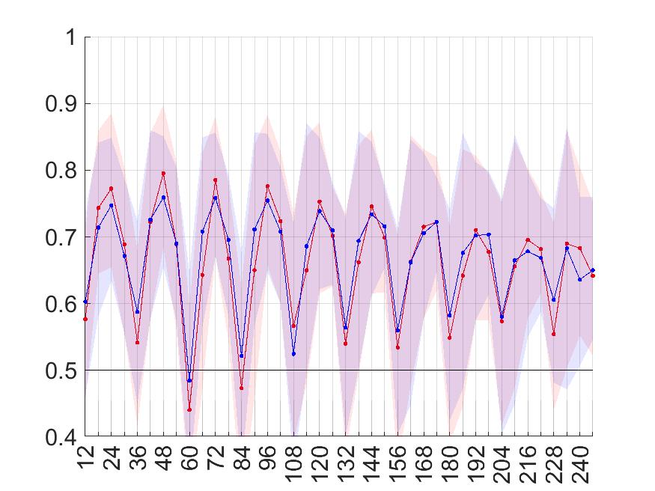
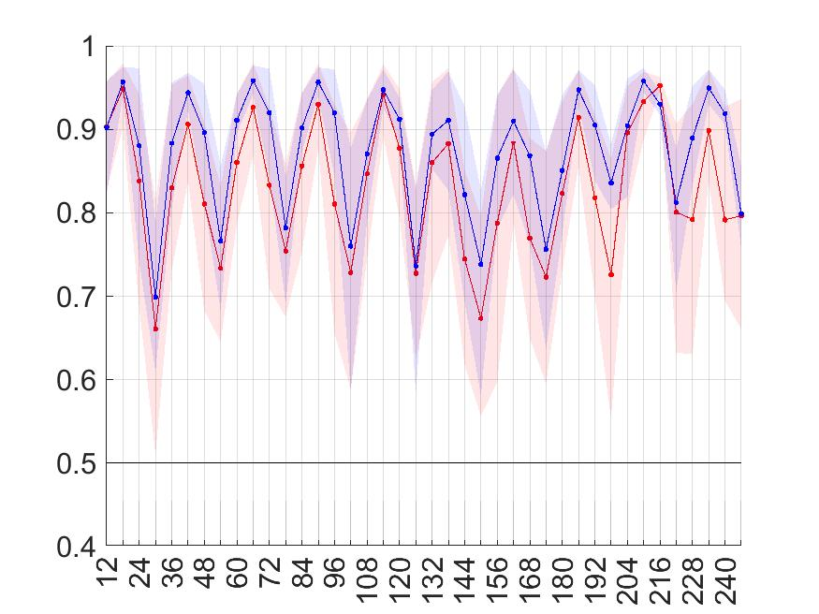
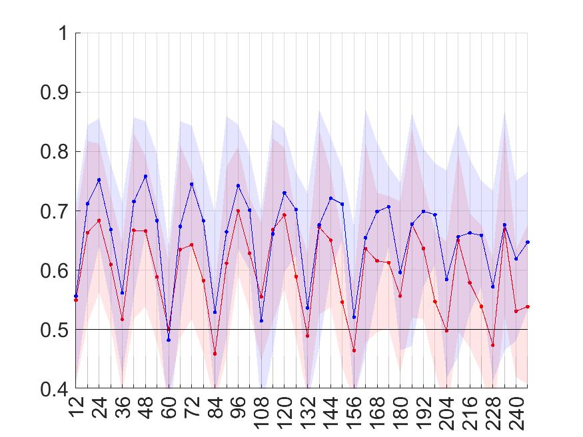
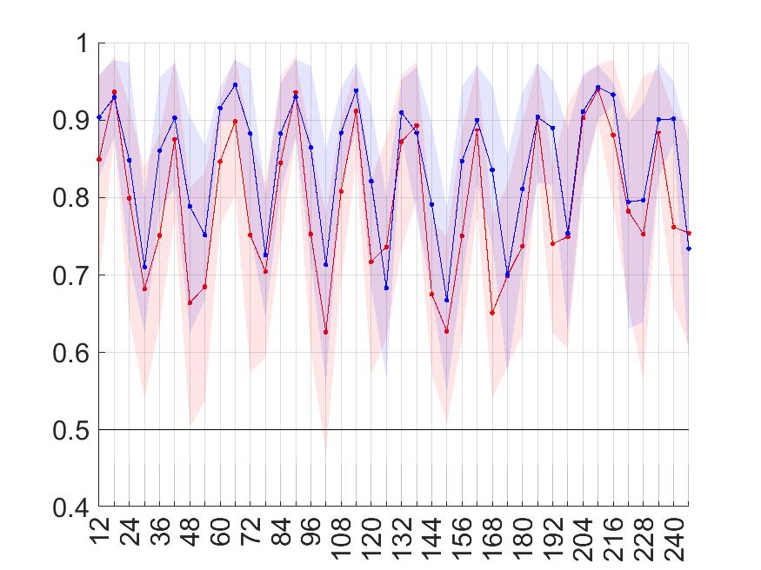
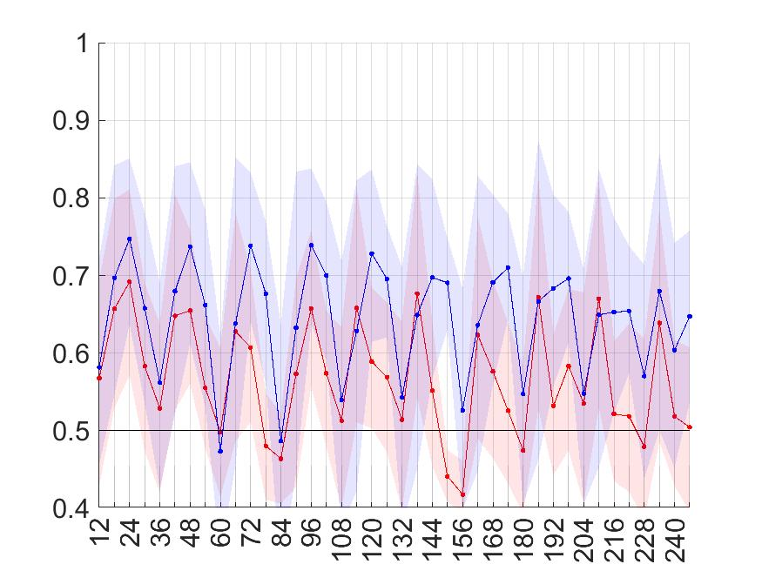
ENS
ecPoint
“La Costa”
“La Sierra”
b
85th percentile
(tp >= 9.419 mm/12h)
85th percentile
(tp >= 6.112 mm/12h)
Area under the ROC
a
d
90th percentile
(tp >= 14.080 mm/12h)
90th percentile
(tp >= 8.880 mm/12h)
Area under the ROC
c
f
95th percentile
(tp >= 22.384 mm/12h)
95th percentile
(tp >= 14.616 mm/12h)
Area under the ROC
e
h
98th percentile
(tp >= 36.011 mm/12h)
98th percentile
(tp >= 22.497 mm/12h)
Area under the ROC
g
j
99th percentile
(tp >= 46.786 mm/12h)
99th percentile
(tp >= 27.501 mm/12h)
Area under the ROC
i
Steps at the end of
12-h accumulation periods
Steps at the end of
12-h accumulation periods

