Slide 1
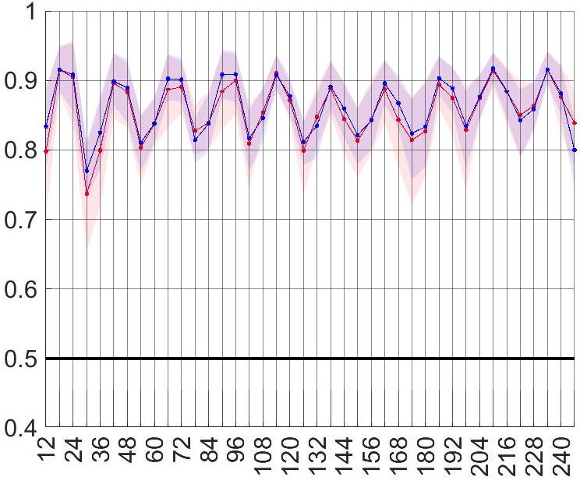
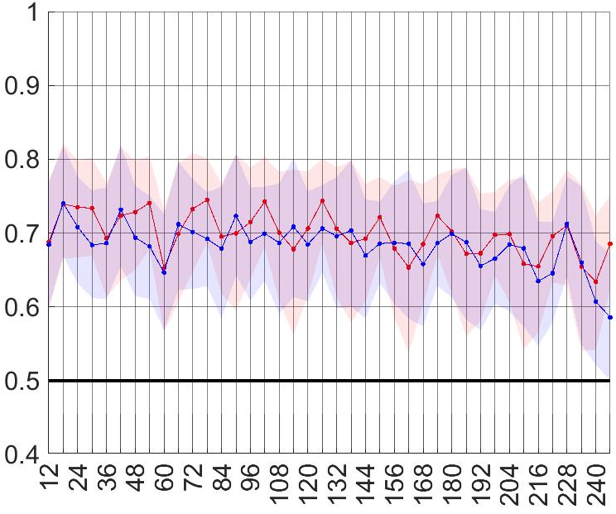
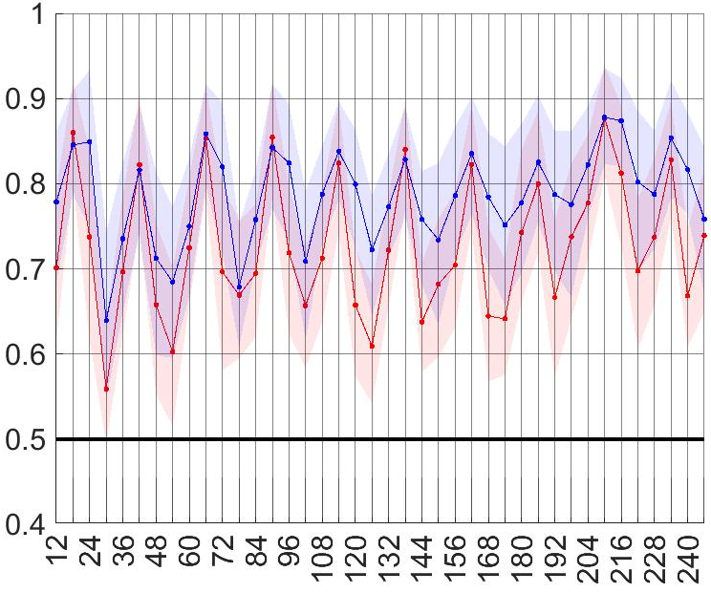
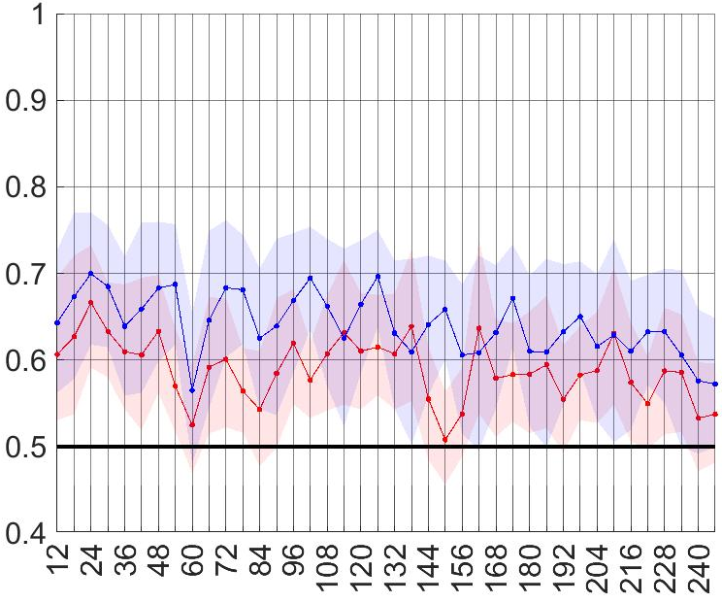
ENS
ecPoint
“La Costa”
“La Sierra”
tp >= 6.112 mm/12h
85th percentile
Area under the ROC
tp >= 9.419 mm/12h
tp >= 27.501 mm/12h
99th percentile
Area under the ROC
tp >= 46.786 mm/12h
Steps at the end of 12 hourly accumulation periods
Steps at the end of 12 hourly accumulation periods

