Slide 1
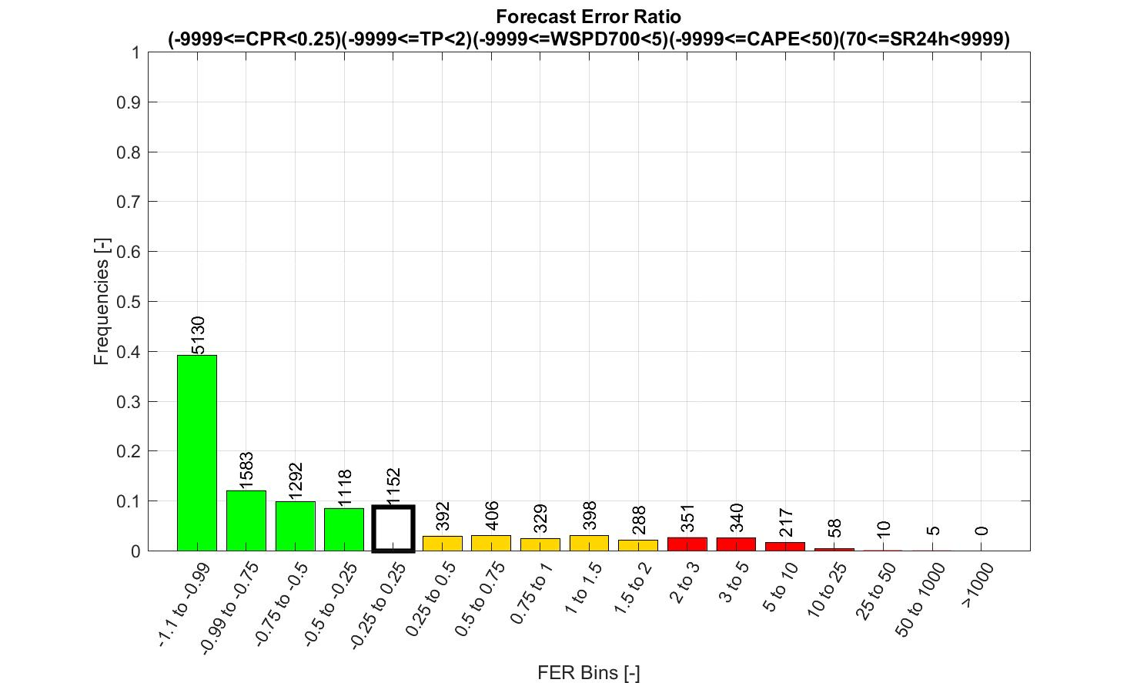
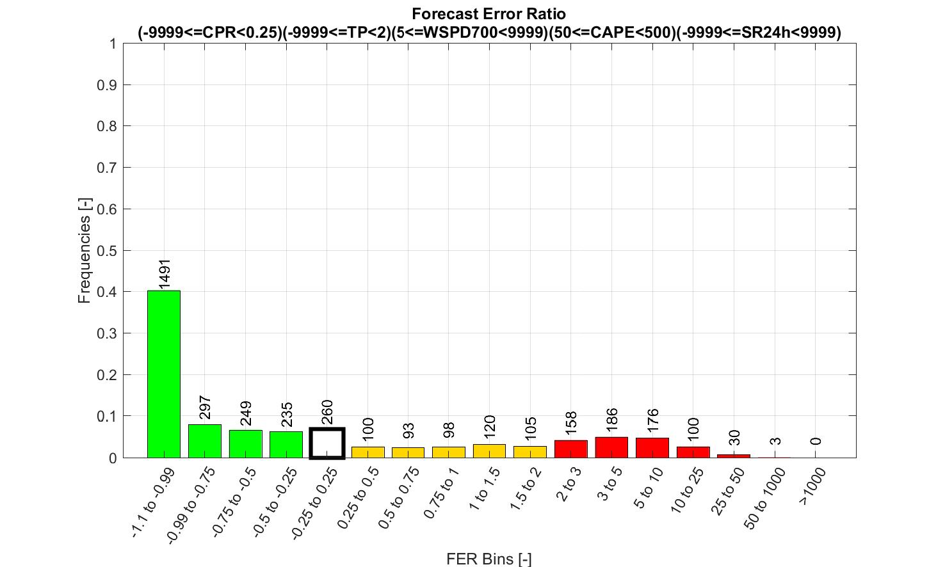
TP considered by ENS as mainly large-scale
TP considered by ENS as mainly convective
TP considered by ENS as mainly large-scale
TP considered by ENS as mainly convective
X: very small TP / very light winds / very low cape / medium solar radiation
(high probabilities of zeros, no long tails)
Main correction: biases
0 – 12 UTC
(6pm – 6am LST)
X
X: very small TP / very light winds / very low cape / high solar radiation
(high probabilities of zeros, no long tails)
=> Main correction: biases
Frequencies (%)
X
X
X
X
X
X
X
6 – 18 UTC
(0am – 12am LST)
X: medium-big TP / very light winds / low-medium cape / medium-high solar radiation
(high probabilities of zeros, longer tails)
=> Main correction: biases + sub-grid variability
X
Frequencies (%)
X
X
X
X
X
X
X
X
X
12 – 24 UTC
(6am – 6pm LST)
X
Frequencies (%)
X
X
X
X
X
X
X
X
X
18 – 6 UTC
(12am – 0am LST)
X
Frequencies (%)
X
X
X
X
X
X
X
X
X
WT Codes
WT Codes

