Slide 1
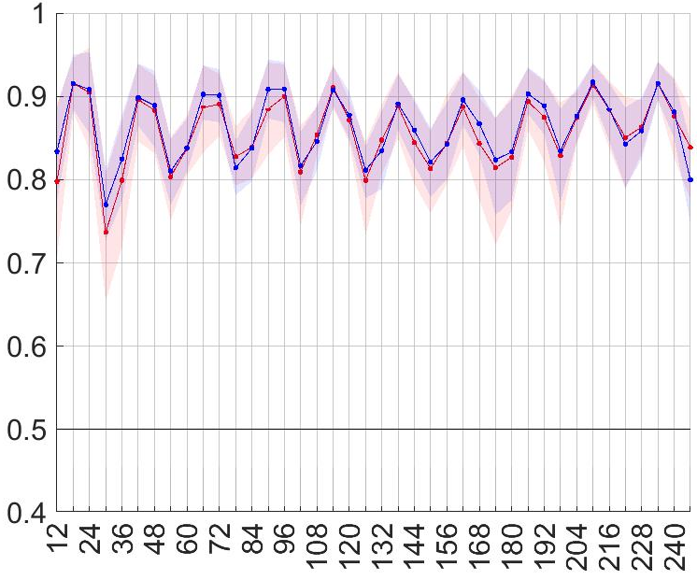
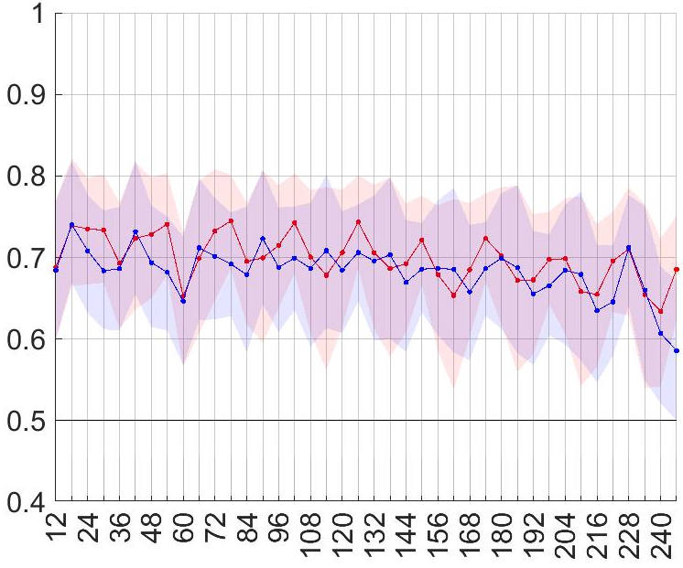
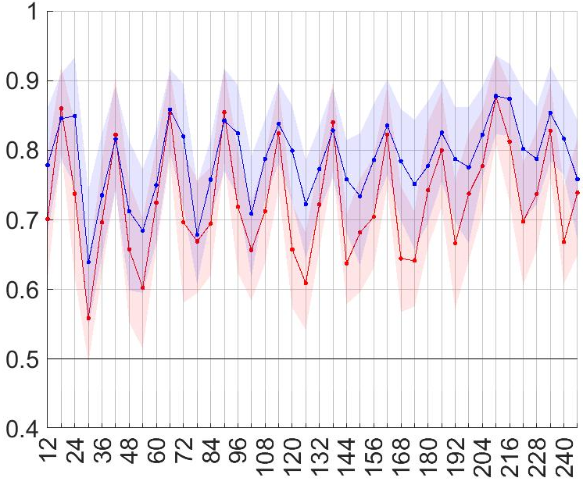
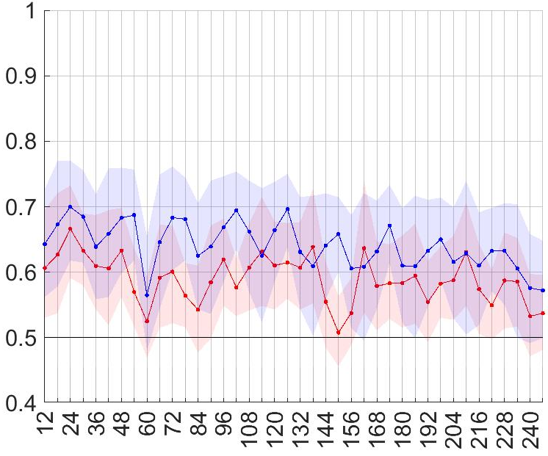
ENS
ecPoint
“La Costa”
“La Sierra”
Area under the ROC
Area under the ROC
Steps at the end of 12-h accumulation periods
Steps at the end of 12-h accumulation periods

Slide 2


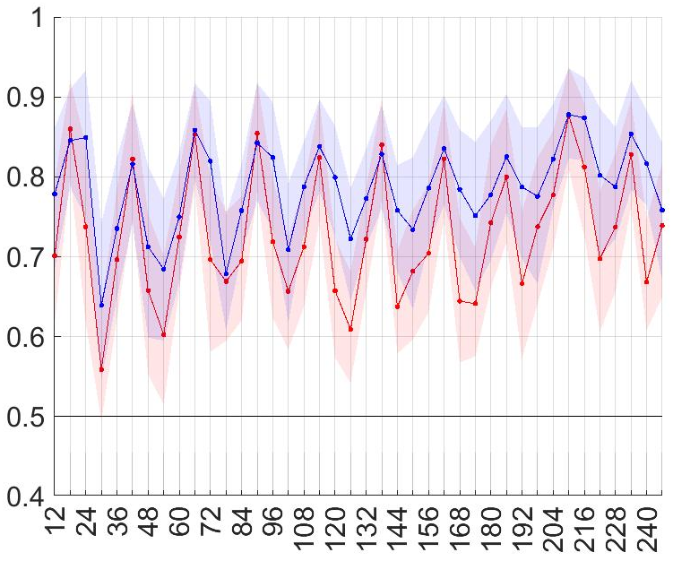

ENS
ecPoint
“La Costa”
“La Sierra”
Area under the ROC
85th percentile
(tp >= 6.112 mm/12h)
No Skill
85th percentile
(tp >= 9.419 mm/12h)
99th percentile
(tp >= 27.501 mm/12h)
Area under the ROC
99th percentile
(tp >= 46.786 mm/12h)
Steps at the end of 12-h accumulation periods
Steps at the end of 12-h accumulation periods

