Slide 1
ENS
ecPoint
“La Costa”
“La Sierra”
85th percentile
Area under the ROC
18
30
99th percentile
Area under the ROC
Steps at the end of 12 hourly accumulation periods
Steps at the end of 12 hourly accumulation periods

Slide 2
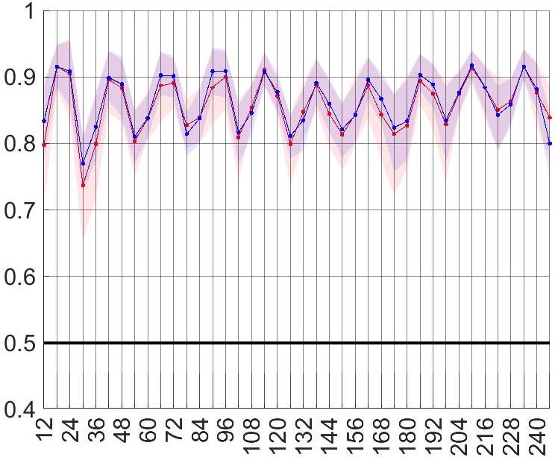
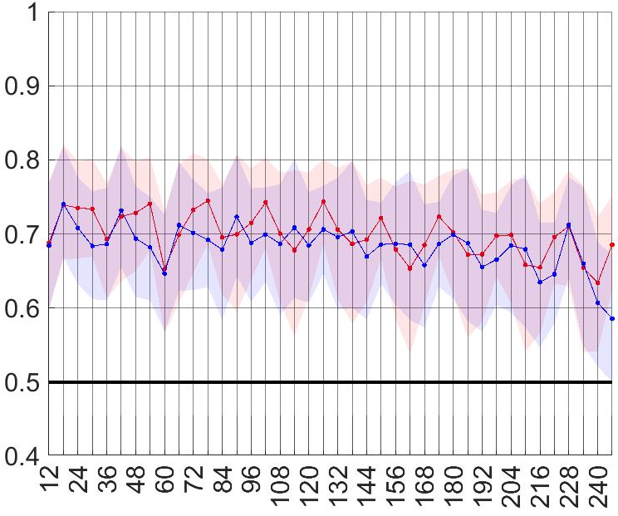
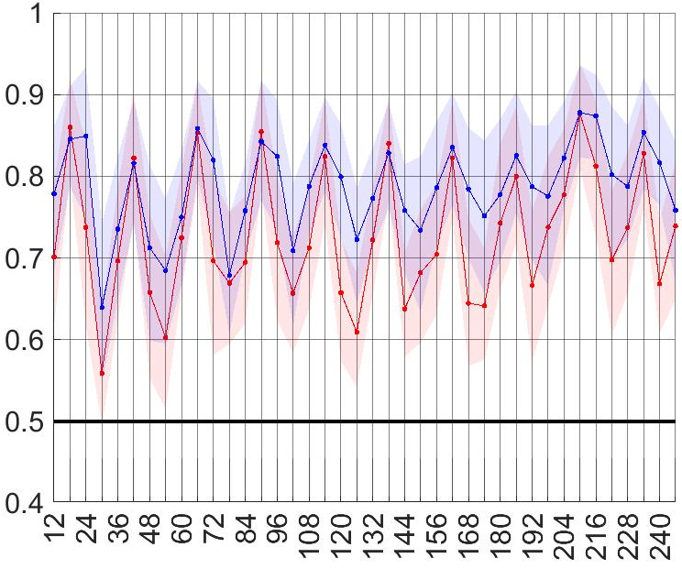
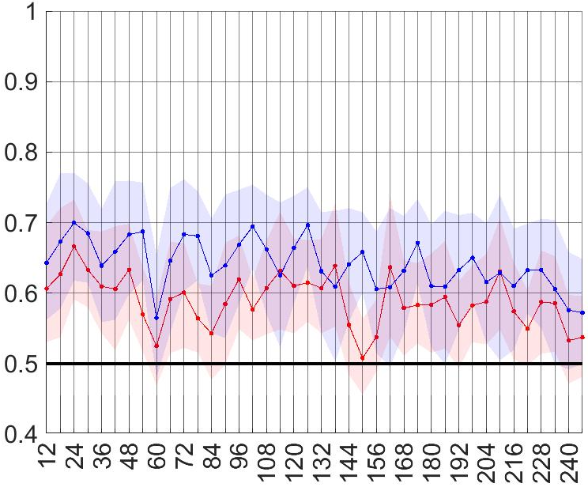
ENS
ecPoint
“La Costa”
“La Sierra”
tp >= 6.112 mm/12h
85th percentile
Area under the ROC
tp >= 9.419 mm/12h
tp >= 27.501 mm/12h
99th percentile
Area under the ROC
tp >= 46.786 mm/12h
Steps at the end of 12 hourly accumulation periods
Steps at the end of 12 hourly accumulation periods

