Slide 1
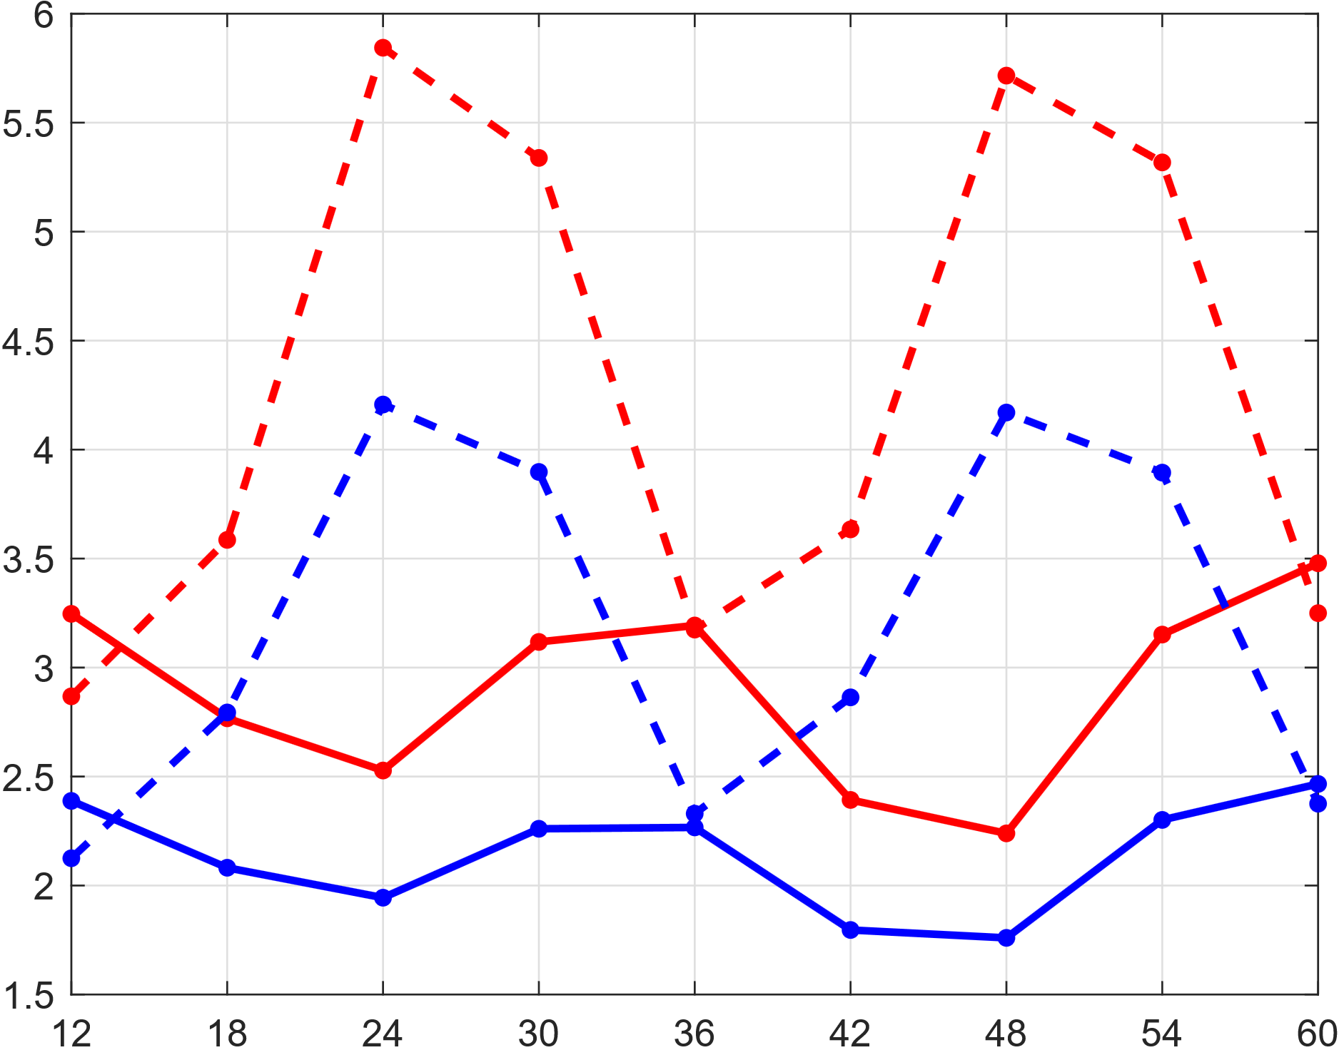
“La Costa”
ENS
“La Sierra”
ecPoint
Rainfall, Annual mean (mm/12h)
0600 – 1800 UTC
(0000 – 1200 LST)
1200 – 0000 UTC
(0600 – 1800 LST)
1800 – 0600 UTC
(1200 – 0000 LST)
0000 – 1200 UTC
(1800 – 0600 LST)
0600 – 1800 UTC
(0000 – 1200 LST)
1200 – 0000 UTC
(0600 – 1800 LST)
1800 – 0600 UTC
(1200 – 0000 LST)
0000 – 1200 UTC
(1800 – 0600 LST)
0000 – 1200 UTC
(1800 – 0600 LST)
Final step of 12-hourly accumulation periods (in hours) for 00 UTC runs

