Slide 1
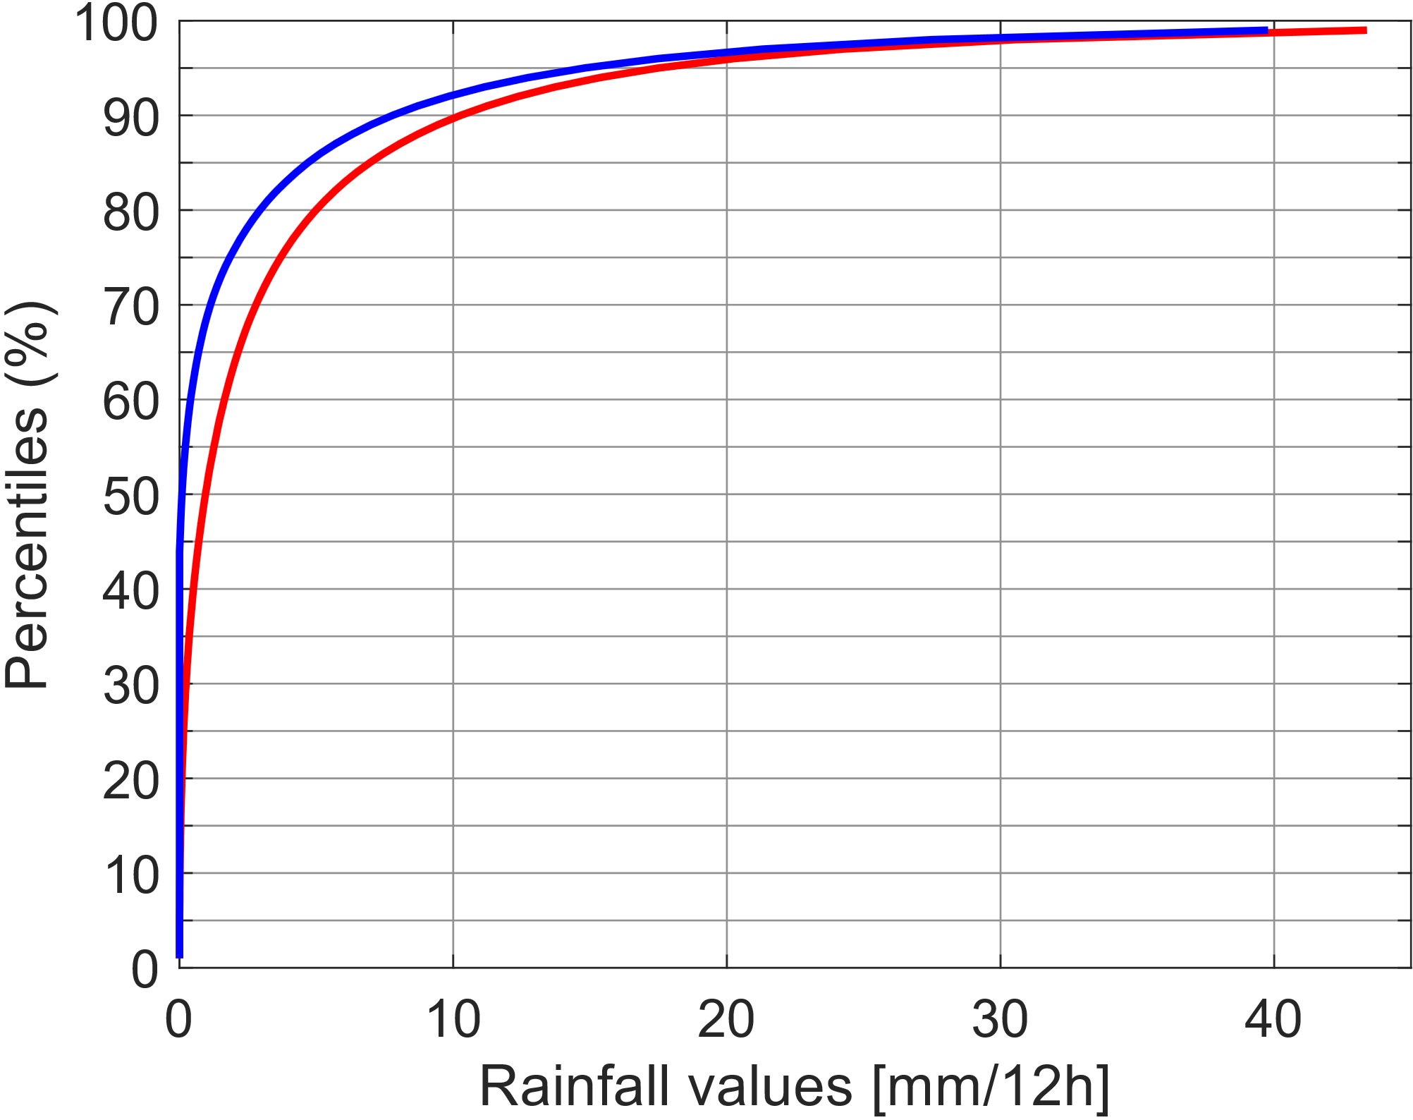
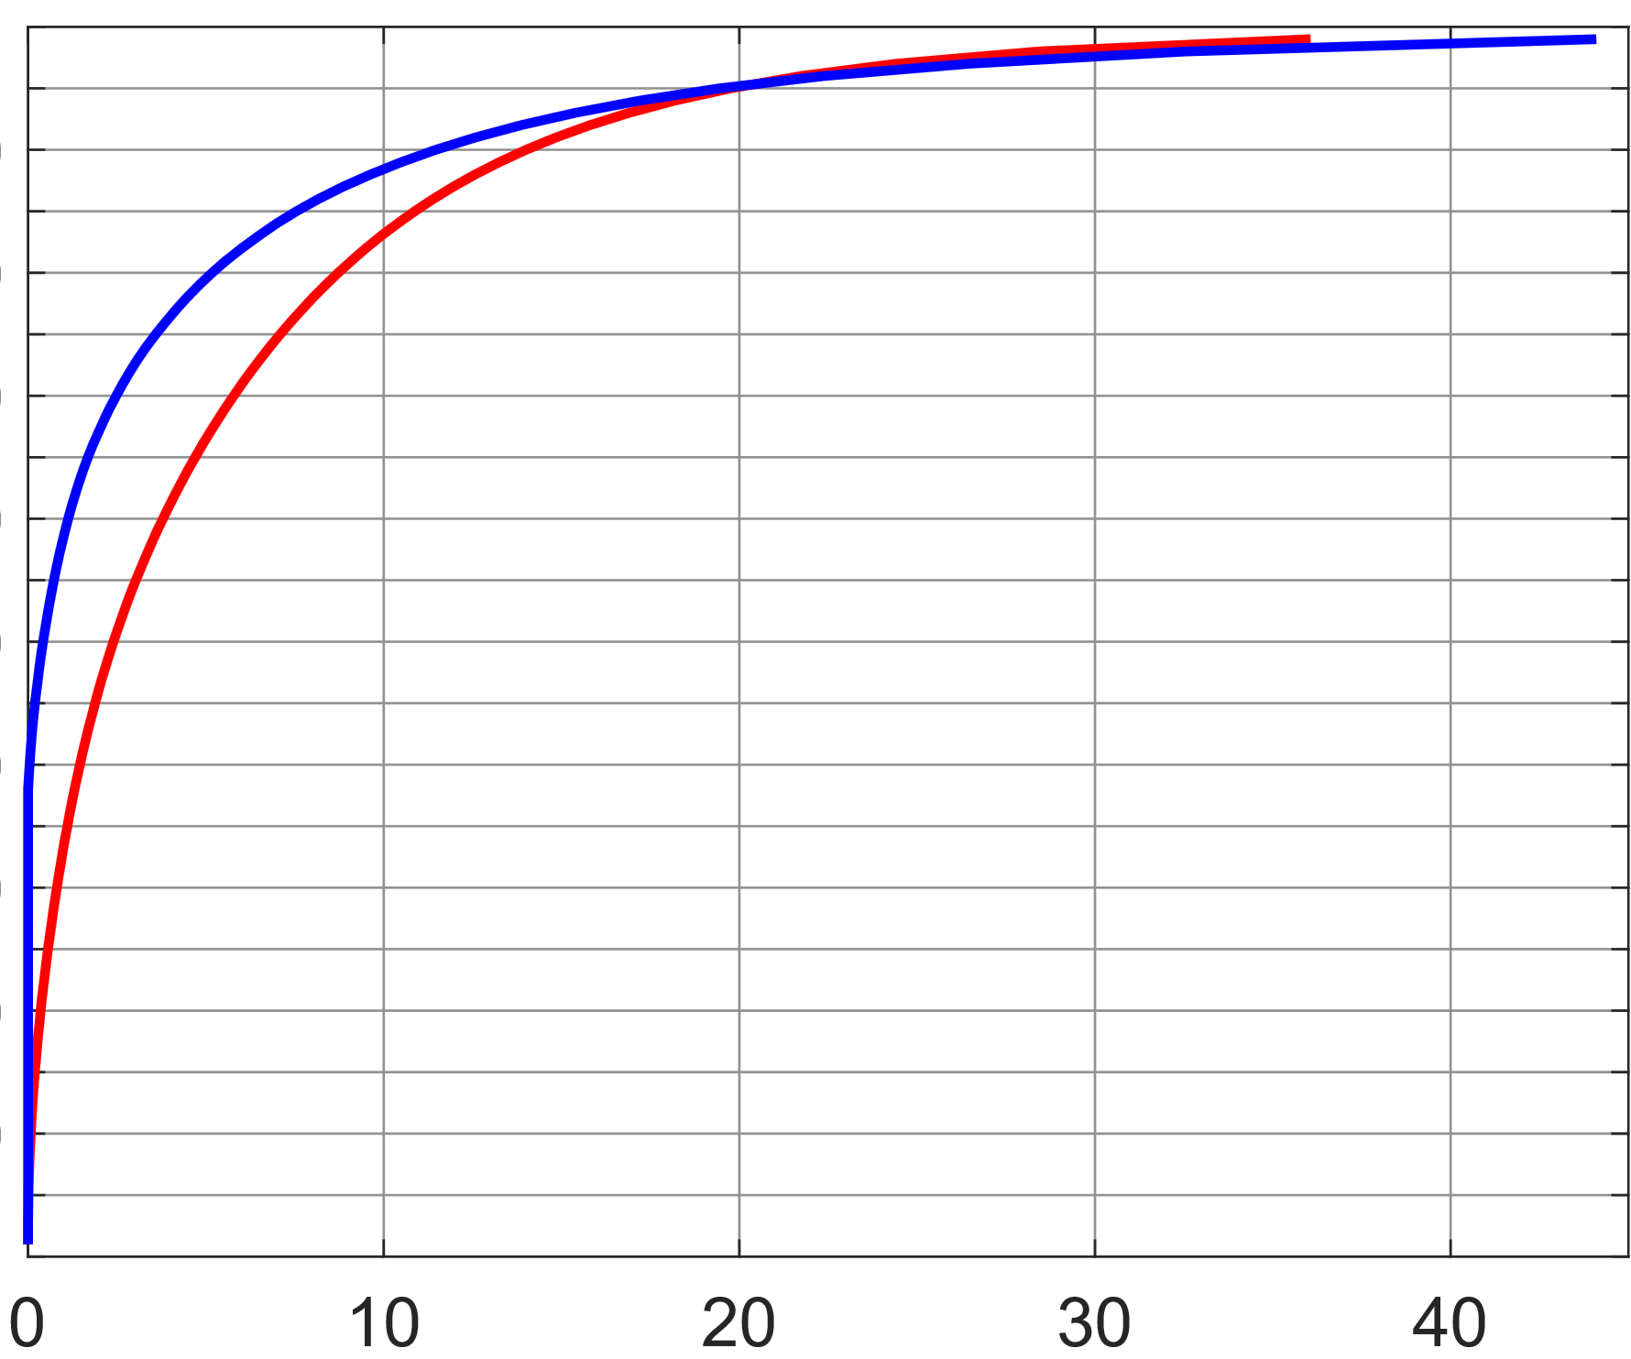
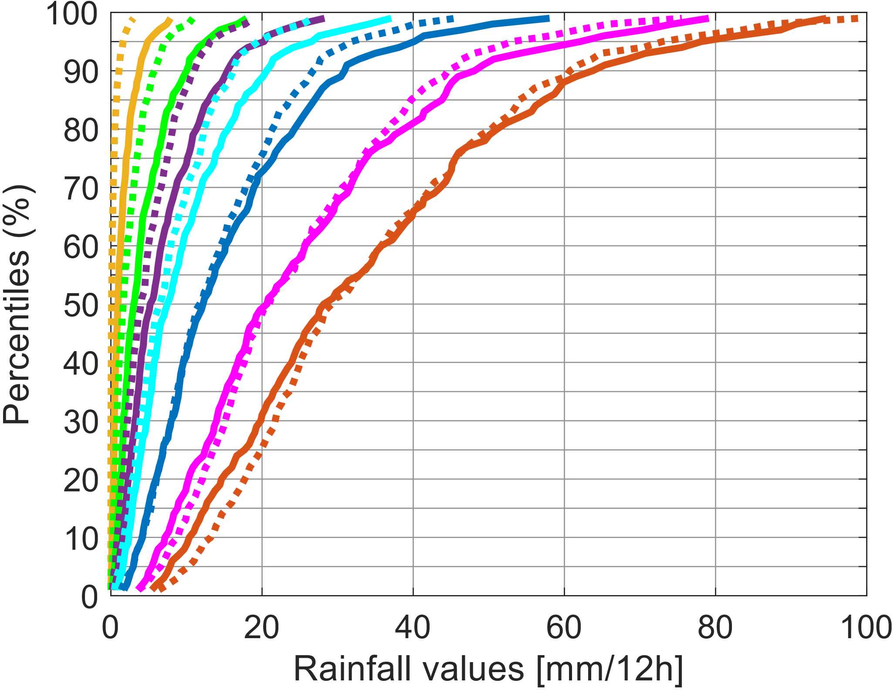
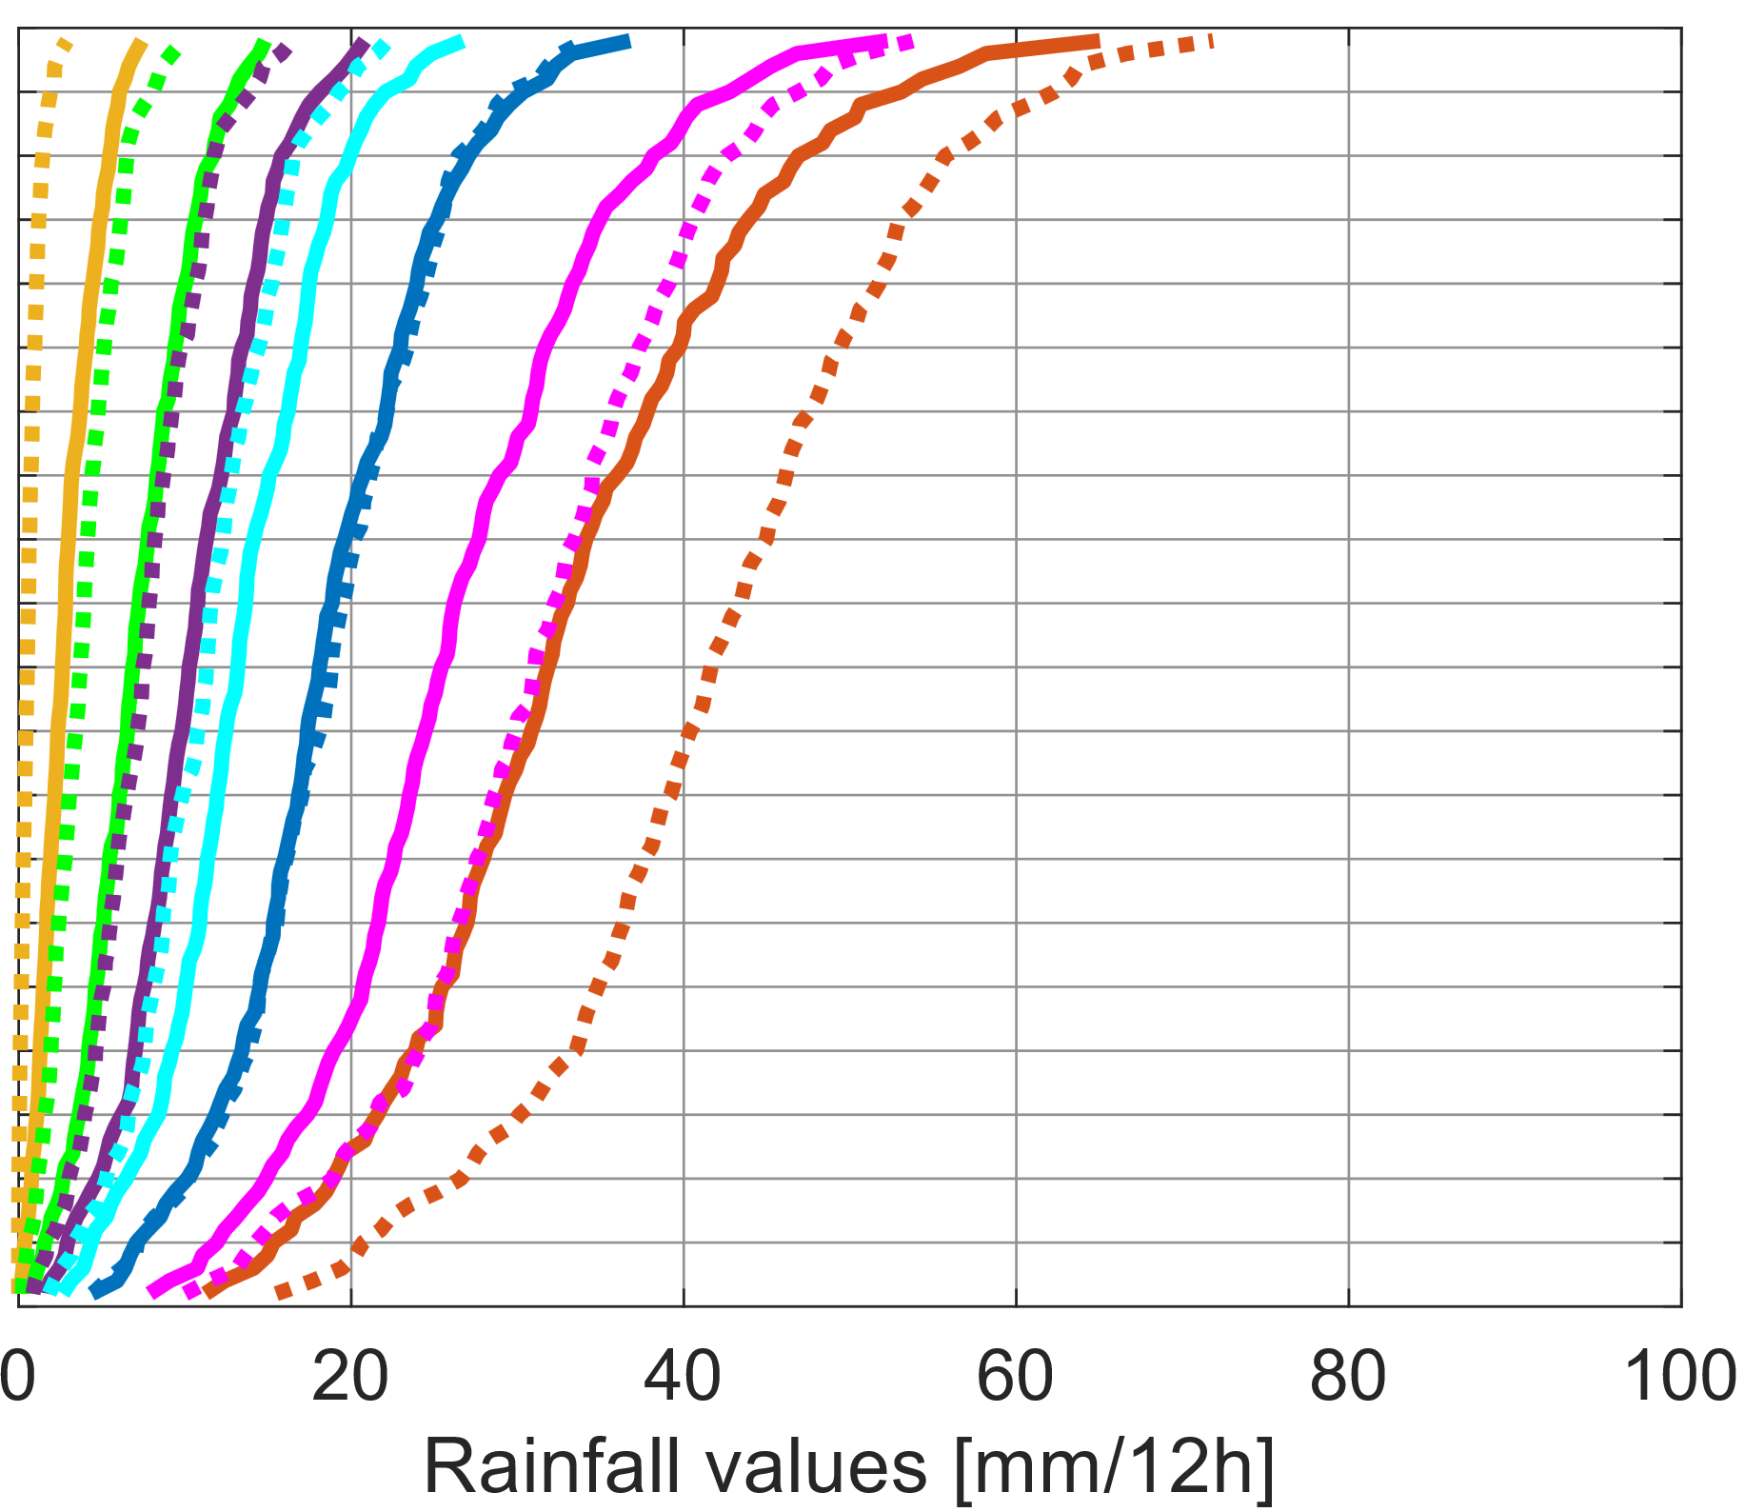
La Costa
La Sierra
All rainfall values for all accumulation periods
ENS
ecPoint
ENS
ecPoint
>=50th percentile
>=75th percentile
>= 85th percentile
>= 90th percentile
>= 95th percentile
Only extreme rainfall values (= Xth percentile) for each accumulation period
>= 98th percentile
>= 99th percentile
ENS
ecPoint
100 0

Slide 2
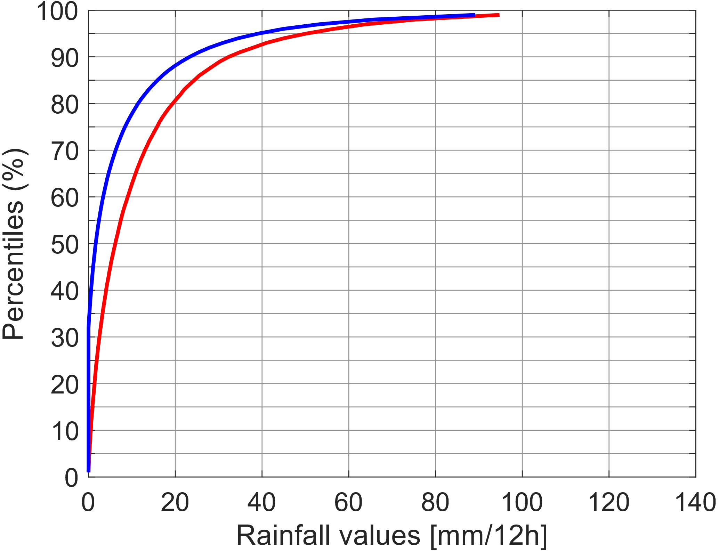
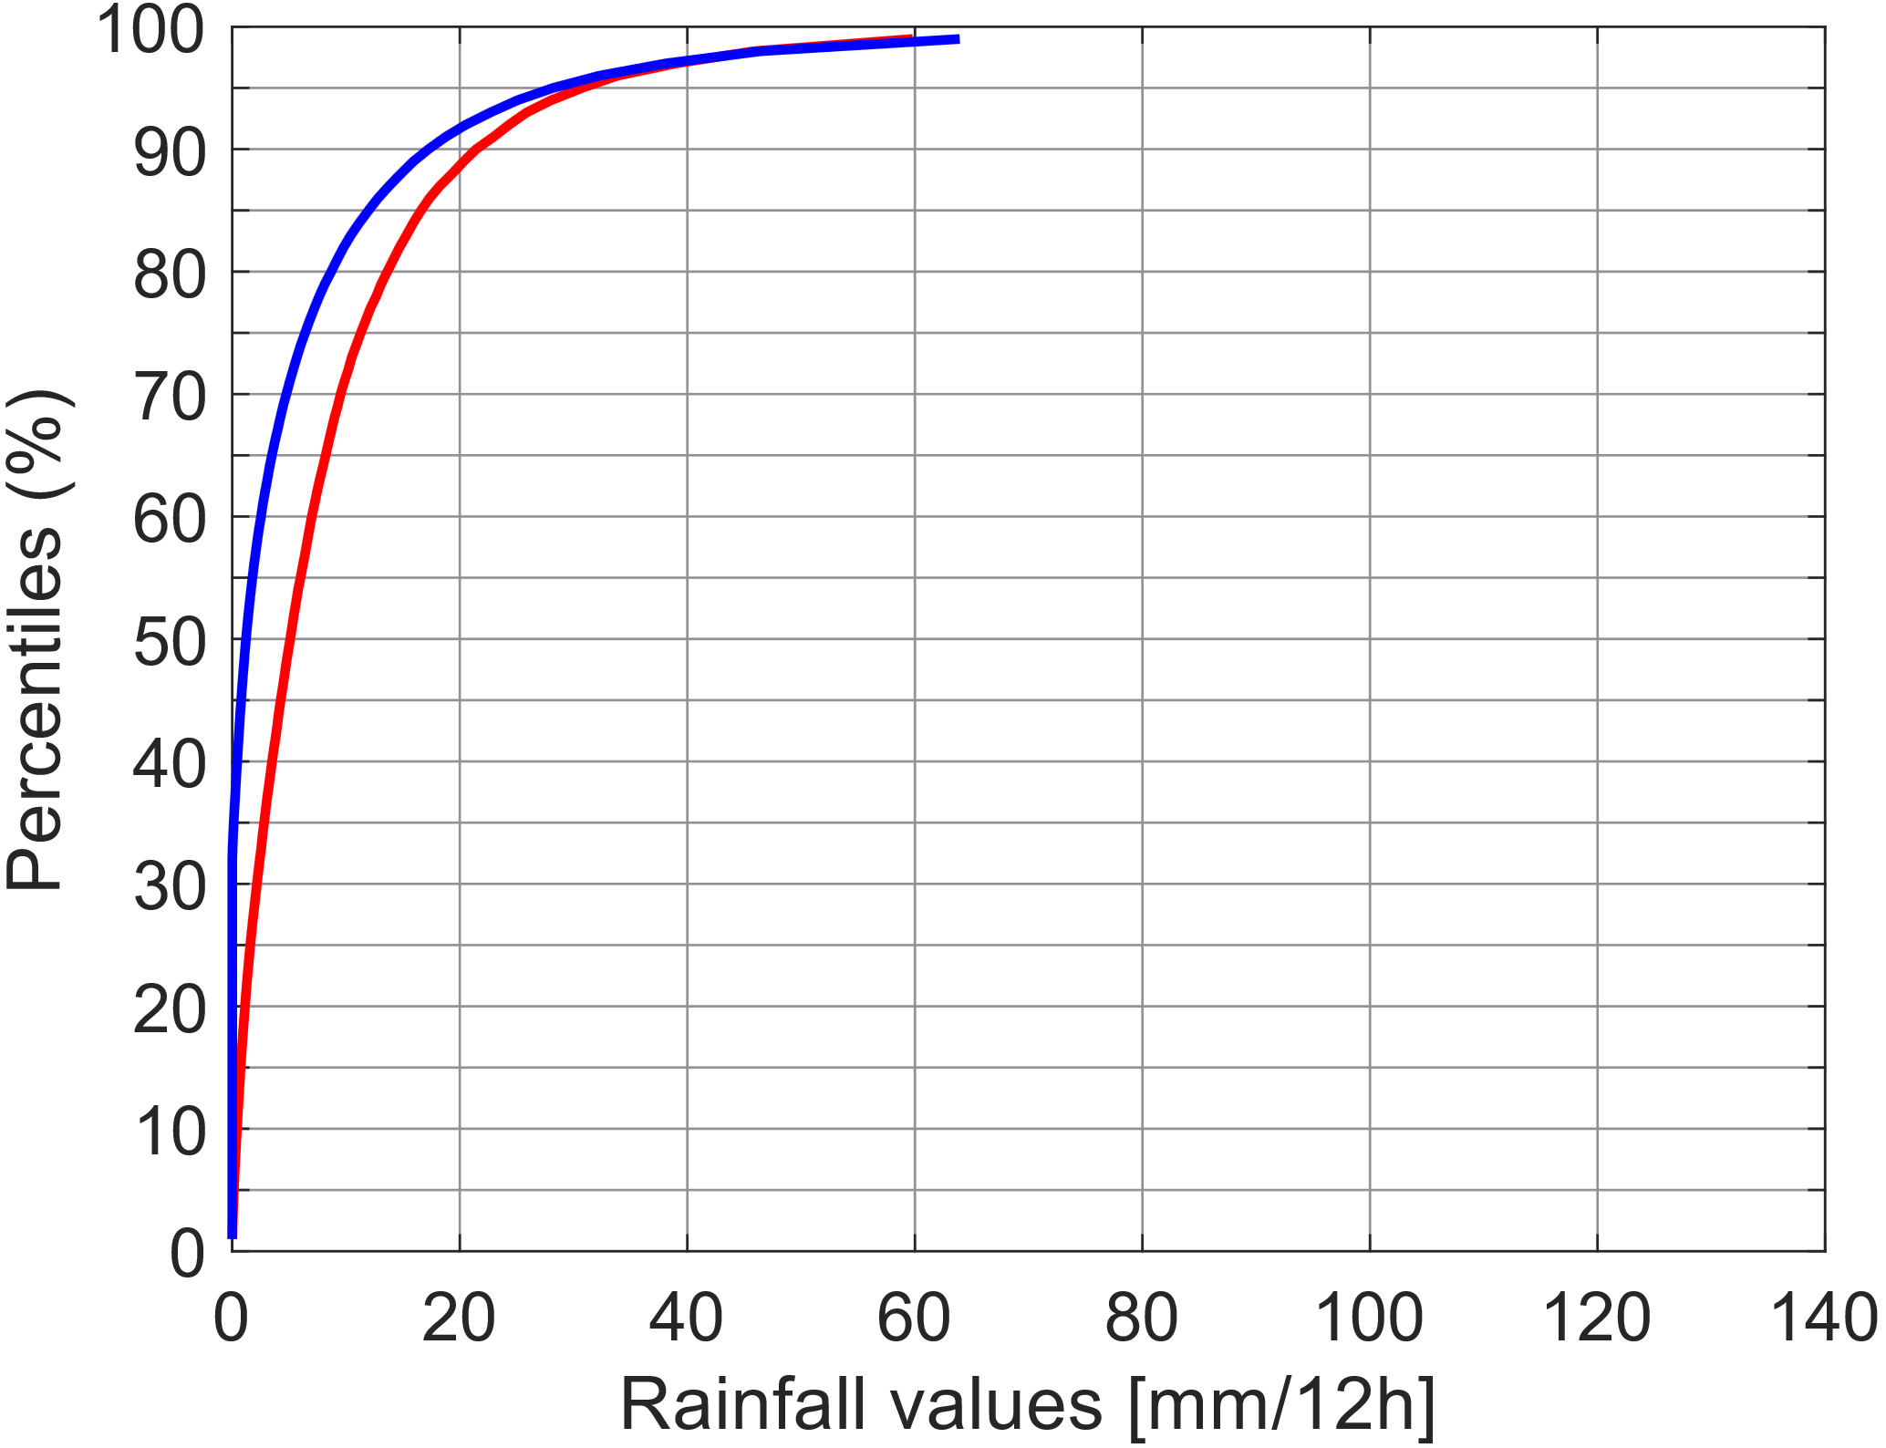
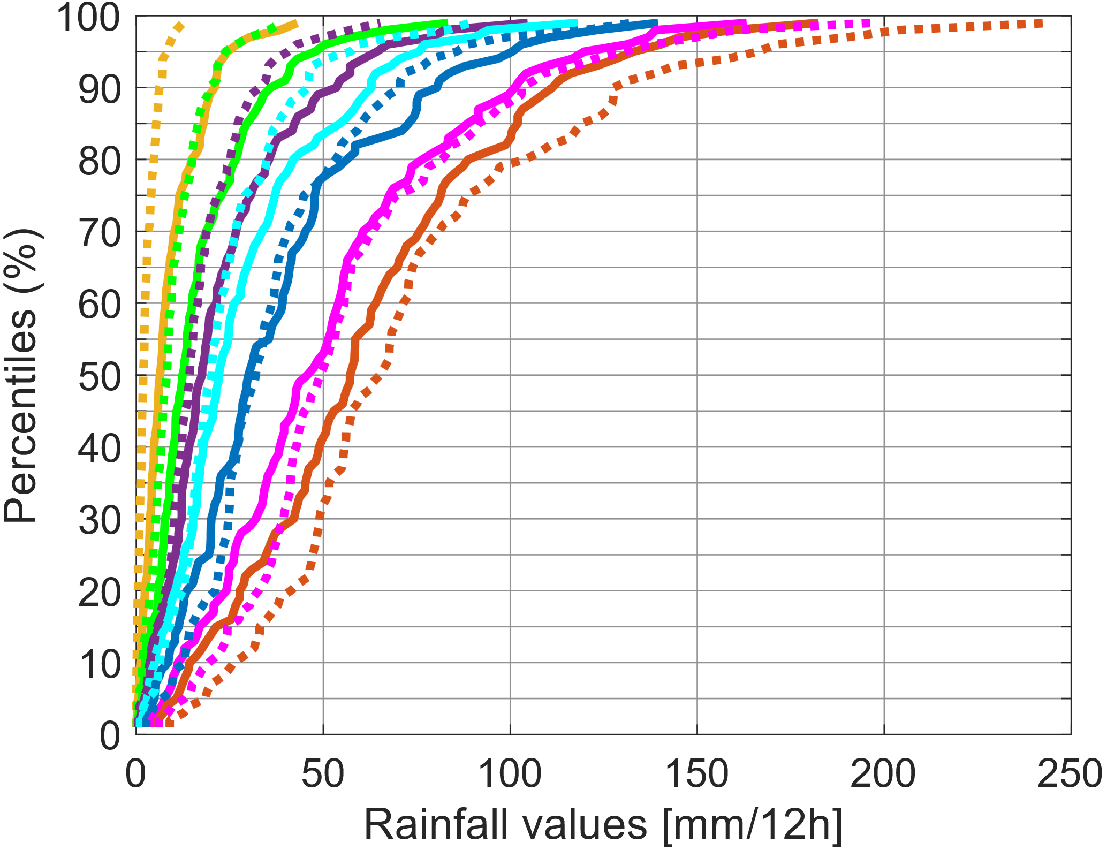
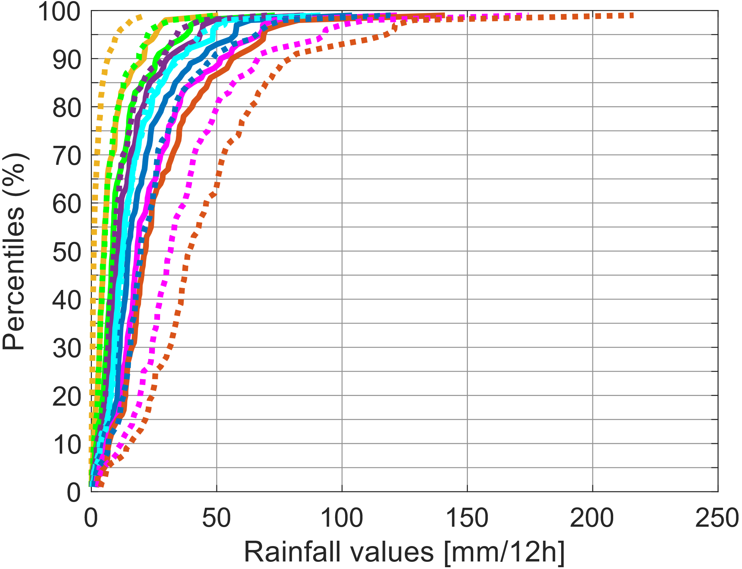
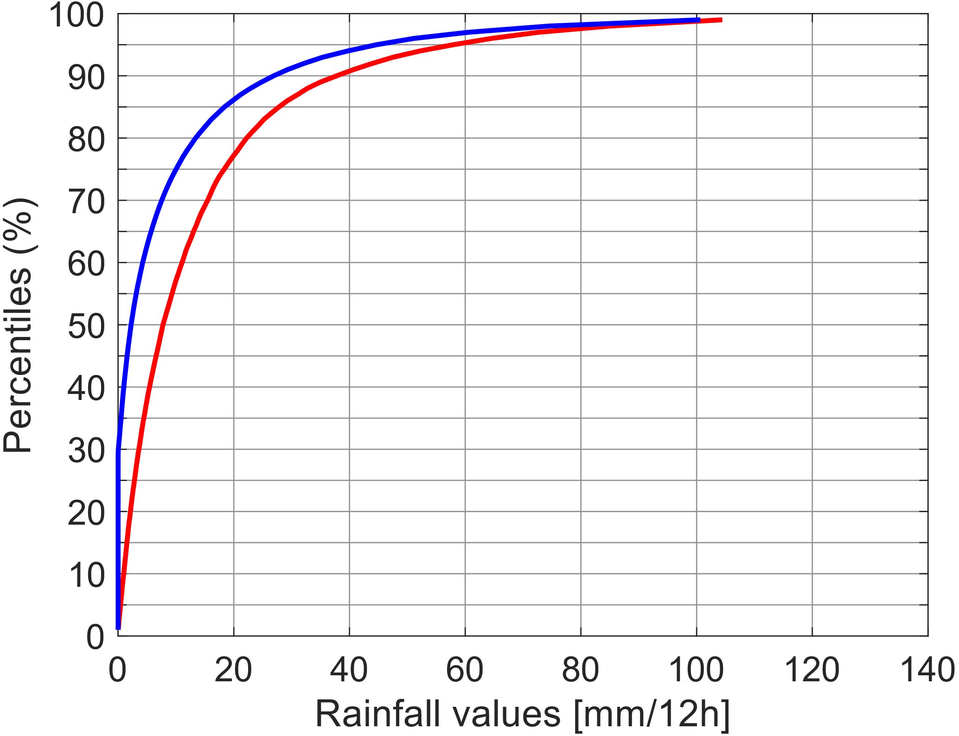
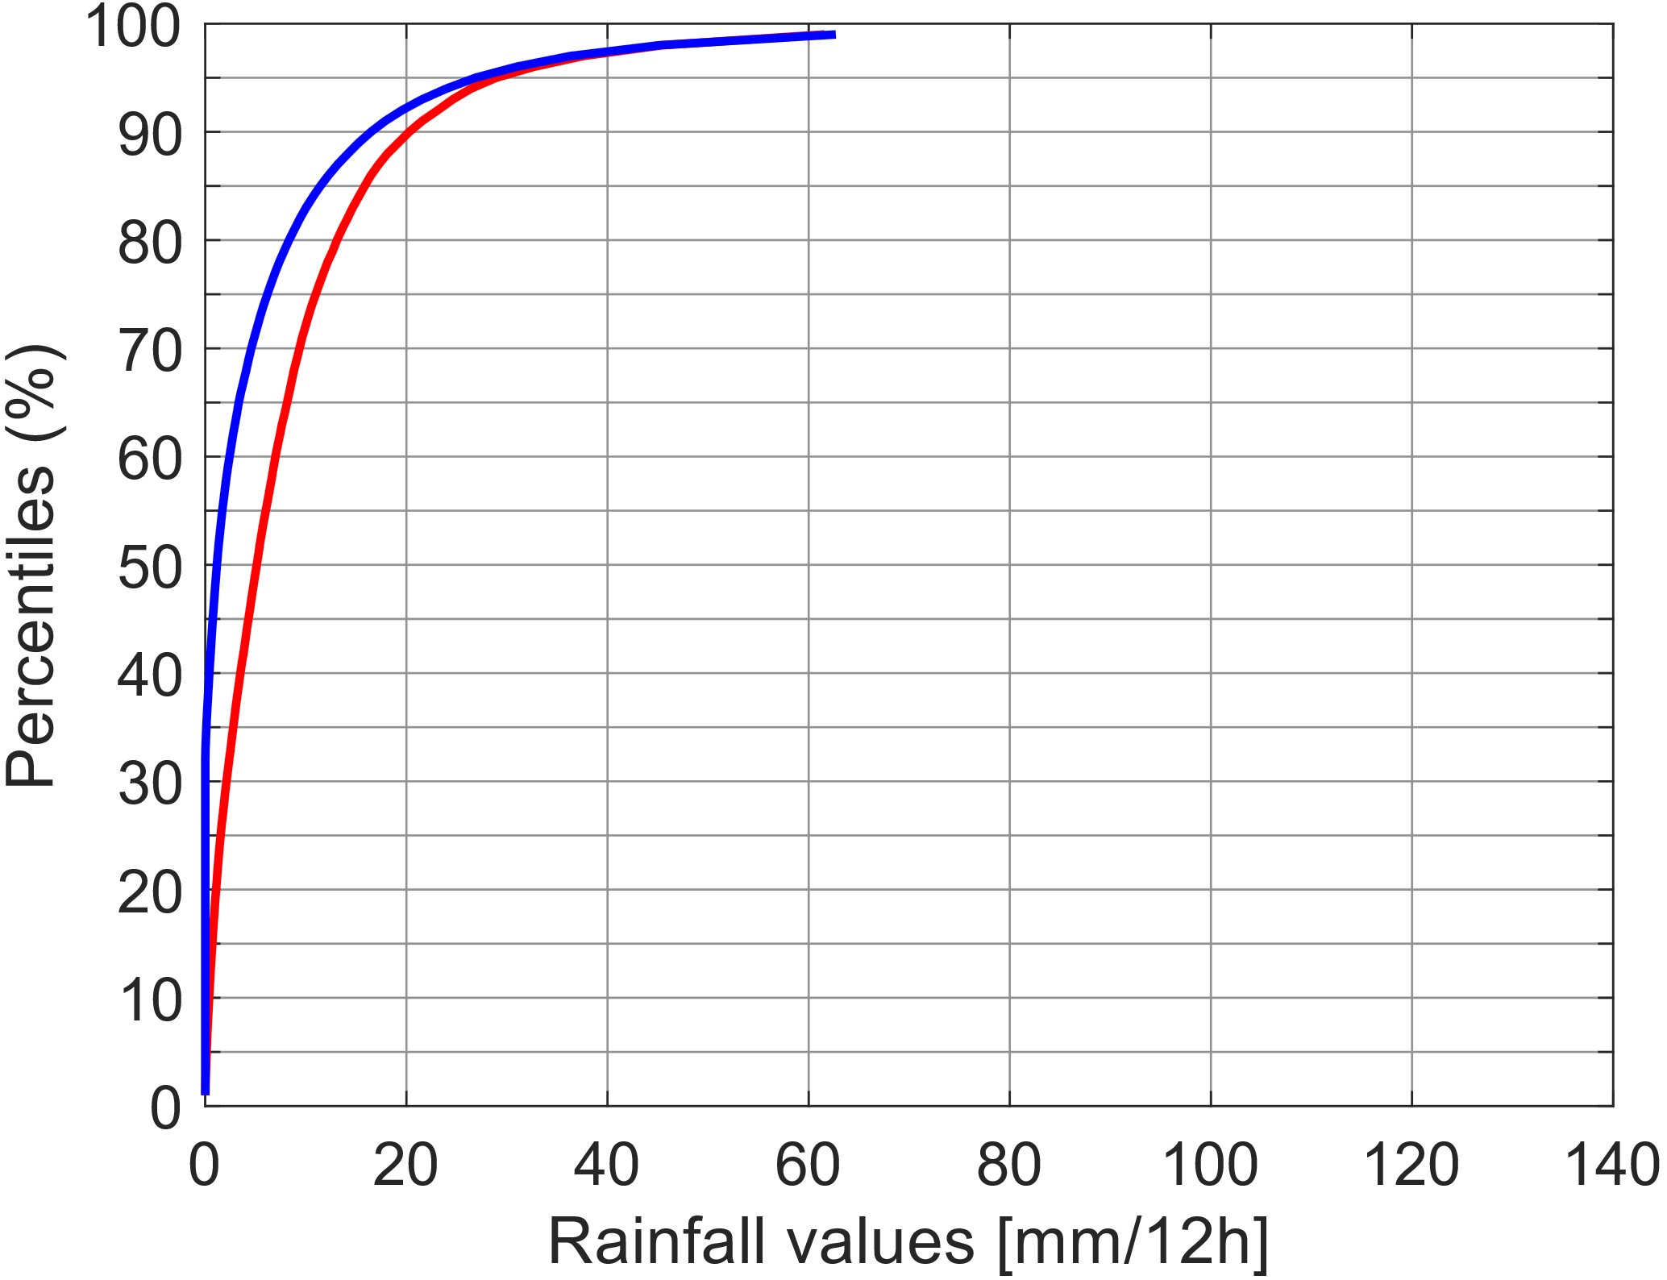
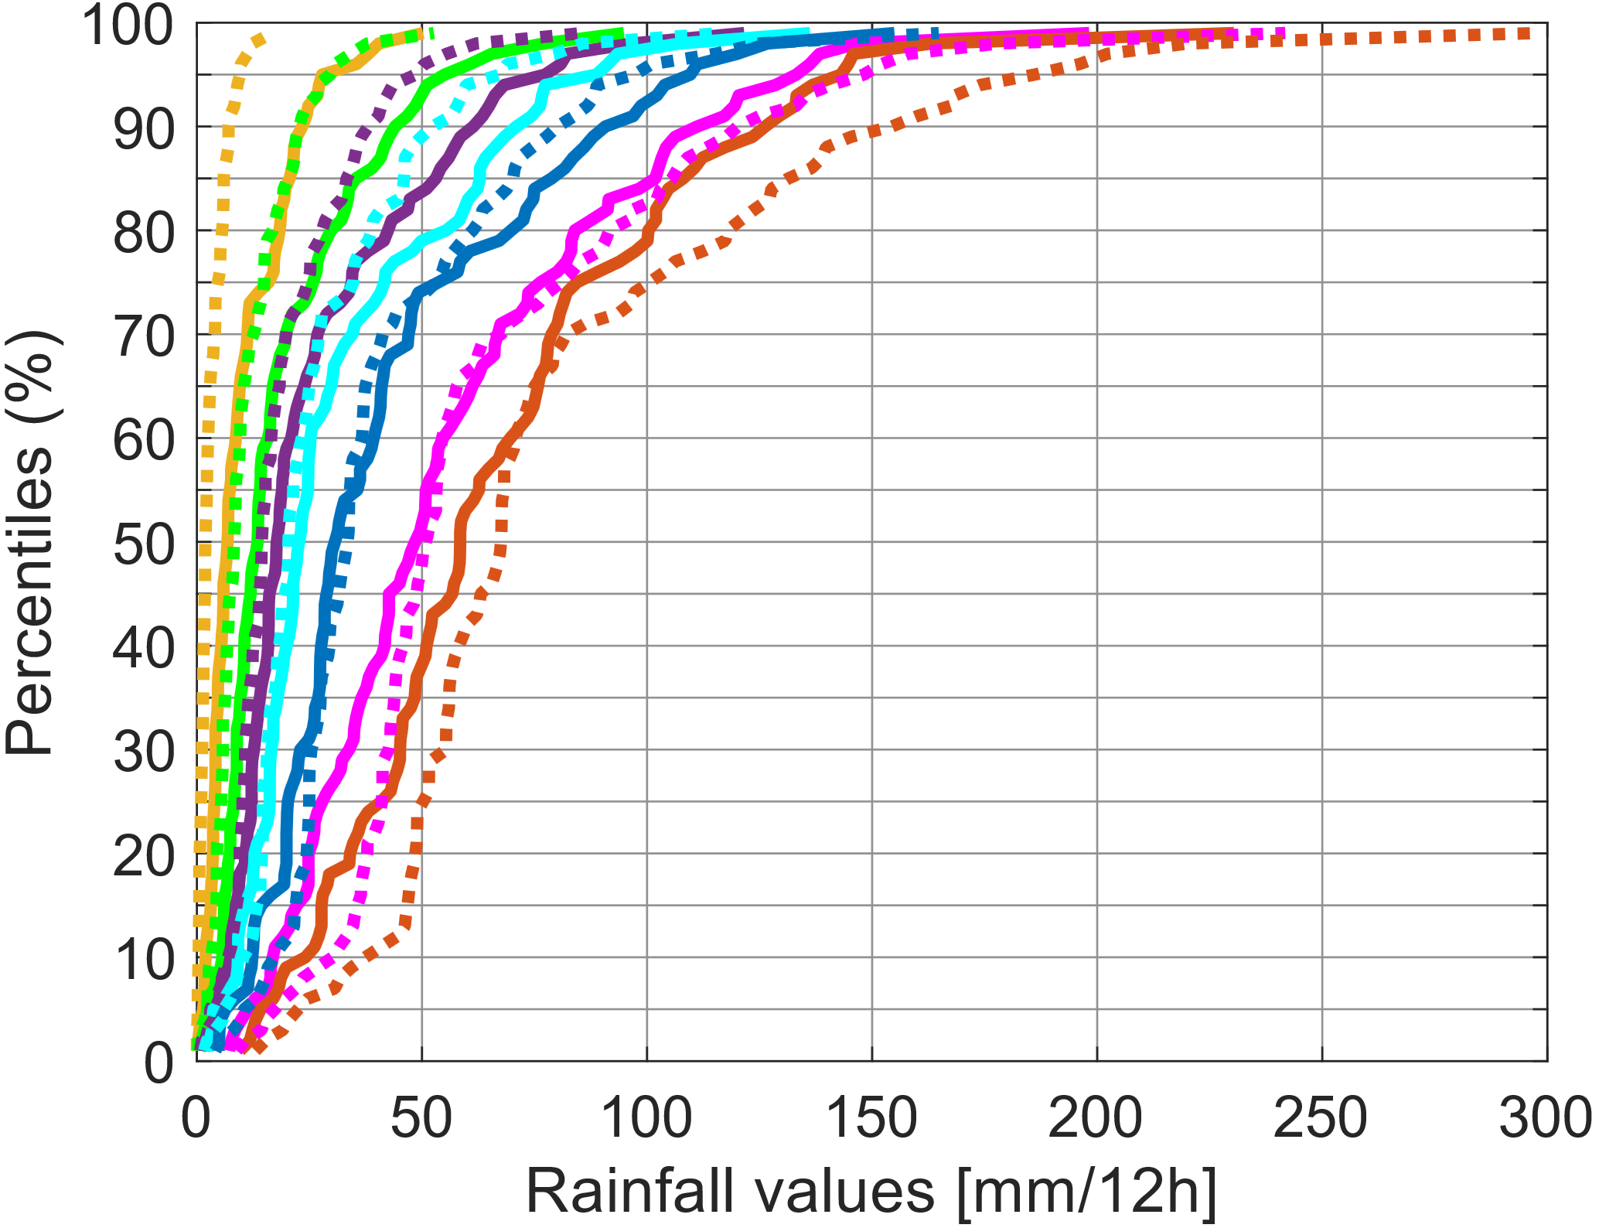
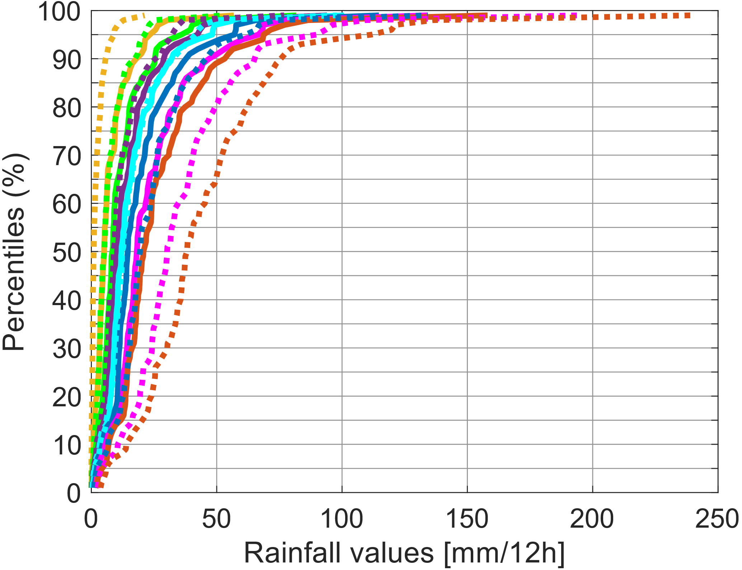
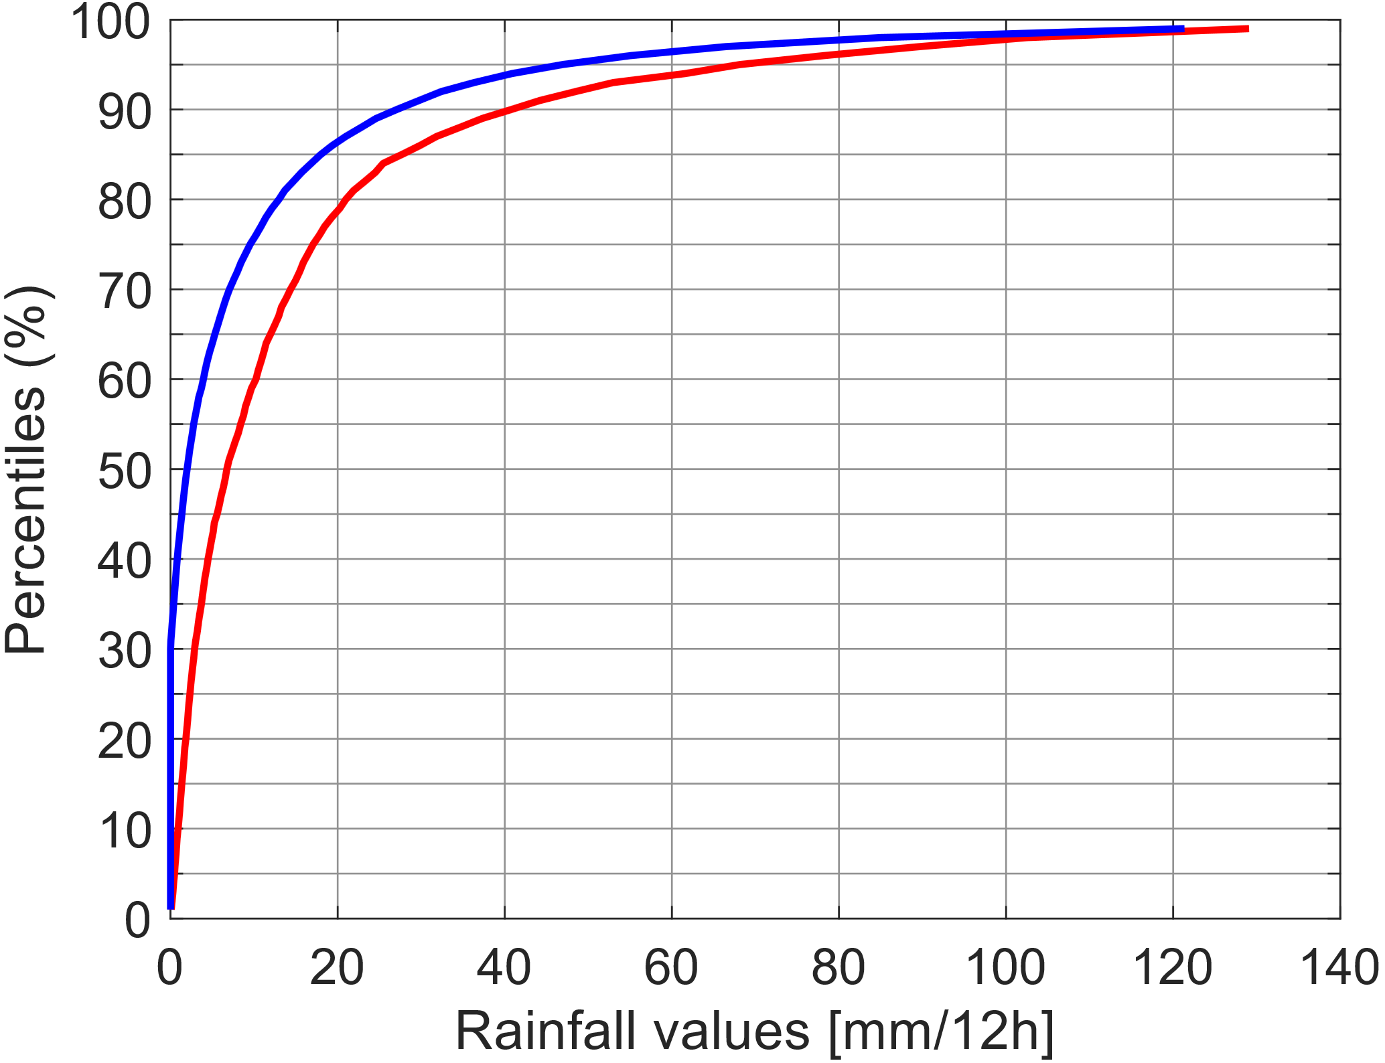
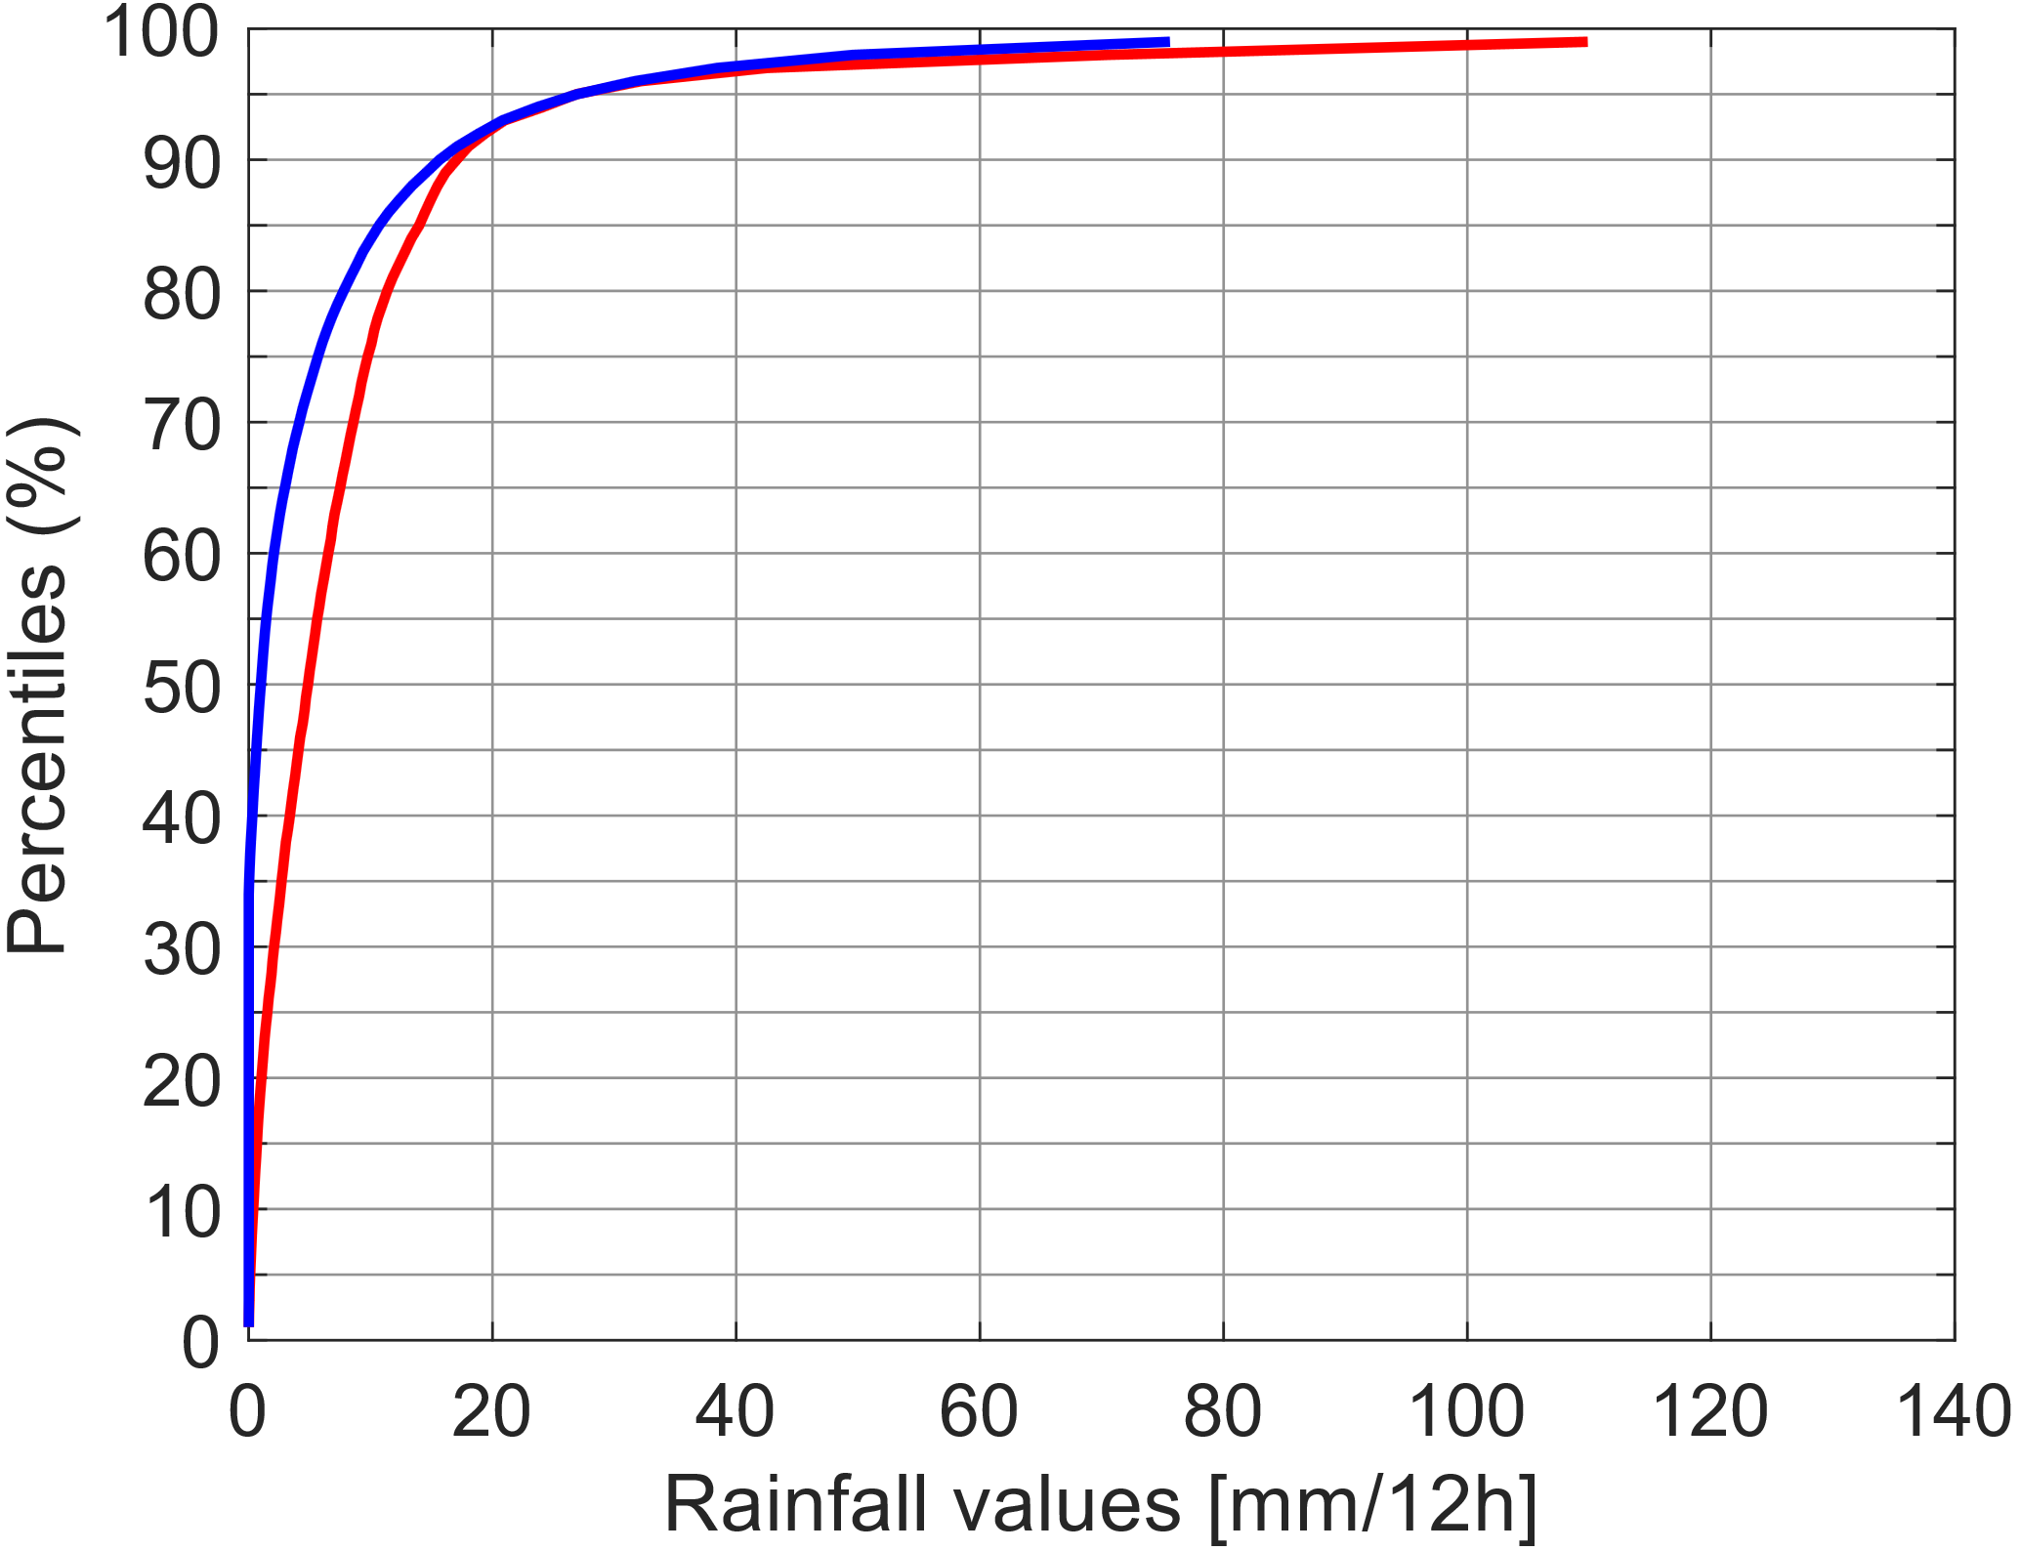
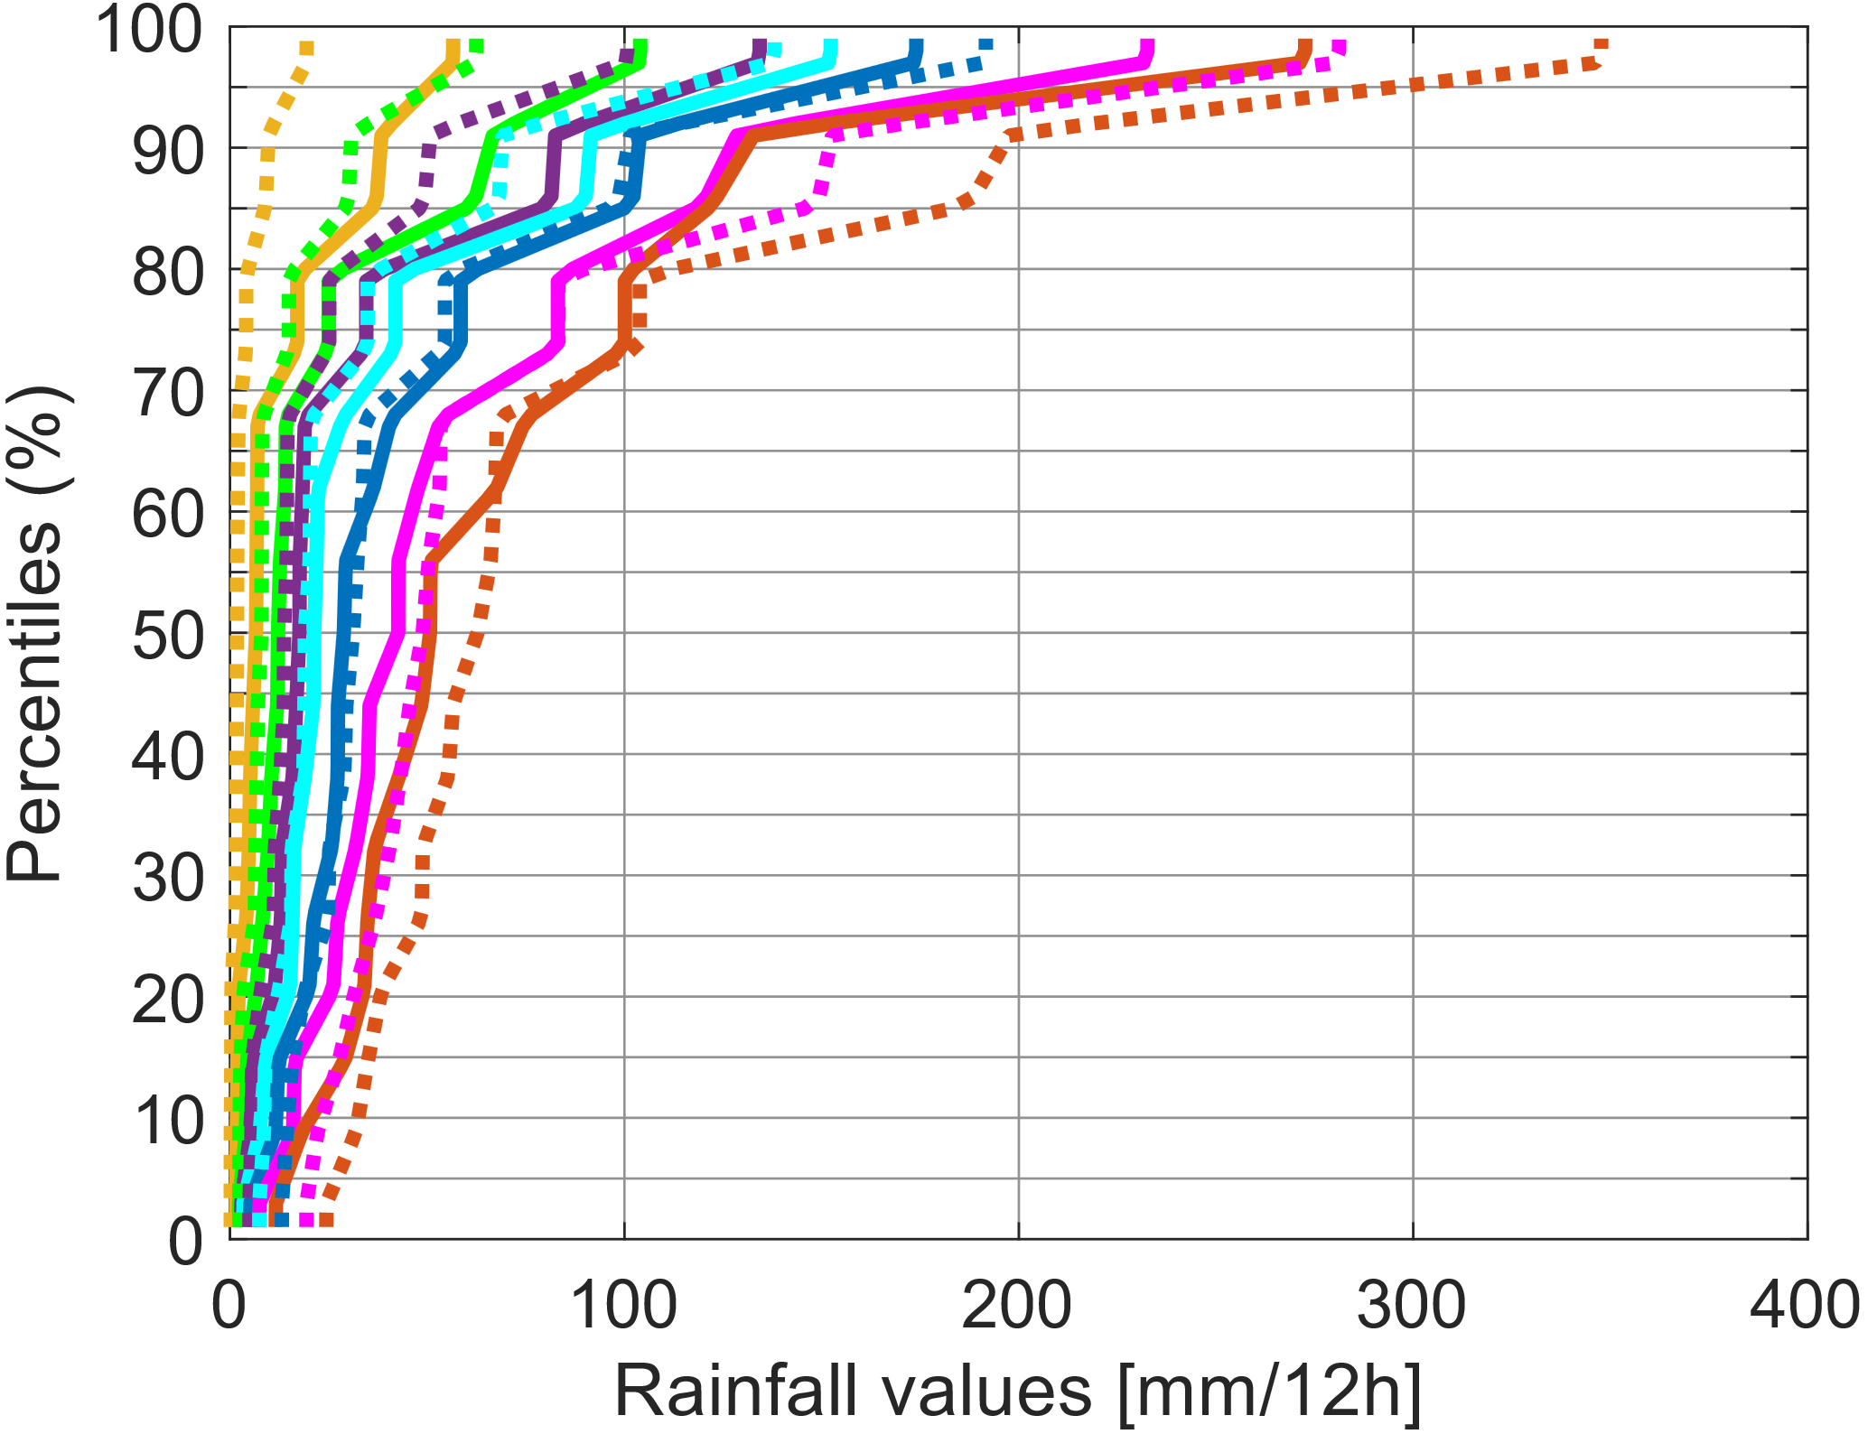
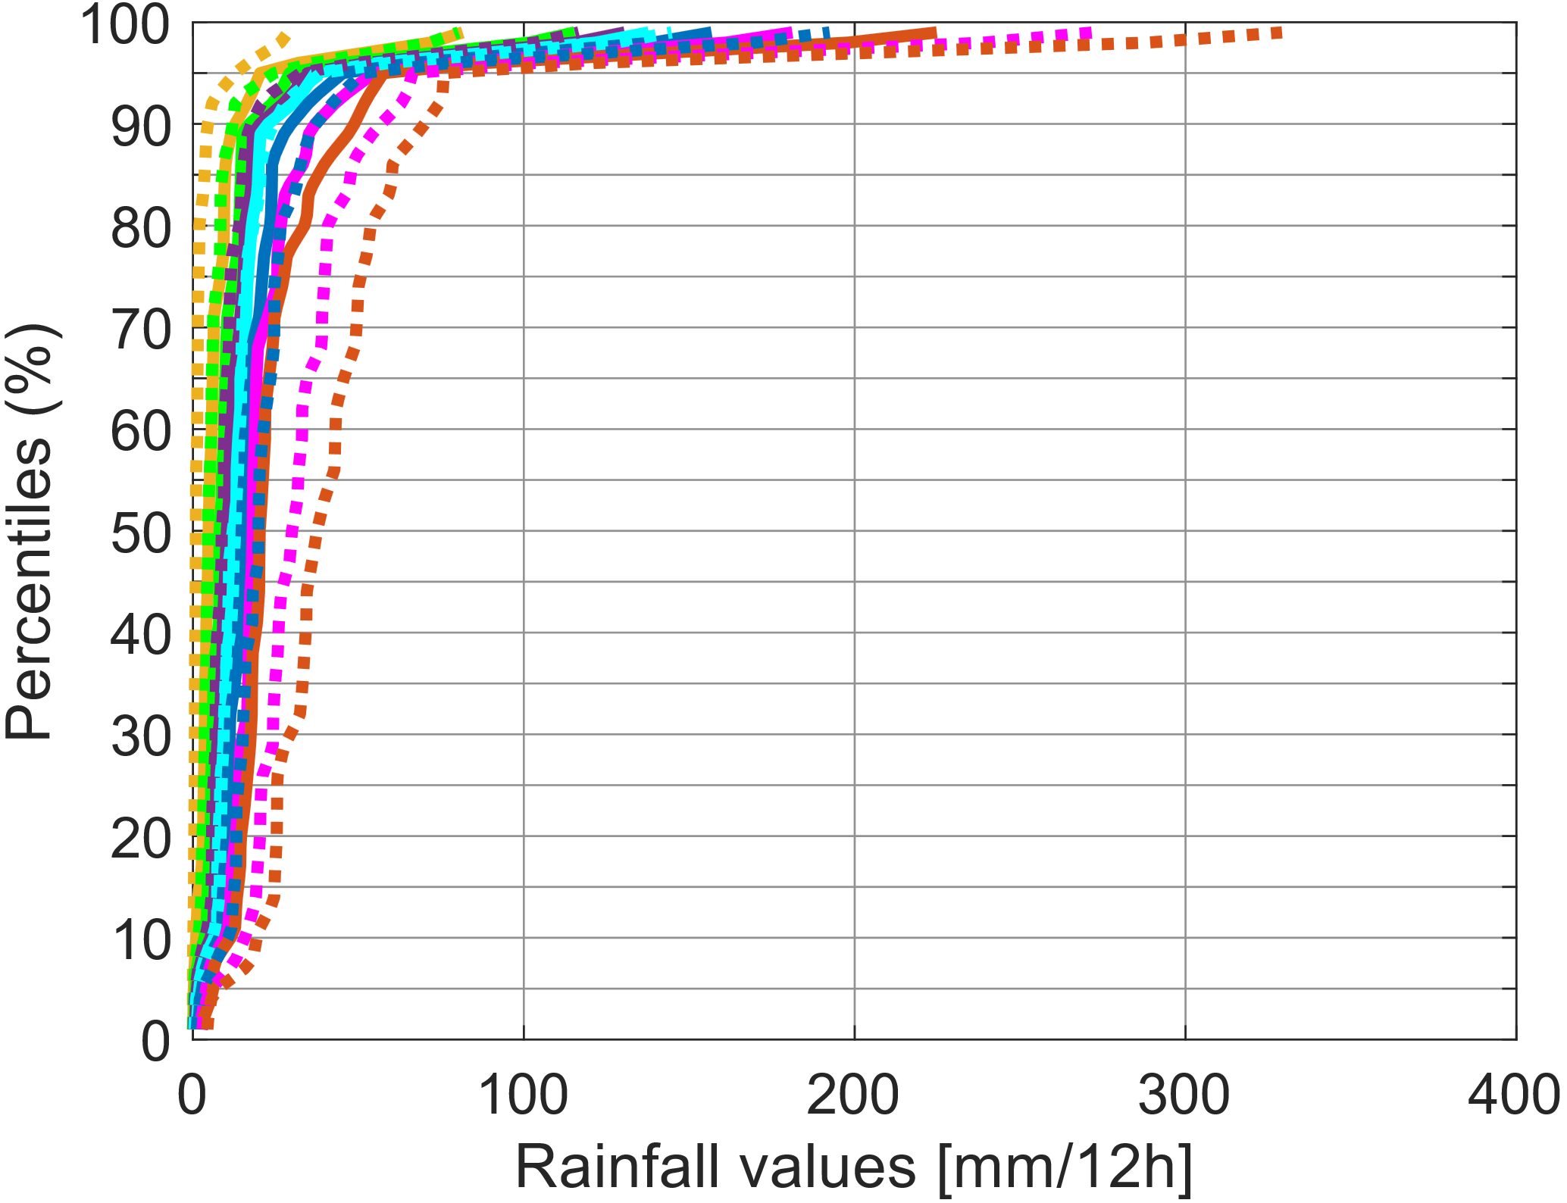
Distribution of rainfall values
associated with flood reports in 2019
La Costa
La Sierra
EFFCI >= 1
All rainfall values
ENS
Percentiles (%)
ecPoint
ENS
ecPoint
Only extreme rainfall values
(>= Xth percentile)
>=50th percentile
Percentiles (%)
>=75th percentile
>= 85th percentile
>= 90th percentile
>= 95th percentile
>= 98th percentile
>= 99th percentile
Rainfall values (mm/12h)
Rainfall values (mm/12h)
EFFCI >= 6
All rainfall values
ENS
Percentiles (%)
ecPoint
ENS
ecPoint
Only extreme rainfall values
(>= Xth percentile)
>=50th percentile
>=75th percentile
Percentiles (%)
>= 85th percentile
>= 90th percentile
>= 95th percentile
>= 98th percentile
>= 99th percentile
Rainfall values (mm/12h)
Rainfall values (mm/12h)
EFFCI >= 10
Percentiles (%)
ENS
All rainfall values
ecPoint
ENS
ecPoint
>=50th percentile
>=75th percentile
Only extreme rainfall values
(>= Xth percentile)
>= 85th percentile
Percentiles (%)
>= 90th percentile
>= 95th percentile
>= 98th percentile
>= 99th percentile
Rainfall values (mm/12h)
Rainfall values (mm/12h)

