Slide 1
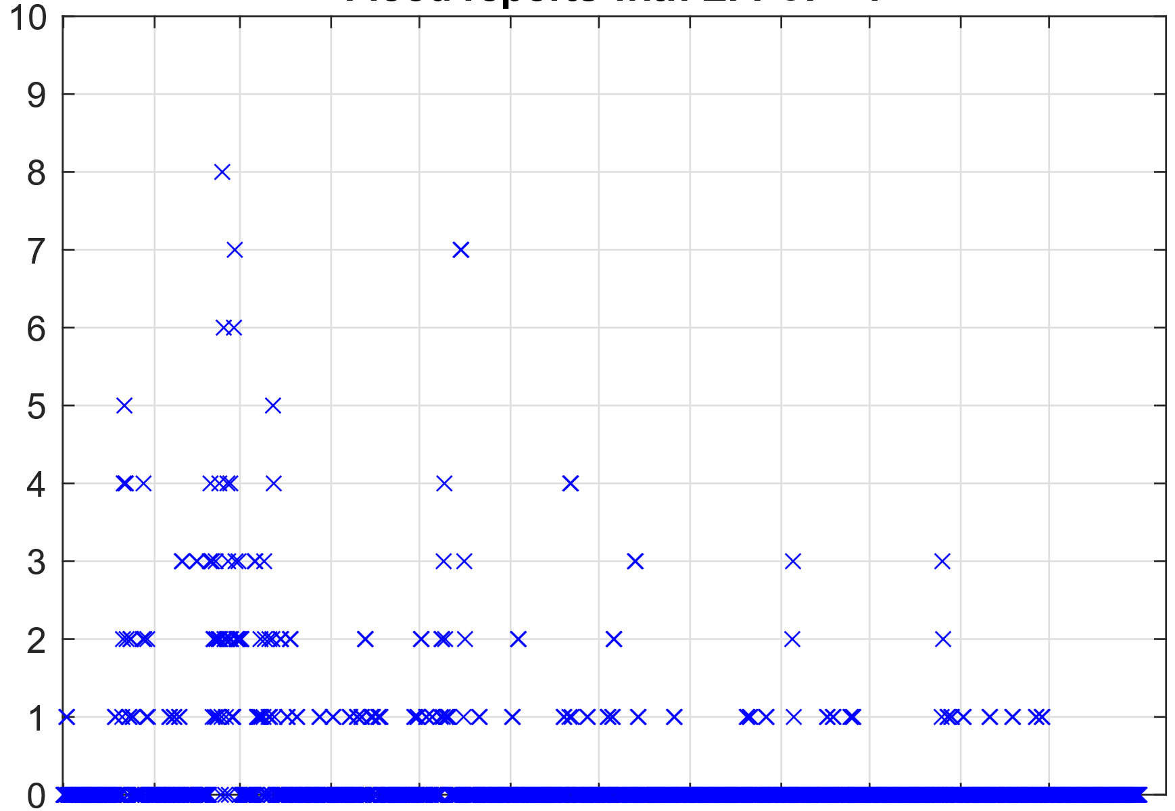
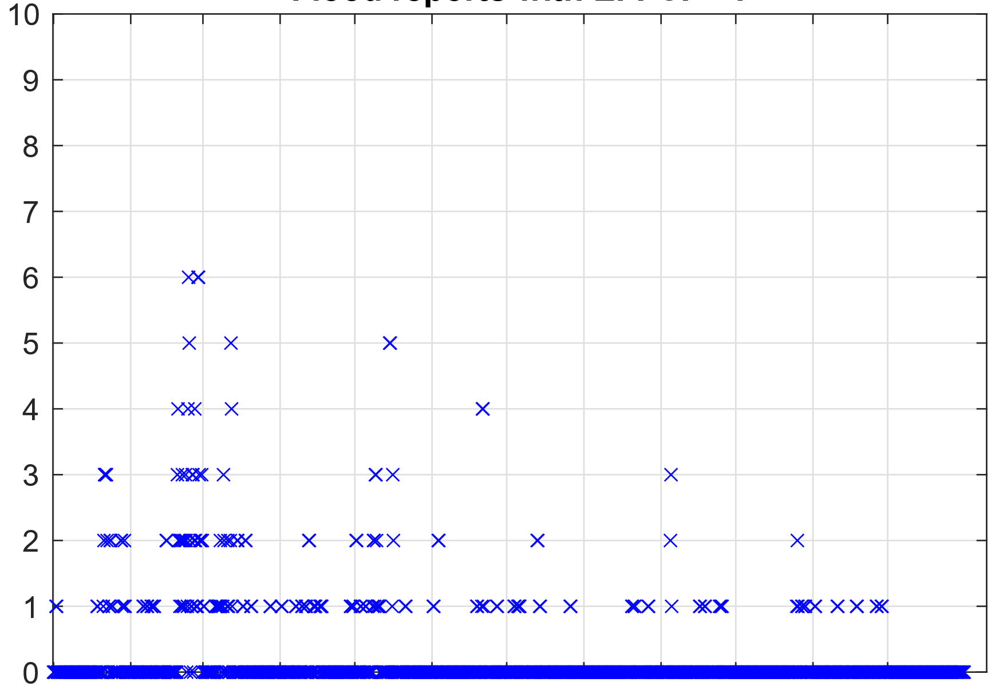
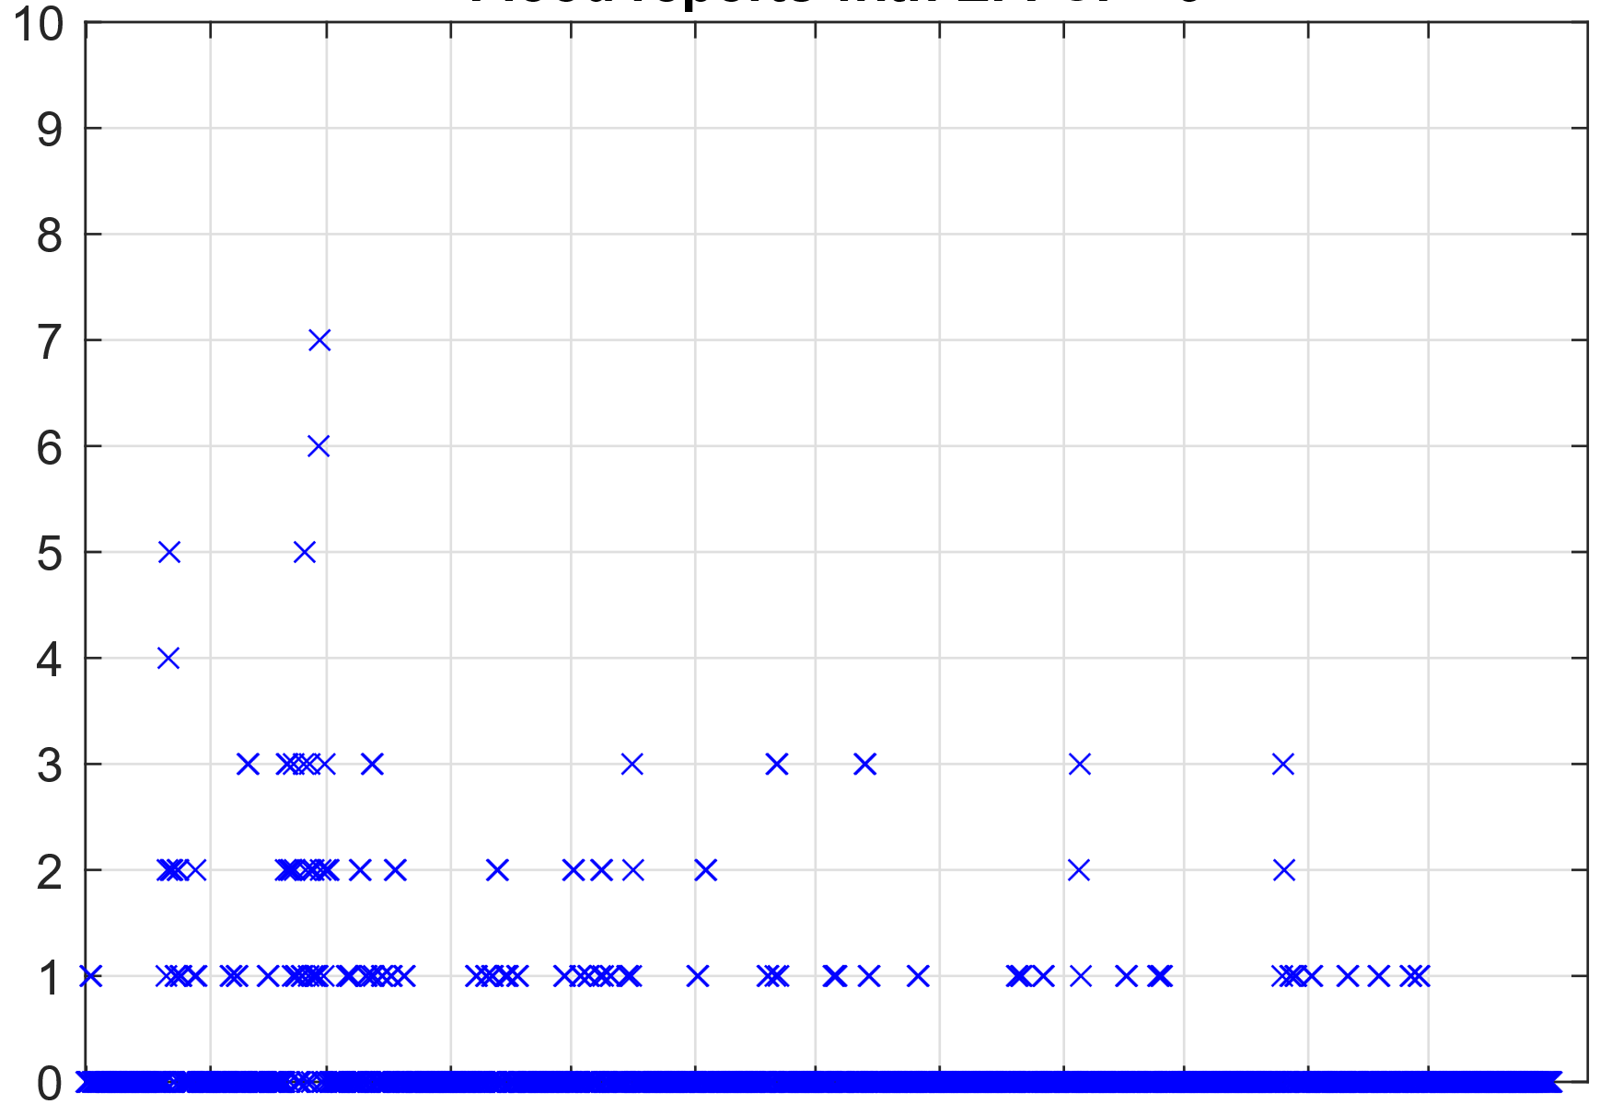
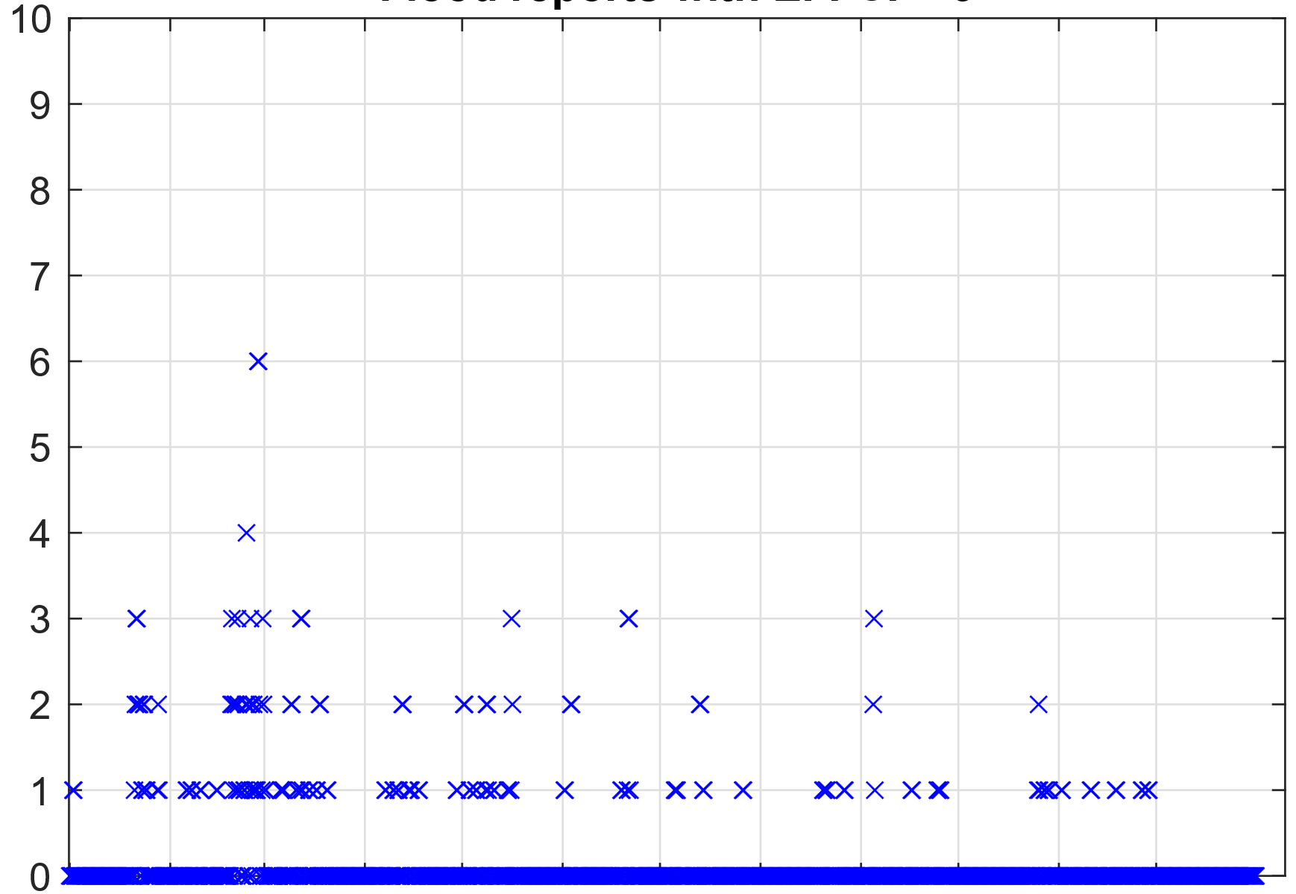
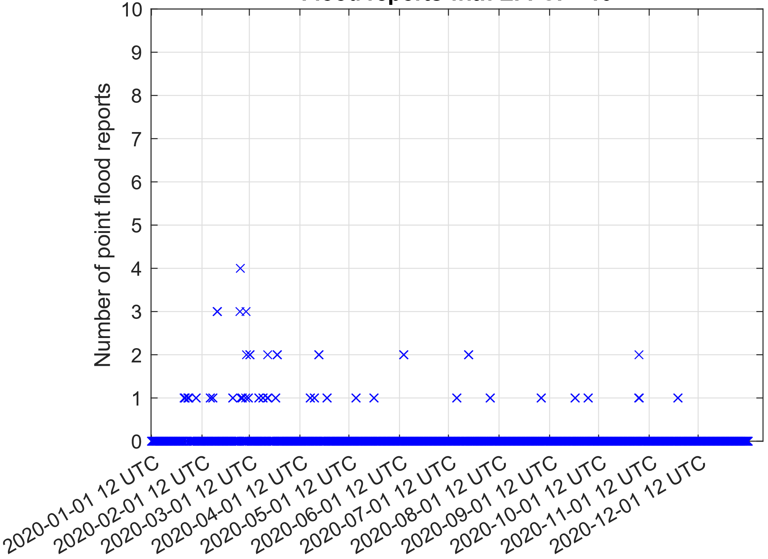
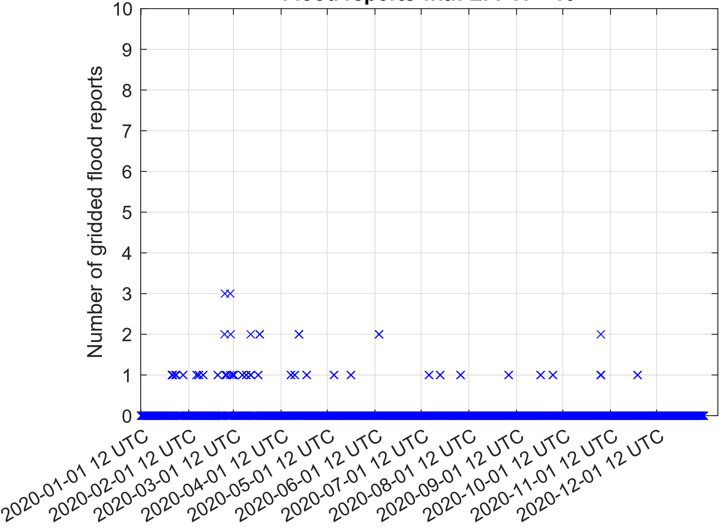
Point flood reports
Gridded flood reports
EFFCI >= 1
Number of reports
EFFCI >= 6
Number of reports
EFFCI >= 10
Number of reports
End of 12-hourly accumulation periods
End of 12-hourly accumulation periods

