Slide 1
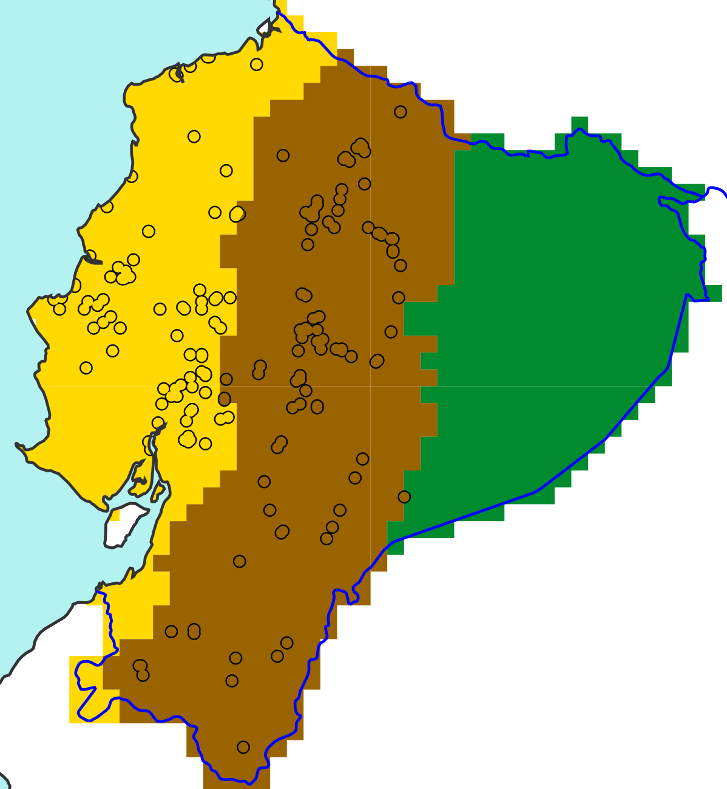
b
x^{th}
a
Percentiles [-]
c
Distribution of the N ecPoint-Rainfall tp(x^{th}) values
tp(x^{th})
x^{th}
Percentiles [-]
N distributions of 396 ecPoint-Rainfall values
Percentiles [-]
75% of flood reports retained
tp(x^{th})
25th
……....
tp(25th) = VRE
x^{th}
Rainfall [mm]
Region “La Costa”
Region “La Sierra”
Region “El Oriente”
Percentiles [-]
tp(x^{th})
N point flood reports in “La Costa”
Rainfall [mm]

