Slide 1
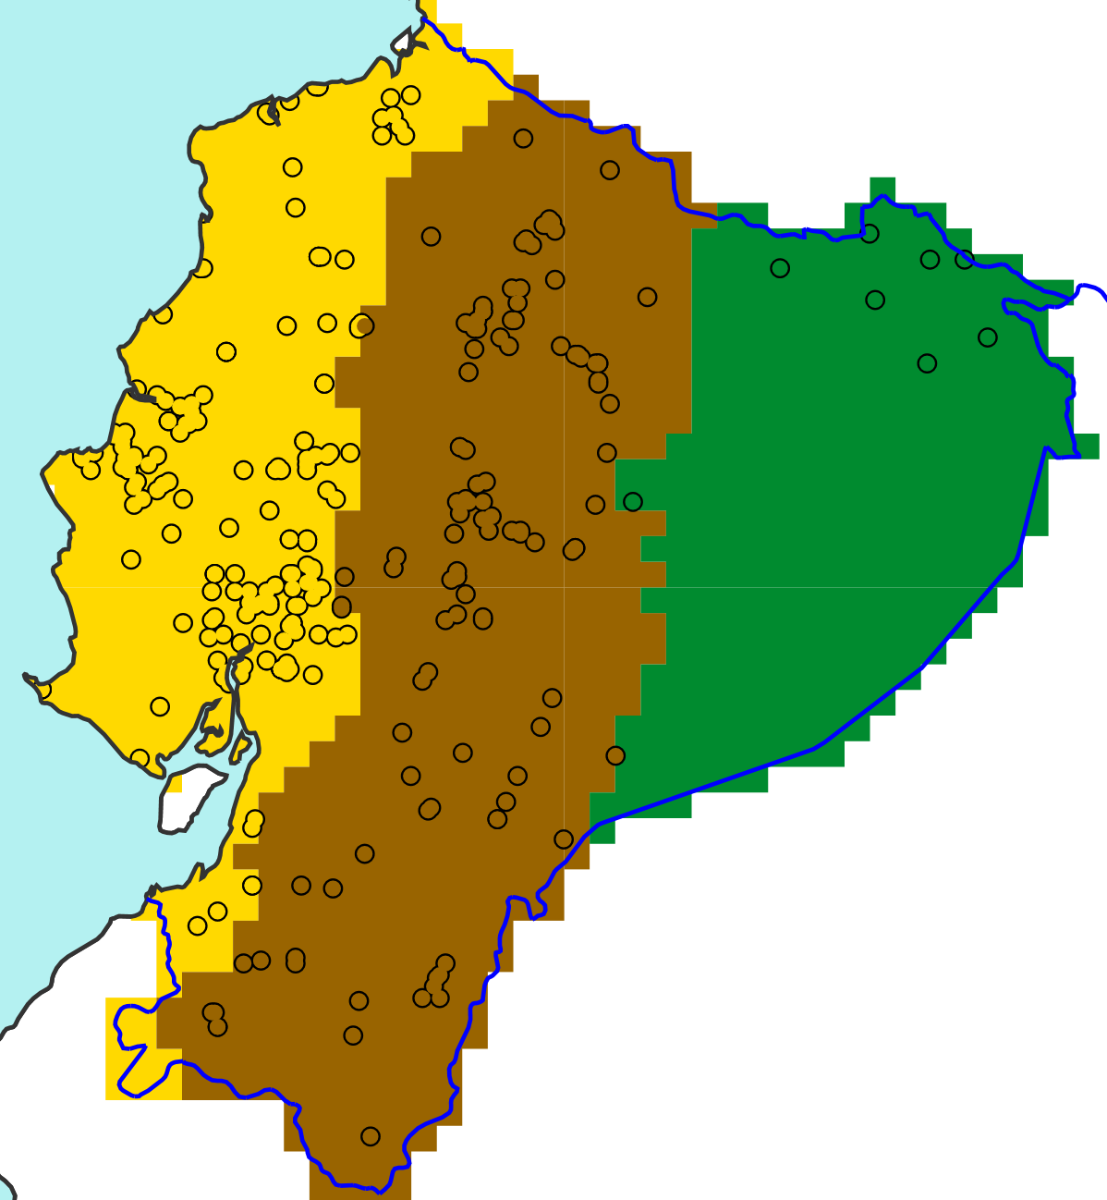
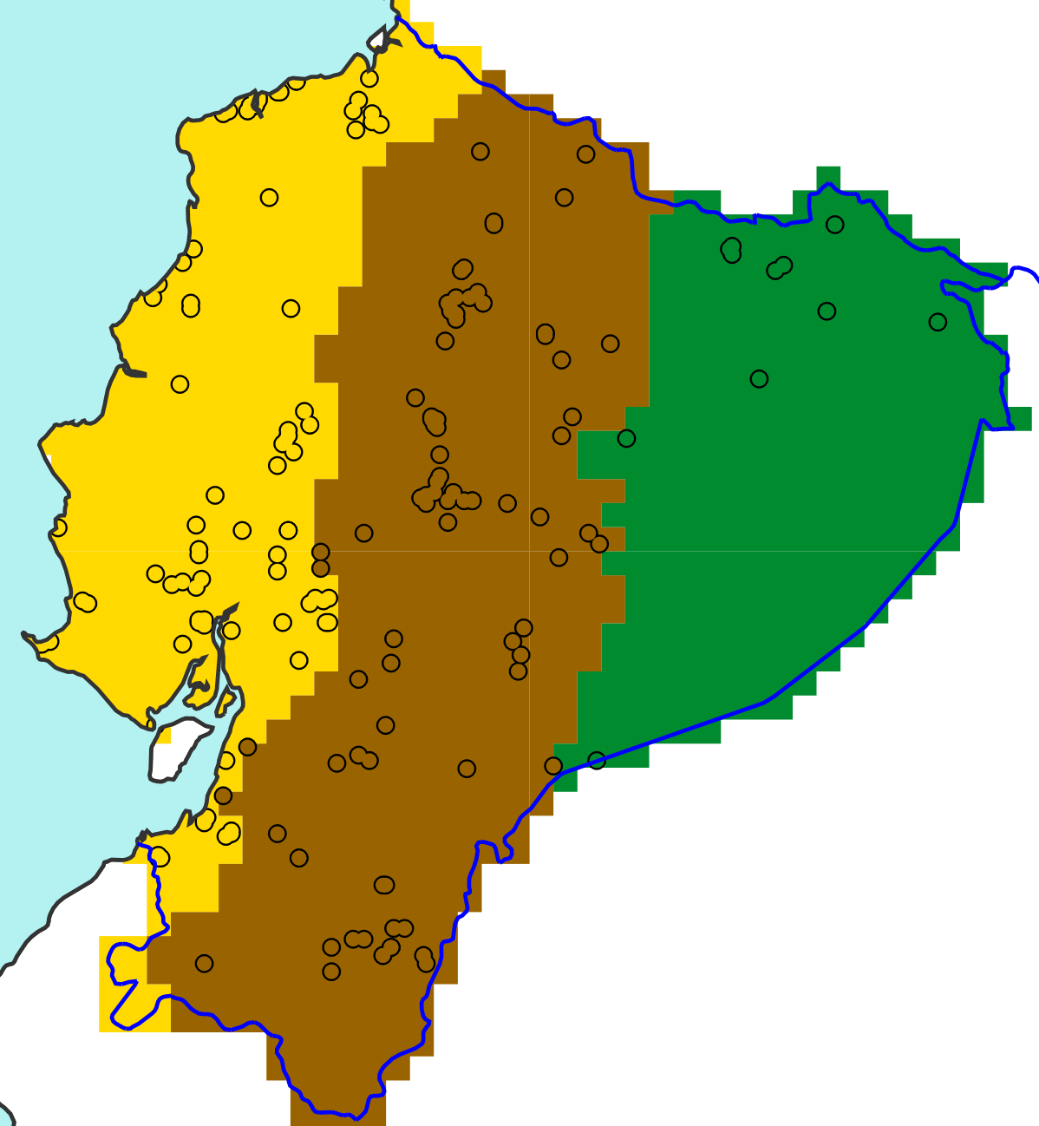
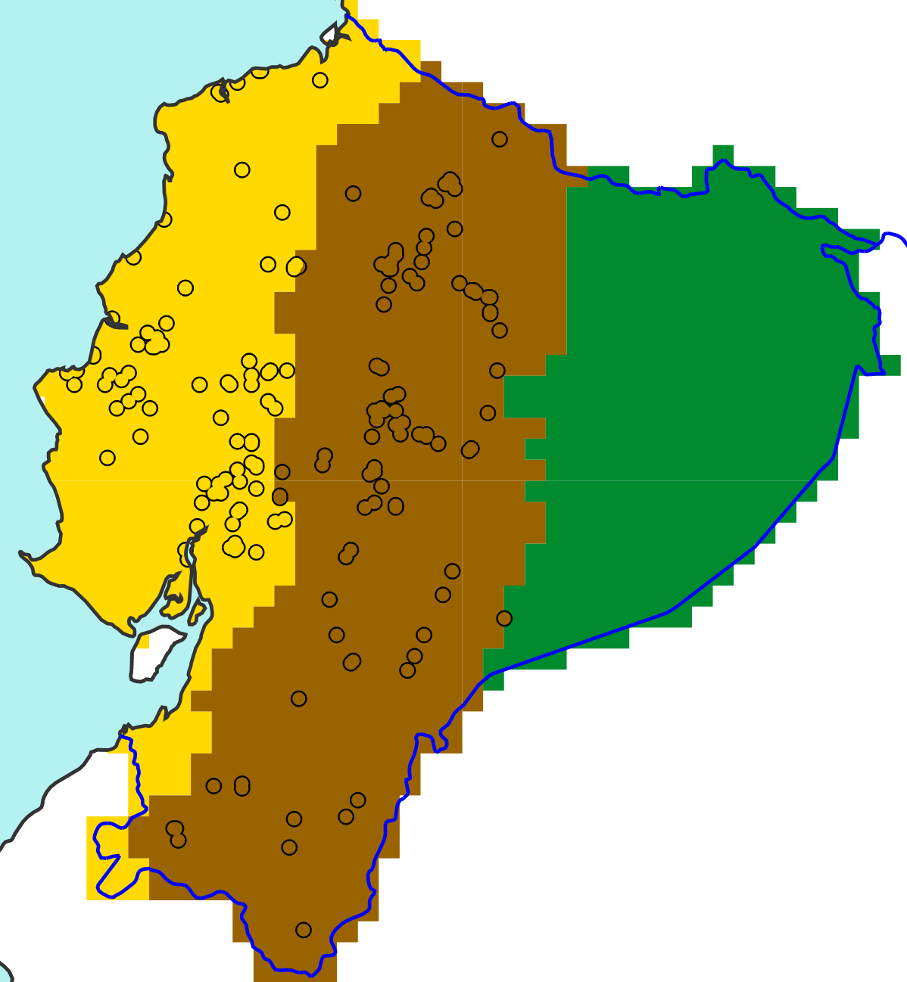

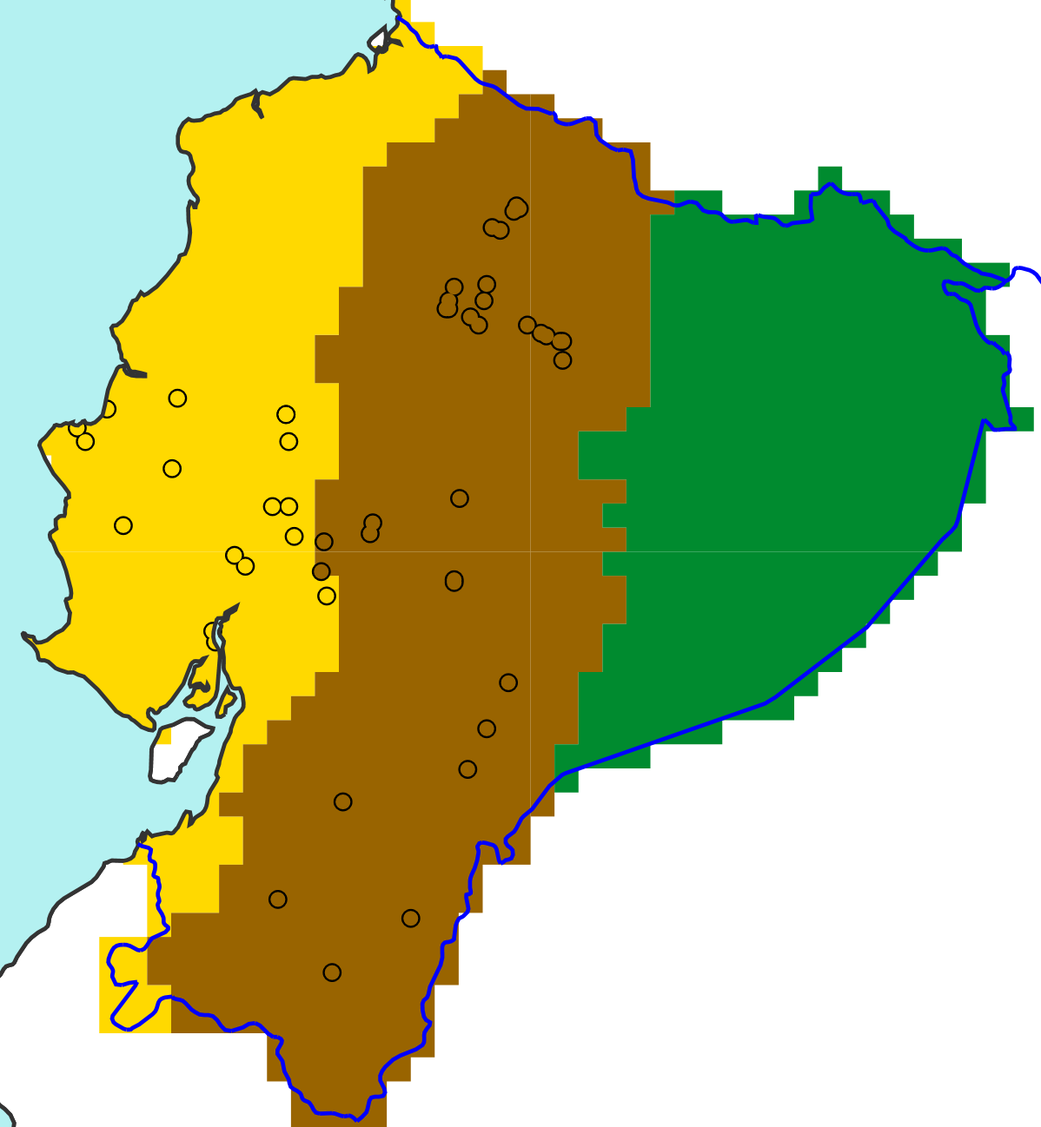
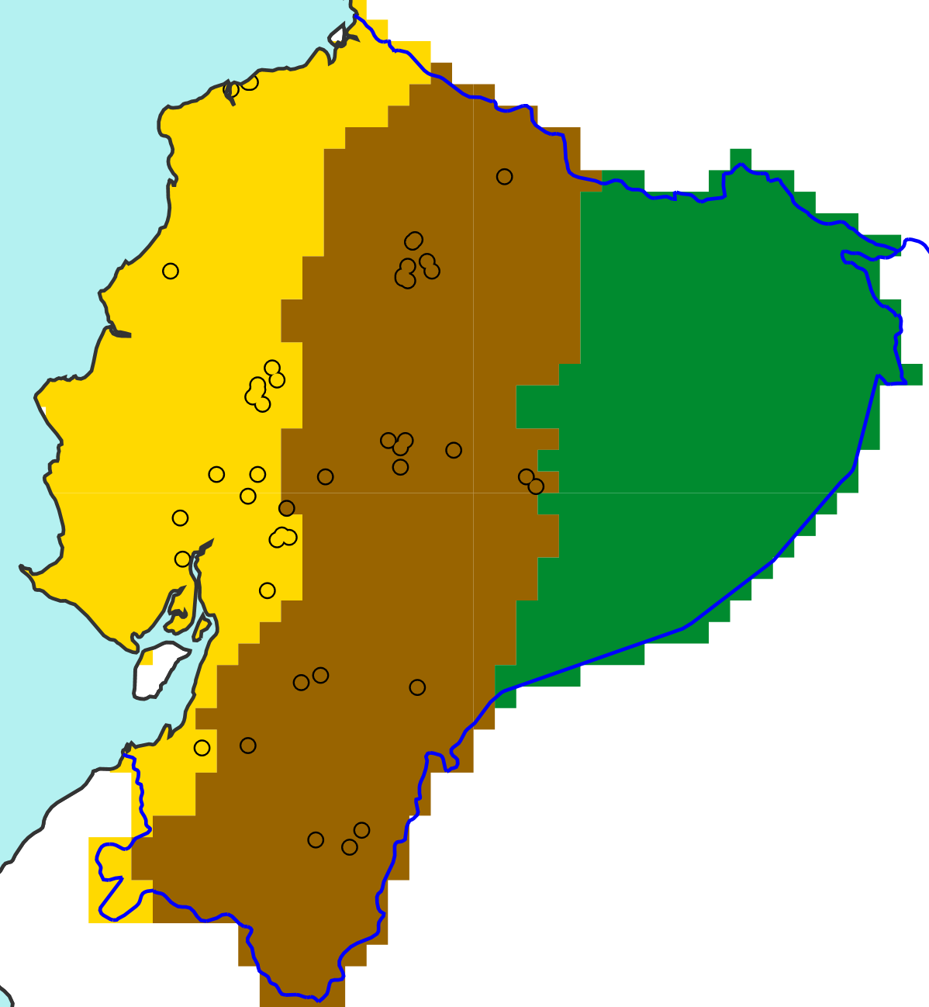
Flood reports in 2019
Flood reports in 2020
a
d
Colombia
Pacific Ocean
EFFCI >=1
Peru
Region “La Costa”
Region “La Sierra”
Region “El Oriente”
b
e
EFFCI >=6
c
f
EFFCI >=10

