Slide 1
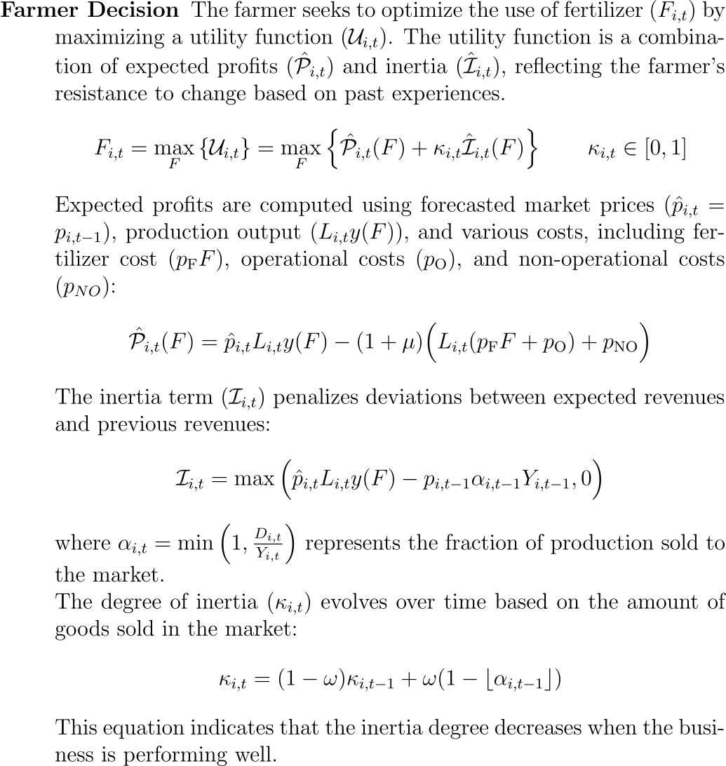
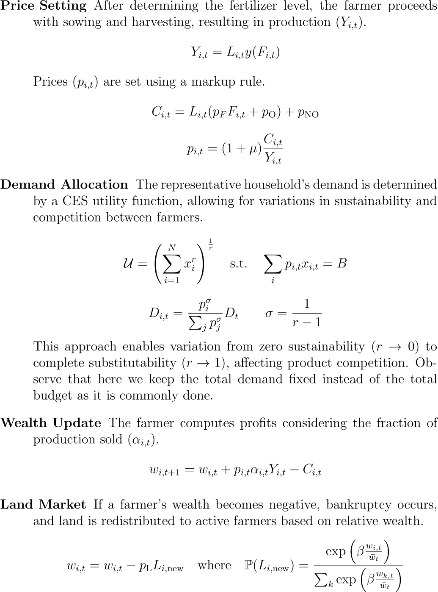

Slide 2


Limiting $κ∈[0,1]$ implies a strong tendency to overproduction (→ becuase of the production function shape)
Would you allow for $κ>1$?
What about using the above updating rule with a quadratic intertia?

Slide 3
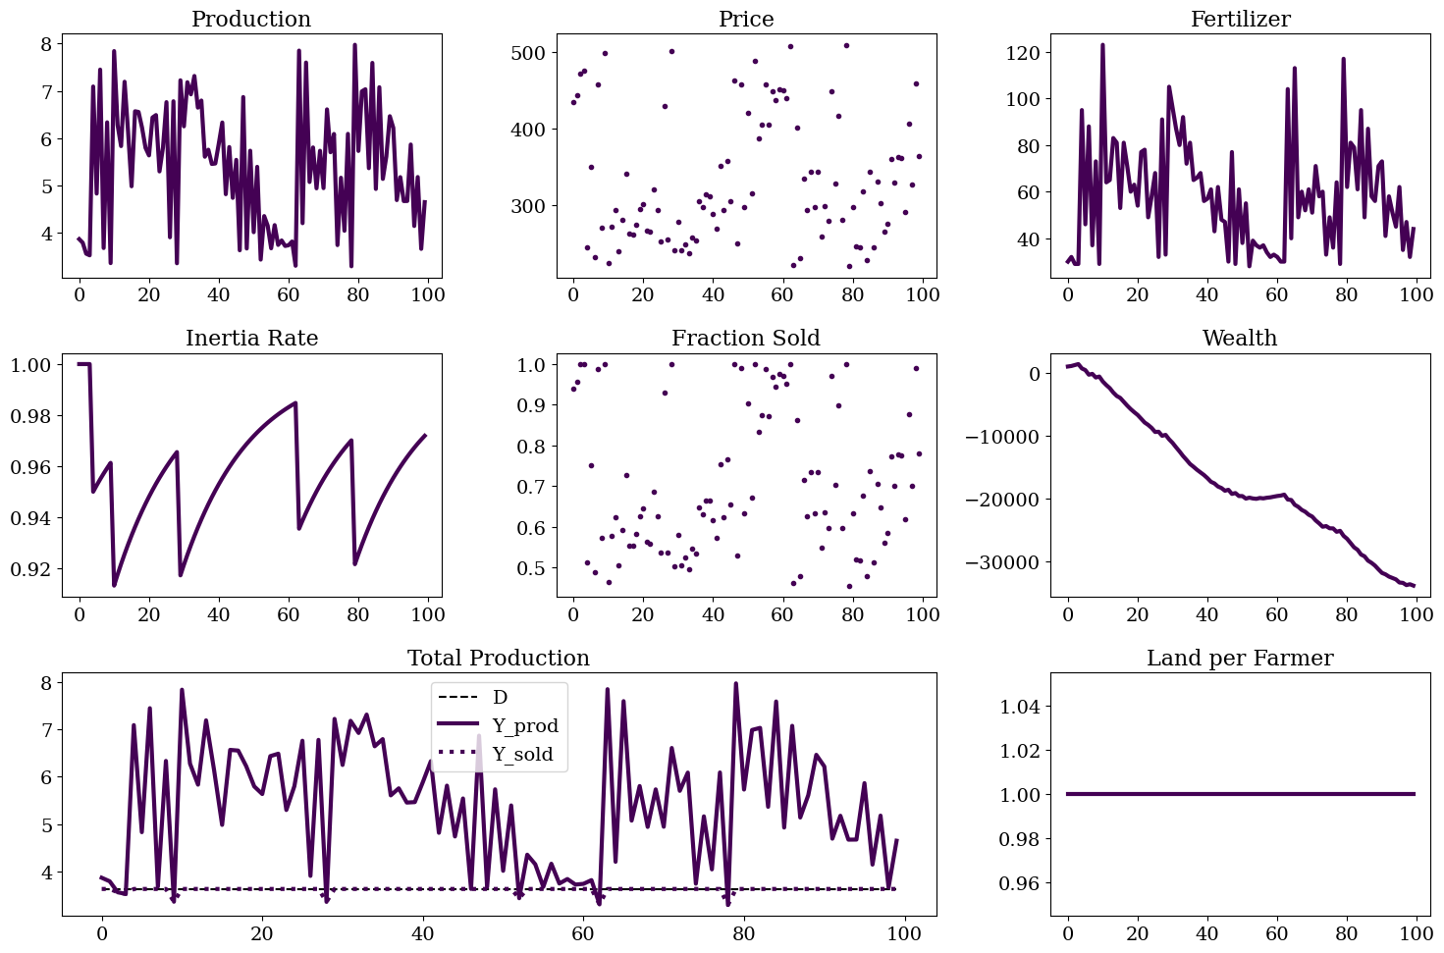


Linear Inertia
In this case the tendency to overproduce lead to a situation of negative profit

Slide 4
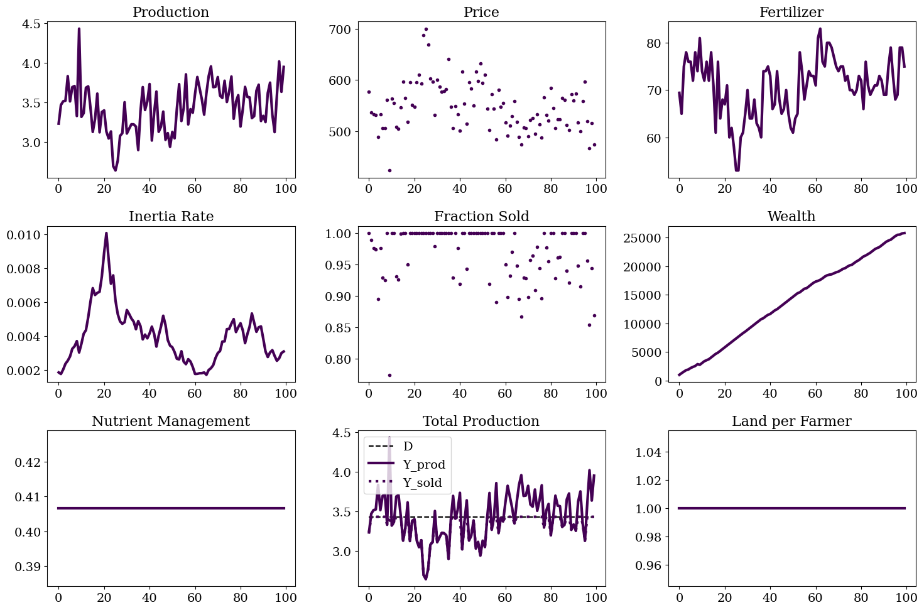

Quadratic Inertia
In this case the tendency to overproduce disappears and the solution is more stable

Slide 5
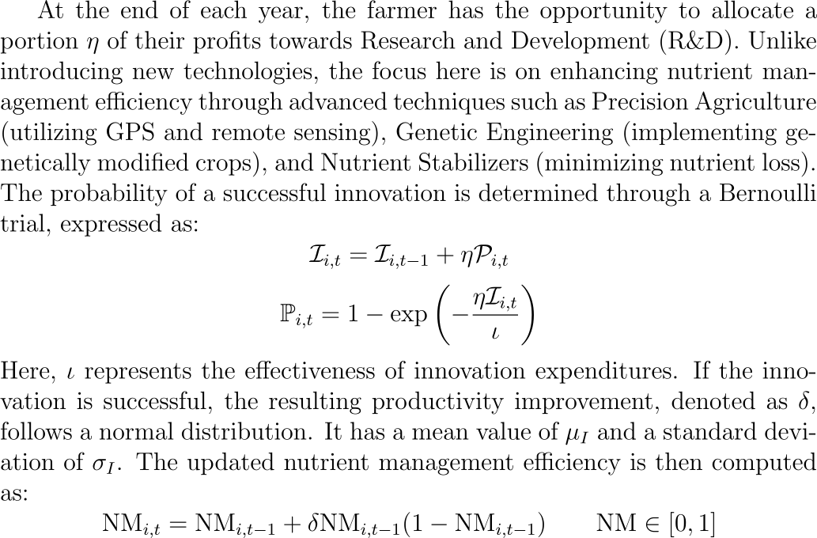




R&D

Slide 6
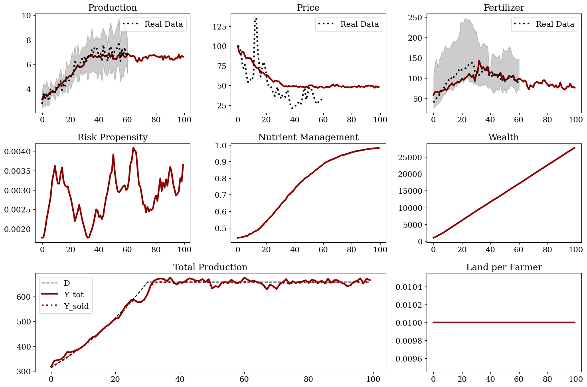



Many Farmers
Here no competition

Slide 7
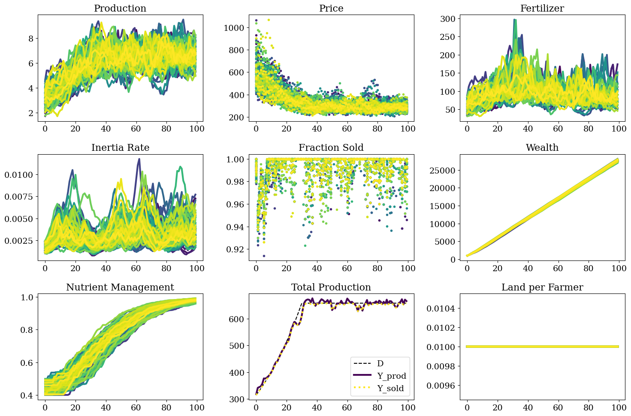
Many Farmers

Slide 8
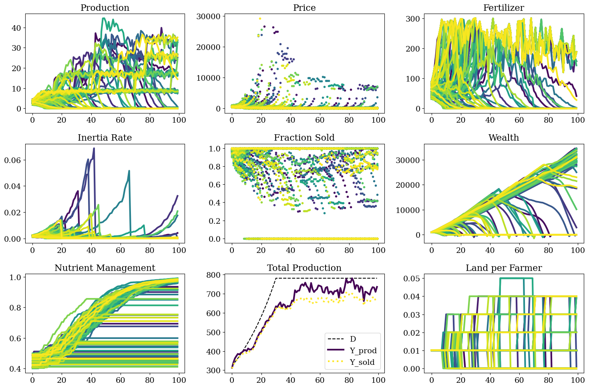

Many Farmers
When there’s competition, all the farmer who are dying strongly affect the dynamics. How can I treat them?

