Slide 1
Quantum Machine Learning For Conspicuity Detection in Production(Long Format)
Womanium Quantum + AI Project
Q-Frontier
Mackenson Polché & Hein Zay Yar Oo

Slide 2
Problem Statement
Womanium Quantum + AI Project
Task 1 is an introduction to Pennylane and its framework.
Taks 2 and 3 introduces two quantum machine learning (QML) models : variational circuit and quanvolutional neural networks.
Task 4 is about developing a QML model to learn the sine function. Precursor to Task 5.
Task 5 is about utilizing hybrid quantum computing models and real-world datasets to accelerate the process of detecting defective Tungsten Inert Gas (TIG) welding parts.

Slide 3
Project Solution : Task 4
Womanium Quantum + AI Project
Initially we discretize the interval from 0 to 2π
Create a quanvolutional circuit with angle embedding and entangler layers.
Develop a hybrid quantum-classical neural network(QCNN) to integrate the quanvolutional layer with classical dense layer.
Train the QCNN with the created dataset and optimize the result with Adam optimizer.
Calculated the R² score.

Slide 4
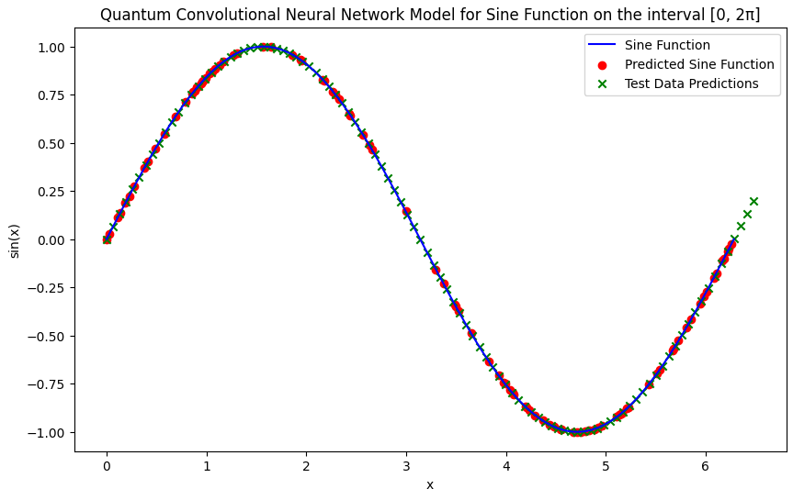
Result : Task 4
Womanium Quantum + AI Project
Achieved perfect R² score of 1.
Excellent fit to the data and perfect predictability.
Potential cause of overfitting.
However, due to simplicity of the sine function, overfitting is not likely.
Will adapt this model for more complicated challenges.

Slide 5
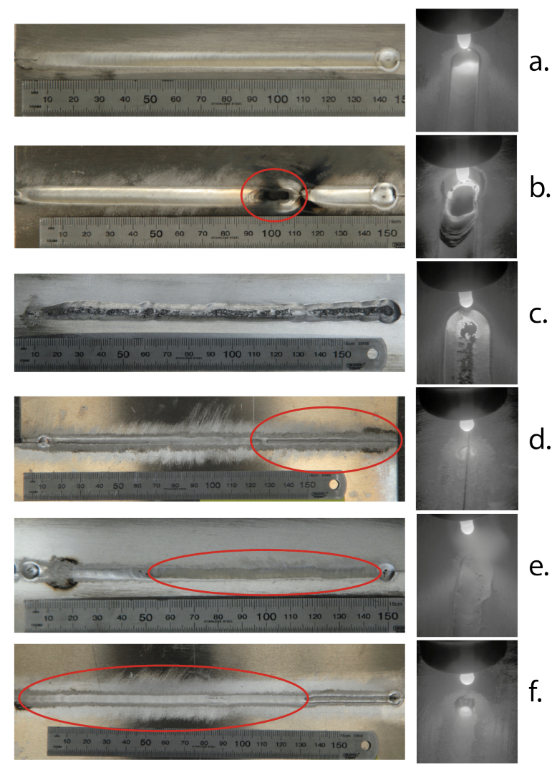
Project Solution : Task 5
Womanium Quantum + AI Project
Two primary objectives: multi-class classification and binary classification
For multi-class classification, we implemented a Quantum Convolutional Neural Network (QCNN) to classify images into six categories:
Good Weld, Burn Through, Contamination, Lack of Fusion, Misalignment, and Lack of Penetration.
For binary classification, we developed a QCNN to classify images into two categories:
Good Weld and Defective, encompassing the five defect types.
[1]

Slide 6
Methodology
Womanium Quantum + AI Project
Designed quantum circuit that employed Amplitude Embedding to encode classical data into quantum states
Implemented Quantum Convolution and Pooling layers to extract significant features and measure the probability distribution of the final state to obtain results.
Trained and evaluated the quantum models, comparing their performance with classical counterparts using accuracy metrics and visualizations.

Slide 7
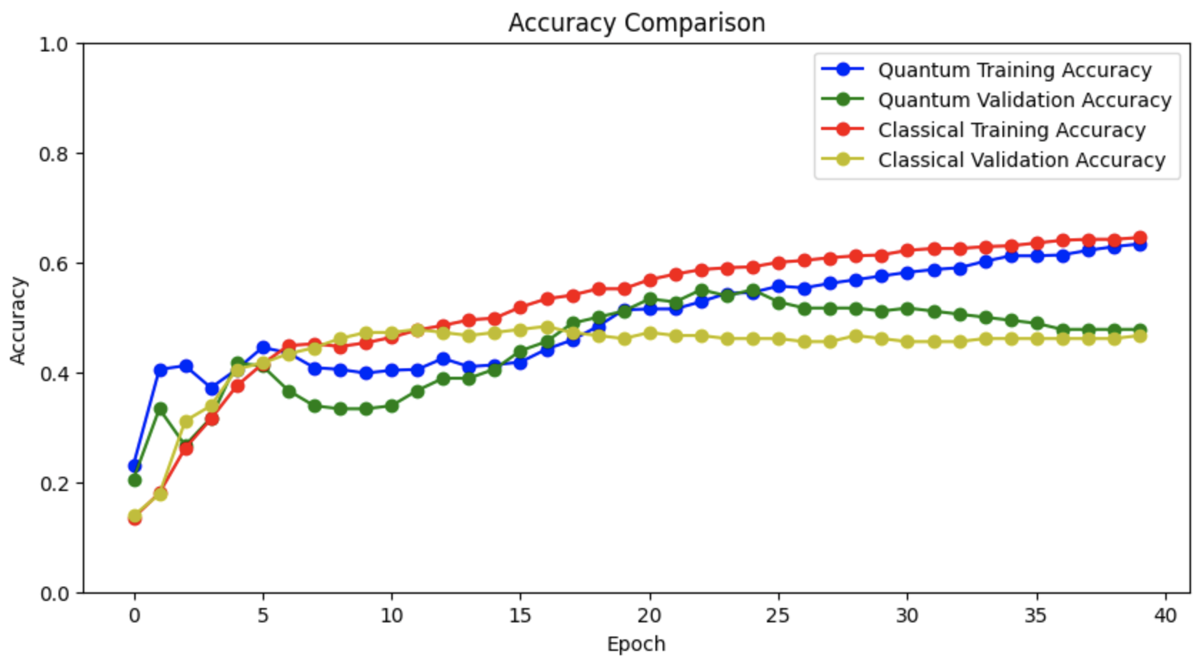
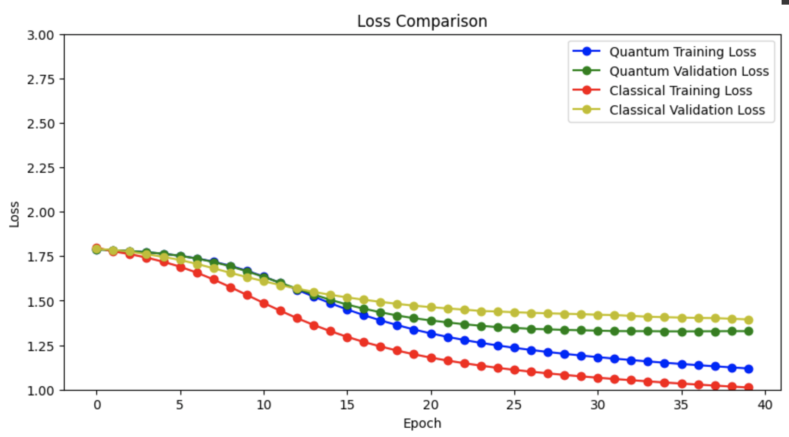
Result: 6-Class Classification
Womanium Quantum + AI Project
For 6-class classification, the classical model slightly outperformed the quantum model in accuracy and loss metrics
Suggesting the need for further optimization in the quantum model for complex tasks.

Slide 8
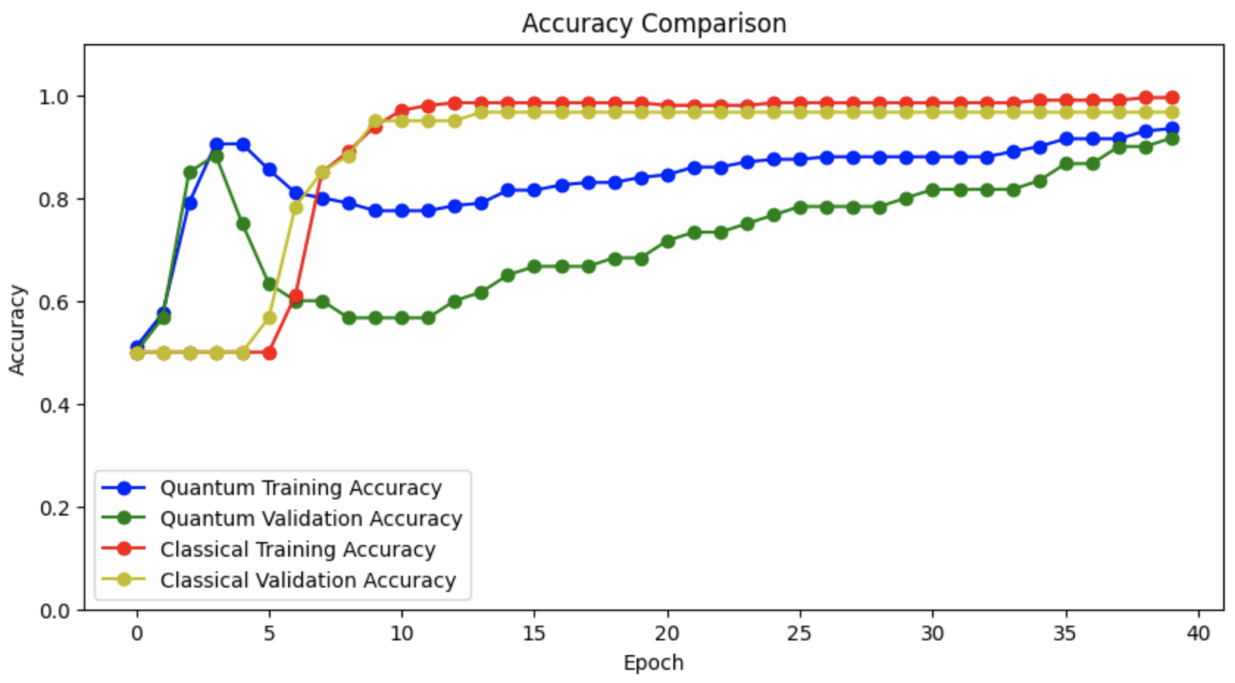
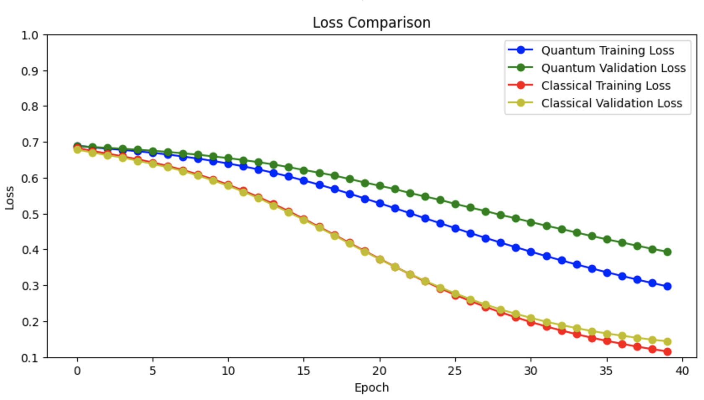
Result: Binary Classification
Womanium Quantum + AI Project
For binary classification, the quantum model demonstrated superior performance, achieving high accuracy quickly and maintaining it consistently.
This highlights the potential of quantum computing for simpler classification problems.

Slide 9
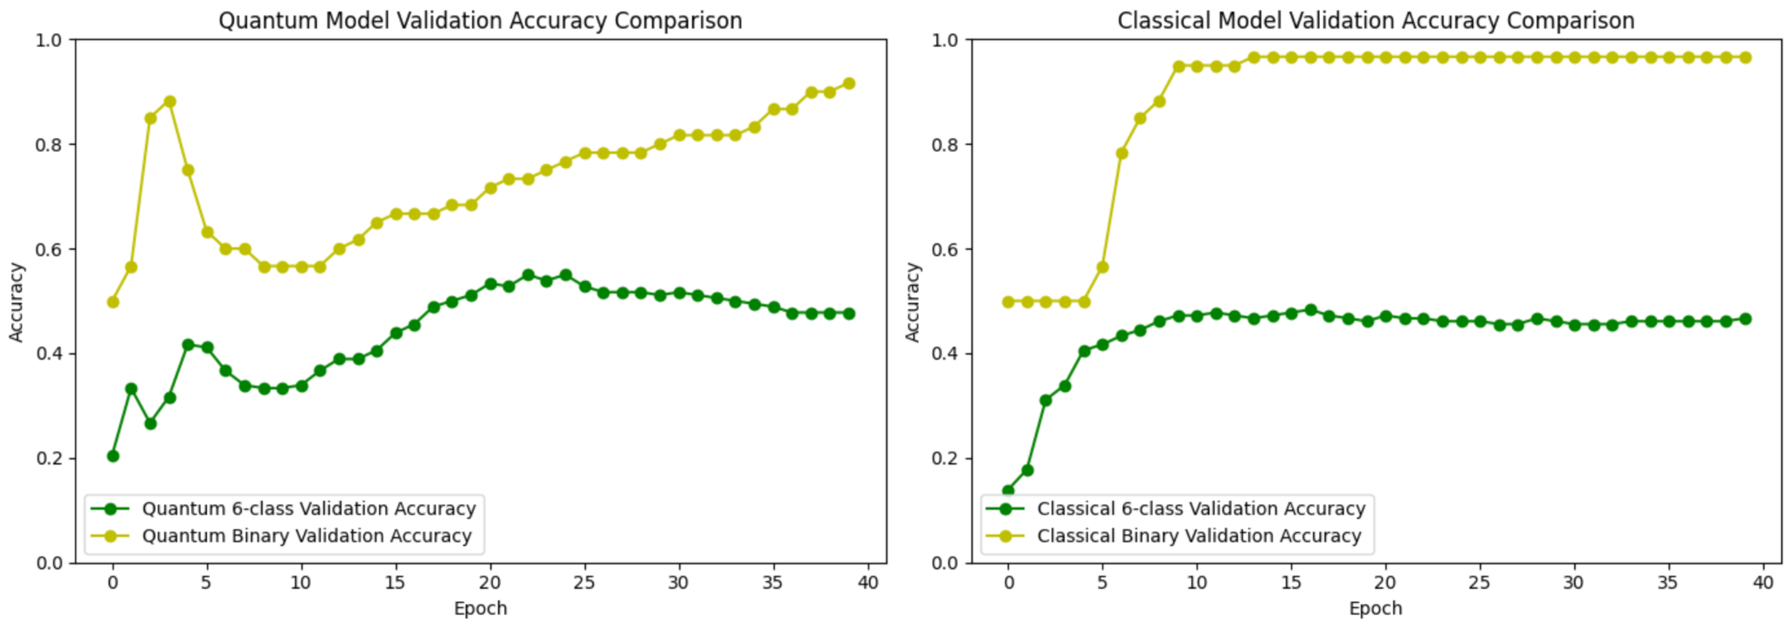
Result : Quantum vs Classical
Womanium Quantum + AI Project
6-class classification: quantum model overperform classical model which showcases the capability to handle datasets with complex features.
Binary classification: both models achieve high accuracy quickly, but classical model reaches near-perfect accuracy and maintains it.
Quantum model demonstrates stability in the learning process for binary classification.

Slide 10
Future Scope
Womanium Quantum + AI Project
Enhancing quantum-classical models by increasing the number of qubits and exploring noise mitigation techniques.
Data augmentation and higher resolution images can improve feature capture
Model optimization through extensive hyperparameter tuning and quantum circuit efficiency should be pursued.
Testing models on actual quantum hardware will address practical challenges. Additionally,
Developing real-time classification systems for industrial applications and extending models to localize defects within images will provide more detailed information for targeted interventions.
Current limitations include quantum hardware constraints and the need for extensive computational resources for model tuning and training.
By pursuing these research directions, the potential of quantum-classical hybrid models in industrial applications can be fully realized.

Slide 11


Summary / Conclusion
Womanium Quantum + AI Project
Thank you very much for your time and attention! We hope you have enjoyed the presentation.

Slide 12
References
Womanium Quantum + AI Project
https://www.sciencedirect.com/science/article/abs/pii/S1526612519302245?via%3Dihub

