Slide 1

Quantum for Portfolio Optimization
WISER Quantum Project
Q-Frontier
Mackenson Polche & Hein Zay Yar Oo

Slide 2
Problem Statement
WISER Quantum Project
Task 1: Translate the mathematical formulation of the bond portfolio optimization problem into executable Python code.
Task 2: Convert the coded formulation into a Quadratic Unconstrained Binary Optimization (QUBO) model.
Task 3: Implement quantum optimization routines ( QAOA & VQE) to solve the QUBO.
Task 4: Validate quantum solutions by evaluating them under the classical benchmark model with hard constraints.
Task 5: Compare the objective values from QAOA and VQE to the classical benchmark and analyze performance.

Slide 3
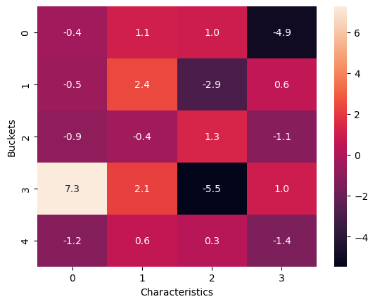
Task 1, 2, 3 & 4
WISER Quantum Project
For Task 1, we studied the mathematical formulation and replicated it using random variables and brute-force optimization.
For Task 2, we transform the optimization problem in a binary variables (1=selected, 0=not) with constraints including sector PMV targets, sector PMV/DXS limits, global cash bounds, and bond-specific trading rule that suitable to use in Quantum Computer.
For Task 3. After having the binary formulation we used QAOA and VQE approach to carry out the optimization process in quantum simulator.
For task 4. We used our QAOA algorithm to solve the mathematical formulation we carried out from task 1.

Slide 4
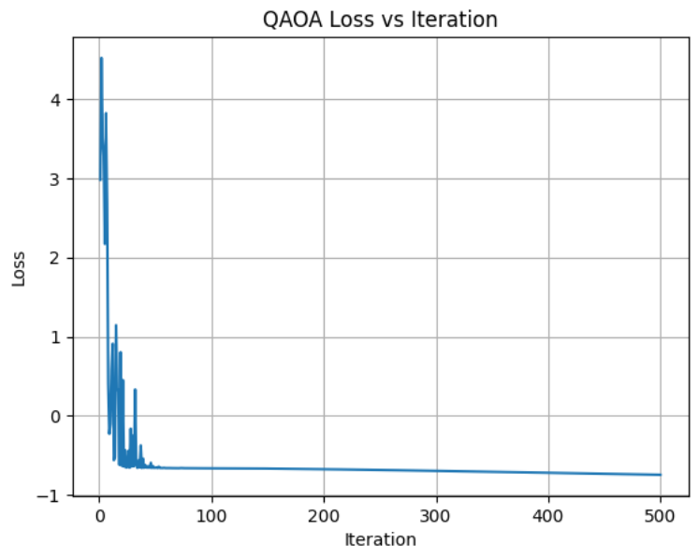
QAOA-RESULTS
WISER Quantum Project
Bond Selection :
020002BJ9: 0 026874DS3: 0 081437AT2: 0 097023CJ2: 0 13645RAD6: 1 13645RBF0: 1 14448CBC7: 1 15135BAW1: 0 21871XAS8: 1 24422EWZ8: 1 24422EXP9: 0 314353AA1: 1 36166NAK9: 1 438516CM6: 1 443201AC2: 0 444859BR2: 1 444859BV3: 1 444859BY7: 1 444859CA8: 0

Slide 5
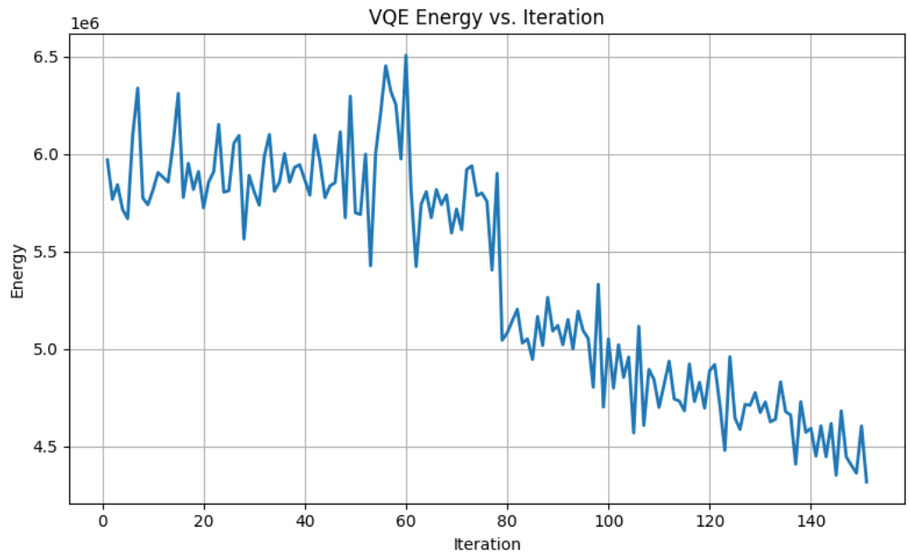
VQE-RESULTS
WISER Quantum Project
Bond Selection:
020002BJ9: 1 026874DS3: 1 081437AT2: 1 097023CJ2: 1 13645RAD6: 1 13645RBF0: 1 14448CBC7: 0 15135BAW1: 1 21871XAS8: 1 24422EWZ8: 1 24422EXP9: 0 314353AA1: 1 36166NAK9: 0 438516CM6: 0 443201AC2: 0 444859BR2: 0 444859BV3: 0 444859BY7: 0 444859CA8: 1

Slide 6
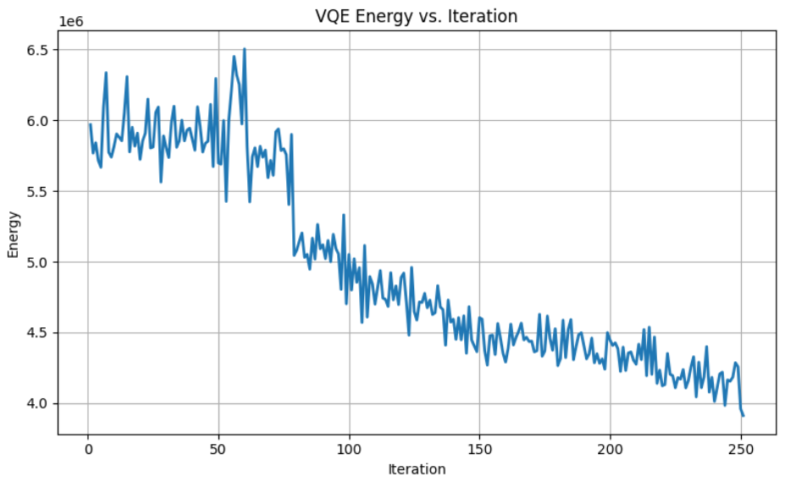
VQE-RESULTS
WISER Quantum Project
Bond Selection: 020002BJ9: 1 026874DS3: 1 081437AT2: 1 097023CJ2: 1 13645RAD6: 1 13645RBF0: 0 14448CBC7: 1 15135BAW1: 0 21871XAS8: 1 24422EWZ8: 0 24422EXP9: 0 314353AA1: 1 36166NAK9: 0 438516CM6: 0 443201AC2: 1 444859BR2: 0 444859BV3: 0 444859BY7: 0 444859CA8: 1

Slide 7
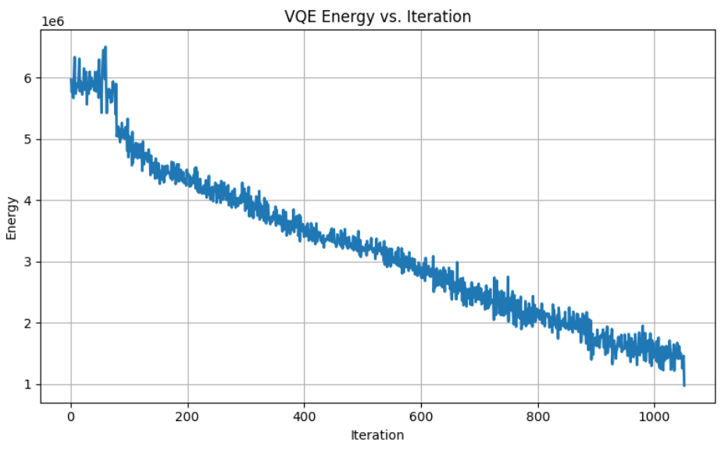
VQE-RESULTS
WISER Quantum Project
Bond Selection:
020002BJ9: 1
026874DS3: 1
081437AT2: 1
097023CJ2: 1
13645RAD6: 1
13645RBF0: 1
14448CBC7: 1
15135BAW1: 1
21871XAS8: 1
24422EWZ8: 1
24422EXP9: 1
314353AA1: 1
36166NAK9: 1
438516CM6: 1
443201AC2: 1
444859BR2: 1
444859BV3: 1
444859BY7: 1
444859CA8: 1

Slide 8
Task 5 Methodology
WISER Quantum Project
Evaluated QAOA and VQE selections against the classical benchmark (docplex.lp) using the same constraints and objective function.
Check feasibility by running each selection through the benchmark model (serverless_runner.py) and verifying that all hard constraints (e.g., sector PMV/DXS floors, cash limits, bond quantity caps) are satisfied.
Identify and log any constraint violations with details on the sector/constraint type, achieved value, and required bound.
Apply repair heuristics to adjust infeasible selections and re-test feasibility under the benchmark.
Compare objective values across methods to assess quantum vs. classical performance.

Slide 9
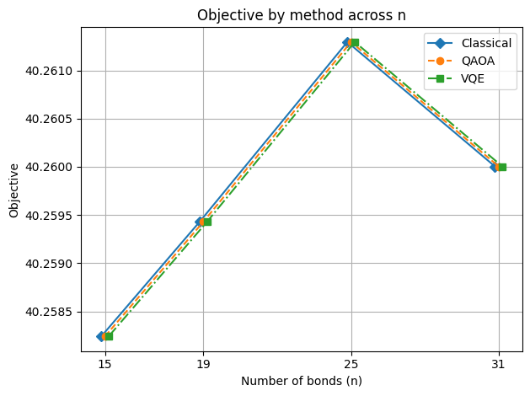
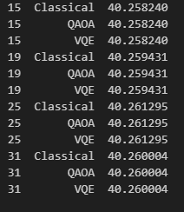
Classical Result
WISER Quantum Project
Present results for both full-universe and reduced-universe bond sets.
Both QAOA and VQE achieved values with 10⁻³ % of the classical optimum.
All quantum solutions were validated for feasibility against the benchmark constraints.
Reducing number of bonds have minimal effect on objective value.

Slide 10
Conclusion
WISER Quantum Project
Performance parity: Quantum approaches achieved objective values comparable to the classical benchmark.
Feasibility validation: All solutions were tested against the benchmark’s hard constraints using a classical routine, confirming whether the quantum selections were feasible before comparison.
Scalability check: Performance was evaluated across different problem sizes, with results indicating stable objective values as the number of bonds varied.
Methodology alignment: Both classical and quantum runs used the same constraint set and objective formulation to ensure fair comparisons.
Implication: Demonstrates that quantum routines can match classical optimization performance for constraint-heavy portfolio selection problems, highlighting potential for future use as quantum hardware matures.

Slide 11
Future Scope
WISER Quantum Project
Access to better hardware to optimize portfolio with 19+ bonds using quantum routines.
Use noise mitigation techniques.
Explore alternative circuit designs (adaptive QAOA, hardware-efficient ansatze) to improve convergence.
Explore quantum-classical approaches.
Build entire optimization pipeline with quantum routines incorporated for faster decision making.

Slide 12


Summary / Conclusion
WISER Quantum Project
Thank you very much for your time and attention! We hope you have enjoyed the presentation.

Slide 13
extra
WISER Quantum Project

