Slide 1
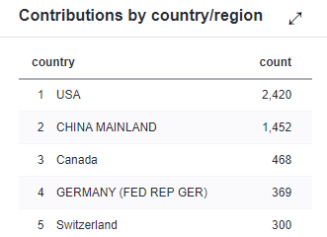
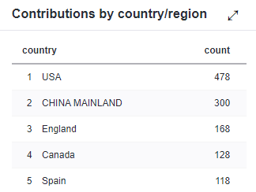
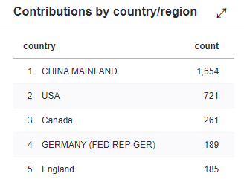
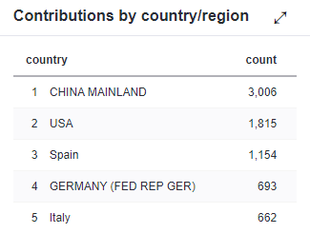
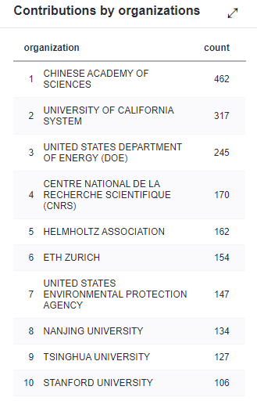
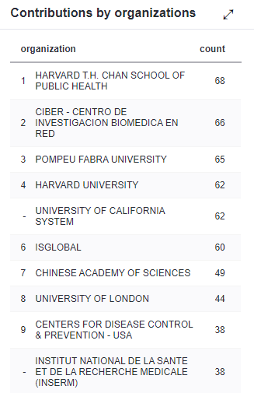
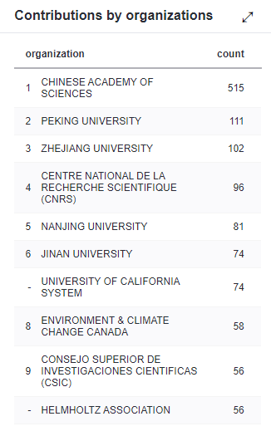
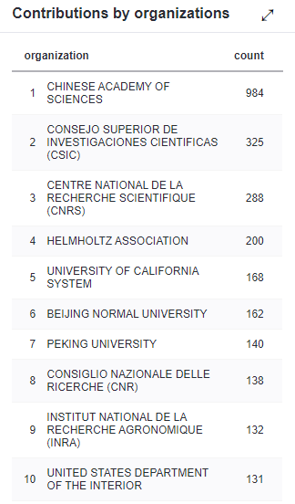
Environmental Science & Technology
AMER CHEMICAL SOC (USA)
24 issues/year
IF_2018 = 21454/3001 = 7.149
Rank （Environ Sci-SCIE）= 14/251 (JCR Q1)
Environment International
PERGAMON-ELSEVIER SCIENCE LTD (England)
12 issues/year
IF_2018 = 4885/615 = 7.943
Rank （Environ Sci-SCIE）= 8/251 (JCR Q1)
Environmental Pollution
ELSEVIER SCI LTD (England)
12 issues/year
IF_2018 = 11571/2025 = 5.714
Rank （Environ Sci-SCIE）= 25/251 (JCR Q1)
Science of The Total Environment
ELSEVIER SCIENCE BV (Netherlands)
24 issues/year
IF_2018 = 29181/5221 = 5.589
Rank （Environ Sci-SCIE）= 27/251 (JCR Q1)

Slide 2
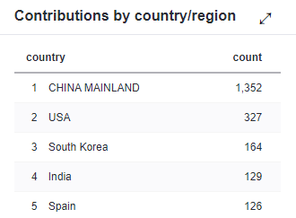
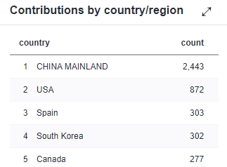
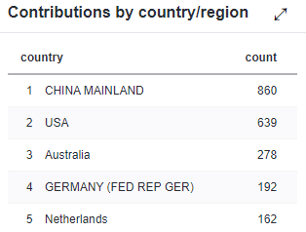
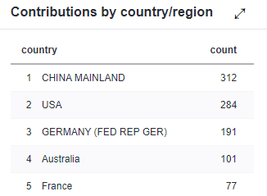
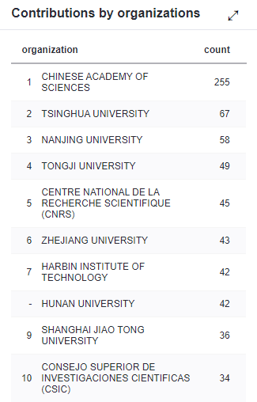
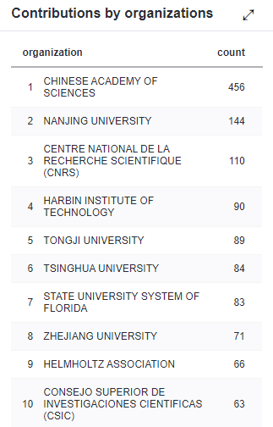
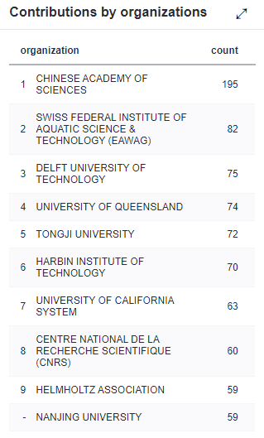
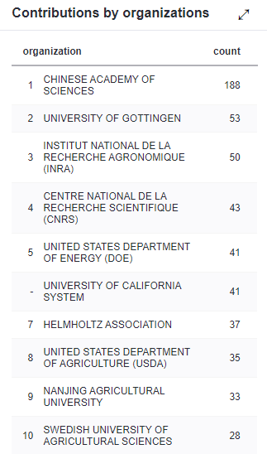
Journal of Hazardous Materials
ELSEVIER SCIENCE BV (Netherlands)
20 issues/year
IF_2018 = 12645/1653 = 7.650
Rank （Environ Sci-SCIE）= 12/251 (JCR Q1)
Chemosphere
PERGAMON-ELSEVIER SCIENCE LTD (England)
40 issues/year
IF_2018 = 18135/3550 = 5.108
Rank （Environ Sci-SCIE）= 32/251 (JCR Q1)
Water Research
ELSEVIER SCI LTD (England)
20 issues/year
IF_2018 = 13445/1699 = 7.913
Rank （Environ Sci-SCIE）= 9/251 (JCR Q1)
Soil Biology & Biochemistry
ELSEVIER SCIENCE BV (Netherlands)
12 issues/year
IF_2018 = 3227/610 = 5.290
Rank （Soil Sci-SCIE）= 1/35 (JCR Q1)

Slide 3
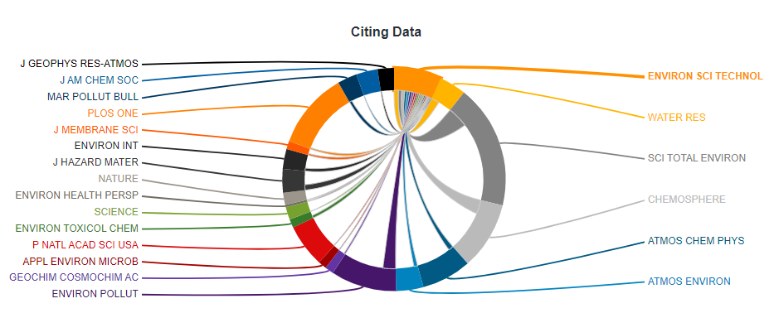
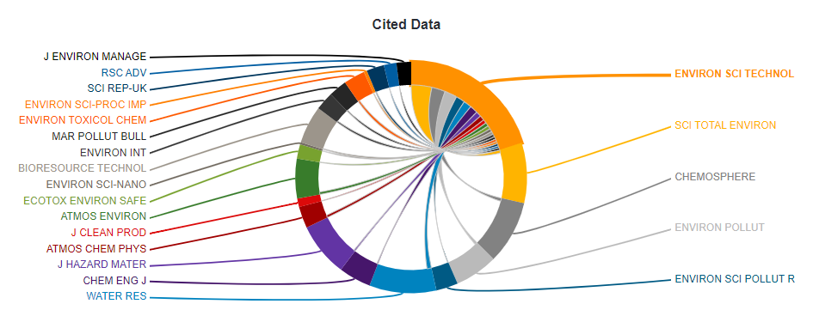

Journal Relationships
(An example of Environmental Science & Technology)

