Slide 1
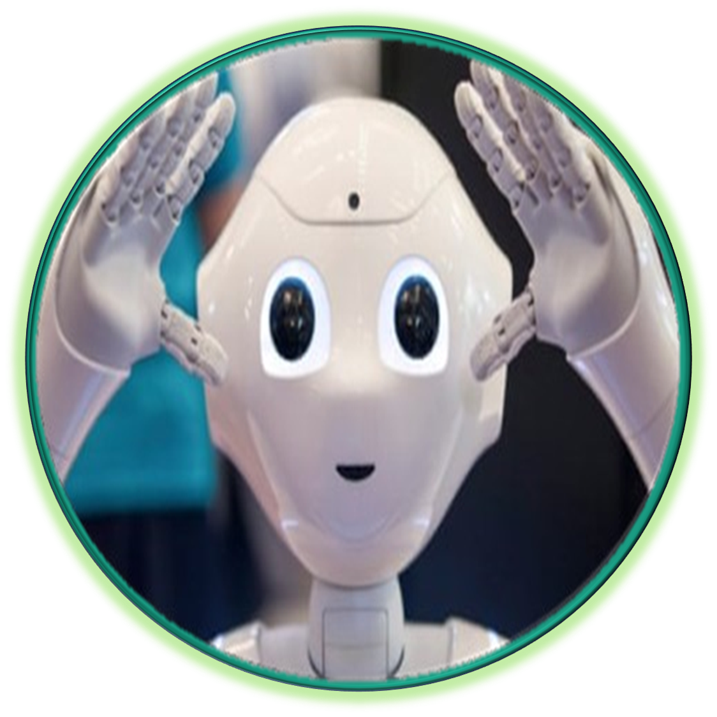
Automated Tests Tool
A tool designed specifically for the business tests. No technical skill required!
Developed for EC to facilitate the user acceptance
CONTACTS
Birthdate:
01/06/2019
Rebecca SHOTSHA
rebecca.shotsha@soprasteria.com
Expertise:
Business Tests.
Non-regression tests.
Prepare data.
Facilitate user acceptance with stakeholder
Philippe GOFFIN
philippe.goffin@soprasteria.com
0495/820.961 Consultant
Experience:
Secretariat General: Transparency Register.
DG INTPA R5: Opsys Project Prospect Project Pador Project CRIS Project
FEATURES
No technical skill required
Very powerful
Data driven method
Roles: Tester, Designer, Admin
Ready for ECAS login
Export in Excel/.json
Batch/cron mode
Rules Engine:
Make decision
sub scenario
TECHNICAL
Artificial Intelligence:
Detect fields
Training tool
Natural language (proto)
WebDriver
JavaScript/Node.js
Vue 3 (user interface)
API Server
Database: MySQL

Slide 2

Philippe Goffin
I worked mainly for the Commission. After more than 30 years at Sopra Steria and having held various positions, I am a kind of Swiss knife: Expert in automation tests, Business Analyst, Project Manager, Quality Officer…
CONTACT
Birthdate:
14/02/1963
Philippe GOFFIN
philippe.goffin@soprasteria.com
0495/820.961 Consultant
History of the Robot:
2019, I created a prototype of the Robot (UI: Excel) for the Secretariat General
2020, I moved to the DG INTPA. We agreed to use the Robot to automate the tests on OPSYS.
2021, I trained a second person to manage the project CRIS.
2024, I created a new version based on a web interface. The new Robot was tested successfully on the project Prospect.
SKILLS
Automation Tests Expert
Business Analyst
Project Manager
Quality Officer
Trainer on the Robot
Hobbies:
Artificial intelligence
Robotics
Film maker: Travel, Technology
Drone pilot: A1 / A3 Open
YouTuber: www.youtube.com/@PhilRoute

Slide 3
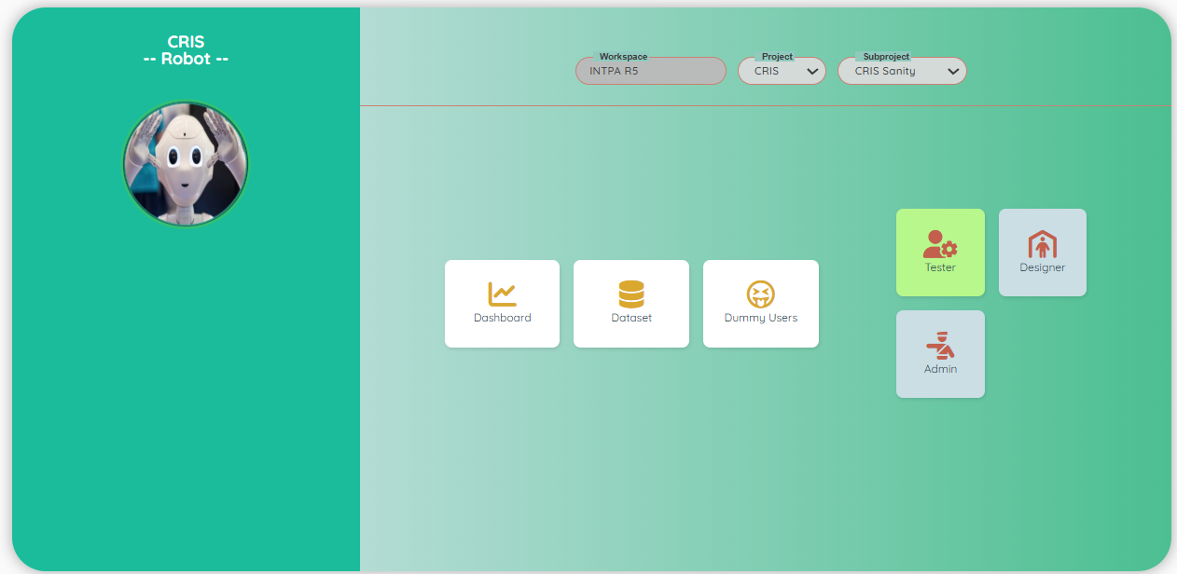
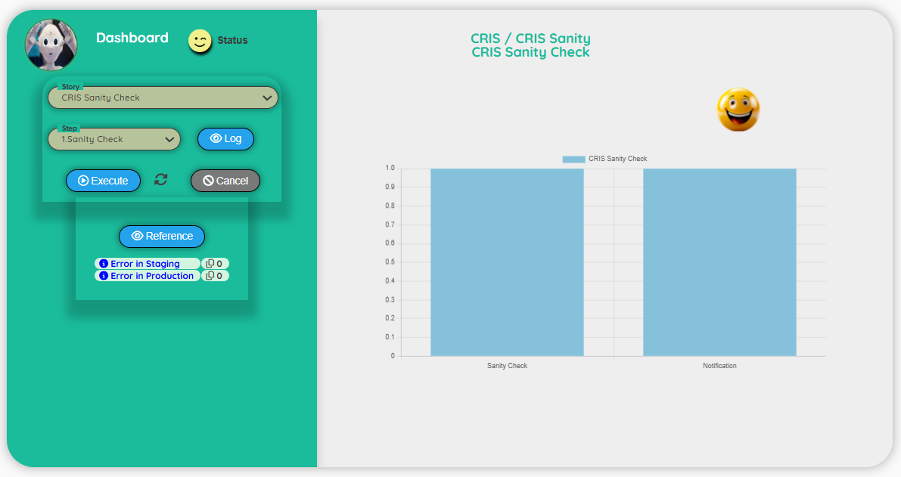
Automated Tests Tool
Because the tester can be a business analyst, we provide an easy-to-use interface, without technical jargon! Tester is responsible for the data and the dummy users.
TESTER
User interface:
Dashboard for the execution

Slide 4
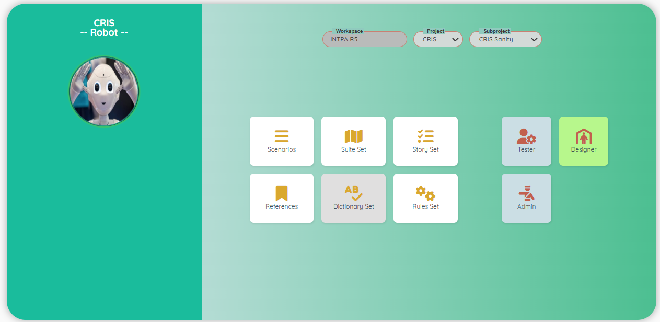
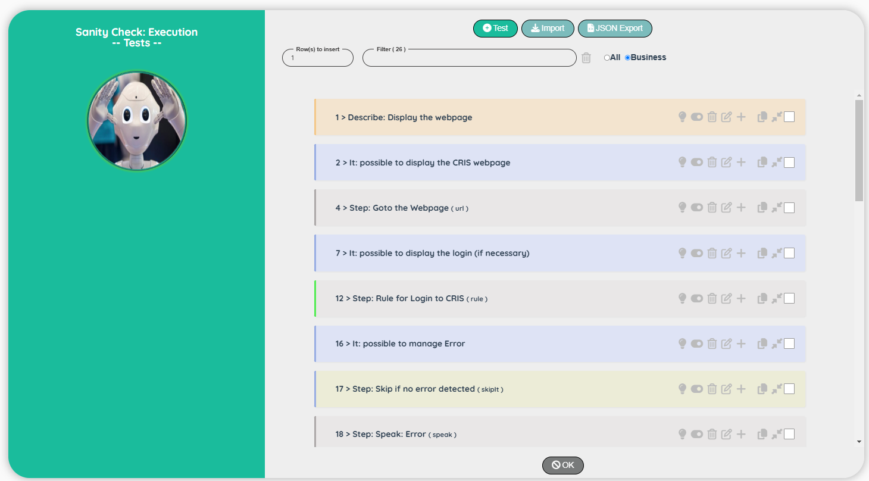
Automated Tests Tool
Designer is responsible of the creation of the scenarios, the dictionary, the rules and the references. Interface is designed to be powerful: copy/paste, import/export, natural language…
DESIGNER
User interface:
Designing a scenario

Slide 5
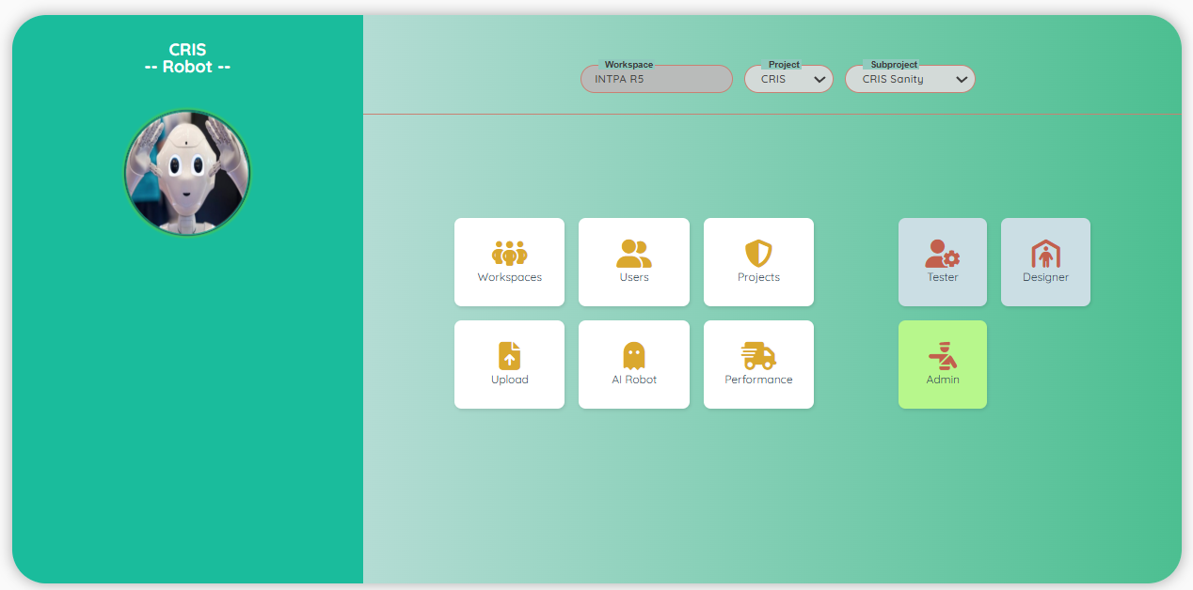
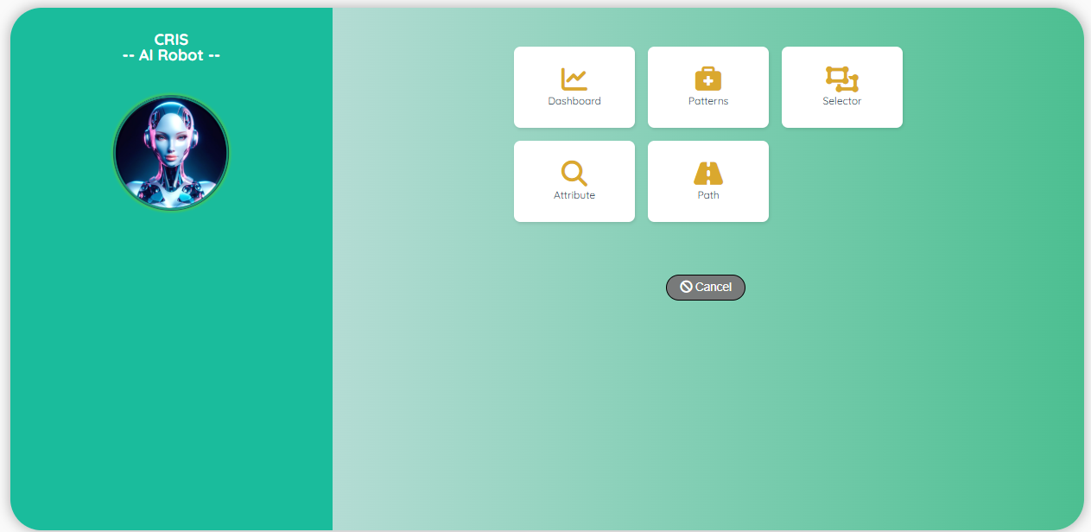
Automated Tests Tool
Administrator is responsible for the management of the projects. He is responsible of the documents and the training of the Robot with AI. (after the training, the Robot can detect an element on the page)
ADMINISTRATOR
User interface:
Train the Robot with AI

Slide 6
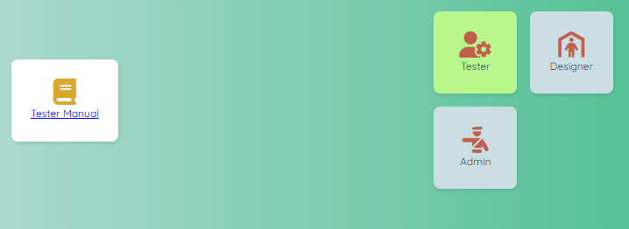
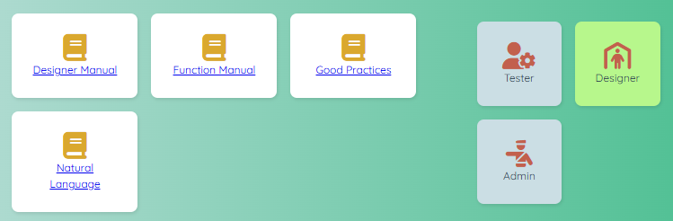
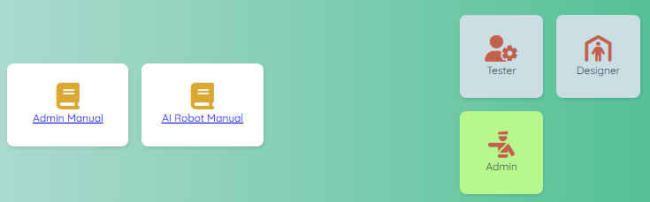
Automated Tests Tool
Documentation is very important!
For each role, we have dedicated books to help the people
TESTER
DESIGNER
ADMINISTRATOR

