Slide 1

Automated Testing Tool
A tool designed specifically for the business tests. No technical skill required!
Developed to facilitate the stakeholder's acceptance
CONTACTS
Launched:
05/2025
Philippe GOFFIN
philippe.goffin@soprasteria.com
0495/820.961 Consultant at Sopra Steria
History of the Robot:
2019-2024, Robot is used at DG INTPA to test a very complex financial application.
2024, a version based on a web interface is created.
2025, a migration of the backend to Playwright
FEATURES
No technical skill required
Very powerful
Data driven method
Roles: Tester, Designer, Admin
Ready for ECAS login
Export in Excel/.json
Batch/cron mode
Performance:
Quick tests execution
Multi browsers
Ready for mobile
TECHNICAL
Rules Engine:
Make decision
sub scenario
Playwright
JavaScript/Node.js
Vue 3 (user interface)
REST API Server
Database: MySQL
Artificial Intelligence:
Detect fields
Training tool
Natural language (proto)

Slide 2
Automated Tests Tool
What is the added-value of this new version powered by Playwright ?
Playwright offers several advantages, making it a more modern and efficient choice for web automation and testing. It excels in speed, reliability, ease of use, and advanced features like auto-waiting, robust locators, and tracing.
Installation:
Only node.js libraries, no external drivers (so less issues with the corporate security of the customer)
Speed:
Compared to the previous version, we gain 87% of performance. This is very important, when you want to use the tool to generate data ready to be used for the business (or stakeholders)
Cross-Browser & Devices:
It’s very easy to change the browser for the execution (just a reference). It’s also possible to simulate a device (smartphone, tablet….). You can also run the tests in headless mode.
Reliability:
More reliable, especially with auto-waiting and robust locators.
Fully compliant with the previous behaviors:
Only the back-end has been migrated, the powerful behaviors are still there: rules engine, dataset, dictionary, able to process very complex scenarios, frame and iFrame managed by the tool….

Slide 3
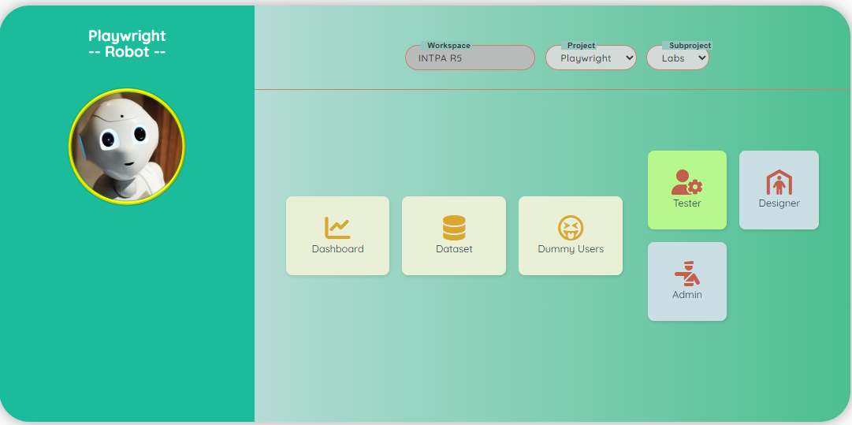
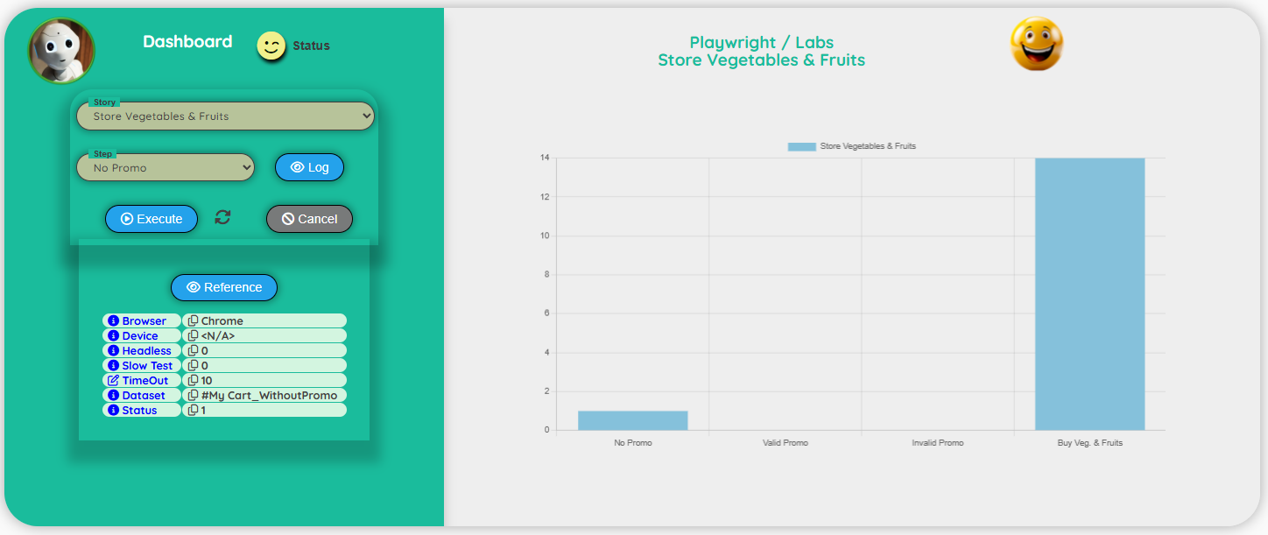
Automated Tests Tool
Because the tester can be a business analyst, we provide an easy-to-use interface, without technical jargon! Tester is responsible for the data and the dummy users.
TESTER
User interface:
Dashboard for the execution

Slide 4
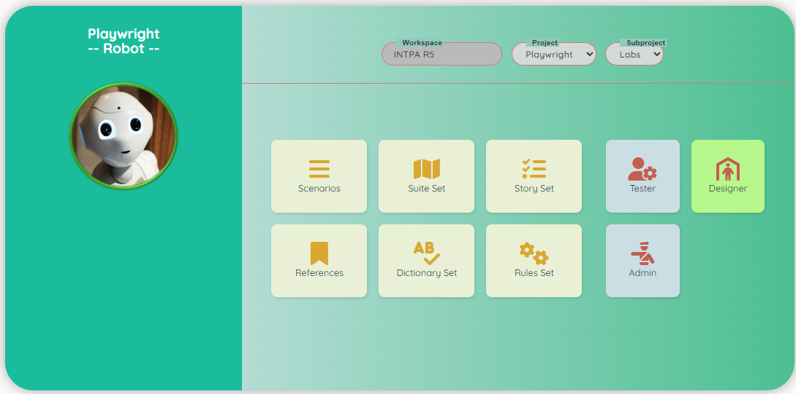
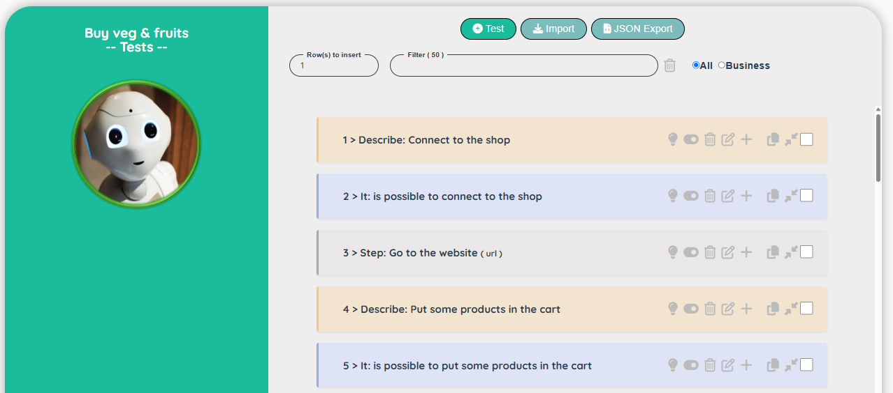
Automated Tests Tool
Designer is responsible of the creation of the scenarios, the dictionary, the rules and the references. Interface is designed to be efficient: copy/paste, import/export, natural language…
DESIGNER
User interface:
Designing a scenario

Slide 5
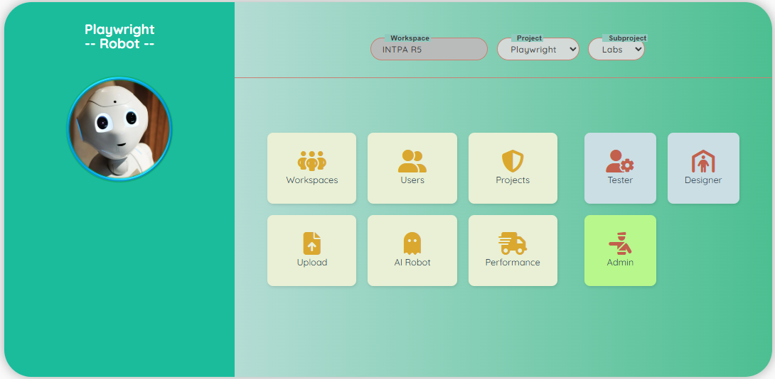
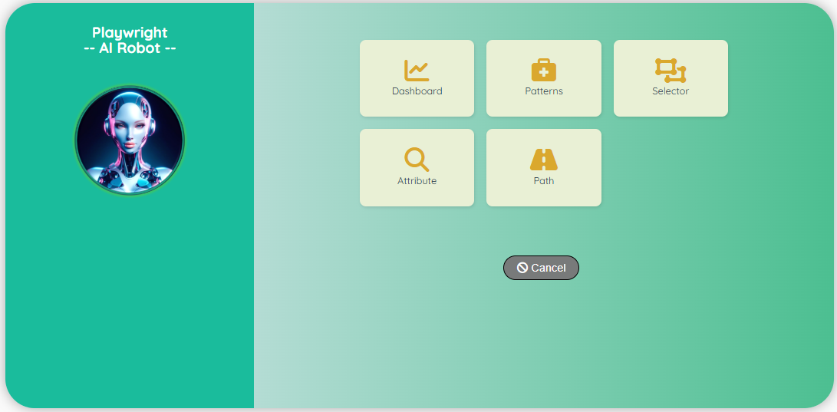
Automated Tests Tool
Administrator is responsible for the management of the projects. He is responsible of the documents and the training of the Robot with AI. (after the training, the Robot can detect an element on the page)
ADMINISTRATOR
User interface:
Train the Robot with AI

Slide 6
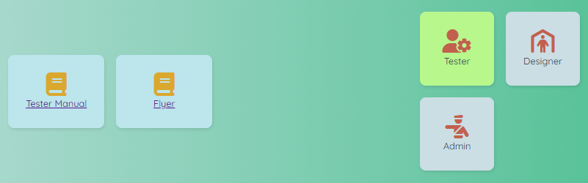
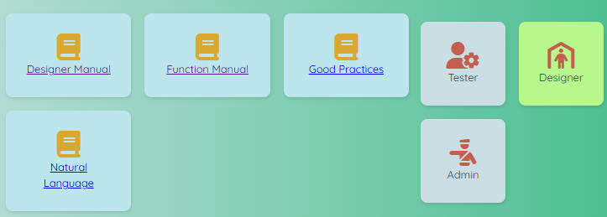
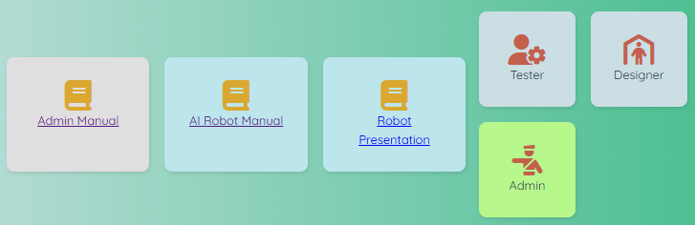
Automated Tests Tool
Documentation is very important!
For each role, we have dedicated books to help the people
TESTER
DESIGNER
ADMINISTRATOR

