Slide 1
Performance Study and Flexible Data Placement Policies for NUMA Non-Volatile Memory Architectures
Diploma Thesis Presentation Filippos Tofalos

Slide 2
1. Introduction
2. Motivation
3. Implementation
4. Evaluation
5. Extension

Slide 3
1. Introduction
2. Motivation
3. Implementation
4. Evaluation
5. Extension

Slide 4
Memory Technology Hierarchy
Latency (ns)
CPU
10⁰
DRAM
10¹
10²-10³
Performance SSD
10⁴
Capacity SSD
10⁵
HDD
10⁶

Slide 5
Memory Technology Hierarchy
Latency (ns)
Read BW: 6 GB/s Write BW: 2 GB/s
CPU
10⁰
Byte Access
DRAM
10¹
Volatile
PMEM
10²-10³
Non-Volatile
Performance SSD
10⁴
Block Access
Capacity SSD
10⁵
HDD
10⁶

Slide 6
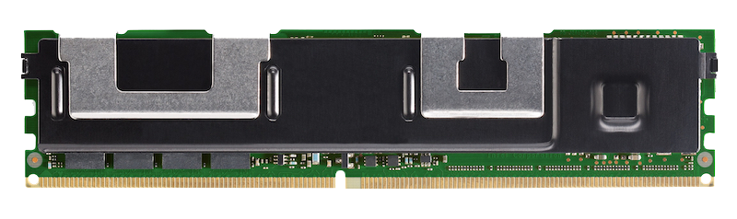
NUMA Topology
Socket 0
Socket 1
Core
Core
Core
Core
Core
Core
Core
Core
LLC Cache
Mesh Interconnect
DRAM
DRAM
DRAM
DRAM
DRAM
DRAM
nvdimm 2
nvdimm 5
nvdimm 1
Interleaved
Interleaved
nvdimm 4
nvdimm 0
nvdimm 3
NUMA NODE 0
NUMA NODE 1

Slide 7
The Direct Access (DAX) Feature
DAX Disabled
DAX Enabled
Intervention of the page cache (temporary buffer for pages, placed at DRAM).
+ For frequently accessed pages, we better utilize DRAM’s wider bandwidth
Core
Direct data transfer from and to some byte addressable device. + We avoid double copying (first copy to the page cache, the second one to the application’s buffer).
Core
Core
Core
Core
Core
Core
Core
DRAM
DRAM
Page
Cache
DRAM
DRAM
DRAM
DRAM

Slide 8
1. Introduction
2. Motivation
3. Implementation
4. Evaluation
5. Extension

Slide 9
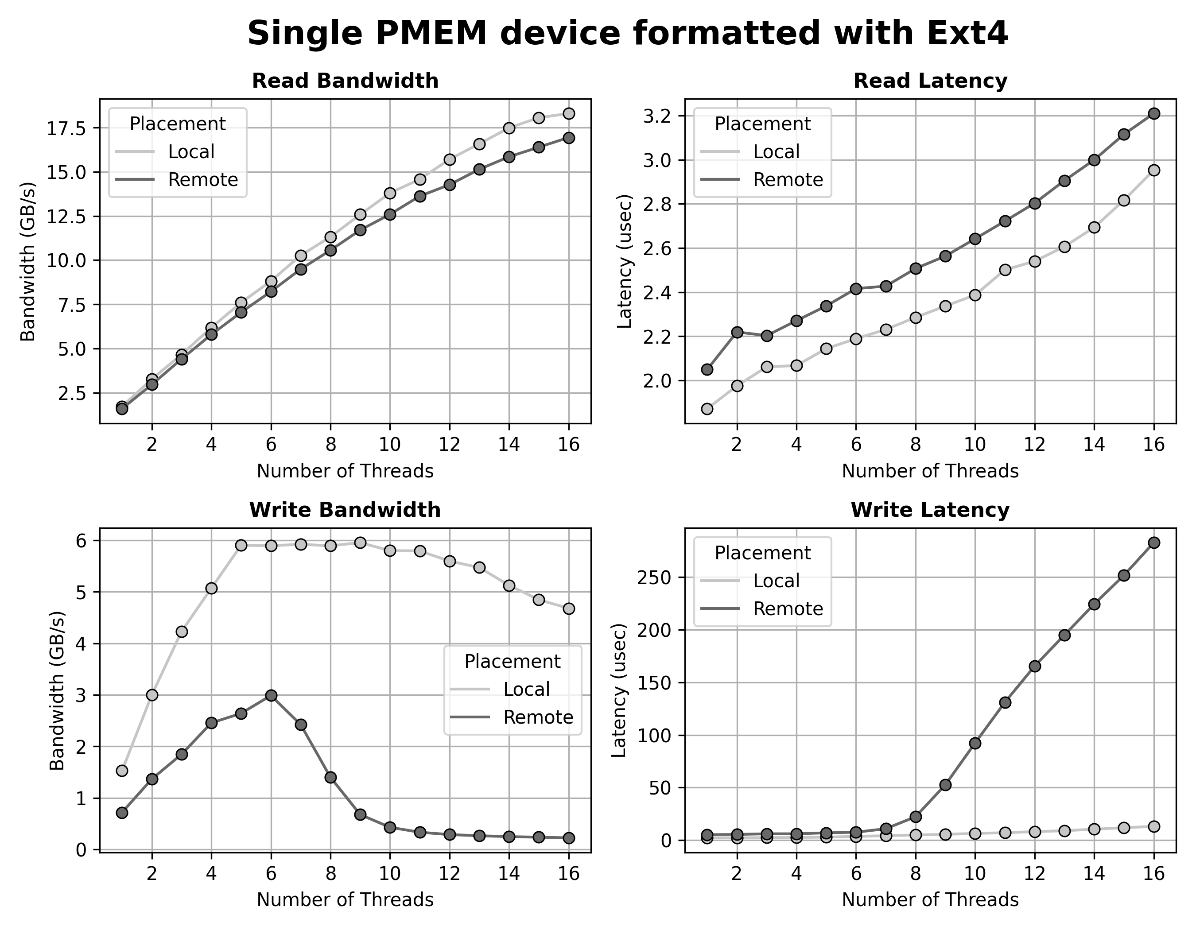
Fundamental Performance Characteristics of PMEM Modules
3 samples per measurement, we keep the latest sample
(1) For few threads, we have half the exp. write BW for remote accesses
(2) For more threads, we observe steep degradation of remote write BW
(1)
Conclusion
We wish to avoid remote writes in every way possible.
(2)

Slide 10
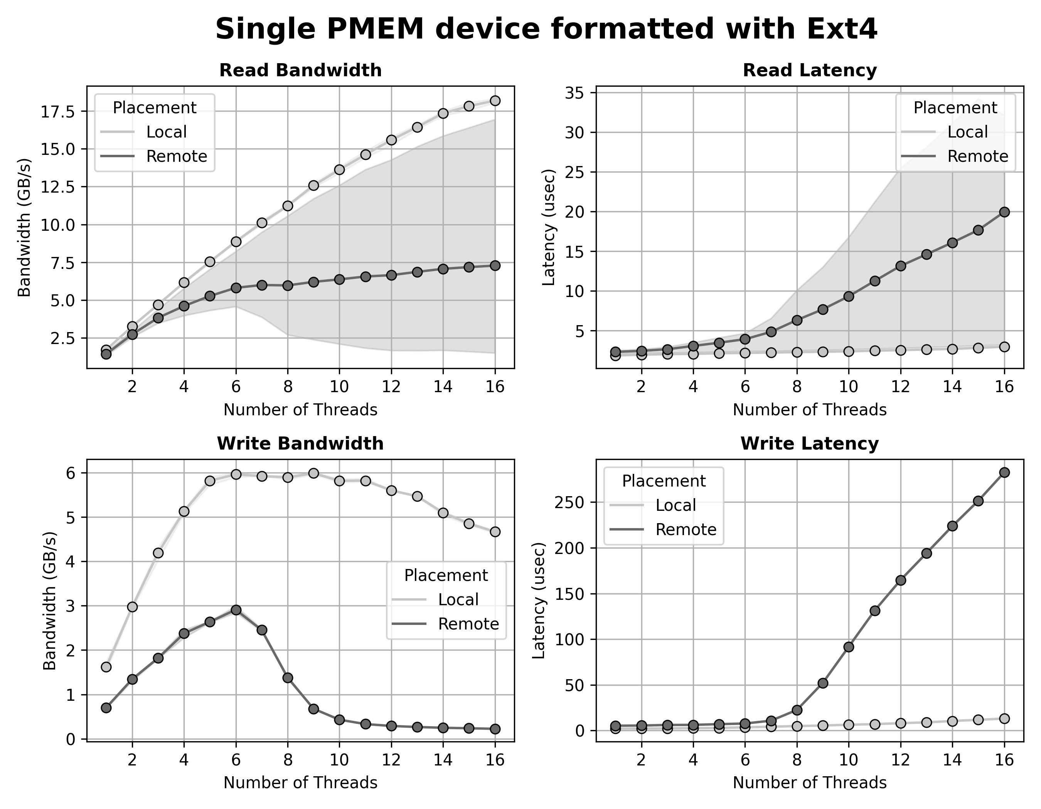
Things get only worse
3 samples per measurement, we keep every sample → shaded area indicates the range of the samples
Best sample
What is responsible for the significant deviation?
First sample preparation: the test files have just been allocated
First read sample: seems to follow the remote write curve
Second sample: not that much better
Mean of samples
Worst sample
Conclusion
We strongly wish to avoid remote writes in every way possible,
as remote writes seem to also affect remote reads!
~ Same curve

Slide 11
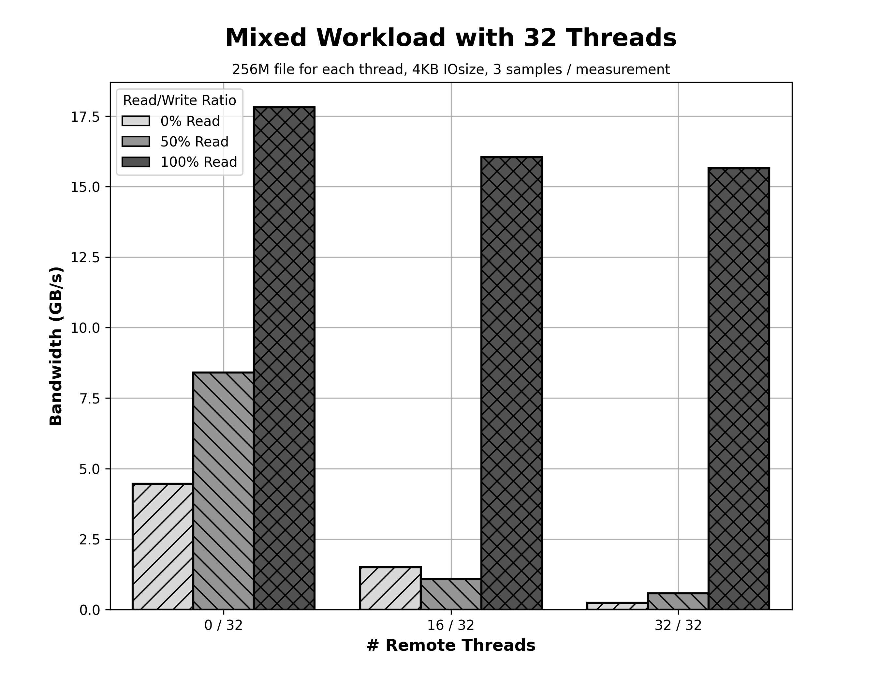
Behavior for mixed workloads
3 samples per measurement, we keep the best one
Since read accesses are affected by previous write accesses, it is logical to examine what’s the behavior of mixed accesses on files (reads + writes).
Conclusion
Mixed remote accesses suffer significantly from the effect of remote write accesses.
Όλα local
16 local + 16 remote
Όλα remote
Τοποθέτηση Νημάτων

Slide 12
Motivation for our Work
sched_setaffinity
System State (CPU & PMEM STATS)
NUMA NODE 0 THREADS
NUMA NODE 1 THREADS
Write accesses must take place locally (with respect to the NUMA nodes) when possible.
Write access categories:
Overwrites (Can be examined in future extension of this work)
Appends (Examined)
Thread Placement/Migration Module
Data to be written
Modified Filesystem
Place threads in a way that utilizes best the aggregate bandwidth of PMEM devices.
/dev/<some-device>
(Created some base infrastructure)
Use every single pmem module under a unifying device
NODE 0 NVDIMMS
NODE 1 NVDIMMS

Slide 13
1. Introduction
2. Motivation
3. Implementation
4. Evaluation
5. Extension

Slide 14
EXT4: Disk Layout (Background Info)
NUMA NODE 0
NUMA NODE 1
Ομαδοποίηση των blocks σε block groups
Block group 1
…
Block group n
…
Block group n
Divided in blocks
STORAGE
 |  | ... |  |  |  | ... |  |  |  | ... |  |  |  | ...
contains 2¹⁵ clusters
size of 128 ∙ (blocks ανά cluster) MB
4KB
Information held per group: Available inodes, Available directories, Available blocks
Cluster = least number of blocks per allocation (bigalloc feature)
Each block can be:
Either a metadata block (inodes, group descriptors, superblock etc.)
Or a data block of some file

Slide 15
EXT4: Relevant Optimizations (Background)
Locality Group Preallocation
Per Inode Preallocations
Stream Allocation
Each CPU has a preallocation pool.
Used to satisfy small requests.
For each block allocation of some file, we may allocate more space than requested.
We keep the excess as a preallocation for future use.
Big requests: We start allocating from the point where the previous stream allocation ended.
PREALLOC POOL
CPU 0
CPU 1
CPU 0
CPU 1
1
2
3
1. Request of 12KB for inode 12
3. Request for the next 2 KB of inode 12. We use the preallocation
1
2
3
Small req. to CPU 0
Small req. to CPU 1
2. Allocate 16 KB instead of 12ΚΒ
Big request to CPU 0
Big request to CPU 1
STORAGE
1
3
2
STORAGE
12ΚΒ
4ΚΒ
STORAGE
1
3
NEW
NEW
2
(Each inode preallocation is exclusive to a singular range of logical blocks of the file)

Slide 16
EXT4: Infrastructure
NUMA NODE 0
NUMA NODE 1
CPU 00
CPU 01
...
CPU 15
CPU 16
CPU 17
...
CPU 31
Request for block allocation
→ Purpose: All block allocations to happen locally (with respect to NUMA)
Linear concatenation of the address spaces (device mapper)
/dev/mapper/linear
Modified EXT4
1
1
1
2
2
2
…
n
n
n
1
1
1
2
2
2
…
n
n
n
/dev/pmem0
/dev/pmem1
ipmctl create –goal ... ndctl create namespace ...
4KB
4KB
1
2
…
n
1
2
…
n
1
2
…
n
1
2
…
n
1
2
…
n
1
2
…
n
nvdimm 0
nvdimm 1
nvdimm 2
nvdimm 3
nvdimm 4
nvdimm 5
NUMA NODE 0
NUMA NODE 1

Slide 17
(Meta)data Write Path
With the aid of the next perf command:
$ perf ftrace -a --inherit -T “<func_name>” command
as well as Elixir bootlin, we obtain the following function call sequences:
Metadata Allocation
Block Allocation
do_sys_open ↦
do_sys_openat2 ↦
do_filp_open ↦
path_openat ↦
open_last_lookups ↦
lookup_open ↦
ext4_create (ptr) ↦
__ext4_new_inode
vfs_write ↦
new_sync_write ↦
call_write_iter ↦
ext4_file_write_iter (ptr) ↦
ext4_dax_write_iter ↦
dax_iomap_rw ↦
iomap_apply ↦
ext4_iomap_begin (ptr) ↦
ext4_iomap_alloc ↦
ext4_map_blocks ↦
ext4_ext_map_blocks ↦
ext4_mb_new_blocks ↦
ext4_mb_regular_allocator
Candidate functions for examination

Slide 18


Metadata Allocation (Vanilla ext4)
__ext4_new_inode
directory?
find_group_orlov
find_group_other
Purpose:
Uniform distribution of first level directories
Purpose:
Keep files’ locality.
Uniform utilization of groups
Example: UNIX directory tree
(root)
bin
etc
...
home
tmp
cp
is
pwd
passwd
user
We want files under the same directory to be in the same group (to exploit locality)
bin
stuff

Slide 19
Metadata Allocation (Vanilla ext4)
__ext4_new_inode
directory?
find_group_orlov
find_group_other
Search for a group with enough free directories, inodes and blocks.
Elsewise: Search for a group with as many free inodes as possible.
Place inode in its parent’s group.
Elsewise: Search for group with enough free inodes and blocks.
Ideal Solution
Emergency Solution
Notes:
Σε αυτήν την διαφάνεια έχω συμπεριλάβει κάποιες λεπτομέρειες για την υλοποίηση των δύο inode allocators.
Το μόνο που χρειάζεται να διακρίνουμε είναι ότι σε κάθε allocator έχουμε ένα ισχυρό κριτήριο επιλογής group, ένα ασθενέστερο, και μια λύση ανάγκης σε περίπτωση που τα δύο προηγούμενα αποτύχουν.

Slide 20
Metadata Allocation (NUMA ext4)
__ext4_new_inode
directory?
find_group_orlov
find_group_other
Search for a group of this NUMA node with enough free directories, inodes and blocks.
Elsewise: Search for a group, starting from those in this group, with as many free inodes as possible.
Place inode in its parent’s group, if it happens to be in this NUMA node.
Elsewise: Search for group , starting from those in this group, with enough free inodes and blocks.
Ideal Solution
Emergency Solution
* this NUMA node = where the allocation routine is executed
Notes:
Σε αυτήν την διαφάνεια έχω συμπεριλάβει κάποιες λεπτομέρειες για την υλοποίηση των δύο inode allocators.
Το μόνο που χρειάζεται να διακρίνουμε είναι ότι σε κάθε allocator έχουμε ένα ισχυρό κριτήριο επιλογής group, ένα ασθενέστερο, και μια λύση ανάγκης σε περίπτωση που τα δύο προηγούμενα αποτύχουν.

Slide 21
Multiblock Allocator: Using Preallocations (Vanilla ext4)
Try to find a group preallocation:
First from this inode’s list
Later from my CPU’s list (*)
ext4_mb_new_blocks
(*) If not stream alloc.
Call mb_regular_allocator
Found?
Claim the storage space
...
...
Failed

Slide 22
Multiblock Allocator: Using Preallocations (NUMA ext4)
Try to find a group preallocation
(of the wanted node’s):
First from this inode’s list
Later from my CPU’s list (*)
ext4_mb_new_blocks
Next NUMA node
(*) If not stream alloc.
Call mb_regular_allocator (for the wanted node)
Found?
Claim the storage space
...
Failed
PREALLOC POOL
CPU 00
CPU 01
CPU 15
CPU 16
CPU 17
CPU 31
...
...
...
...
...
...
...
1
2
Stream alloc. Goal (node 0)
Stream alloc. Goal (node 1)
Data blocks of inode 14 (12 blocks)
Data blocks of inode 12
Preallocation for inode 14
STORAGE
1
2
NUMA NODE 0
NUMA NODE 1

Slide 23


Multiblock Allocator: Using Preallocations (NUMA ext4)
Try to find a group preallocation:
(of the wanted node’s):
First from this inode’s list
Later from my CPU’s list (*)
ext4_mb_new_blocks
Next NUMA node
(*) If not stream alloc.
Call mb_regular_allocator (for the wanted node)
Found?
Claim the storage space
...
Failed
PREALLOC POOL
CPU 00
CPU 01
CPU 15
CPU 16
CPU 17
CPU 31
...
...
...
...
...
...
...
1
2
CPU 01: Req. 4ΚΒ for inode 12
Stream alloc. Goal (node 0)
Stream alloc. Goal (node 1)
Data blocks of inode 14 (12 blocks)
Data blocks of inode 12
Preallocation for inode 14
STORAGE
1
2
NUMA NODE 0
NUMA NODE 1

Slide 24


Multiblock Allocator: Using Preallocations (NUMA ext4)
Try to find a group preallocation:
(of the wanted node’s):
First from this inode’s list
Later from my CPU’s list (*)
ext4_mb_new_blocks
Next NUMA node
(*) If not stream alloc.
Call mb_regular_allocator (for the wanted node)
Found?
Claim the storage space
...
Failed
PREALLOC POOL
CPU 00
CPU 01
CPU 15
CPU 16
CPU 17
CPU 31
...
...
...
...
...
...
...
2
CPU 01: Req. 8ΚΒ for inode 14
Stream alloc. Goal (node 0)
Stream alloc. Goal (node 1)
Data blocks of inode 14 (12 blocks)
Data blocks of inode 12
Preallocation for inode 14
STORAGE
2
NUMA NODE 0
NUMA NODE 1
Remote prealloc.
Remote prealloc.

Slide 25
Multiblock Allocator: Using Preallocations (NUMA ext4)
Try to find a group preallocation:
(of the wanted node’s):
First from this inode’s list
Later from my CPU’s list (*)
ext4_mb_new_blocks
Next NUMA node
Not a stream allocation
(*) If not stream alloc.
Call mb_regular_allocator (for the wanted node)
Found?
Claim the storage space
...
Failed
PREALLOC POOL
CPU 00
CPU 01
CPU 15
CPU 16
CPU 17
CPU 31
...
...
...
...
...
...
...
2
CPU 01: Req. 64ΚΒ for inode 12
Stream alloc. Goal (node 0)
Stream alloc. Goal (node 1)
Data blocks of inode 14 (12 blocks)
Data blocks of inode 12
Preallocation for inode 14
STORAGE
2
NUMA NODE 0
NUMA NODE 1

Slide 26
Multiblock Allocator: Stream Allocation
ext4_mb_regular_allocator
Function is responsible for allocating new blocks when necessary.
In its implementation, we examine how (optimization) stream allocation is used.
As seen, or our optimization it is sufficient to use a global stream alloc. goal per NUMA node.
Afterwards, we examine how it works and how we modified it.

Slide 27
Multiblock Allocator: Stream Allocation (Vanilla ext4)
- Goal = stream allocation goal (under stream alloc.)
- Criterion = 0
ext4_mb_regular_allocator
Input: allocation context
Found
For each group (starting from the goal) we search for one satisfying the criterion
Not found
...
Loosen criterion
Not possible
...
Criterion categories:
Cr | Condition for group
0 | Continuous blocks satisfy the request
1 | Enough blocks to satisfy the request
2 | None
Less strict criterion
Less optimal allocation

Slide 28
Multiblock Allocator: Stream Allocation (Vanilla ext4)
- Goal = stream allocation goal (under stream alloc.)
- Criterion = 0
ext4_mb_regular_allocator
Input: allocation context
Found
For each group (starting from the goal) we search for one satisfying the criterion
Not found
...
Loosen criterion
Not possible
...
Loosen Criterion
Goal
?
?
?
?
?
?
?
?
?
?
Block Groups
blk grp 0 | blk grp 1 | blk grp 2 | blk grp 3 | blk grp 4 | blk grp 5 | blk grp 6 | blk grp 7
STORAGE
NUMA NODE 0
NUMA NODE 1

Slide 29
Multiblock Allocator: Stream Allocation (NUMA ext4)
- Goal = stream allocation goal for the given node (under stream alloc.)
- Criterion = 0
ext4_mb_regular_allocator
Input: allocation context, NUMA node
Found
For each group of the given node (starting from the goal) we search for one satisfying the criterion
Not found
...
Loosen criterion
Not possible
...
Loosen Criterion
Goal
?
?
We searching group of another node
?
?
?
?
Block Groups
blk grp 0 | blk grp 1 | blk grp 2 | blk grp 3 | blk grp 4 | blk grp 5 | blk grp 6 | blk grp 7
STORAGE
NUMA NODE 0
NUMA NODE 1

Slide 30
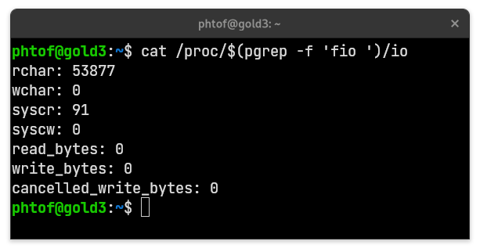
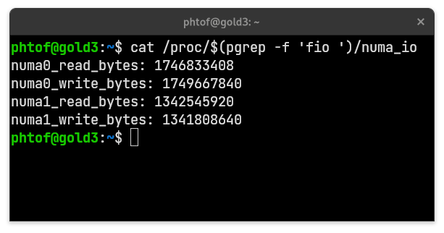
NUMA IO Accounting
The most important information for deciding on which node to place some thread:
Which NUMA node the thread reads from and writes to the most?
For Linux kernel version 5.13: 1) there is no IO statistics collection for DAX accesses, and
2) what collection does happen, is not on a per-node basis.
We modified some DAX and device mapper drivers so that better statistics may be provided via| a new procfs file.
No DAX accounting
Pre-existing interface (io)
New interface (numa_io)

Slide 31
Userspace Component *
How the userspace component functions:
procfs
popen(“ps”, “r”)
/proc/<pid>/stat
/proc/<pid>/numa_io
pmwatch
Read Hardware counters
Decision for where to place recorded threads
Userspace component
We collect statistics from:
Interfaces of procfs
Intel’s PMWatch for examining hardware counters, and
the ps executable, for keeping tab of running threads
(*) There was time only for a base implementation, more info on how it can be extended is in the thesis

Slide 32
Userspace Component
A summary of the thread placement policy implemented this far:
Based on this work
☑
PMEM congestion on some node?
❎
Relocate threads that append frequently
☑
CPU cores congestion on some node?
❎
Relocate threads with high CPU utilization
Relocate each thread to the node it accesses the most

Slide 33
1. Introduction
2. Motivation
3. Implementation
4. Evaluation
5. Extension

Slide 34



Methodology
Stability Assessment
Correctness Assessment
Aging of the filesystem via Geriatrix ⁽³⁾: repeated creation of files and directories, utilizing 90% of the available storage.
Done in 3 stages:
Execution of FIO ⁽¹⁾
Execution of modified Filebench ⁽²⁾
Execution of bash script doing IO via redirection
Later: Test if files have been placed as expected.
Result: (For 2) Reduction of miss rate from 50% down to < 5%
Visualizing our Results
Fully automated methodology ⁽⁴⁾ for:
Creating and mounting devices
Creating a suitable workspace on top of them
Collect experimentation results
Producing final figures
(1) https://github.com/axboe/fio
(2) https://github.com/filebench/filebench
(3) https://github.com/saurabhkadekodi/geriatrix
(4) https://github.com/PhTof/Diploma

Slide 35
Performance Evaluation
Types of device configuration
Single device
Linear map
/dev/mapper/linear
Vanilla EXT4
Vanilla EXT4
/dev/pmem0
/dev/pmem1
/dev/pmem0
/dev/pmem1
Striped map
Linear map (modified)
/dev/mapper/striped
Vanilla EXT4
/dev/mapper/linear
Modified EXT4
1 | 1 | 2 | 2 | 3 | 3 | ... | ... | n | n
1 | 2 | 3 | ... | n
1 | 2 | 3 | ... | n
/dev/pmem0
/dev/pmem1
/dev/pmem0
/dev/pmem1

Slide 36
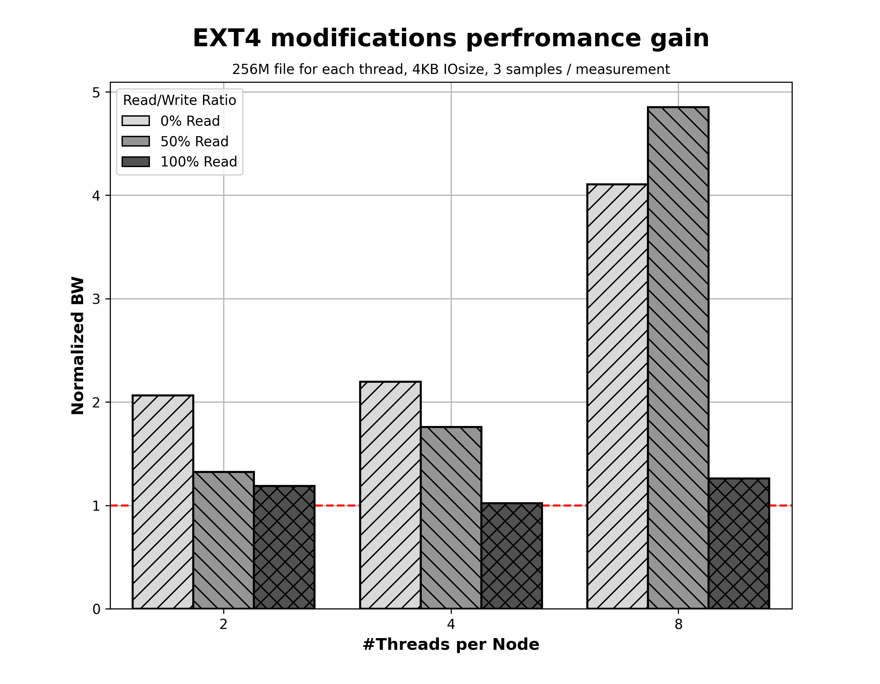
Performance Evaluation (FIO)
*
(*) Normalization Base:
Vanilla ext4 on a linear map

Slide 37
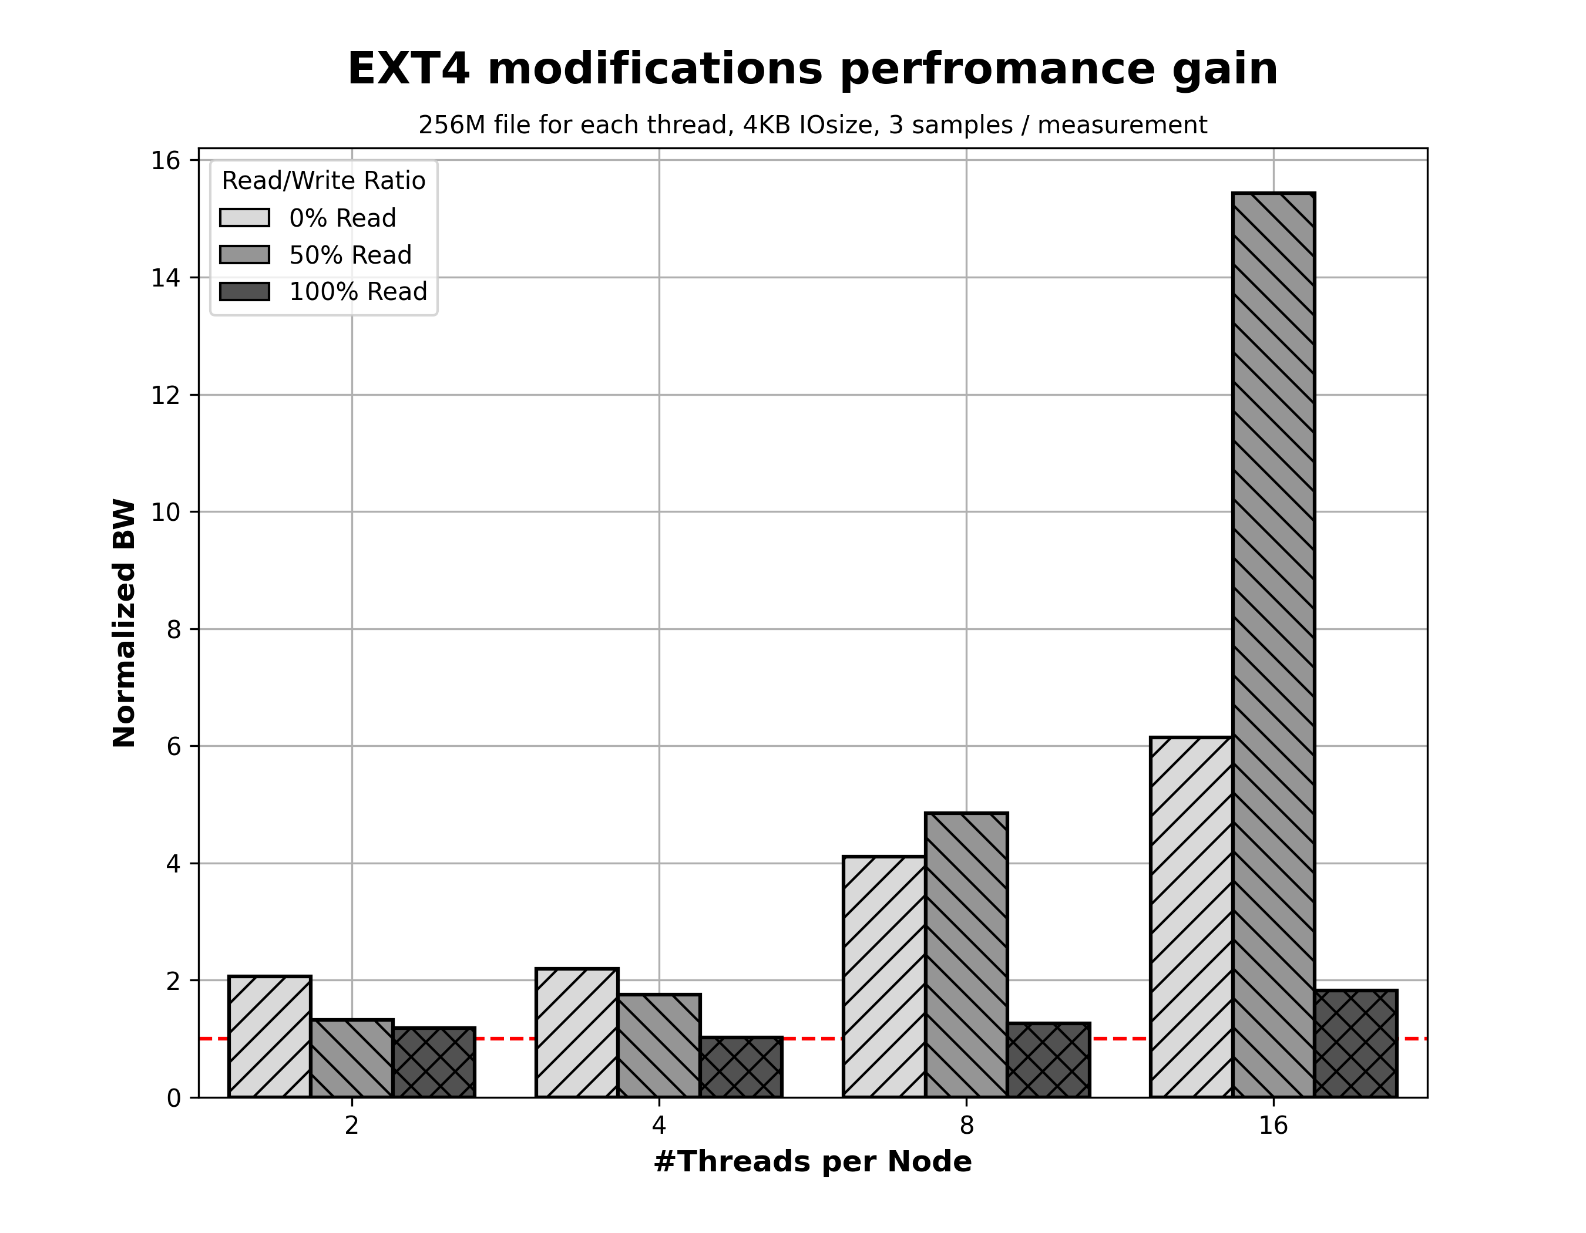
Performance Evaluation (FIO)
First step in correcting the problem in mixed accesses

Slide 38
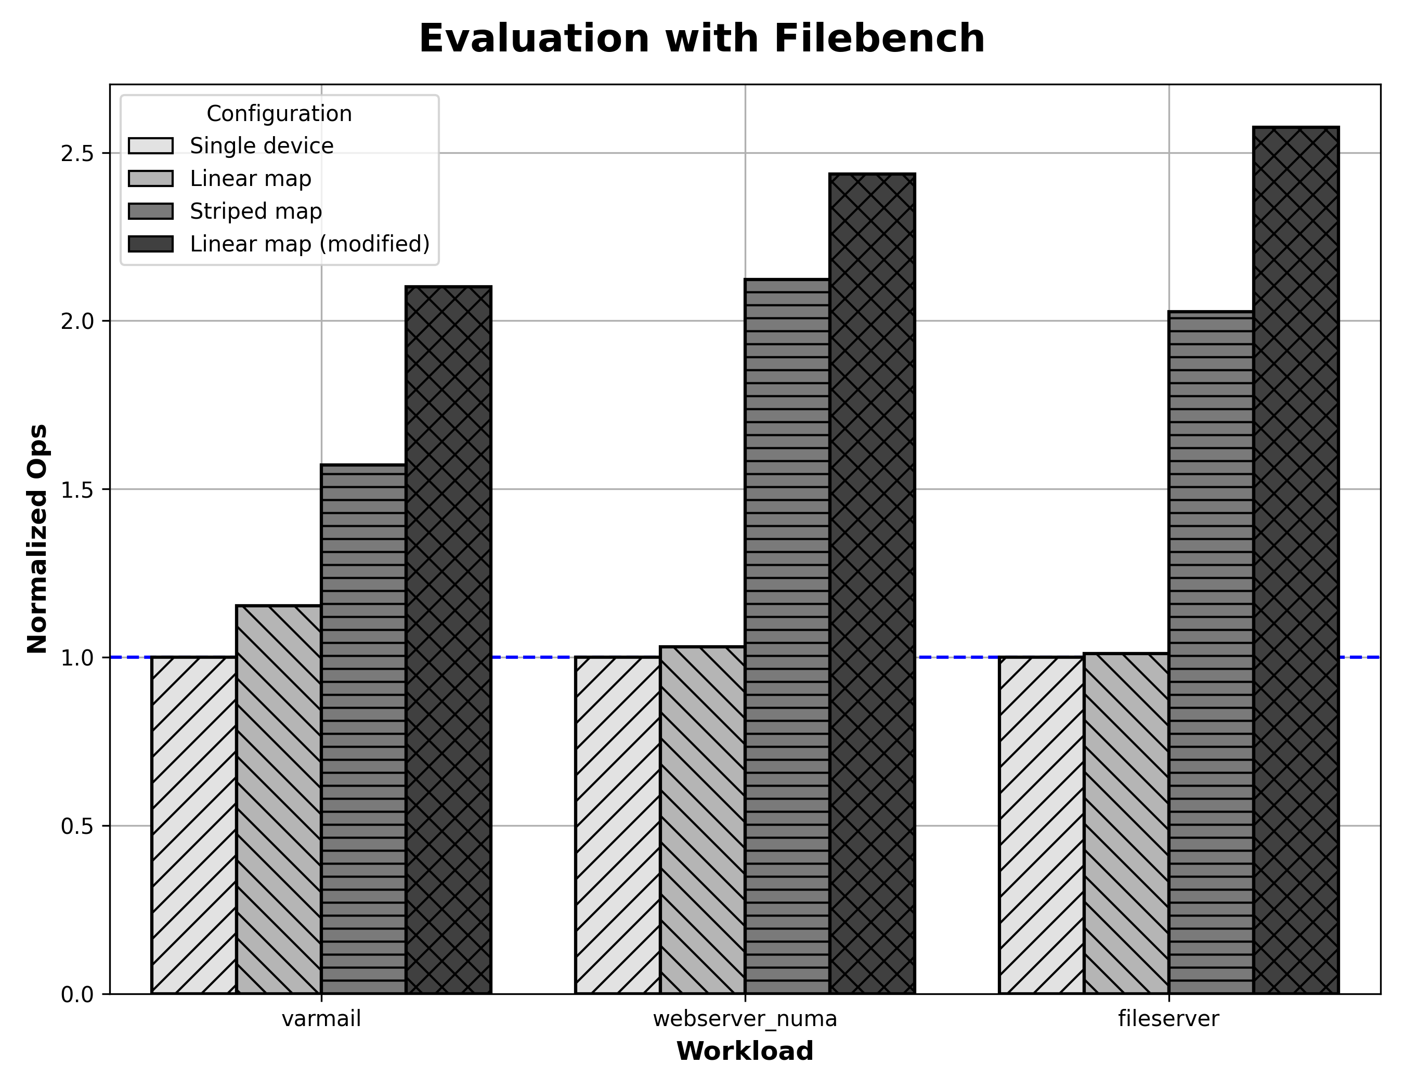
Performance Evaluation (Filebench)
*
(*) Normalization Base:
Single device with vanilla ext4
Workload | Improvement over linear vanilla | Improvement over striped vanilla
varmail | 82% | 34%
webserver_numa | 136% | 14%
fileserver | 154% | 27%

Slide 39
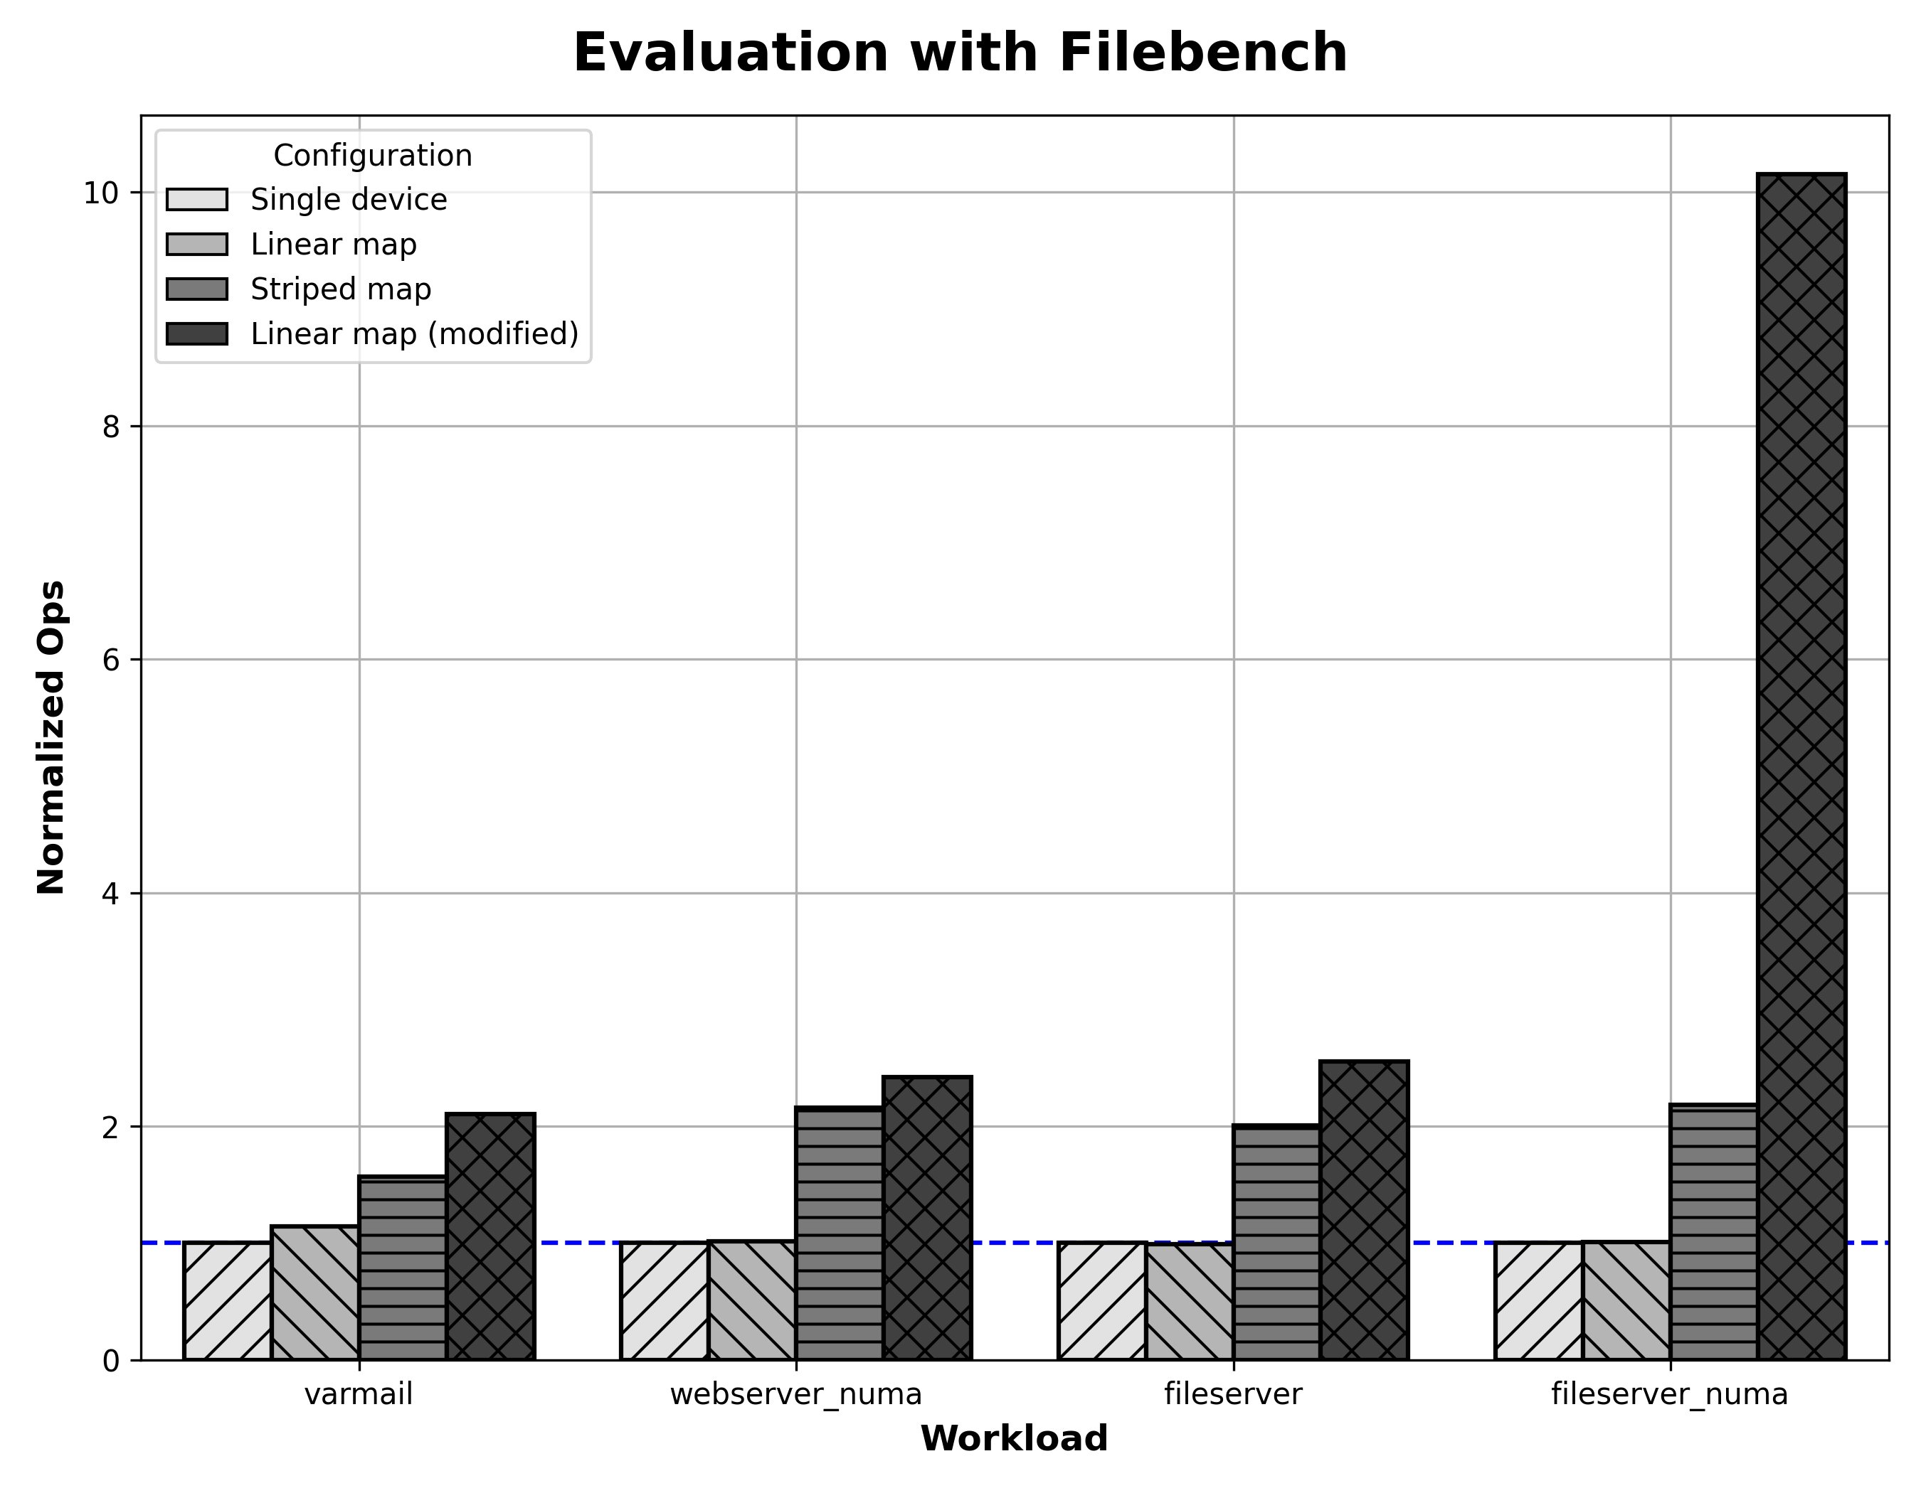
Performance Evaluation(Filebench)
*

Slide 40
1. Introduction
2. Motivation
3. Implementation
4. Evaluation
5. Extension

Slide 41
Possible solution for Overwrites: Disabling DAX on a Per-file basis (Ext4)
Socket 0
Socket 1
Core
Core
Core
Core
Core
Core
Read File 0 and File 1 from the same process
Core
Core
Disable DAX for File 0 →
Remote access via the page cache →
NUMA effect becomes smoother
LLC Cache
Mesh Interconnect
Page
Cache
DRAM
DRAM
DRAM
nvdimm 2
nvdimm 5
File 0
DAX off
File 1
DAX on
nvdimm 1
nvdimm 4
nvdimm 0
nvdimm 3
NUMA NODE 0
NUMA NODE 1

