Slide 1
Graphisoft Cloud dev patterns session 2019.11.11 Attila Balogh-Biró

Slide 2
Agenda
The Twelve-factor App
Cloud design patters classifications
Design patterns overview
Azure Spring Cloud demo
Notes:
The contributors to this document have been directly involved in the development and deployment of hundreds of apps, and indirectly witnessed the development, operation, and scaling of hundreds of thousands of apps via our work on the Heroku platform.

Slide 3
The Twelve-factor App

Slide 4
Twelve-factor apps background
Software erosion
Adam Wiggins
https://github.com/heroku/12factor
Notes:
The contributors to this document have been directly involved in the development and deployment of hundreds of apps, and indirectly witnessed the development, operation, and scaling of hundreds of thousands of apps via our work on the Heroku platform.
This document synthesizes all of our experience and observations on a wide variety of software-as-a-service apps in the wild. It is a triangulation on ideal practices for app development, paying particular attention to the dynamics of the organic growth of an app over time, the dynamics of collaboration between developers working on the app’s codebase, and avoiding the cost of software erosion.
Adam Wiggins hacker, entrepreneur, heroku founder

Slide 5
Twelve-factor apps are
Use declarative formats for setup automation, to minimize time and cost for new developers joining the project;
Have a clean contract with the underlying operating system, offering maximum portability between execution environments;
Are suitable for deployment on modern cloud platforms, obviating the need for servers and systems administration;
Minimize divergence between development and production, enabling continuous deployment for maximum agility;
And can scale up without significant changes to tooling, architecture, or development practices.

Slide 6
The factors
I. Codebase
II. Dependencies
III. Config
IV. Backing services
V. Build, release, run
VI. Processes
VII. Port binding
VIII. Concurrency
IX. Disposability
X. Dev/prod parity
XI. Logs
XII. Admin processes
Notes:
I. Codebase
One codebase tracked in revision control, many deploys
II. Dependencies
Explicitly declare and isolate dependencies
III. Config
Store config in the environment
IV. Backing services
Treat backing services as attached resources
V. Build, release, run
Strictly separate build and run stages
VI. Processes
Execute the app as one or more stateless processes
VII. Port binding
Export services via port binding
VIII. Concurrency
Scale out via the process model
IX. Disposability
Maximize robustness with fast startup and graceful shutdown
X. Dev/prod parity
Keep development, staging, and production as similar as possible
XI. Logs
Treat logs as event streams
XII. Admin processes
Run admin/management tasks as one-off processes

Slide 7
Codebase
Use version control
One repository / application to ease CI/CD pipelines
Code should not be shared between applications
Notes:
Code should not be shared between applications — you can’t add dependencies of deployable services (think Spring Boot or Play applications) on each other. So, if there is common code you want to use across applications, create a repo for that code as a library, publish it to Maven, and integrate using Maven, sbt, Gradle or any other tool you prefer.

Slide 8
Dependencies
Avoid copy pasting dependencies to the project codebase, use dependency management tools
If you are depending libraries which belongs to the environment, ensure that you are using the proper versions, so all environments are in sync

Slide 9
Backing services
Infrastructure related service like database, message brokers or any API accessible consumer services like IDMs, GitHub etc.
The key aspect is you must be able to easily swap this kind of backing services from one provider to another without code changes
Use interfaces as an abstraction layer and change the behavior dynamically
Notes:
In order to solve for this challenge, we generally suggest coding to Interfaces where you create a Façade which can be used by an application to integrate with backing services.
Depending upon the configurations (e.g., in Spring Boot .yml file) we can inject the appropriate backing service at runtime. A Plugin based architecture also provides a way to add support for different types of services using a Façade to an application.

Slide 10
Config
Configurations are a central part of any application, specifically when there is a need to support multiple environments or clients
The assumption is that all configuration are stored in .config, .yml, .json or .properties and not in the code
There should be a strict separation between config and code
Centralized config management good be an options as well
Notes:
Database connection properties
· Backing services credentials and connection information
· Application environment specific information such as Host IP, Port, etc.
There should be a strict separation between config and code. Code should remain the same irrespective of where the application is being deployed, but configurations can vary.
So the rule of thumb is, Properties, which vary depending upon the environment or client, should go into config files as in the examples above. REST endpoints/API (URI) and other components that don’t vary can be safely put into the code.
In order to achieve the above, most frameworks support the use of System Environment variables inside configuration files. For instance, in the Spring Boot yaml file you can write:
Security.oauth2.client.clientSecret: ${CL_SERVICE_PASSWORD}

Slide 11
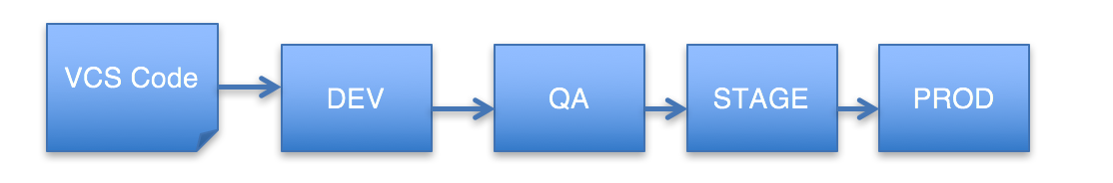
Build, release, run
A twelve-factor application requires a strict separation between Build, Release and Run stages
Notes:
Build
The Build phase takes code from VCS and builds an executable bundle. For Java/Scala environments, it’s mostly JAR, though with Spring Boot you can generate executables such as deb, rpm, etc. For now, I’ll focus on JAR.
Ideally, this stage should also take care of executing all Unit Tests available in an application. If tests fail, then the entire process should be abandoned as you don’t want a failing application deployed.
This can be assumed as Continuous Integration (CI) where code from the VCS is continuously pulled as and when changed by a team member and built on a server. Make sure your builds are fast to get quicker feedback since this is a stage that tends to fail.
Release
In this stage, an executable build is combined with environment specific configurations, assigned a unique release number, and made ready to execute on the environment.
Run
Finally, the package is executed on an environment using the necessary execution commands. This can be seen as Continuous Deployment once pipeline and all previous stages pass.

Slide 12
Processes
This factor is focused on executing the app as one or more stateless processes
A Process is an application running on server
Make the process stateless as much as possible, see load balanced environments, auto-scaling capabilities

Slide 13
Processes general best practices
Use a database to store state if needed for subsequent requests
Avoid using sticky-session, and instead use scalable cache stores such as Memcached or Redis for storing session information
Package assets in executables (e.g. by using webjars at build time)

Slide 14
Port Binding
Twelve-Factor acts as a standalone service and is self contained
The Port on which the application is connected to is also stored in Config
This approach also helps in Backing Services communication

Slide 15
Concurrency
Don’t rely too much on threads in an application as vertical scaling can be limited for process running on server
Adhere to Process guidelines to achieve Horizontal Scaling
Don’t daemonize or write PID for app process as the platform process manages handle processes better

Slide 16
Disposability
Processes in twelve-factor apps should be started or stopped in minimal time
Similarly Run and Stop should be minimal to avoid catastrophic failures between different applications working as backing services
Disposability is also about keeping HTTP requests short which sometimes is not possible
The implicit message in this factor is to provide resiliency and automated scaling of application processes
Notes:
Consider the example of a retail website which has services such as web-app, auth-service, catalogue-service, order-service, etc. In the case of failure of a process of order-service, the user should still be able to access the website and eventually within no time should be able to order immediately as order-service comes up.
The implicit message in this factor is to provide resiliency and automated scaling of application processes, which is generally easier to achieve with Cloud and Containerized deployments.

Slide 17
Logs
Twelve-factor apps should not be concerned about routing and storage of it’s output stream or writing/managing logfiles
The app will write it’s event stream to stdout.
There are plenty of logging frameworks and log aggregation frameworks available
Notes:
Consider the example of a retail website which has services such as web-app, auth-service, catalogue-service, order-service, etc. In the case of failure of a process of order-service, the user should still be able to access the website and eventually within no time should be able to order immediately as order-service comes up.
The implicit message in this factor is to provide resiliency and automated scaling of application processes, which is generally easier to achieve with Cloud and Containerized deployments.

Slide 18
Cloud design patterns

Slide 19
Cloud design patterns classification
Availability
Data management
Design and implementation
Messaging
Management and monitoring
Performance and Scalability
Resiliency
Security
Notes:
Availability
is the proportion of time that the system is functional and working, usually measured as a percentage of uptime. It can be affected by system errors, infrastructure problems,
malicious attacks, and system load.
Cloud applications typically provide users with a service level agreement (SLA),
so applications must be designed to maximize availability
Data Management
Data management is the key element of cloud applications,
and influences most of the quality attributes. Data is typically hosted in different locations and across multiple servers
for reasons such as performance, scalability or availability, and this can present a range of challenges.
For example, data consistency must be maintained,
and data will typically need to be synchronized across different locations
Design and impl:
Good design encompasses factors such as consistency and coherence in component design and deployment, maintainability to simplify administration and development,
and reusability to allow components and subsystems to be used in other applications and in other scenarios. Decisions made during the design and implementation phase have a huge impact on the quality and the total cost of ownership of cloud hosted applications and services.
Messaging:
The distributed nature of cloud applications requires a messaging infrastructure that connects the components and services, ideally in a loosely coupled manner in order to maximize scalability
Management and Monitoring
Cloud applications run in a remote datacenter where you do not have full control of the infrastructure or, in some cases, the operating system.
This can make management and monitoring more difficult than an on-premises deployment.
Applications must expose runtime information that administrators and operators
can use to manage and monitor the system, as well as supporting changing business requirements and customization without requiring the application to be stopped or redeployed.
Security
Security is the capability of a system to prevent malicious or accidental actions outside of the designed usage, and to prevent disclosure or loss of information.
Cloud applications are exposed on the Internet outside trusted on-premises boundaries,
are often open to the public, and may serve untrusted users.
Applications must be designed and deployed in a way that protects them from malicious attacks,
restricts access to only approved users, and protects sensitive data

Slide 20
Availability patterns
Health Endpoint monitoring
Queue-Based Load leveling
Throttling
Etc.
Notes:
HEM:
Implement functional checks in an application that external tools can access through exposed endpoints at regular intervals. This can help to verify that applications and services are performing correctly.
QBLL:
Many solutions in the cloud involve running tasks that invoke services. In this environment, if a service is subjected to intermittent heavy loads, it can cause performance or reliability issues.
Use a queue that acts as a buffer between a task and a service it invokes in order to smooth intermittent heavy loads that can cause the service to fail or the task to time out. This can help to minimize the impact of peaks in demand on availability and responsiveness for both the task and the service.

Slide 21
Data management
Cache-Aside
CQRS
Event Sourcing
Static Content Hosting
Etc.

Slide 22
Design and implementation
Ambassador
Anti-corruption Layer
External Configuration Store
Gateway Aggregation
Sidecar
Leader election
Etc.
Notes:
Consider the example of a retail website which has services such as web-app, auth-service, catalogue-service, order-service, etc. In the case of failure of a process of order-service, the user should still be able to access the website and eventually within no time should be able to order immediately as order-service comes up.
The implicit message in this factor is to provide resiliency and automated scaling of application processes, which is generally easier to achieve with Cloud and Containerized deployments.

Slide 23
Messaging
Asynchronous request-reply
Pipes and Filters
Publish-Subscriber
Etc.
Notes:
Consider the example of a retail website which has services such as web-app, auth-service, catalogue-service, order-service, etc. In the case of failure of a process of order-service, the user should still be able to access the website and eventually within no time should be able to order immediately as order-service comes up.
The implicit message in this factor is to provide resiliency and automated scaling of application processes, which is generally easier to achieve with Cloud and Containerized deployments.

Slide 24
Resiliency
Circuit breaker
Service discovery
Compensating transaction
Retry
Etc.
Notes:
Consider the example of a retail website which has services such as web-app, auth-service, catalogue-service, order-service, etc. In the case of failure of a process of order-service, the user should still be able to access the website and eventually within no time should be able to order immediately as order-service comes up.
The implicit message in this factor is to provide resiliency and automated scaling of application processes, which is generally easier to achieve with Cloud and Containerized deployments.

Slide 25
Security
Federated Indentity
Gatekeeper
Valet Key
Notes:
Consider the example of a retail website which has services such as web-app, auth-service, catalogue-service, order-service, etc. In the case of failure of a process of order-service, the user should still be able to access the website and eventually within no time should be able to order immediately as order-service comes up.
The implicit message in this factor is to provide resiliency and automated scaling of application processes, which is generally easier to achieve with Cloud and Containerized deployments.

Slide 26
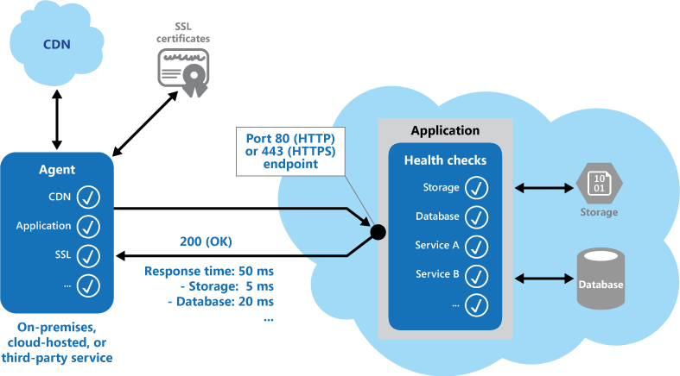
Health Endpoint monitoring pattern
Notes:
Implement health monitoring by sending requests to an endpoint on the application.
The application should perform the necessary checks, and return an indication of its status.
A health monitoring check typically combines two factors:
The checks (if any) performed by the application or service in response to the request to the health verification endpoint.
Analysis of the results by the tool or framework
that performs the health verification check.
The response code indicates the status of the application and, optionally, any components or services it uses.
The latency or response time check is performed by the monitoring tool or framework. The figure provides an overview of the pattern.

Slide 27
Issues
How to validate the response?
The number of endpoints to expose for an application
Caching the endpoint status
Notes:
How to validate the response. For example, is just a single 200 (OK) status code sufficient to verify the application is working correctly? While this provides the most basic measure of application availability,
and is the minimum implementation of this pattern, it provides little information about the operations,
trends, and possible upcoming issues in the application
One approach is to expose at least one endpoint for the core services that the application uses and another for lower priority services, allowing different levels of importance to be assigned to each monitoring result.
Also consider exposing more endpoints, such as one for each core service, for additional monitoring granularity.
Whether to use the same endpoint for monitoring as is used for general access, but to a specific path designed for health verification checks, for example, /HealthCheck/{GUID}/ on the general access endpoint. This allows some functional tests in the application to be run by the monitoring tools, such as adding a new user registration, signing in, and placing a test order, while also verifying that the general access endpoint is available
Caching the endpoint status. It could be expensive to run the health check too frequently.
If the health status is reported through a dashboard, for example, you don't want every request from the dashboard to trigger a health check. Instead, periodically check the system health and cache the status. Expose an endpoint that returns the cached status.

Slide 28
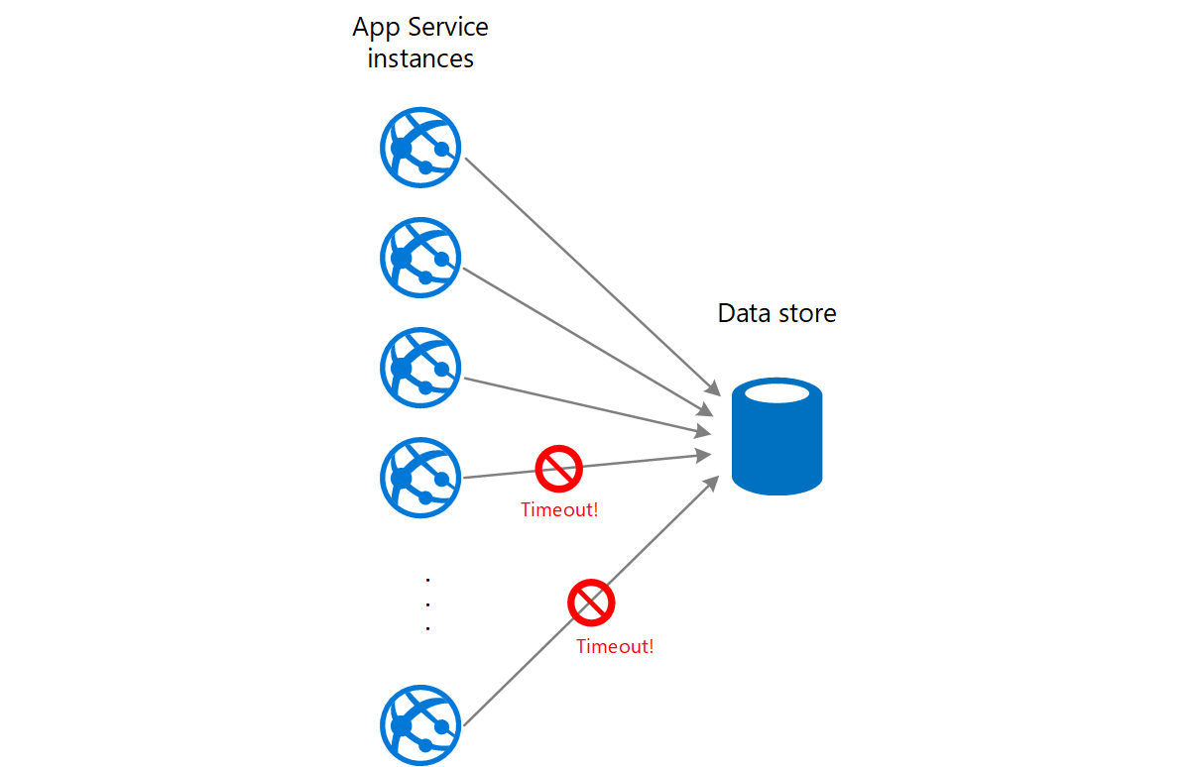
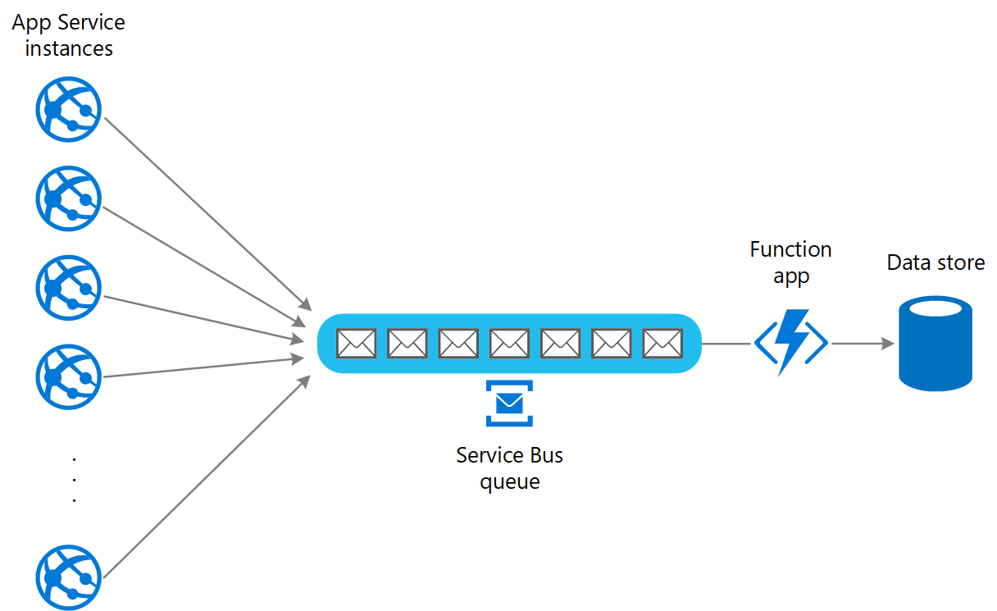
Queue based load leveling
Notes:
Many solutions in the cloud involve running tasks that invoke services.
In this environment, if a service is subjected to intermittent heavy loads, it can cause performance or reliability issues.
A service could be part of the same solution as the tasks that use it, or it could be a third-party service providing access to frequently used resources such as a cache or a storage service.
If the same service is used by a number of tasks running concurrently,
it can be difficult to predict the volume of requests to the service at any time.
A service might experience peaks in demand that cause it to overload and be unable to respond
to requests in a timely manner.
Flooding a service with a large number of concurrent requests can
also result in the service failing if it's unable to handle the contention these requests cause.
Solution
Refactor the solution and introduce a queue between the task and the service.
The task and the service run asynchronously.
The task posts a message containing the data required by the service to a queue.
The queue acts as a buffer, storing the message until it's retrieved by the service.
The service retrieves the messages from the queue and processes them.
Requests from a number of tasks, which can be generated at a highly variable rate, can be passed to the service through the same message queue. This figure shows using a queue to level the load on a service.

Slide 29
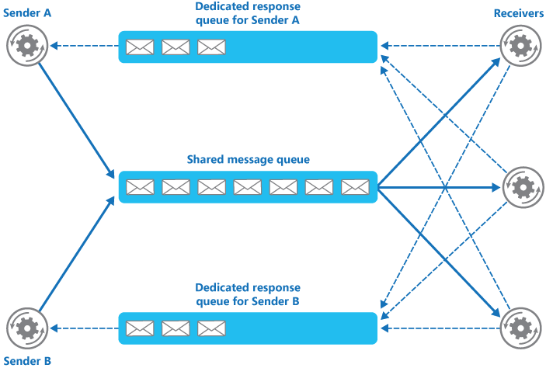
Queue based load leveling
Notes:
Request/response messaging. In this pattern a sender posts a message to a queue and expects a response from the receiver. You can use this pattern to implement a reliable system where you must confirm that a message has been received and processed. If the response is not delivered within a reasonable interval, the sender can either send the message again or handle the situation as a timeout or failure. This pattern usually requires a separate communications channel in the form of a dedicated message queue to which the receiver can post its response messages (the sender can provide the details of this queue as part of the message that it posts to the receiver). The sender listens for a response on this queue. This pattern typically requires some form of correlation to enable the sender to determine which response message corresponds to which request sent to the receiver.

Slide 30
Issues
Latency
Additional service.
Scaling.
How to partition the anti-corruption layer.
How ACL will be integrated into your monitoring, release, and configuration processes?
Transaction behavior, data consistency
If the anti-corruption layer is part of an application migration strategy, consider whether it will be permanent, or will be retired after all legacy functionality has been migrated.
Notes:
The anti-corruption layer may add latency to calls made between the two systems.
The anti-corruption layer adds an additional service that must be managed and maintained.
Consider how your anti-corruption layer will scale.
Consider whether you need more than one anti-corruption layer. You may want to decompose functionality into multiple services using different technologies or languages, or there may be other reasons to partition the anti-corruption layer.
Consider how the anti-corruption layer will be managed in relation with your other applications or services. How will it be integrated into your monitoring, release, and configuration processes?
Make sure transaction and data consistency are maintained and can be monitored.
Consider whether the anti-corruption layer needs to handle all communication between different subsystems, or just a subset of features.
If the anti-corruption layer is part of an application migration strategy, consider whether it will be permanent, or will be retired after all legacy functionality has been migrated.
See Strangler pattern

Slide 31
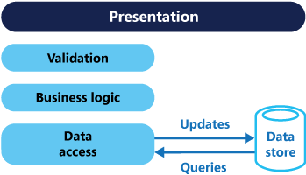
CQRS context and problem
Notes:
In traditional architectures, the same data model is used to query and update a database.
That's simple and works well for basic CRUD operations.
In more complex applications, however, this approach can become unwieldy.
For example, on the read side, the application may perform many different queries, returning data transfer objects (DTOs) with different shapes.
Object mapping can become complicated.
On the write side, the model may implement complex validation and business logic. As a result, you can end up with an overly complex model that does too much.
Read and write workloads are often asymmetrical, with very different performance and scale requirements.
There is often a mismatch between the read and write representations of the data, such as additional columns or properties that must be updated correctly even though they aren't required as part of an operation.
Data contention can occur when operations are performed in parallel on the same set of data.
The traditional approach can have a negative effect on performance due to load on the data store and data access layer, and the complexity of queries required to retrieve information.
Managing security and permissions can become complex, because each entity is subject to both read and write operations, which might expose data in the wrong context.

Slide 32
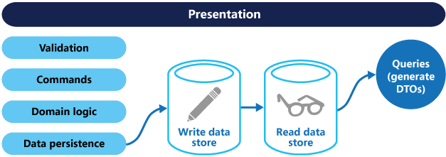
CQRS solution
Notes:
CQRS separates reads and writes into different models, using commands to update data, and queries to read data.
Commands should be task based, rather than data centric. ("Book hotel room", not "set ReservationStatus to Reserved").
Commands may be placed on a queue for asynchronous processing, rather than being processed synchronously.
Queries never modify the database. A query returns a DTO that does not encapsulate any domain knowledge.
The models can then be isolated, as shown in the following diagram, although that’s not an absolute requirement.
If separate read and write databases are used, they must be kept in sync.
Typically this is accomplished by having the write model publish an event whenever it updates the database.
Updating the database and publishing the event must occur in a single transaction.
Benefits of CQRS include:
Independent scaling. CQRS allows the read and write workloads to scale independently, and may result in fewer lock contentions.
Optimized data schemas. The read side can use a schema that is optimized for queries,
while the write side uses a schema that is optimized for updates.
Security. It's easier to ensure that only the right domain entities are performing writes on the data.
Separation of concerns. Segregating the read and write sides can result in models that are more maintainable and flexible.
Most of the complex business logic goes into the write model. The read model can be relatively simple.
Simpler queries. By storing a materialized view in the read database, the application can avoid complex joins when querying.

Slide 33
Issues
Latency
Additional service.
Scaling.
How to partition the anti-corruption layer.
How ACL will be integrated into your monitoring, release, and configuration processes?
Transaction behavior, data consistency
If the anti-corruption layer is part of an application migration strategy, consider whether it will be permanent, or will be retired after all legacy functionality has been migrated.
Notes:
The anti-corruption layer may add latency to calls made between the two systems.
The anti-corruption layer adds an additional service that must be managed and maintained.
Consider how your anti-corruption layer will scale.
Consider whether you need more than one anti-corruption layer. You may want to decompose functionality into multiple services using different technologies or languages, or there may be other reasons to partition the anti-corruption layer.
Consider how the anti-corruption layer will be managed in relation with your other applications or services. How will it be integrated into your monitoring, release, and configuration processes?
Make sure transaction and data consistency are maintained and can be monitored.
Consider whether the anti-corruption layer needs to handle all communication between different subsystems, or just a subset of features.
If the anti-corruption layer is part of an application migration strategy, consider whether it will be permanent, or will be retired after all legacy functionality has been migrated.
See Strangler pattern

Slide 34
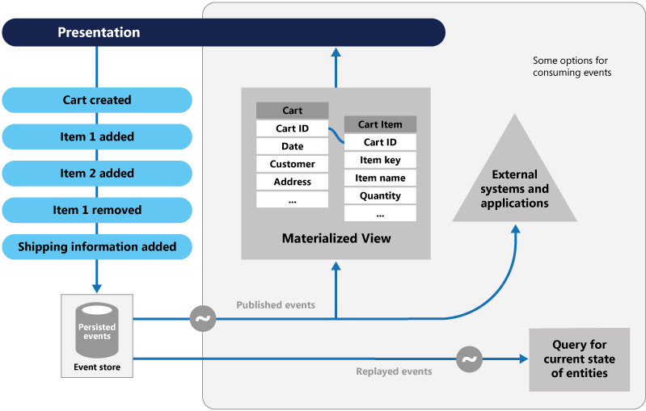
Event Sourcing context and problem
Notes:
Implement health monitoring by sending requests to an endpoint on the application.
The application should perform the necessary checks, and return an indication of its status.
A health monitoring check typically combines two factors:
The checks (if any) performed by the application or service in response to the request to the health verification endpoint.
Analysis of the results by the tool or framework
that performs the health verification check.
The response code indicates the status of the application and, optionally, any components or services it uses.
The latency or response time check is performed by the monitoring tool or framework. The figure provides an overview of the pattern.

Slide 35
Event Sourcing
Notes:
The fundamental idea of Event Sourcing is that of ensuring every change to the state of an application
is captured in an event object, and that these event objects are themselves stored
in the sequence they were applied for the same lifetime as the application state itself.
Instead of storing the state of an entity in the database,
you store the series of changes that led to that state.
An event is immutable once it is created, meaning that you only have to implement two operations,
CREATE and READ. If an entity is updated or removed,
that is realized using the creation of an “update” or “remove” event.
The simplest way to think of using Event Sourcing is to calculate a requested application state by
starting from a blank application state and then applying the events to reach the desired state.
It's equally simple to see why this is a slow process, particularly if there are many events.
In many applications it's more common to request recent application states,
if so a faster alternative is to store the current application state and if someone wants the special features that Event Sourcing offers then that additional capability is built on top.
Application states can be stored either in memory or on disk. Since an application state is purely derivable from the event log, you can cache it anywhere you like

Slide 36
Issues
Latency
Additional service.
Scaling.
How to partition the anti-corruption layer.
How ACL will be integrated into your monitoring, release, and configuration processes?
Transaction behavior, data consistency
If the anti-corruption layer is part of an application migration strategy, consider whether it will be permanent, or will be retired after all legacy functionality has been migrated.
Notes:
The anti-corruption layer may add latency to calls made between the two systems.
The anti-corruption layer adds an additional service that must be managed and maintained.
Consider how your anti-corruption layer will scale.
Consider whether you need more than one anti-corruption layer. You may want to decompose functionality into multiple services using different technologies or languages, or there may be other reasons to partition the anti-corruption layer.
Consider how the anti-corruption layer will be managed in relation with your other applications or services. How will it be integrated into your monitoring, release, and configuration processes?
Make sure transaction and data consistency are maintained and can be monitored.
Consider whether the anti-corruption layer needs to handle all communication between different subsystems, or just a subset of features.
If the anti-corruption layer is part of an application migration strategy, consider whether it will be permanent, or will be retired after all legacy functionality has been migrated.
See Strangler pattern

Slide 37
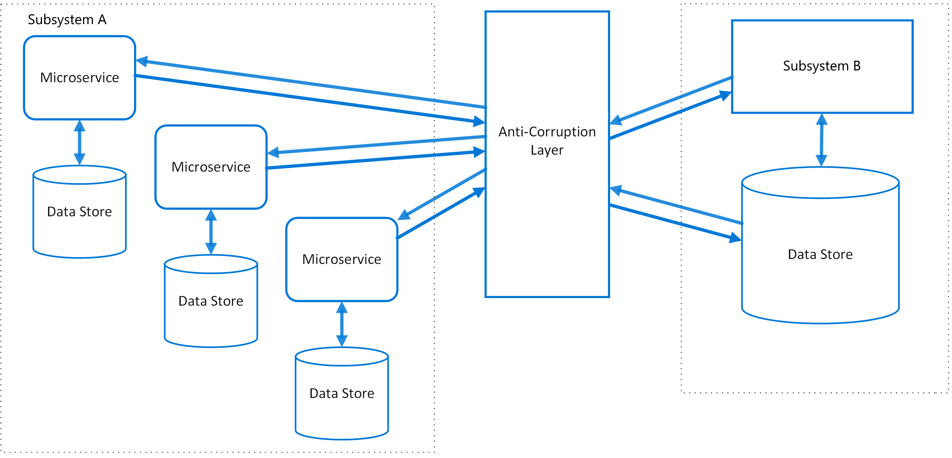
Anti-corruption layer context
Notes:
Most applications rely on other systems for some data or functionality.
For example, when a legacy application is migrated to a modern system, it may still need existing legacy resources.
New features must be able to call the legacy system. This is especially true of gradual migrations, where different features of a larger application are moved to a modern system over time.
Often these legacy systems suffer from quality issues such as convoluted data schemas or obsolete APIs.
The features and technologies used in legacy systems can vary widely from more modern systems.
To interoperate with the legacy system, the new application may need to support outdated infrastructure, protocols, data models, APIs,
or other features that you wouldn't otherwise put into a modern application.
Maintaining access between new and legacy systems can force the new system to adhere to at least some of the legacy system's APIs or other semantics. When these legacy features have quality issues, supporting them "corrupts" what might otherwise be a cleanly designed modern application.
Similar issues can arise with any external system that your development team doesn't control, not just legacy systems.
Solution
Isolate the different subsystems by placing an anti-corruption layer between them. This layer translates communications between the two systems, allowing one system to remain unchanged while the other can avoid compromising its design and technological approach.

Slide 38
Issues
Latency
Additional service.
Scaling.
How to partition the anti-corruption layer.
How ACL will be integrated into your monitoring, release, and configuration processes?
Transaction behavior, data consistency
If the anti-corruption layer is part of an application migration strategy, consider whether it will be permanent, or will be retired after all legacy functionality has been migrated.
Notes:
The anti-corruption layer may add latency to calls made between the two systems.
The anti-corruption layer adds an additional service that must be managed and maintained.
Consider how your anti-corruption layer will scale.
Consider whether you need more than one anti-corruption layer. You may want to decompose functionality into multiple services using different technologies or languages, or there may be other reasons to partition the anti-corruption layer.
Consider how the anti-corruption layer will be managed in relation with your other applications or services. How will it be integrated into your monitoring, release, and configuration processes?
Make sure transaction and data consistency are maintained and can be monitored.
Consider whether the anti-corruption layer needs to handle all communication between different subsystems, or just a subset of features.
If the anti-corruption layer is part of an application migration strategy, consider whether it will be permanent, or will be retired after all legacy functionality has been migrated.
See Strangler pattern

Slide 39
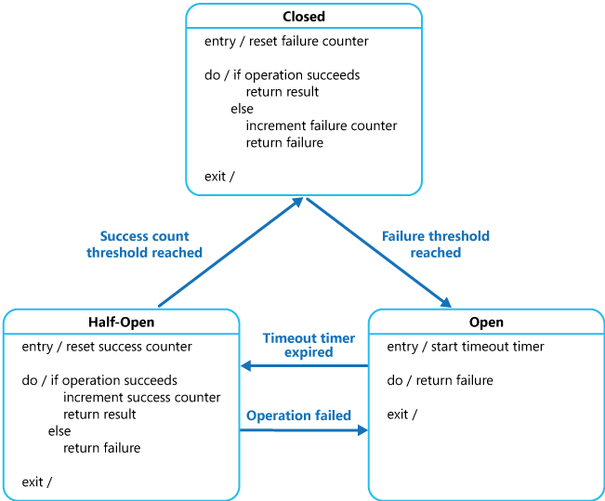
Circuit braker pattern
Notes:
In a distributed environment, calls to remote resources and services can fail due to transient faults, such as slow network connections, timeouts, or the resources being overcommitted or temporarily unavailable.
These faults typically correct themselves after a short period of time, and a robust cloud application should be prepared to handle them by using a strategy such as the Retry pattern.
However, there can also be situations where faults are due to unanticipated events, and that might take much longer to fix.
These faults can range in severity from a partial loss of connectivity to the complete failure of a service.
In these situations it might be pointless for an application to continually retry an operation that is unlikely to succeed, and instead the application should quickly accept that the operation has failed and handle this failure accordingly.
The Circuit Breaker pattern, popularized by Michael Nygard in his book, Release It!, can prevent an application from repeatedly trying to execute an operation that's likely to fail.
Allowing it to continue without waiting for the fault to be fixed or wasting CPU cycles while it determines that the fault is long lasting.
The Circuit Breaker pattern also enables an application to detect whether the fault has been resolved.
If the problem appears to have been fixed, the application can try to invoke the operation.

Slide 40
Circuit braker pattern
Closed, normal way of working, the dependent service is operational
Open: Failure rate exceeded, requests are blocked by CB
Half-Open: Time out applied, limited number of request enabled
Notes:
Closed: The request from the application is routed to the operation.
The proxy maintains a count of the number of recent failures, and if the call to the operation is unsuccessful the proxy increments this count.
If the number of recent failures exceeds a specified threshold within a given time period, the proxy is placed into the Open state.
At this point the proxy starts a timeout timer, and when this timer expires the proxy is placed into the Half-Open state.
The purpose of the timeout timer is to give the system time to fix the problem that caused the failure before allowing the application to try to perform the operation again.
Open: The request from the application fails immediately and an exception is returned to the application.
Half-Open: A limited number of requests from the application are allowed to pass through and invoke the operation. If these requests are successful, it's assumed that the fault that was previously causing the failure has been fixed and the circuit breaker switches to the Closed state (the failure counter is reset). If any request fails, the circuit breaker assumes that the fault is still present so it reverts back to the Open state and restarts the timeout timer to give the system a further period of time to recover from the failure.

Slide 41
Issues
Exception Handling.
Types of Exceptions
Logging
Recoverability
Testing Failed Operations
Manual Override
Concurrency.
Accelerated Circuit Breaking
Notes:
Exception Handling. An application invoking an operation through a
circuit breaker must be prepared to handle the exceptions raised if the operation is unavailable.
The way exceptions are handled will be application specific.
For example, an application could temporarily degrade its functionality, invoke an alternative operation to try to perform the same task or obtain the same data, or report the exception to the user and ask them to try again later.
Types of Exceptions. A request might fail for many reasons, some of which might indicate a more severe type of failure than others. For example, a request might fail because a remote service has crashed and will take several minutes to recover, or because of a timeout due to the service being temporarily overloaded.
A circuit breaker might be able to examine the types of exceptions that occur and adjust its strategy depending on the nature of these exceptions. For example, it might require a larger number of timeout exceptions to trip the circuit breaker to the Open state compared to the number of failures due to the service being completely unavailable.
Logging. A circuit breaker should log all failed requests (and possibly successful requests) to enable an administrator to monitor the health of the operation.
Recoverability. You should configure the circuit breaker to match the likely recovery pattern of the operation it's protecting. For example, if the circuit breaker remains in the Open state for a long period, it could raise exceptions even if the reason for the failure has been resolved. Similarly, a circuit breaker could fluctuate and reduce the response times of applications if it switches from the Open state to the Half-Open state too quickly.
Testing Failed Operations. In the Open state, rather than using a timer to determine when to switch to the Half-Open state, a circuit breaker can instead periodically ping the remote service or resource to determine whether it's become available again. This ping could take the form of an attempt to invoke an operation that had previously failed, or it could use a special operation provided by the remote service specifically for testing the health of the service, as described by the Health Endpoint Monitoring pattern.
Manual Override. In a system where the recovery time for a failing operation is extremely variable, it's beneficial to provide a manual reset option that enables an administrator to close a circuit breaker (and reset the failure counter). Similarly, an administrator could force a circuit breaker into the Open state (and restart the timeout timer) if the operation protected by the circuit breaker is temporarily unavailable.
Concurrency. The same circuit breaker could be accessed by a large number of concurrent instances of an application. The implementation shouldn't block concurrent requests or add excessive overhead to each call to an operation.
Resource Differentiation. Be careful when using a single circuit breaker for one type of resource if there might be multiple underlying independent providers. For example, in a data store that contains multiple shards, one shard might be fully accessible while another is experiencing a temporary issue. If the error responses in these scenarios are merged, an application might try to access some shards even when failure is highly likely, while access to other shards might be blocked even though it's likely to succeed.
Accelerated Circuit Breaking

Slide 42
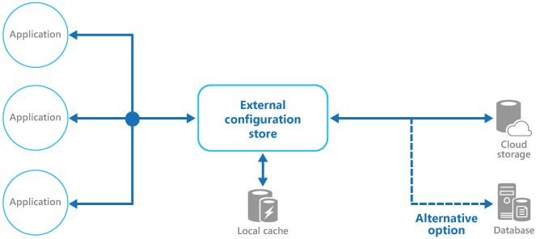
External config management
Notes:
The majority of application runtime environments include configuration information that's held in files deployed with the application. In some cases, it's possible to edit these files to change the application behavior after it's been deployed. However, changes to the configuration require the application be redeployed, often resulting in unacceptable downtime and other administrative overhead.
Local configuration files also limit the configuration to a single application, but sometimes it would be useful to share configuration settings across multiple applications. Examples include database connection strings, UI theme information, or the URLs of queues and storage used by a related set of applications.
It's challenging to manage changes to local configurations across multiple running instances of the application, especially in a cloud-hosted scenario. It can result in instances using different configuration settings while the update is being deployed.

Slide 43
Resources
https://github.com/PhaceBP/clouddps

Slide 44
THANK YOU!

