Slide 1
JAVA 8 lambdas, functional interfaces
and streams

Slide 2


Lambda Function
Functions are now first-class citizens
Store a method in a Lambda for deferred execution.
Lambdas are not objects (reflection and “this” do not work

Slide 3
Behavior Parameterization
What is the problem with a “STRICTLY” object-oriented programming language? Everything is either a primitive or an object.
What's good about the OO paradigm?
+ OO is extremely powerful. It affords inheritence, polymorphism, and reflection….however...
+ Strict OO forces you to think in terms of Objects living on the heap and your code is highly imperative (branching and explicit looping).
+ OO was a great leap forward from procedural programming.
+ OO is not going to be replaced any time soon. It's way too powerful. Rather it will live alongside functional programming.
Notes:
The term Java functional programming refers to functional programming in Java.
Functional programming in Java has not been easy historically, and there were even several aspects of functional programming that were not even really possible in Java.
In Java 8 Oracle made an effort to make functional programming easier, and this effort did succeed to some extent.
Functional Programming Basics
Functional programming contains the following key concepts:
Functions as first class objects
Pure functions
Higher order functions
Pure functional programming has a set of rules to follow too:
No state
No side effects
Immutable variables
Favour recursion over looping
Even if you do not follow all of these rules all the time, you can still benefit from the functional programming ideas in your applications.
As you will see, functional programming is not the right tool for every problem out there.
Especially the idea of "no side effects" makes it hard to e.g. write to a database (that is a side effect). You need to learn what problems functional programming is good at solving, and which it is not.
Functions as First Class Objects
In the functional programming paradigm, functions are first class objects in the language.
That means that you can create an "instance" of a function, as have a variable reference that function instance, just like a reference to a String, Map or any other object.
Functions can also be passed as parameters to other functions.
In Java, methods are not first class objects. The closest we get is Java Lambda Expressions.
I will not cover Java lambda expressions here, as I have covered them in both text and video in my Java Lambda expression tutorial.
Pure Functions
A function is a pure function if:
The execution of the function has no side effects.
The return value of the function depends only on the input parameters passed to the function.

Slide 4
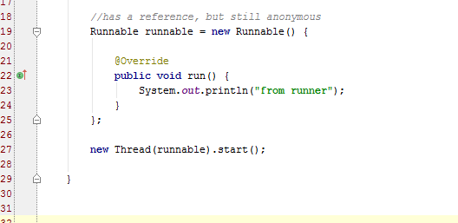
How did Java deal with “functional” programming prior to Java8. Anon (inner) classes!

Slide 5
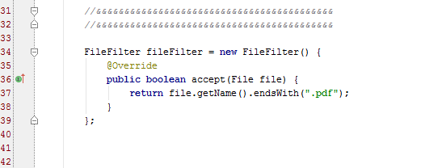
Another example of anon class

Slide 6
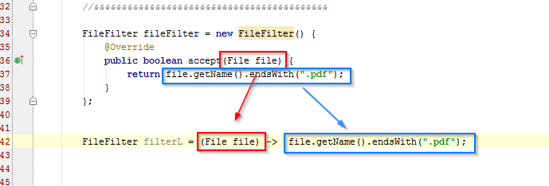
Our first Lambda expression
1/ start with a “functional interface” - a functional interface has ONE non-default abstract method.
2/ create an anonymous class and implement its method
3/ use the format as seen above
4/ no need for return statements, that's implied

Slide 7
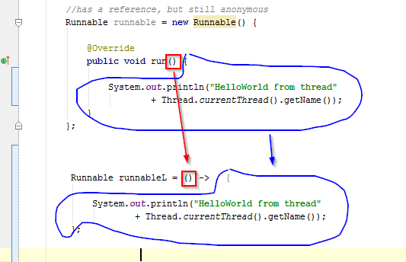
Another example

Slide 8
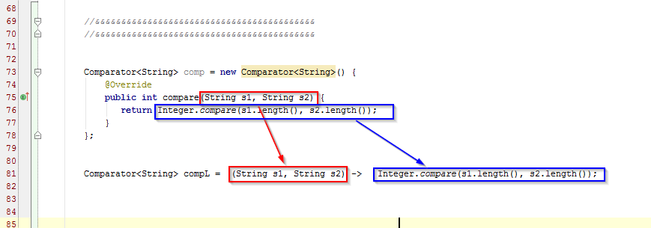
Another example

Slide 9
The “Type” of Lambda Expression
The java ‘Type’ of a lamba expression is a “Functional Interface”
Functional Interface is an interface with exactly ONE non-default, non-overriding method.
A Lambda can NOT use reflection as it is NOT an object.
A lambda can not use the “this” keyword as it is NOT an object.
Much like instance methods, a lambda does not live on the heap.

Slide 10
Lambda Expression
The concept of “Functional Interface” is new, but many of the interfaces in Java7 and before are “functional interfaces” such as Runnable, Comparable, etc.
Older (Java7 and earlier) interfaces have been decorated with default methods to preserve backwards compatibility

Slide 11
Location of Functional Interfaces
You may define your own “Functional Interfaces”
Java8 defines many in: java.util.function.*
43 interfaces in 4 categories, such as Function, Supplier, Consumer, Predicate.

Slide 12
Can I store a Lamba Expression in a variable in Java?
Yes!
Wherever a method requires an anonymous inner class (with one method), you may put a lamba expression.
For example: Collections.sort(list, compL);
You may also use lambda expressions with Streams

Slide 13
Is a Lambda expression an Object?
Not really. It is an ‘object without identity’.
It does not inherit from Object and so you can’t call the .equals(), .hashcode(), etc.
There is no ‘new’ keyword in lamba, so there is far less overhead both at compile- and run-time.
You can't use 'this' keyword to identify it using reflection.

Slide 14
The Lambda Calculus
The lambda calculus was introduced in the 1930s by Alonzo Church as a mathematical system for defining computable functions.
The lambda calculus serves as the computational model underlying functional programming languages such as Lisp, Haskell, and Ocaml.
Features from the lambda calculus such as lambda expressions have been incorporated into many widely used programming languages like C++ and now very recently Java 8.

Slide 15
Syntax of Java 8 Lambdas
A Java 8 lambda is basically a method in Java without a declaration usually written as (parameters) -> { body }. Examples,
  (int x, int y) -> { return x + y; }
  x -> x * x
  ( ) -> x
A lambda can have zero or more parameters separated by commas and their type can be explicitly declared or inferred from the context.
Parenthesis are not needed around a single parameter.
( ) is used to denote zero parameters.
The body can contain zero or more statements.
Braces are not needed around a single-statement body.

Slide 16
What is Functional Programming?
A style of programming that treats computation as the evaluation of mathematical functions
Eliminates side effects
Treats data as being immutable
Expressions have referential transparency – this reference will do this and this only.
Functions can take functions as arguments and return functions as results
Prefers recursion over explicit for-loops

Slide 17
Why do Functional Programming?
Allows us to write easier-to-understand, more declarative, more concise programs than imperative programming
Allows us to focus on the problem rather than the code
Facilitates parallelism

Slide 18
Imperative versus Declarative
Imperative: is a style of programming where you program the algorithm with control flow and explicit steps. Think pseudocode algorithm with branching and looping logic.
Declarative: is a style of programming where you declare what needs be done without concern for the control flow.
Functional programming: is a declarative programming paradigm that treats computation as a series of functions and avoids state and mutable data to facilitate concurrency an in particular parallelism.

Slide 19
Java 8
Java 8 is the biggest change to Java since the inception of the language
Lambdas are the most important new addition
Java is playing catch-up: most major programming languages already have support for lambda expressions
A big challenge was to introduce lambdas without requiring recompilation of existing binaries (default methods in interfaces)

Slide 20
Benefits of Lambdas in Java 8
Enabling functional programming
Writing leaner more compact code
Facilitating parallel programming
Developing more generic, flexible and reusable APIs
Being able to pass behaviors as well as data to functions

Slide 21
Java 8 Lambdas
Syntax of Java 8 lambda expressions
Functional interfaces
Variable capture
Method references
Default methods

Slide 22
Example 1:
Print a list of integers with a lambda
List<Integer> intSeq = Arrays.asList(1,2,3);
intSeq.forEach(x -> System.out.println(x));
x -> System.out.println(x) is a lambda expression that defines an anonymous function with one parameter named x of type Integer
Notes:
List<Integer> is a parameterized type, parameterized by the type argument <Integer>
the Arrays.asList method returns a fixed-size list backed by an array; it can take “vararg” arguments
forEach is a method that takes as input a function and calls the function for each value on the list
Note the absence of type declarations in the lambda; the Java 8 compiler does type inference
Java 8 is still statically typed
Braces are not needed for single-line lambdas (but could be used if desired).

Slide 23
Example 2:
A multiline lambda
List<Integer> intSeq = Arrays.asList(1,2,3);
intSeq.forEach(x -> {
x += 2;
System.out.println(x);
});
Braces are needed to enclose a multiline body in a lambda expression.
Notes:
Note: braces are needed to enclose a multiline lambda expression

Slide 24
Example 3:
A lambda with a defined local variable
List<Integer> intSeq = Arrays.asList(1,2,3);
intSeq.forEach(x -> {
int y = x * 2;
System.out.println(y);
});
Just as with ordinary functions, you can define local variables inside the body of a lambda expression
Notes:
Just as with ordinary functions, you can define local variables inside the lambda expression

Slide 25
Example 4:
A lambda with a declared parameter type
List<Integer> intSeq = Arrays.asList(1,2,3);
intSeq.forEach((Integer x -> {
x += 2;
System.out.println(x);
});
You can, if you wish, specify the parameter type.
Notes:
You can, if you wish, specify the parameter type
The compiler knows the type of intSeq is a list of Integers
Since the compiler can do type inference, you don’t need to specify the type of x.

Slide 26
The java.util.function.* library
Functional Interfaces:
Examine the SDK java.util.function
Consumers
Predicates
Suppliers
Functions
Numeric Performance Functional Interfaces
Operators
Notes:
Functional interfaces are a common idiom in Java code.
Examples of existing JDK functional interfaces: Runnable, Comparable<T>, Callable<V>.
Design decision: Java 8 lambdas should work with existing Java code without requiring recompilation.

Slide 27
4 categories of Functional Interfaces
Functional Interface archetypes | Example used in
Consumer | forEach(Consumer), peek(Consumer)
Predicate | filter(Predicate)
Function | map(Function)
Supplier | reduce(Supplier) collect(Supplier)
See java.util.function.*
ConsumerMain

Slide 28
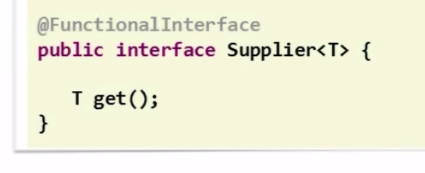
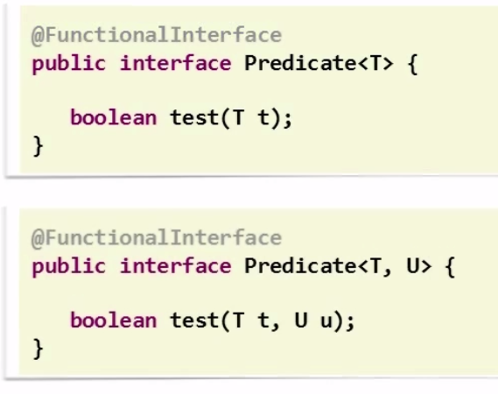
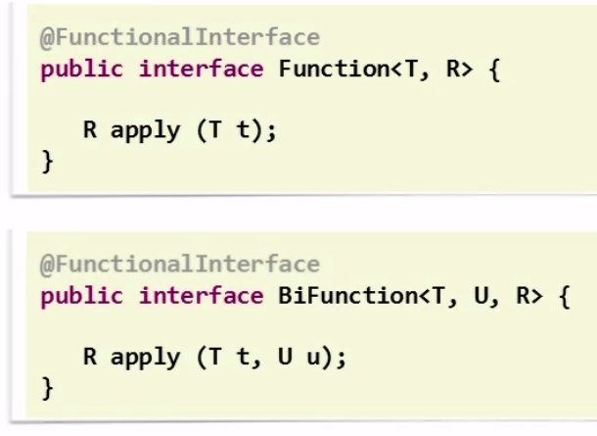
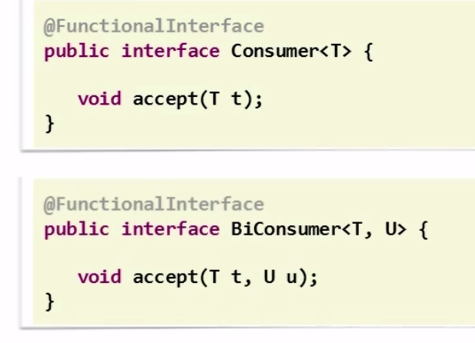
4 categories of Functional Interfaces

Slide 29
Functional Interfaces
Design decision: Java 8 lambdas are assigned to functional interfaces.
A functional interface is a Java interface with exactly one non-default method. E.g.,
public interface Consumer<T> {
void accept(T t);
}
The package java.util.function defines many new useful functional interfaces.
Notes:
Functional interfaces are a common idiom in Java code.
Examples of existing JDK functional interfaces: Runnable, Comparable<T>, Callable<V>.
Design decision: Java 8 lambdas should work with existing Java code without requiring recompilation.

Slide 30
Implementation of Java 8 Lambdas
The Java 8 compiler first converts a lambda expression into a function
It then calls the generated function
For example, x -> System.out.println(x) could be converted into a generated static function
public static void genName(Integer x) {
System.out.println(x);
}
Notes:
What type should be generated for this function? How should it be called?
What class should the translated lambda expression function be placed it?
Should the generated method be a static or an instance method?
The Java 8 designers spent a lot of time thinking about how to implement lambdas!

Slide 31
Variable Capture
Lambdas can interact with variables defined outside the body of the lambda
Using these variables is called variable capture
These variables must be effectively final.

Slide 32
Local Variable Capture Example
public class LVCExample {
public static void main(String[] args) {
List<Integer> intSeq = Arrays.asList(1,2,3);
int var = 10;
intSeq.forEach(x -> System.out.println(x + var));
} Note: local variables used inside the body of a lambda must be final or effectively final
Notes:
This lambda “captures” the variable var.

Slide 33
Static Variable Capture Example
public class SVCExample {
private static int var = 10;
public static void main(String[] args) {
List<Integer> intSeq = Arrays.asList(1,2,3);
intSeq.forEach(x -> System.out.println(x + var));
}
}

Slide 34
Method References
Method references can be used to pass an existing function in places where a lambda is expected
The signature of the referenced method needs to match the signature of the functional interface method

Slide 35
Summary of Method References
Method Reference Type | Syntax | Example
static | ClassName::StaticMethodName | String::valueOf
constructor | ClassName::new | ArrayList::new
specific object instance | objectReference::MethodName | x::toString
arbitrary object of a given type | ClassName::InstanceMethodName | Object::toString

Slide 36
Conciseness with Method References
We can rewrite the statement
intSeq.forEach(x -> System.out.println(x));
more concisely using a method reference
intSeq.forEach(System.out::println);

Slide 37
Default Methods
Java 8 uses lambda expressions and default methods in conjunction with the Java collections framework to achieve backward compatibility with existing published interfaces
We need default methods because, for example, the Collections interface has no stream() method and we'd like to use existing Collections interface to stream.

Slide 38
Streams
Declarative— More concise and readable
Composable— Greater flexibility
Parallelizable— Better performance

Slide 39
What is a stream?
A stream is “a sequence of elements from a source that supports data processing operations.” Internal iteration.
Collections are held in memory space. You need the entire collection to iterate. SPACE
Streams are created on-demand and they are infinite. TIME

Slide 40
Sequence of Elements
Sequence of elements— Like a collection, a stream provides an interface to a sequenced set of values of a specific element type. Because collections are data structures, they’re mostly about storing and accessing elements, but streams are also about expressing computations such as filter, sorted, and map.

Slide 41
Source
Source— Streams consume from a data-providing source such as collections, arrays, or I/O resources.
Note that generating a stream from an ordered collection preserves the ordering. The elements of a stream coming from a list will have the same order as the list.

Slide 42
Data processing
Data processing— Streams support database-like operations and common operations
from functional programming languages to manipulate data, such as filter, map, reduce, find, match, sort, and so on. Stream operations can be executed either sequentially or in parallel.

Slide 43
Pipelining
Pipelining— Many stream operations return a stream themselves, allowing operations to be chained and form a larger pipeline. This enables certain optimizations such as laziness and short-circuiting. A pipeline of operations can be viewed as a database-like query on the data source.

Slide 44

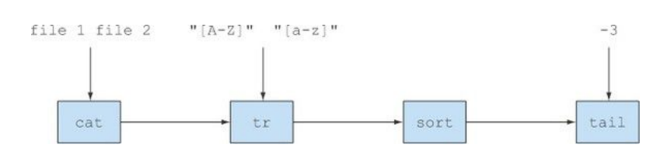
Streams are like Unix pipes
Locally - nav to /h/dev/java/adv/2015
$ cat a.txt b.txt | tr "[a-z]" "[A-Z]" | sort | tail -3

Slide 45
Iteration
Internal iteration— In contrast to collections, which are iterated explicitly using an iterator,
stream operations do the iteration behind the scenes for you.

Slide 46
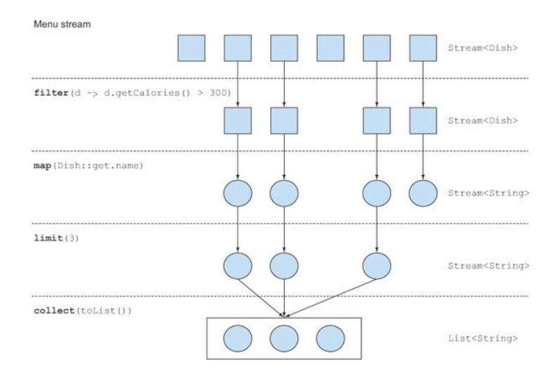
Typical operations
map(Dish::getName)

Slide 47
Examine the Collections Interface
Stream is defined in the collections interface. All these new methods are grandfathered-in starting with Java8 using default.

Slide 48
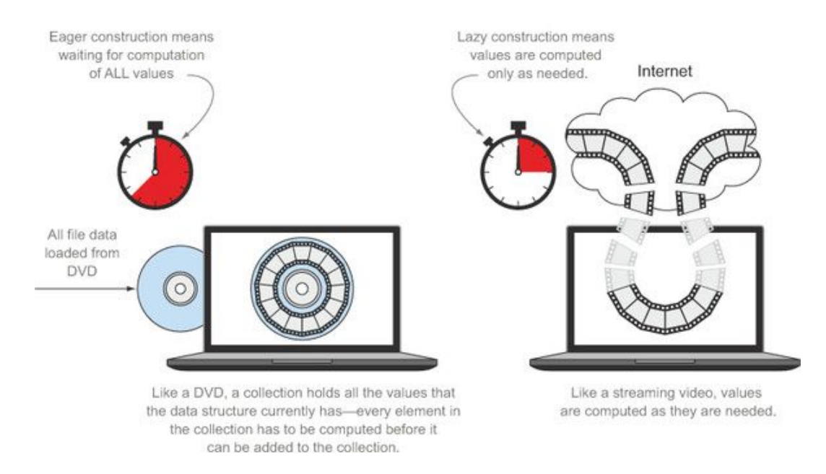
Streams are infinite

Slide 49
Streams are consumed
> Streams are consumed. You can iterate over them only once.
> You can get a new stream from the initial data source to traverse it again just like for an iterator (assuming it’s a repeatable source like a collection; if it’s an I/O channel,
you’re out of luck).

Slide 50
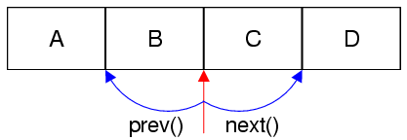
Iterator
See IteratorDriver

Slide 51
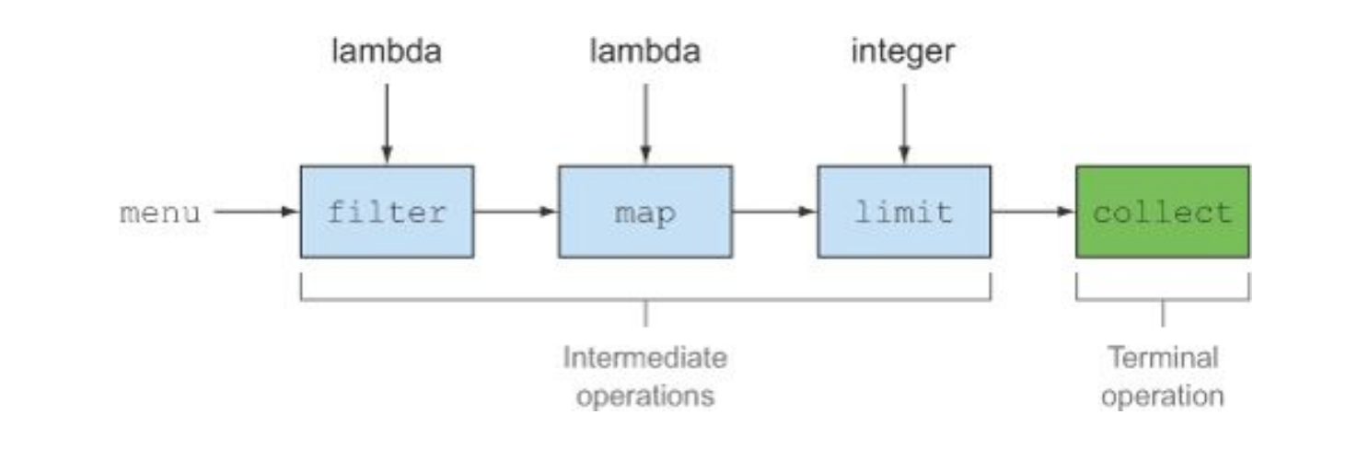
Intermediate versus Terminal ops
Only the terminal operation can consume the stream which is done in a lazy manner – or on-demand.

Slide 52
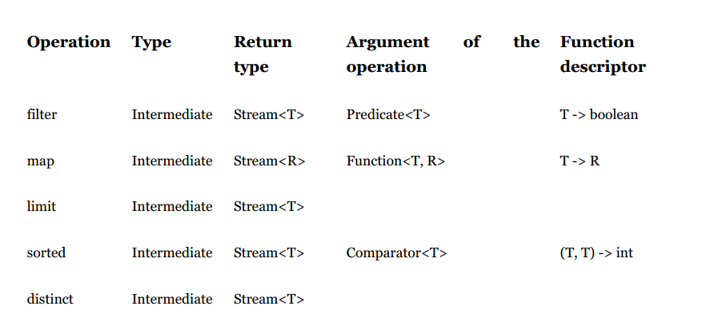
Examples of intermediate ops

Slide 53
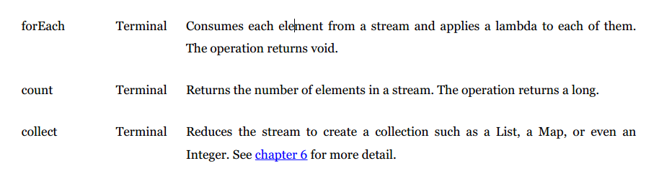
Examples of terminal ops

Slide 54
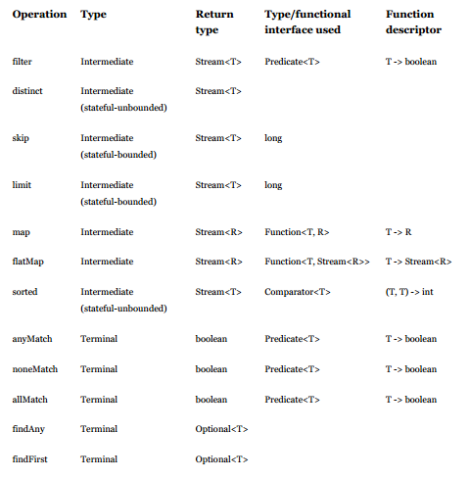
Table of ops

Slide 55
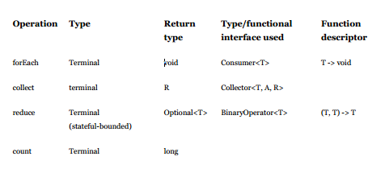
Table of ops (more)

Slide 56
Streams

Slide 57
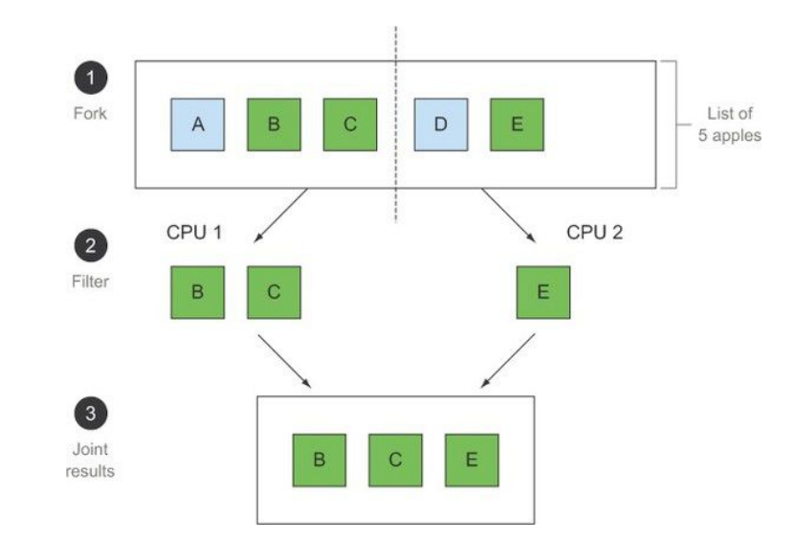
Fork-Join (nothing is mutated)
Java8 takes advantage of the Fork-Join interface
introduced in Java7

Slide 58
Collections versus Streams
Collections are grouped in space.
Streams are grouped in time.
As with time, you can not visit the past or future.
Similar to an iterator that has been spent.
Imagine trying to visit a frame streamed from an online video server that has not yet been sent to the client; impossible!

Slide 59
Stream API
The new java.util.stream package provides utilities to support functional-style operations on streams of values.
A common way to obtain a stream is from a collection:
Stream<T> stream = collection.stream();
Streams can be sequential or parallel.
Streams are useful for selecting values and performing actions on the results.

Slide 60
Stream Operations
An intermediate operation keeps a stream open for further operations. Intermediate operations are lazy.
A terminal operation must be the final operation on a stream. Once a terminal operation is invoked, the stream is consumed and is no longer usable.

Slide 61
Example Intermediate Operations
filter excludes all elements that don’t match a Predicate.
map performs a one-to-one transformation of elements using a Function.

Slide 62
A Stream Pipeline
A stream pipeline has three components:
A source such as a Collection, an array, a generator function, or an IO channel;
Zero or more intermediate operations; and
A terminal operation

Slide 63
Map is a transform operation
Takes a Stream<T> and returns a Stream<T>

Slide 64
Stream Example
int sum = widgets.stream()
.filter(w -> w.getColor() == RED)
.mapToInt(w -> w.getWeight())
.sum();
Here, widgets is a Collection<Widget>. We create a stream of Widget objects via Collection.stream(), filter it to produce a stream containing only the red widgets, and then transform it into a stream of int values representing the weight of each red widget. Then this stream is summed to produce a total weight.
From Java Docs
Interface Stream<T>

Slide 65
Parting Example: Using lambdas and stream to sum the squares of the elements on a list
List<Integer> list = Arrays.asList(1,2,3);
int sum = list.stream().map(x -> x*x).reduce((x,y) -> x + y).get();
System.out.println(sum);
Here map(x -> x*x) squares each element and then reduce((x,y) -> x + y) reduces all elements into a single number
http://viralpatel.net/blogs/lambda-expressions-java-tutorial/

Slide 66
Default methods

Slide 67
The default methods
A Virtual Extension Method aka default aka defender methods are not the same as abstract methods.
difference between Java8 interfaces with default methods and abstract classes: Abstract class can hold state of object. Abstract class can have constructors and member variables. Whereas interfaces with Java 8 default methods cannot maintain state.
Used for backwards compatibility; look at Collections.java in the Java8 JDK.

Slide 68
Default Methods
Java 8 uses lambda expressions and default methods in conjunction with the Java collections framework to achieve backward compatibility with existing published interfaces
For a full discussion see Brian Goetz, Lambdas in Java: A peek under the hood.
https://www.youtube.com/watch?v=MLksirK9nnE

Slide 69
What is a Stream
A stream is a limitless iterator that allows you to process collections.
You can chain operations. This chain is called a pipeline.
You must have at least one terminal operation and zero or more intermediary operations.
The pipeline usually takes the form of map-filter-reduce pattern.
Any stream operation that returns a Stream<T> is an intermediate operation, and any object that returns void is terminal.
Intermediate operations are lazy, whereas terminal operations are eager.
A terminal operation will force the stream to be “spent” and you can NOT re-use that reference, though you can always get a new stream.
May be parallelized and optimized across cores.
See StreamMain

Slide 70
Method references
You can refer to static or non-static method simply by using the double colon (method reference) notation like so:
System.out::println
stringLengthComparator::compare

Slide 71
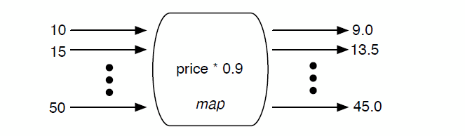
Map is a transform
The .map() method is not an associative data structure, rather it is a transformative operation. It takes a Stream<T> and it returns either a Stream<T> or Stream<U>.
Example: Stream<String> to Stream<String>
Example: Stream<String> to Stream<Date>

Slide 72
Intermediary operation
Intermediary operation: A method that takes a Stream and returns a Stream.
They are lazily loaded and will only be executed if you include a terminal operation at the end.
  The peek() method
  The map() method
  The filter() method

Slide 73
Terminal operation
Terminal operation: A method that takes a Stream<T> and returns void.
They are eagerly loaded and will cause the entire pipeline to be executed.
A terminal operation will “spend” the stream.
  The forEach() method
  The count() method
  The max() method
  The collect() method
  The reduce() method

Slide 74
Stream API
The new java.util.stream package provides utilities to support functional-style operations on streams of values.
A common way to obtain a stream is from a collection:
Stream<T> stream = collection.stream();
Streams can be sequential or parallel.
Streams are useful for selecting values and performing actions on the results.

Slide 75
Stream Operations
An intermediate operation keeps a stream open for further operations. Intermediate operations are lazy.
A terminal operation must be the final operation on a stream. Once a terminal operation is invoked, the stream is consumed and is no longer usable.

Slide 76
Example Intermediate Operations
filter excludes all elements that don’t match a Predicate.
map performs a one-to-one transformation of elements using a Function.

Slide 77
A Stream Pipeline
A stream pipeline has three components:
A source such as a Collection, an array, a generator function, or an IO channel;
Zero or more intermediate operations; and
A terminal operation

Slide 78
Stream Example
int sum = widgets.stream()
.filter(w -> w.getColor() == RED)
.mapToInt(w -> w.getWeight())
.sum();
Here, widgets is a Collection<Widget>. We create a stream of Widget objects via Collection.stream(), filter it to produce a stream containing only the red widgets, and then transform it into a stream of int values representing the weight of each red widget. Then this stream is summed to produce a total weight.
From Java Docs
Interface Stream<T>

Slide 79
References
A lot of the material in this lecture is discussed in much more detail in these informative references:
The Java Tutorials, http://docs.oracle.com/javase/tutorial/java/index.html
Lambda Expressions, http://docs.oracle.com/javase/tutorial/java/javaOO/lambdaexpressions.html
Adib Saikali, Java 8 Lambda Expressions and Streams, www.youtube.com/watch?v=8pDm_kH4YKY
Brian Goetz, Lambdas in Java: A peek under the hood. https://www.youtube.com/watch?v=MLksirK9nnE

Slide 80
References
A lot of the material in this lecture is discussed in much more detail in these informative references:
The Java Tutorials, http://docs.oracle.com/javase/tutorial/java/index.html
Lambda Expressions, http://docs.oracle.com/javase/tutorial/java/javaOO/lambdaexpressions.html
Adib Saikali, Java 8 Lambda Expressions and Streams, www.youtube.com/watch?v=8pDm_kH4YKY
Brian Goetz, Lambdas in Java: A peek under the hood. https://www.youtube.com/watch?v=MLksirK9nnE

