Slide 1
Regular Expressions in Java
Attila Balogh-Biró 2019

Slide 2
Regular Expressions
Textual pattern used to search in text
The result of matching a regular expression against a text
True / False
Set of matches
Notes:
A regular expression is a textual pattern used to search in text. You do so by "matching" the regular expression against the text.
The result of matching a regular expression against a text is either:
A true / false specifying if the regular expression matched the text.
A set of matches - one match for every occurrence of the regular expression found in the text.

Slide 3
Java Regex Core Classes
java.util.regex package
java.util.regex.Pattern
java.util.regex.Matcher
java.util. PatternSyntaxException
Notes:
The Pattern class is used to create patterns (regular expressions). A pattern is precompiled regular expression in object form (as a Pattern instance), capable of matching itself against a text.
The Matcher class is used to match a given regular expression (Pattern instance) against a text multiple times.
In other words, to look for multiple occurrences of the regular expression in the text.
The Matcher will tell you where in the text (character index) it found the occurrences. You can obtain a Matcher instance from a Pattern instance
A PatternSyntaxException object is an unchecked exception that indicates a syntax error in a regular expression pattern.

Slide 4
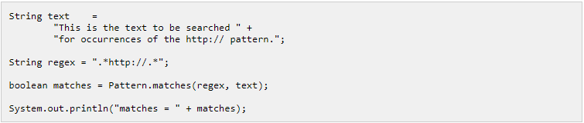
Java Regex Pattern example
Notes:
The pattern variable contains the regular expression as a String.
The regular expression matches all texts which contains one or more characters (.*) followed by the text http:// followed by one or more characters (.*).
The third line uses the Pattern.matches() static method to check if the regular expression (pattern) matches the text.
If the regular expression matches the text, then Pattern.matches() returns true.
If the regular expression does not match the text Pattern.matches() returns false.

Slide 5
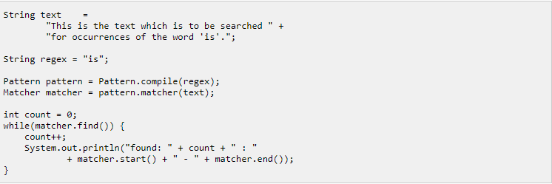
Java Regex Matcher example
Notes:
From the Pattern instance a Matcher instance is obtained.
Via this Matcher instance the example finds all occurrences of the regular expression in the text.

Slide 6
Basic Syntax
Characters
Character Classes
Predefined Character Classes
Boundary Matchers
Quantifiers
Logical operators

Slide 7
Characters & character classes
Attila
\0101
\x41
\u0041
[abc]
[aA]ttila
Notes:
This simple regular expression will match occurrences of the text “Attila" in a given input text.
You can use any characters in the alphabet in a regular expression.
You can also refer to characters via their octal, hexadecimal or Unicode codes. Here are two examples:
These three expressions all refer to the uppercase A character.
The first uses the octal code (101) for A, the second uses the hexadecimal code (41) and the third uses the Unicode code (0041).
Character classes are constructs that enable you to specify a match against multiple characters instead of just one.
In other words, a character class matches a single character in the input text against multiple allowed characters in the character class.
For instance, you can match either of the characters a, b or c like this:

Slide 8
Character Classes
Character class | Matches | Operation name
[abc] | a, or b or c | Simple class
[^abc] | any character except a, b, and c. | Negation
[a-zA-Z] | any character from a to z, or A to Z, including a, A, z and Z | Range
[a-d[m-p]] | any character from a to d, or from m to p | Union
[a-z&&[def]] | d, e, or f. | Intersection
[a-z&&[^bc]] | all characters from a to z except b and c | Substraction
[a-z&&[^m-p]] | all characters from a to z except the characters from m to p | Substraction
Notes:
The Java regular expression syntax has a few predefined character classes you can use.
For instance, the \d character class matches any digit, the \s character class matches any white space character, and the \w character matches any word character.
The predefined character classes do not have to be enclosed in square brackets, but you can if you want to combine them. Here are a few examples:

Slide 9
Predefined Character Classes
Character | Matches
. | Any single character
\d | Any digit [0-9]
\D | Any NON digit character [^0-9]
\s | Any white space character (space, tab, line break, carriage return)
\S | Any non-white space character
\w | Any word character
\W | Any non-word character
Notes:
The Java regular expression syntax has a few predefined character classes you can use.
For instance, the \d character class matches any digit, the \s character class matches any white space character, and the \w character matches any word character.
The predefined character classes do not have to be enclosed in square brackets, but you can if you want to combine them. Here are a few examples:

Slide 10
Boundary Matchers
Character | Matches
^ | the beginning of a line
$ | then end of a line
\b | a word boundary
\B | a non-word boundary
\A | the beginning of the input text
\G | the end of the previous match
\Z | the end of the input text except the final terminator if any
\z | the end of the input text
Notes:
The syntax also include matchers for matching boundaries,
like boundaries between words, the beginning and end of the input text etc.
For instance, the \w matches boundaries between words, the ^ matches the beginning of a line, and the $ matches the end of a line

Slide 11
Quantifiers
Greedy | Reluctant | Possessive | Matches
X? | X?? | X?+ | X once, or not at all (0 or 1 time)
X* | X*? | X*+ | X zero or more times
X+ | X+? | X++ | X one or more times
X{n} | X{n}? | X{n}+ | X exactly N times
X{n,} | X{n,}? | X{n,}+ | X at least N times
X{n,m} | X{n,m}? | X{n,m}+ | X at least N time, but at most M times
Notes:
Quantifiers enables you to match a given expression or subexpression multiple times.
The * character is a quantifier that means "zero or more times". There is also a + quantifier meaning "one or more times", a ? quantifier meaning "zero or one time“
Quantifiers can be either "reluctant", "greedy" or "possesive".
A reluctant quantifier will match as little as possible of the input text.
A greedy quantifier will match as much as possible of the input text.
A possesive quantifier will match as much as possible, even if it makes the rest of the expression not match anything, and the expression to fail finding a match.
I will illustrate the difference between reluctant, greedy and possesive quantifiers with an example. Here is an input text:

Slide 12
Logical operators
Construct | Matches
XY | X and Y (X followed by Y)
X|Y | X OR Y
Notes:
The Java regular expression syntax has a few predefined character classes you can use.
For instance, the \d character class matches any digit, the \s character class matches any white space character, and the \w character matches any word character.
The predefined character classes do not have to be enclosed in square brackets, but you can if you want to combine them. Here are a few examples:

