Slide 1

Introduction to Java SE

Slide 2
Who am I?
Balogh-Biró Attila
Cloud Solution Architect at Microsoft
Instructor
Spring Framework
Java EE
Java SE
Design Patterns
Cloud technologies

Slide 3
Table of Contents
Introduction to Eclipse IDE
Collections and Generic Types
Java I/O
Java Annotation
Reflection
JMX
JConsole
Regular Expressions

Slide 4
2. Introduction to Eclipse IDE
Eclipse Overview
Eclipse in Action

Slide 5
Eclipse Overview
Integrated Development Environment (IDE)
written mostly in Java
download it
https://www.eclipse.org/downloads/
no need of installation
downloaded archive should be extracted
to start eclipse, run eclipse executable (in root dir)
needs a Java Runtime Environment to run
ready for using Eclipse!

Slide 6
Table of Contents
Introduction to Eclipse IDE
Collections and Generic Types
Java I/O
Java Annotation
Reflection
JMX
JConsole
Regular Expressions

Slide 7
Collections and Generic Types
Collection Framework
The Collection Superinterface
Lists
Sets
Maps
Iterator Interface
Support Classes
Collections and Generic Types
Ordering Within Collection
Generic Types
Type Erasure
Generic Methods

Slide 8
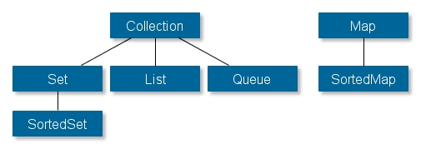
Collection Framework
flexible and powerful mechanism for handling collections of objects
based on interfaces
Notes:
In order to understand and use the Java Collections API effectively it is useful to have an overview of the interfaces it contains. So, that is what I will provide here.
There are two "groups" of interfaces: Collection's and Map's.
Here is a graphical overview of the Collection interface hierarchy:
The Java Iterator interface represents an object capable of iterating through a collection of Java objects, one object at a time.
The Iterator interface is one of the oldest mechanisms in Java for iterating collections of objects (although not the oldest - Enumerator predated Iterator).

Slide 9
Framework Requirements on Objects
collection elements are objects
use wrapper classes for primitive types
behavioural contract for objects in collections
otherwise collection behaviour not guaranteed
objects compared using equals() method
return true if o1 == o2
return false if !( o2 instanceof o1 )
determine equality by checking fields
if o1.equals(o2) then o2.equals(o1)
hashCode() method also used
must be implemented in line with equals() method
if o1.equals(o2) then o1.hashCode() == o2.hashCode()

Slide 10
The Collection SuperInterface
The most abstract interface is the Collection interface, this represents a group of objects that may contain duplicates.
add(Object x) - Adds x to this collection.
addAll(Collection c) - Adds every element of c to this collection.
clear() - Removes every element from this collection.
contains(Object x) - Returns true if this collection contains x.
containsAll(Collection c) - Returns true if this collection contains every element of c.
isEmpty() - Returns true if this collection contains no elements.
iterator() - Returns an Iterator over this collection.
remove(Object x) - Removes x from this collection.
removeAll(Collection c) - Removes every element in c from this collection.
retainAll(Collection c) - Removes from this collection every element that is not in c.
size() - Returns the number of elements in this collection.
toArray() - Returns an array containing the elements in this collection

Slide 11
Lists
provides an ordered collection of objects
elements can be accessed using integer index
user has control over where elements are added
rather like a variable length array
void add(int index, Object x)
Object get(int index)
int indexOf(Object x)
Object remove(int index)
common implementations
Vector
Stack
ArrayList
LinkedList
Notes:
ArrayList has following features –
Ordered – Elements in arraylist preserve their ordering which is by default the order in which they were added to the list.
Index based – Elements can be randomly accessed using index positions. Index start with '0'.
Dynamic resizing – ArrayList grows dynamically when more elements needs to be added than it’s current size.
Non synchronized – ArrayList is not synchronized, by default. Programmer needs to use synchronized keyword appropiately or simply use Vectorclass.
Duplicates allowed – We can add duplicate elements in arraylist. It is not possible in sets.
LinkedList Features
Doubly linked list implementation which implements List and Deque interfaces. Therefore, It can also be used as a Queue, Deque or Stack.
Permits all elements including duplicates and NULL.
LinkedList maintains the insertion order of the elements.
It is not synchronized. If multiple threads access a linked list concurrently, and at least one of the threads modifies the list structurally, it must be synchronized externally.
Use Collections.synchronizedList(new LinkedList()) to get synchronized linkedlist.
The iterators returned by this class are fail-fast and may throw ConcurrentModificationException.
It does not implement RandomAccess interface. So we can access elements in sequential order only. It does not support accessing elements randomly.
We can use ListIterator to iterate LinkedList elements.
ArrayList vs LinkedList
ArrayList is implemented with the concept of dynamic resizable array. While LinkedList is a doubly linked list implementation.
ArrayList allows random access to it’s elements while LinkedList does not.
LinkedList, also implements Queue interface which adds more methods than ArrayList, such as offer(), peek(), poll(), etc.
While comparing to LinkedList, ArrayList is slower in add and remove, but faster in get, because there is no need of resizing array and copying content to new array if array gets full in LinkedList.
LinkedList has more memory overhead than ArrayList because in ArrayList each index only holds actual object but in case of LinkedList each node holds both data and address of next and previous node.

Slide 12
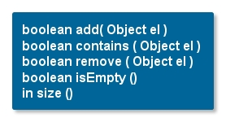
Sets
provides a collection with no duplicate elements
no ordering or position information for elements
may or may not allow null elements
depends on implementation
HashSet
Set interface implemented using a hash table
doesn't guarantee to iterate the elements in any specific order
constant time access to elements assuming good hash function
TreeSet
Set interface implemented as a tree
concept of natural order
Notes:
The first difference between the Java Set and List interface is, that the same element cannot occur more than once in a Java Set.
This is different from a Java List where each element can occur more than once.
The second difference between a Java Set and Java List interfaces is, that the elements in a Set has no guaranteed internal order.
The elements in a List has an internal order, and the elements can be iterated in that order.
HashSet Features
It implements Set Interface.
Duplicate values are not allowed in HashSet.
One NULL element is allowed in HashSet.
It is un-ordered collection and makes no guarantees as to the iteration order of the set.
This class offers constant time performance for the basic operations(add, remove, contains and size).
HashSet is not synchronized. If multiple threads access a hash set concurrently, and at least one of the threads modifies the set, it must be synchronized externally.
Use Collections.synchronizedSet(new HashSet()) method to get the synchronized hashset.
The iterators returned by this class’s iterator method are fail-fast and may throw ConcurrentModificationException if the set is modified at any time after the iterator is created, in any way except through the iterator’s own remove() method.
HashSet also implements Searlizable and Cloneable interfaces.
HashSet class offers constant time performance of O(1)for the basic operations(add, remove, contains and size), assuming the hash function disperses the elements properly among the buckets.
TreeSet Features
It extends AbstractSet class which extends AbstractCollection class.
It implements NavigableSet interface which extends SortedSet interface.
Duplicate values are not allowed in TreeSet.
NULL is not allowed in TreeSet.
It is an ordered collection which store the elements in sorted order.
Like HashSet, this class offers constant time performance for the basic operations(add, remove, contains and size).
TreeSet does not allow to insert heterogeneous objects because it must compare objects to determine sort order.
TreeSet is not synchronized. If multiple threads access a hash set concurrently, and at least one of the threads modifies the set, it must be synchronized externally.
Use Collections.synchronizedSortedSet(new TreeSet()) method to get the synchronized TreeSet.
The iterators returned by this class’s iterator method are fail-fast and may throw ConcurrentModificationException if the set is modified at any time after the iterator is created, in any way except through the iterator’s own remove() method.
TreeSet also implements Searlizable and Cloneable interfaces.

Slide 13
Maps
java.util.Map
stores values against keys
put(Object key, Object value) and get(Object key)
separate from Collection interface
common methods
Object put(Object key, Object value)
Object get(Object key)
boolean containsKey(Object key)
void clear()
Set keySet()
Collection values()
Java’s two most important Map classes are java.util.HashMap and java.util.TreeMap.
Notes:
Java HashMap Features
HashMap cannot contain duplicate keys.
HashMap allows multiple null values but only one null key.
HashMap is an unordered collection. It does not guarantee any specific order of the elements.
HashMap is not thread-safe. You must explicitly synchronize concurrent modifications to the HashMap. Or you can use Collections.synchronizedMap(hashMap) to get the synchronized version of HashMap.
A value can be retrieved only using the associated key.
HashMap stores only object references. So primitives must be used with their corresponding wrapper classes. Such as int
will be stored as Integer.
HashMap implements Cloneable and Serializable interfaces.
LinkedHashMap Features
The important things to learn about Java LinkedHashMap class are:
It stores key-value pairs similar to HashMap.
It contains only unique keys. Duplicate keys are not allowed.
It may have one null key and multiple null values.
It maintains the order of K,V pairs inserted to it by adding elements to internally managed doubly-linked list.
TreeMap provides the performance of log(n) for most operations like add(), remove() and contains().
HashMap performs with constant-time performance O(1) for same operations. In that way, HashMap performs much better than TreeMap.
TreeMap has better performance in memory management as it does not maintain an array internally to store key-value pairs. In
HashMap, array size is determined while initialization or resizing which if is often more than needed at the time. It waste the memory.

Slide 14
Iterator Interface
abstract mechanism for traversing a Collection
defines hasNext() and next() methods
throws ConcurrentModificationException if underlying collection is modified
also provides remove() method
Collections support iterator() method to return
object that implements interface

Slide 15
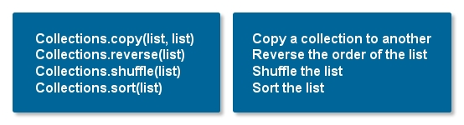
Support Classes
Collections class
creating Collections from existing ones
efficient locking strategies
high performance

Slide 16
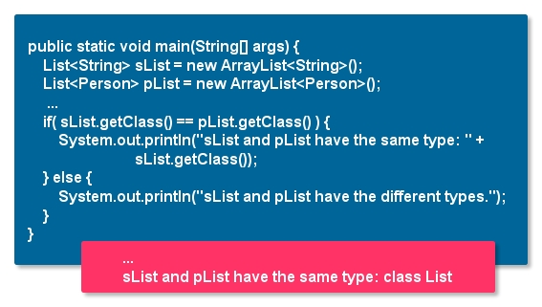
Collections and Generic Types
from Java 5
objects retrieved from generic collections need not be cast
generic types give greater type safety in collections
Raw Types and Type Erasure
note generic type syntax
<?> means any type
<? extends E> means any subtype of E

Slide 17
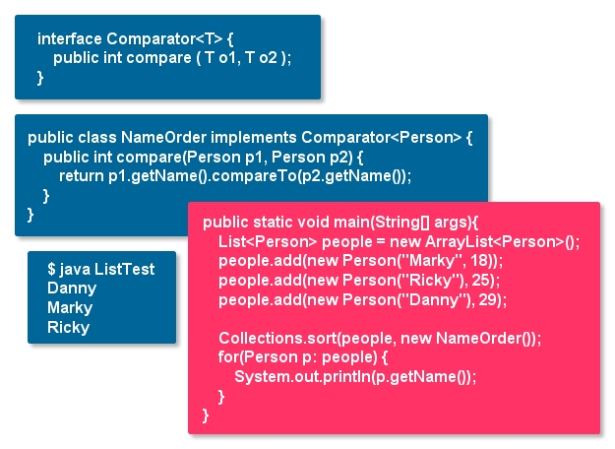
Ordering within Collection
classes may have ordering criteria
allows sorting functionality
supports collections that maintain order
contract of compareTo():
return -1 if o less than this
return 0 if o is "equal to" this
return 1 if o is greater than this
natural ordering may be "consistent with equals"
(x.equals(y)) ==
(x.compareTo(y) == 0)
usually true but not always
- java.math.BigDecimal

Slide 18
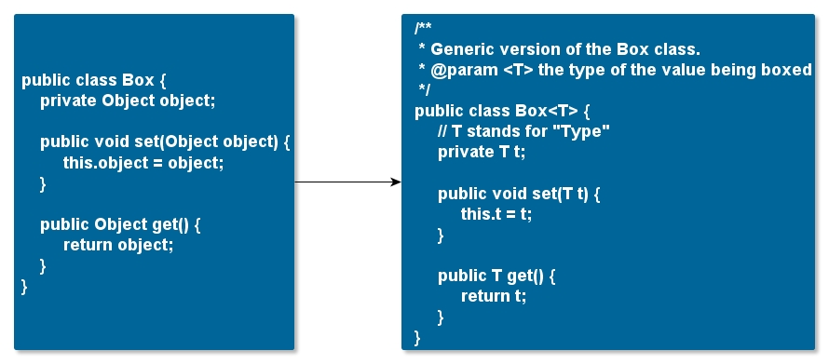
Generic Types
generic type
generic class or interface
parameterized over types

Slide 19
Generic Types cont’d
type variable can be any non-primitive type you specify
any class type
any interface type
any array type
enumerations
even another type variable
commonly used type parameter names
E - Element (used extensively by the Java Collections Framework)
K - Key
N - Number
T - Type
V - Value
S,U,V etc. - 2nd, 3rd, 4th types

Slide 20


Generic Types cont’d
reference the generic Box class
perform a generic type invocation
replaces T with some concrete value
the T in Box<T> is a type parameter and the Integer in Box<String> is a type argument
invocation of a generic type is generally known as a parameterized type.
to instantiate this class
use the new keyword
place <Integer> between the class name and the parenthesis

Slide 21

Generic Types cont’d
a generic class can have multiple type parameters
the diamond
Java SE 7 and later
can replace the type arguments with empty set of type arguments (<>)
as long as the compiler can determine the type arguments from the context

Slide 22
Raw Types and Compatibility
raw type
name of a generic class or interface
without any type arguments
collection types all modified to be generic types
pre-Java 5 code will still work
generic types become raw types
Java 5 compiler will issue warnings
raw types bypass generic type checks
deferring the catch of unsafe code to runtime
you should avoid using raw types.

Slide 23
Type Erasure
generics
tighter type checks at compile
support generic programming
Java compiler applies type erasure
replace all type parameters in generic types with their bounds or Object if the type parameters are unbounded
produced bytecode contains only ordinary classes, interfaces, and methods
insert type casts if necessary to preserve type safety
generate bridge methods to preserve polymorphism in extended generic types
type erasure ensures that no new classes are created for parameterized types
generics incur no runtime overhead

Slide 24
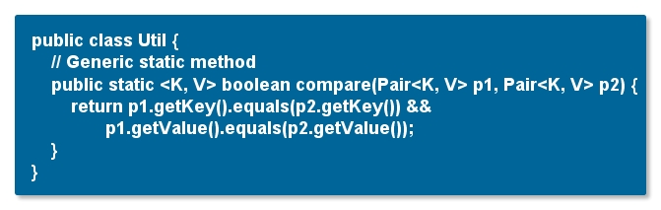
Generic Methods
generic methods
introduce their own type parameters
similar to declaring a generic type
the type parameter's scope is limited to the method where it is declared
static and non-static generic methods are allowed
syntax for a generic method
type parameter inside angle brackets
type parameter appears before the method's return type

Slide 25
Bounded Type Parameters
you want to restrict the types that can be used as type arguments in a parameterized type
method that operates on numbers might only want to accept instances of Number or its subclasses
to declare a bounded type parameter
list the type parameter's name
followed by the extends keyword
followed by its upper bound
extends is used in a general sense
"extends" (as in classes)
"implements" (as in interfaces)

Slide 26
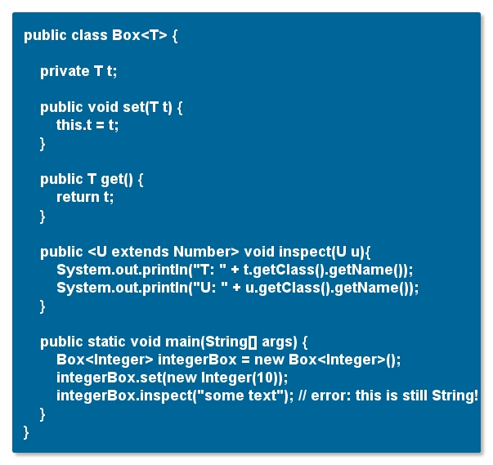
Bounded Type Parameters cont’d

Slide 27

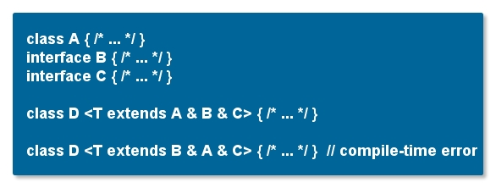
Multiple Bounds
type parameter can have multiple bounds
type variable with multiple bounds is a subtype of all the types listed in the bound
if one of the bounds is a class, it must be specified first

Slide 28
Table of Contents
Getting Started with Java
Introduction to Eclipse IDE
Collections and Generic Types
Java Annotation
Java I/O
Reflection
JMX
JConsole
Regular Expressions

Slide 29

Annotations in Java 5
major enhancement to the language
modifiers that can be added to code
package declarations
type declarations
constructors
methods
fields
parameters
variables
standard annotations supplied
also framework for user defined annotations
access to annotations for processing tools

Slide 30
Java Annotation
Annotation in Java 5
Defining a New Annotation Type
Annotating Annotation Types
Inheriting Annotations
Working with Annotations

Slide 31
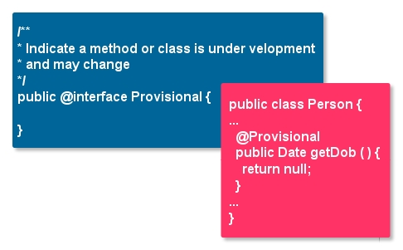
Defining a New Annotation Type
one more type available in Java 5
defined using @interface

Slide 32
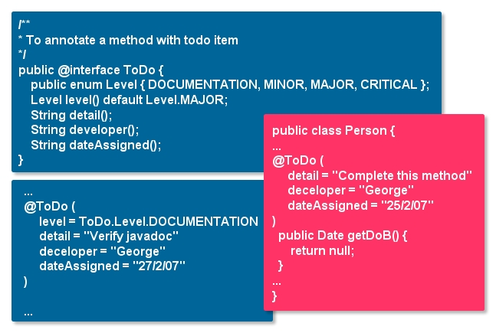
Default Values
in some cases, it is convenient to include values that have a default in an annotation
"default" keyword

Slide 33
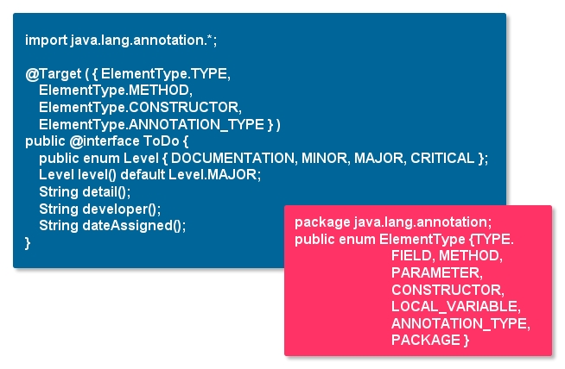
Annotating Annotation Types
allows annotation to be better targeted
compiler can check for correct usage
@Target meta-annotation
specifies entities to which annotation can be applied

Slide 34
Inheriting Annotations
@Inherited meta-annotation
marker
specifies that annotation is inherited by subclasses
default is not to inherit

Slide 35
Working with Annotations
use reflection APIs to retrieve details of annotations
requires RetentionPolicy.RUNTIME
not always efficient
process source files for annotations
perform additional validation
generate configuration files automatically
rewrite source code to add boilerplate code
add instrumentation
getAnnotation() checks for specific annotation
returns instance of annotation type or null
getDeclaredAnnotations() returns all annotations

Slide 36
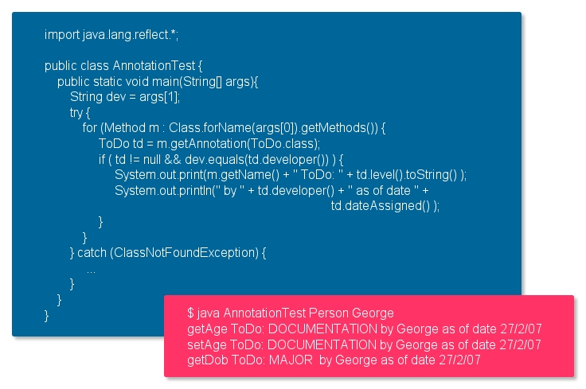
Example

Slide 37
Table of Contents
Getting Started with Java
Introduction to Eclipse IDE
Collections and Generic Types
Java Annotation
Java I/O
Reflection
JMX
JConsole
Regular Expressions

Slide 38
Java I/O
Streams, Readers, and Writers
File Input and Output
Object Streams and Serialization
Versioning of Serializable Objects
“New I/O” or NIO

Slide 39
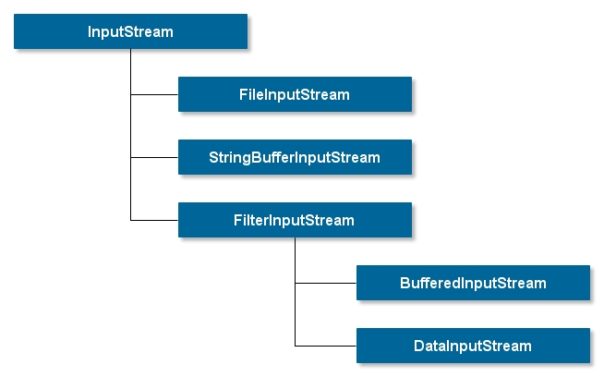
Streams, Readers and Writers
a stream is a sequence of bytes.
input streams obtain bytes from an external source
output streams move bytes to an external target
streams can be used to communicate between Java threads
streams are used to transfer data as bytes
Reader obtains character data
convert bytes to characters using appropriate conversion
Writer outputs character data
convert Unicode characters to bytes according to local conversion rules

Slide 40
Standard Streams
Java provides 3 standard I/O streams
System.in InputStream for standard input
System.out PrintStream for standard output
System.err PrintStream for standard error output
construct a Reader object from System.in for input
use buffered I/O for efficiency
BufferedReader
BufferedWriter
BufferedInputStream
BufferedOutputStream

Slide 41
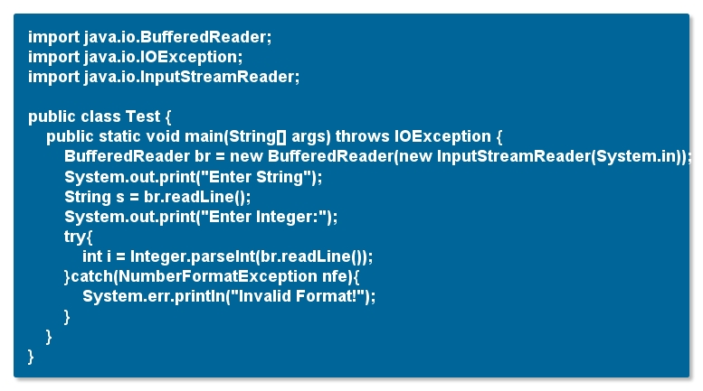
I/O Example

Slide 42
File Input and Output
read files with FileReader or FileInputStream
constructor uses filename or File object
can throw FileNotFoundException
reading methods return -1 or null on EOF
write to files using FileWriter or FileOutputStream
constructor uses filename or File object
can throw IOException when creating file (e.g. disk full)
use close() method to end an I/O stream
avoid closing an already closed stream
GUI applications can use FileDialog / JFileChooser

Slide 43
File Input and Output cont’d
file class encapsulates file information
think of File objects as holding file path names, not files
hides details of directory and file separator characters
contains useful file and directory methods
canRead() file is readable
canWrite() file is writeable
canExecute() file is executable
exists() file exists
delete() delete file
isDirectory() tests if a name is a directory
length() size of file
list() list all files in a directory as String[]
mkdir() creates a directory
lastModified() time&date of last change as a Date

Slide 44
Object Stream and Serialization
data input and output streams
reading and writing primitives and strings
object streams
reading and writing objects
the process of writing an object
serialization
need an instance of java.io.ObjectOutputStrem
serialization and deserialization
transient fields
a class that might be serialized should implement
Serializable interface

Slide 45
Versioning of Serializable Objects
Java serialization provides a serialVersionUID (suid)
for version control
in the ObjectStreamClass
suid is used to inform the Java serialization mechanism which version of the class is compatible with this serialized object
the Java serialization mechanism automatically computes a hash value
ObjectStreamClass's computeSerialVersionUID method passes the
class name
sorted member names
modifiers
Interfaces
to the secure hash algorithm (SHA), which returns a hash value

Slide 46
“New I/O” or NIO
many additions to I/O facilities
"New I/O"
low-level I/O operations
channels and buffers
memory mapped I/O
non-blocking I/O
much improved performance
file locking
shared and exclusive locks

Slide 47
Table of Contents
Getting Started with Java
Introduction to Eclipse IDE
Collections and Generic Types
Java I/O
Java Annotation
JMX
JConsole
Regular Expressions

Slide 48
Table of Contents
Getting Started with Java
Introduction to Eclipse IDE
Collections and Generic Types
Java I/O
Java Annotation
Reflection
JMX
JConsole
Regular Expressions

Slide 49
What exactly is a class?
It’s a collection of different things, such as:
Fields
Methods
Constructors
We define these different things with names, types, parameters, values, expressions, etc while programming, but in reflection all of this already exists.

Slide 50
Programming vs Reflecting
We use reflection to manipulate things that already exist and, normally, are set.
But unlike programming, we are not tied to specific names, types or views.
We have the ability to dynamically change what things are, regardless of how they were written!
More specifically, we are modifying objects at runtime.

Slide 51
What do you mean Runtime?
Normally you program something like this:
Write/Modify the class, methods, etc
Compile it
Run it
If you want to make any changes you have to recompile and rerun that class.

Slide 52
What do you mean Runtime?
With reflection, we can manipulate a class without ever recompiling it:
Write/Modify the class, methods, etc
Compile it
Run it
Modify the class here!
It is important to note that another class is the one doing the modification.

Slide 53
Uses of Reflection
Some common uses of reflection:
To load and use classes unknown at compile time, but have set methods.
Example: The Critters assignment
Test programs by forcing specific states
By debuggers to inspect running programs
Malicious things
Hacking

Slide 54
Programming Reflection
To program with reflection, we must put on our meta-thinking caps.
We are going to modify classes from classes with classes!
To do this we have a great set of classes in the following package:
java.lang.reflect.*;

Slide 55
java.lang.Reflect.*
Some classes we will go over, (there are more):
Method
Describes a method for a class and gives access to it.
Field
Describes a field for a class, its type, name, etc.
Constructor<T>
Provides information about constructors and the ability to execute a constructor and get a new class instance

Slide 56
java.lang.Reflect.*
AccessibleObject
Describes the accessibility of an object, i.e. its view public, private, protected, default.
Array
A special class created just for reflecting with Arrays, since Arrays are such odd objects in Java we must use this class to manipulate them.

Slide 57
So where do we start?
To start manipulating a class we must first get a hold of that class’s “blueprint”.
Using the java.lang.Class class
There are two ways to do this, if the class is already loaded:
Class<? extends Object> theClass = ClassName.class;
Or if we need to cause it to load:
Class theClass = Class.forName(“class.package”);
We won’t use this second one, its rather complex at times.
Example Package: “java.lang.String”

Slide 58
So where do we start?
So now we have the definition of a class.
This is like the blueprint to the entire thing, it lists where everything is and how to get to it.
It is important to point out that this class has information that pertains to the structure of the class, not specific instance information, but hold that thought for a little later.
For now lets look at how to get some information from the class

Slide 59
The parts of the Class
Fields
Methods
Constructors
Miscellaneous

Slide 60
Getting those sweet fields
There are two ways to get class fields:
getFields();
Returns an array of Field objects, specifically all the fields that are public for this class and its super classes.
getDeclaredFields();
Returns an array of Field objects, regardless of view.
Optionally if you know the field name:
getField(String name);
Returns a Field with the given name

Slide 61
The parts of the class
Fields
Methods
Constructors
Miscellaneous

Slide 62
Calling all methods, report for duty
Like Fields there are two ways to get Methods
getMethods();
Returns all the public methods for this class and any it inherits from super classes.
getDeclaredMethods();
Returns all the methods for this class only regardless of view.
Like Fields you can also get a specific method, but it takes more information.

Slide 63
Calling all methods, report for duty
To get a specific method you call
getMethod(String name, Class<?>… parameterTypes);
The name parameter is pretty straight forward, but does Class<?>… mean?
This means you can pass any number of Class<?> parameters after the name.
The Class<?> parameters you pass reference the types of parameters the method takes.

Slide 64
Calling all methods, report for duty
For example, say we have this method:
public int doSomething(String stuff, int times, int max){}
If we were trying to get this specific method we would have to call getMethod like this:
getMethod(“doSomething”, String.class, int.class, int.class);
We are directly passing the types, and this is because the reflection will use the method “fingerprints” to track it down and return it to us.

Slide 65
The parts of the class
Fields
Methods
Constructors
Miscellaneous

Slide 66
Building blocks
To get the constructos we have the methods:
getConstructors()
Returns all public constructors for the class
getDeclaredConstructors()
Returns all constructors for the class, regardless of view
We can again get specific constructors with:
getConstructor(Class<?>… parameterTypes);
Returns the constructor that takes the given parameters

Slide 67
The parts of the class
Fields
Methods
Constructors
Miscellaneous

Slide 68
The others
For this session we will only focus on variables and methods, but there are a number of other useful methods:
getEnclosingMethod()
Gets the method that declared an anonymous class
getName()
Returns the class name
newInstance()
Creates a new instance of the class

Slide 69
The classes of reflection
Field
Method
Constructor
????????????

Slide 70
The Field class
Some useful methods:
get(Object obj)
Gets the value of this field in the given object
getPrimitiveType(Object obj)
set(Object obj, Object value)
Sets the value of this field in the given object, if possible
setPrimitiveType(Object obj, PrimitiveType value)
getType()
Returns the type of this field
getName()
Returns the name of this field

Slide 71
The Field class
You may have noticed the two methods getPrimitiveType(..) and setPrimitiveType(..)
Here PrimitiveType is replaced with a real primative type, so if a field represents an int you would say, getInt() or setInt().
This is done because primitive types are not classes and so we need a special way to get and set them

Slide 72
The Field class
The first parameter to all of those methods was Object obj
This parameter is a specific instance of the class.
a constructed version of the class
Like I mentioned before the Field object represents a generic version of a field for a class, it holds no value, its just a blueprint as to where it would be in the class.
To get a value we must provide a class that has been constructed already.

Slide 73
The Field class
Don’t forget we can have two types of fields, static/non-static
If we want to get the value of a static field, we can pass null as the Object obj parameter.

Slide 74
The classes of Reflection
Field
Method
Constructor
????????????

Slide 75
The Method class
Some useful methods
getName()
Gets the methods name
getReturnType()
Gets the type of variable returned by this method
getParameterTypes()
Returns an array of parameters in the order the method takes them
invoke(Object obj, Object… args)
Runs this method on the given object, with parameters.

Slide 76
The Method class
The main method of this class that we will use is invoke(Object obj, Object... params)
The first parameter is exactly like the Field class methods, it is an instantiated class with this method that we can invoke.
The second parameter means we can pass as many parameters as necessary to call this method, usually we will have to use the result of getParameterTypes() in order to fill those in.

Slide 77
The classes of Reflection
Field
Method
Constructor
????????????

Slide 78
The Constructor class
Some useful methods
getParameterTypes()
Returns an array of parameter types that this constructor takes
newInstance(Object… initargs)
Creates a new class that this constructor is from using the given parameters as arguments.

Slide 79
The Constructor class
Only two methods? Well yes, we only have an hour to work with here! And the others are not as interesting.
The method we are most concerned with is newInstance(Object… initArgs)
This is similar to invoke(..) for methods except we don’t pass an already instantiate object because we are making a new one!
Like methods we will probably call getParameterTypes() first.

Slide 80
Overview
Lets take a step back and look at all this information
We can get a class blueprint and it’s a class of type Class from java.lang.Class
For reflection we use classes like Field, Method, and Constructor to reference pieces of the class
These are generic versions and we must pass them constructed versions (except for constructors)
From each of these reflection classes we have the ability to manipulate instances of classes.

Slide 81
Lets try it out
So it turned out what we learned works pretty well for everything with a public visibility.
But what about those private, protected, and default views?
Java kept throwing an IllegalAccessException, we just don’t have permissions to edit those.
Well not to worry we can get permission!

Slide 82
The classes of Reflection
Field
Method
Constructor
AccessibleObject!

Slide 83
The AccessibleObject
The accessible object is a superclass that Field, Method, and Constructor extend
How convenient!
But what does it do?
It controls access to variables by checking the accessibility of a field, method, or constructor anytime you try to get, set, or invoke one.

Slide 84
The AccessibleObject
Some very useful methods:
isAccessible()
Tells whether or not the object can be accessed based on its view type
A public field, method, or constructor will return true
The other types will return false.
setAccessible(boolean flag)
This will override the accessibility setting to whatever is passed in, true or false

Slide 85
Overriding Accessability
So how can we use this?
Well suppose we have a Field object that references a field in our class that was declared like this:
private String secretMessage;
Well as we have seen we get an Exception, but we can avoid it by overriding the accessibility
theField.setAccessible(true);

Slide 86
Overriding Accessability
Now before you start the triangle pyramid of evil, note:
It is possible to prevent use of setAccessible()
You do this using a SecurityManager to prevent access to variables

Slide 87
Arrays
If you wish to manipulate arrays with Reflection you must use the java.lang.reflect.Array class, you cannot use the Field class
This is because Java does not handle Arrays in the same way it handles Objects or Primatives

Slide 88
Arrays
Useful Methods
get(Object array, int index)
Gets the value from the array at the given index
getPrimitiveType(Object array, int index)
set(Object array, int index, Object value)
Sets the value in the array at the index to the given value
setPrimitiveType(Object array, int index, PrimitiveType value)

Slide 89
Arrays
Just like the Field class, the PrimitiveType is replaced by an actual primitive type and you must use this type of placement when accessing a primitive array
But there are a couple more methods that are unique to this class

Slide 90
Arrays
Unique Methods
getLength(Object array)
Returns the length of the given array
newInstance(Class<?> componentType, int… dimensions)
Creates a new array of the given type and with the given dimensions
newInstance(Class<?> componentType, int length)
Creates a new array of the given type and with the given length

Slide 91
Table of Contents
Getting Started with Java
Introduction to Eclipse IDE
Collections and Generic Types
Java I/O
Java Annotation
Reflection
JMX
JConsole
Regular Expressions

Slide 92
JMX
Architecture of the JMX Technology
Monitoring and Management of the JVM

Slide 93
Architecture of JMX tech.
The Java Management Extensions (JMX) technology is a standard part of the Java Platform, Standard Edition (Java SE platform).
The JMX technology provides a simple, standard way of managing resources such as applications, devices, and services.
The JMX technology can be divided into three levels, as follows:
Instrumentation
JMX agent
Remote management
The core component of a JMX agent is the MBean server.

Slide 94
Monitoring and Management of JVM
The Java VM has built-in instrumentation that enables you to monitor and manage it by using the JMX technology.
The platform MXBeans are a set of MXBeans that is provided with the Java SE platform for monitoring and managing the Java VM.

Slide 95
Table of Contents
Getting Started with Java
Introduction to Eclipse IDE
Collections and Generic Types
Java I/O
Java Annotation
Reflection
JMX
JConsole
Regular Expressions

Slide 96
JConsole
JConsole
Starting JConsole
Setting up Local Monitoring
Setting up Remote Monitoring
Connect to a JMX Agent
The JConsole Interface

Slide 97
JConsole
JConsole
The jconsole executable can be found in JDK_HOME/bin
You start JConsole by typing the following command at the command line.
jconsole
The command syntax to start JConsole for local monitoring of a specific application is the following.
jconsole processID
To start JConsole for remote monitoring, you use the following command syntax.
jconsole hostName:portNum

Slide 98
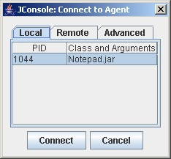
Connecting to JMX agent
If you do not provide any arguments when you start jconsole, the first thing you see is the connection dialog box. This dialog box has three tabs:
Local
Remote
Advanced
The local tab lists any JVMs running on the local system
To monitor a remote JVM, enter:
Host name: name of the machine on which the JVM is running.
Port number: the JMX agent port number you specified when you started the JVM.
User name and password: the user name and password to use
The advanced tab enables you to connect to other JMX agents (MBean servers) by specifying their JMX URL, and the user name and password.

Slide 99
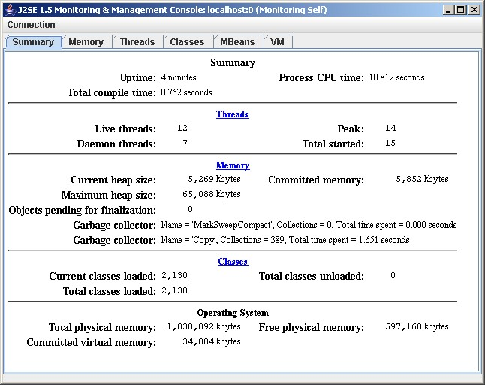
The JConsole interface
The jconsole interface is composed of six tabs:
Summary tab: displays summary information on the JVM and monitored values.
Memory tab: displays information on memory use.
Threads tab: displays information on thread use.
Classes tab: displays information on class loading
MBeans tab: displays information on MBeans
VM tab: displays information on the JVM

Slide 100
Table of Contents
Getting Started with Java
Introduction to Eclipse IDE
Collections and Generic Types
Java I/O
Java Annotation
JMX
JConsole
Regular Expressions

Slide 101
Regular Expressions
Regular Expressions
Regular Expressions in Java
Regular Expression Syntax
Special Characters
Quantifiers
Assertions
The Pattern Class
The Matcher class

Slide 102
Regular Expressions in Java
In Java, the tools for using REs are found primarily in two classes, both in java.util.regex.
The Pattern class.
The Matcher class.
The Pattern and Matcher classes work together.
// Determine if the pattern ERROR occurs in a line
Pattern p = Pattern.compile(“ERROR”);
Matcher m = p.matcher(“Abort: ERROR 339 has occured”);
boolean result = m.find();

Slide 103
Regular Expressions Syntax
comprehensive syntax for specifying patterns of text
^ metacharacter: a pattern must start at the beginning of the string
period metacharacter (.): matches any single character.
The RE "12." matches any three-character sequence starting with "12":
"125"
"As simple as 123"
"The address is 7412 Main Street." - What matches?
"Today I turned 12” - Why does this not match?

Slide 104

Special Characters
Special Characters
\w (word character)
\s (whitespace character), \S matches any non-space character
\d {digit character) , \D matches any non-digit character
[A-Za-z_0-9] is the same as \w
[\n\r\f\t ] is the same as \s
[0-9] is the same as \d

Slide 105
Quantifiers
* - matches any number, even zero, of the preceding RE character.
+ - matches one or more of the preceding RE character.
? - matches either zero or one of the preceding RE character.
You can specify any quantity of an RE character by using {}
{n}
{n,}
{n,m}

Slide 106
Assertions
Assertions anchor a pattern to a specific location in a string. ^ and $ anchor a pattern to the beginning or ending, respectively, of a string.
^s\d - Matches a line starting with s followed by a digit.
sh$ - Matches a line ending with sh.

Slide 107
The Pattern class
Use Pattern.compile(String regex) or Pattern.compile(String regex, int flags) to create a pattern object. Some of the flags are:
CASE_INSENSITIVE - Allows case-insensitive matching.
COMMENTS - Allows whitespace and comments in a pattern.
MULTILINE - Searches for patterns in a multiline string.
The following will match "CAT", "Cat", "cat", etc. ..
Pattern p = Pattern. compile ("cat”, Pattern.CASE_INSENSITIVE) ;
The flags() method returns which flags are set for a pattern.
int f1 = p.flags();
The pattern() method returns the regular expression.
String re = p.pattern();

Slide 108
The Matcher class
The Matcher Class
Matcher class: return data about a previous match.
start() - returns the start index of the previous match.
end() - returns the index of the last character matched, plus one.
group() - returns the string which was previously matched by the pattern.
replaceFirst(String s) replaces the first matched pattern with s.
replaceAll(String s) replaces all occurrences of the pattern with s.

Slide 109
Excellence in Software Engineering
THANK YOU
FOR YOUR KIND ATTENTION!
Thank you for your attention!

